Slide 1


Software Construction and Evolution - CSSE 375
Software Documentation 1
Shawn & Steve
Right – For programmers, it’s a cultural perspective. He’d feel almost the same way if it were 20 pages of documents to write.
Notes:
http://www.business2community.com/strategy/is-your-shipping-documentation-all-at-sea-0388206

Slide 2

Software Documentation
Software Requirements Specification
  Requirements Analysis & Specification (CSSE 371)
Software Design Specification
  Software Architecture and Design (CSSE 374)
Other Key Deliverables
  User Documents
  Installation and
  Configuration Documents
  Maintenance Documents
  Source Code
  Project Documents
Q1
Notes:
While software documentation requirements for delivery vary from organization to organization, these are a reasonable set.
For today, we focus on User Documents.
Q1: What are the deliverable software documents that CSSE 371 and CSSE 374 focused on?

Slide 3
User Documentation
Book Definition: User documentation refers to those documents containing descriptions of the functions of a system without reference to how these function are implemented
Bohner’izm - User Documentation is that “part of the system” developed to ensure that usability and understandability does not elude those who will develop, maintain, and use it
Notes:
It’s all those other details that if not present when needed, the user (and other stakeholders) will be disappointed in the system as they try to figure out how the system works.

Slide 4






User Documentation: Audience
Users (and customers :-)
Operators
Helpdesk
Technical support
Q2
Notes:
Software is a product and has customers – while organizations pay, customers (users) make decisions on the product!
So, are software maintainers an audience for user documentation? Why?
Q2: In writing the use documentation, who is the audience?

Slide 5

Why Spend Time on User Documentation?
Helps Prevent Customer Dissatisfaction!
Helps Developers
Understand System
Helps Technical
Support, Helpdesk,
(and Maintainers)
Helps System
Survive Evolve!
Q3
Notes:
Why do you suppose there exists “signs/cartoons” like the above?
Users cannot figure out something with the system and become frustrated.
After paying good money for the product and it does not meet their expectations, they want to express themselves
Q3: While maintainers are not the primary audience for user documentation, does it help them in their job? If yes, how?

Slide 6
User Documentation
Constituent Document | Function
Installation Manual / Guide | System installation and set up, configuration and customization to hardware and other software systems
Beginner’s Guide / Tutorial | Simple explanations of how to get started using the system
Reference Guide | Provides in-depth description of each system facility and how it can be used
Maintenance Manual / Guide | Outlines the software change processes Refers to req’ts & design specifications Refers to test data and results Summary of new features for releases
Quick Reference Card | Serves as a lookup for key capabilities
System Administration Guide | Provides information on services such as networking, security, and upgrading
Q4
Notes:
Q4: What role does the maintenance manual / guide serve for the user?

Slide 7

Examples of Printed Documentation
Quick reference cards
Brief “getting started” notes
User tutorials
Reference manuals
Alphabetic command lists

Slide 8

Examples of Online Documentation
Online Help Facility
Online Tutorials
Demonstrations
Man(ual) Pages (Unix)
Q5
Notes:
Q5: What are the advantages of having online documentation? [[available with the system during operation, provides

Slide 9
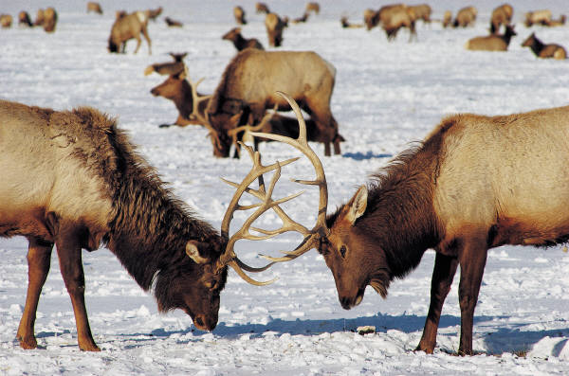
User Documentation Challenges
Merely presents
operator descriptions
Usability is not considered
  Organized according
  to system functions
  instead of key user goals
  Describes how the system works and not how it can be used
Information overload
  Too voluminous for novice users

Slide 10

Reading Computer Display more Difficult than Paper (1 of 2)
Low contrast between
characters and backgrounds
Emitted light rather than reflected
Poor fonts
Smaller displays require frequent
page turning

Slide 11
Reading Computer Display more Difficult than Paper (2 of 2)
Reduced body motion make them
more fatiguing
Layout and formatting problems
Note: these are changing with
emerging technology like
iPad, Kindle, eBook, etc.
Q6

Slide 12
Printed Manuals: Suggested Guidelines
(1 of 2)
Let users task guide organization
Let user learning process shape sequencing
Present semantics before syntax
Keep writing style clean and simple
Show numerous examples

Slide 13
Printed Manual: Suggested Guidelines for more Involved Documents (2 of 2)
Offer meaningful and complete sample sessions
Provide table of contents, indices, and glossaries
Use advance organizers and summaries
Include list of error messages

Slide 14
Developing Printed Manuals
Prepare user manuals before implementation
Use professional writers and copy editors
  Depends on scale of project
Review drafts thoroughly
Field test early drafts
Provide feedback mechanism to readers
Revise to reflect changes regularly
Notes:
You must be kidding! How will I know how my software will turn out?!?
Nope… I’m not kidding; it’s a quality thing like test driven development

Slide 15

User Documentation Life Cycle
Develop specifications
Prototype
Draft, Edit,
Review,
repeat…
Field test
Publish
Perform post project review
Maintain
Q7

Slide 16
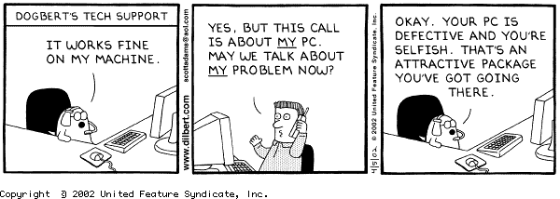
The Funny Side of User Interactions

Slide 17
Effective Documentation
(not just what’s said, but how it’s said)
Writing style
  Active voice
  Splitting text into manageable chunks
  Repeating complex explanations in different ways
Document standards
Quality assessment
Procedures to encourage concurrent updates
Good design methodologies
Documentation support tools
Q8

Slide 18
Discussion of Maintenance Documentation Survey
Survey of software industry professionals
Highlights preferences for and aversions against software documentation tools
Participants agree that documentation tools should seek to better extract knowledge from software artifacts
2 Observations
  Some large-scale software projects had an abundance of documentation
  small to medium-scale software projects had little to no software documentation
Q9
Notes:
This was your reading assignment for today – a journal article, on the course website under Resources.

Slide 19
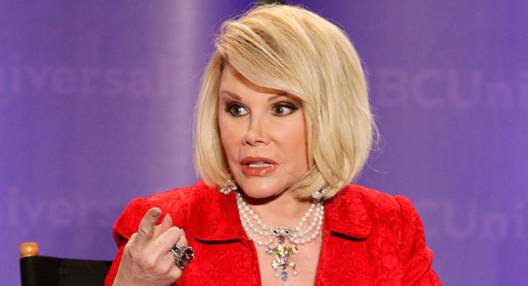
What the 50 Questions Addressed?
Participant’s personal preference for different types of documentation, and their effectiveness
Ability of a document’s attributes, as opposed to its content, to promote (or hinder) effective communication
State of software documentation in the participant’s organization
Comparison of past projects to current ones
Effectiveness of
documentation tools and
technologies
CAN WE TALK???
Notes:
“Can we talk?” is comedienne Joan Rivers’ most famous line. Image from http://www.politico.com/blogs/click/2013/01/joan-rivers-first-ladys-new-do-is-a-dont-154775.html.

