Slide 1
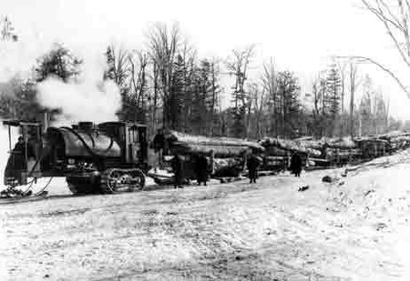

Software Construction and Evolution - CSSE 375
Exception Handling – Logging & Special Situations
Below - Logging has always been its own world. Here a “log hauler” engine built before 1918 pulls 8 sleds of logs out of the woods at 3-4 mph! From http://blog.hemmings.com/index.php/2010/01/05/lombard-the-great-steam-powered-horse-emancipator/
Steve Chenoweth
Office: Moench Room F220
Phone: (812) 877-8974
Email: chenowet@rose-hulman.edu
Notes:
This material is largely taken from Robust Java: Exception Handling, Testing and Debugging, by Stephen Stelting. Prentice-Hall, 2005. ISBN 0-13-100852-8.

Slide 2

Last week we saw…
Exception handling
principles --
  Handling unusual stuff
  Making your project into a
  product by doing so
  Need to be systematic
Language facilities for this –
  Some like Java give lots of help
  Handling of exceptions is a lot like handling of threading
    The program jumps out of its “normal” sequence when things happen
Above – In exception situations unusual things happen. Here, The Blob goes after the Colonial Theater. From http://retroroadmap.com/2010/06/03/beware-of-the-blob-2010-blobfest-goes-to-eleven/
Q4

Slide 3
Logging
Like “chaining exceptions” last week –
  It’s a way to handle a zillion different exceptions in a consistent way
It’s also one of the basic ways to handle exceptions. From the list we first discussed.
Notice that logging doesn’t give the user or operator “notice” unless you make that happen
  When would you not want to do that?
Q5
Notes:
The rest of the list of the options for exception handling was:
Ask the user or application for input
Use default values or alternate data
Forward control to some other part of the app
Convert the exception to another form
Ignore the problem
Retry the action
Take an alternate or recovery action
Prepare the system for shutdown

Slide 4
Logging in Java
There’s a standardized API for this
  Can output to System.out
  Can use a third-party logging framework
  Can develop a custom API for a project
  Suitable for distributed systems
  Provides a standard set of logging tools for big systems
  It’s thread-safe

Slide 5
How it works in Java
Loggers
  Provide standard log methods to apps
Handlers
  Perform the actual logging functions
Filters
  Can make decisions about what’s actually logged
A log manager can be created for repeated calls
Exception
Log manager
Logger
Handler
Filter
Log
Notes:
Log manager is optional, for the more complex situations where you want to have different loggers enabled.

Slide 6
Example – One-time logging operation
Logger simpleLogger = Logger.getAnonymousLogger();
Then logging calls the method “log” on this object.
  Passes a string describing the exception
  Builds the log for later analysis after a run, etc.
  Can also add “logging” level to a log call
    Like Level.SEVERE
Filters – can restrict errors to those of sufficient importance
  SimpleLogger.setLevel(Level.WARNING)
  Won’t log anything less than a WARNING
Q6

Slide 7
What it looks like in action…
package com.wombat;
public class Nose{
// Obtain a suitable logger.
private static Logger logger =
Logger.getLogger("com.wombat.nose");
public static void main(String argv[]){
// Log a FINE tracing message
logger.fine("doing stuff");
try{
Wombat.sneeze();
} catch (Error ex){
// Log the error
logger.log(Level.WARNING,"trouble sneezing",ex);
}
logger.fine("done");
}
}
Notes:
From http://download.oracle.com/javase/1.4.2/docs/guide/util/logging/overview.html

Slide 8
Other special situations - Assertions
You use these in unit testing Java code:
  assert [logical condition]; , or
  assert [logical condition] : [expression];
Allows you to test for “invariants”
Can enable / disable with switches like -ea
Also useful to test for preconditions, postconditions, and status in a production system
  Like running it when you’re watching!
  Need to enable, so
  Don’t use in place of regular validity checks
Q7

