Slide 1
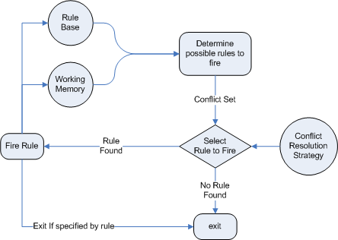

Software Construction and Evolution - CSSE 375
Exception Handling – Chaining & Threading
Below – Chaining is a concept at the heart of several different areas of CS. Below, we see a Rule-based AI system, where chaining the rules is a key to giving the system generality and power. From a description of JBoss, at http://docs.redhat.com/docs/en-US/JBoss_Enterprise_BRMS_Platform/5/html-single/JBoss_Rules_5_Reference_Guide/index.html
Steve Chenoweth
Office: Moench Room F220
Phone: (812) 877-8974
Email: chenowet@rose-hulman.edu
Notes:
In AI, both “forward chaining” and “backward chaining” are used in rule-based and planning systems.

Slide 2
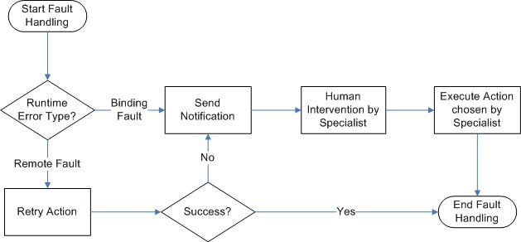
Exception Handling - Chaining
Below – One example of error handling chaining – escalation. Note that, at some point, humans get involved! From http://technology.amis.nl/blog/2485/extending-the-oracle-bpel-error-hospital-with-custom-java-actions
In Java, chaining
lets you set up
associations between exceptions.
This lets you throw a “custom exception” within an exception, explaining what it means – a “root cause”
Notes:
The idea is to find a way to get at a root cause of a problem, through various (program and/or human) resources.

Slide 3
Java Chaining Example
try{
// lots of risky I/O operations!
}
catch (java.io.IOException rootCause){
throw new ConnectionException(rootCause);
}
Which requires a constructor like:
public class ConnectionException extends java.io.IOException{
public ConnectionException(Throwable cause){
// analyzes the cause
}
}
Thus, you can group related exceptions in ways you define.
So, here’s an exception routine throwing a more general exception!
Q1
Notes:
From Robust Java: Exception Handling, Testing and Debugging, by Stephen Stelting. Prentice-Hall, 2005. ISBN 0-13-100852-8, p 38.

Slide 4
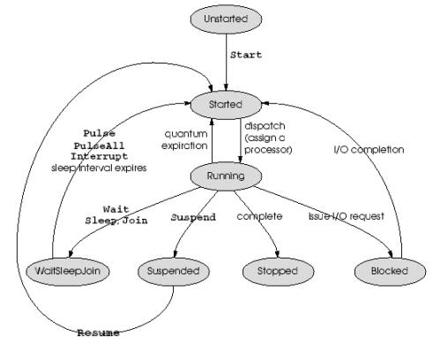
Exception Handling - Threading
Typical issue –
  You want to make the GUI multi-task, for efficiency.
  So, things finish when you’re in the middle of something else.
  What happens if they finish in an error condition?
Above – Multithreading in .Net, from http://rthumati.wordpress.com/2009/10/27/multithreading/
Notes:
Answer is that you need to be able to return to the logic responsible for the activity which finished in an error condition. And, if that impacts later things as well, then those need to be dealt with, too. All of this will then interrupt the current flow of activities, and both program and user need to understand how to continue from there.
Perfect example – suppose that Amazon let you go ahead and shop for other things, while it processes an order for you. What if it ends up that the item in the order is out-of-stock? Maybe you therefore don’t want the other thing that goes with this, either? (E.g., the workbook to go with the textbook.)

Slide 5
Thread Design
Use a design tool that shows step-by-step functionality, like:
  State chart, or
  Sequence diagram
Add the possible error situations, and how you’ll deal with those
  E.g., at what point does one thread need to check to see if another finished properly?
Q2

Slide 6
How do threads communicate?
Different for different kinds of multi-threaded programs.
For producer / consumer systems, for example:
  Consumer threads can actively check the state of the producer
  Consumer threads can wait for the producer by calling the join method
  Producer thread can actively notify the consumers
  Producer thread can throw an InterruptedException to notify the consumer threads
Let’s talk about this one…
Notes:
From Stelting’s book, pp 62-3.

Slide 7
Thread exceptions to communicate!
How it works –
  Producer method calls the interrupt method on the consumer threads
  If consumer method’s already running, it can call its method interrupted, which will return true if it’s been the target of an interrupt call. Or,
  If the thread was blocked during the call, the producer’s interrupt call will cause an InterruptedException to be thrown for the consumer.
Advantages –
  Threads can be notified during blocking calls
  Easy to use for groups of threads
  Immediate notification
Q3

Slide 8
Example
import java.util.*;
public class ProducerThread implements Runnable{
private ThreadGroup consumers;
private Thread runner;
private boolean shutdown;
private ArrayList tasks;
public ProducerThread(ThreadGroup msgConsumers) {
msgConsumers.checkAccess();
consumers = msgConsumers;
tasks = new ArrayList();
runner = new Thread(this);
runner.start();
}
public void shutdown(){
shutdown = true;
}
public synchronized void addTask(Task t){
if (t != null){
tasks.add(t);
}
}
public synchronized Task removeTask(){
Task rtnTask = null;
if (!tasks.isEmpty()){
rtnTask = (Task) tasks.remove(0);
}
}
private boolean hasTasks(){
return tasks.isEmpty();
}
public void run(){
while (!shutdown){
if (hasTasks()){
consumers.interrupt();
}
try {
Thread.sleep(1000);
}
catch (InterruptedException exc){
}
}
}
}
Code goes here for “what it does when sleep’s interrupted”
Notes:
This is a single collection of threads, managed within a ThreadGroup object.
From Stelting pp. 63-4.

