Slide 1

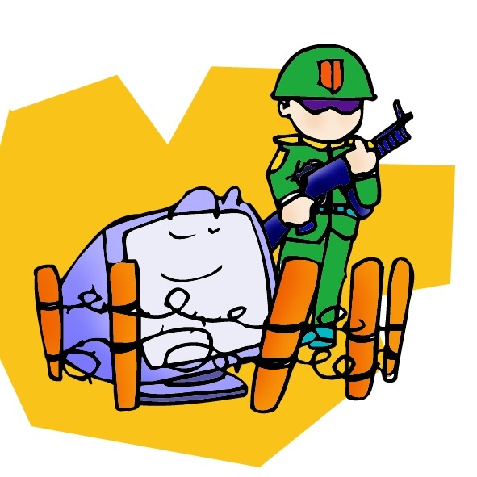

Software Construction and Evolution - CSSE 375
Defensive Programming & Error Handling
Shawn & Steve
Above – As you see behind me on the shelf, there are two worlds. I live in the one where you can be a pacifist, and it is pragmatic.

Slide 2
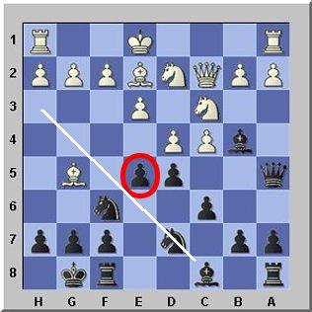
Defensiveness
What does it mean to be defensive?
When are we defensive?
Good defense?
Not so good defense?
Right - In the chess game shown, black has just moved the pawn from e5-e6. This suggests that moving the knight on d7 also will provide mobility to the bishop on c8, as shown. The ability to handle unforeseen circumstances defensively is a part of playing black in chess. The setup shown is a part of the “Cambridge Springs Defence.”
Notes:
Defensive when something is of value and it is threatened…
We are defensive when something of value is threatened -- our honor, our family, our integrity, our possessions …
Leads us to be protective…
Chess image from http://www.expert-chess-strategies.com/cambridge-springs.html.

Slide 3
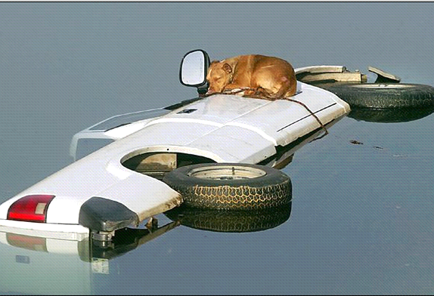
What is Defensive Programming?
Analogous to
“Defensive Driving”
  You expect “unexpected”
  problems to crop up
Protect against
“suspicious”
programming
  Input data, not as specified
  Function arguments, file contents, human input
  Module behavior, not as specified
Don’t let the dog drive!
Q1
Notes:
You expect “unexpected” problems to crop up
turn is signal on, but car doesn’t turn
you brake, but he doesn’t slow down behind
Q1: How is Defensive Programming analogous to defensive driving?

Slide 4
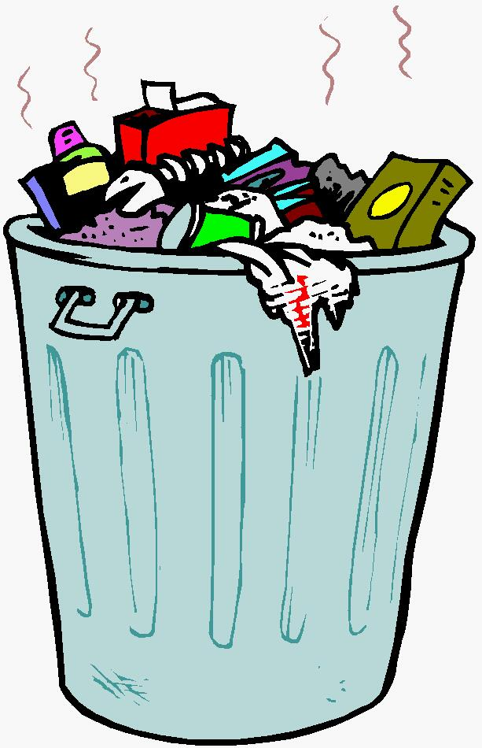
Where do some Bad Smells come from?
“Garbage in, garbage out”
(inappropriate for production code)
Check the values of all data from external sources
Check the values of all routine input parameters
Need to decide how to handle bad inputs
Q2
Notes:
-Numeric values within tolerance, Strings short enough to handle; Strings are valid (e.g. injected SQL)
Q2: How can we protect our programs from potential input problems as a matter of practice?

Slide 5
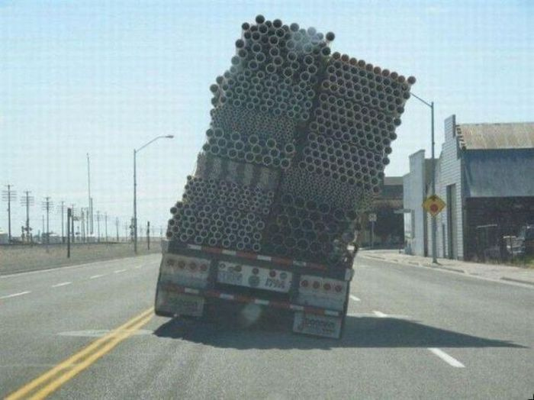
Unsafe Programming Constructs
Pointers
Dynamic memory allocation
Floating-point numbers
Parallelism
Recursion
Interrupts
All are valuable in specific circumstances, but should be used with discretion
Q3
Notes:
Q3: What are three “unsafe programming constructs” and state briefly why are they unsafe? In your opinion, which one is worst, and why?
Above image: Sometimes things you see on the road are a definition of “unsafe.” From http://1funny.com/unsafe-cargo/.

Slide 6

Need Error Handling Strategy
Defensive programming
uncovers “errors”
  if (error happened) {
  what code goes here?
  }
Best to have a planned
strategy regarding errors
Notes:
Don’t leave up to individual coder’s judgment
Don’t handle on ad hoc basis
Otherwise, code quality (via error checking & handling) will vary widely across system

Slide 7
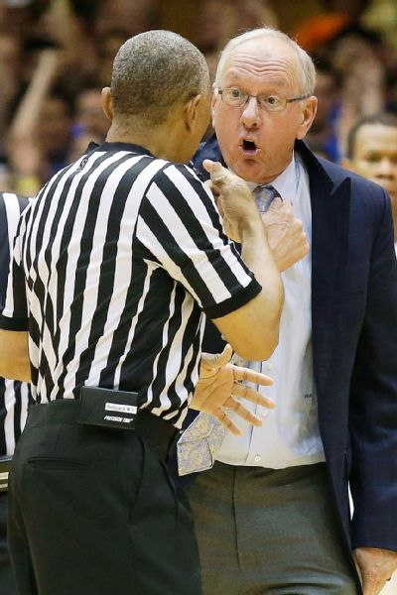
Uniformity in Error Handling Strategy
Don’t leave up to individual
coder’s judgment
Don’t handle on ad hoc basis
Otherwise, code quality
(via error checking & handling)
will vary widely across system
General principle: Handle errors in context, in the same place where you detected them
Q4
Notes:
Q4: In general, how should errors be uniformly handled?
Image – judgment calls in action. It often is a matter of your point of view! From http://espn.go.com/mens-college-basketball/story/_/id/10511616/acc-commissioner-john-swofford-ref-made-judgment-call-syracuse-orange-charge-vs-duke-blue-devils.

Slide 8

Handling Expected Errors
Return a neutral value
  Might continue operating but return a neutral value known to be harmless
    Empty string, 0, etc.
Substitute next piece of valid data
  Typically when processing a stream,
  e.g. reading from a file or sampling data
Return the same answer as the previous time
  E.g. temperature reading software sampling
Substitute the closest legal value
Q5-1
Notes:
We promised to get back to these, in the previous class discussion on exception handling.
In light of expecting the unexpected… how do we handle Expected Errors?
…coming on in, we’ve been expecting you…
Q5: When handling Expected Errors, what are three approaches that you believe are good to consider? And which one would you not want to use, of those shown on slides 8-9?

Slide 9
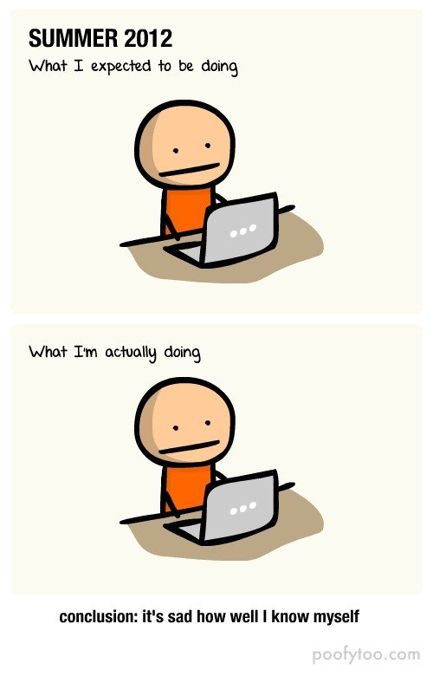
Handling Expected Errors (continued)
Log a warning message to a file
Return an error code
  Set a status variable, throw exception
Call a centralized error processing
routine
  Hard to reuse though in other programs
Display an error message
Depends on context… even Shut down
Q5-2
Notes:
Q5: When handling Expected Errors, what are three approaches that you believe are good to consider? And which one would you not want to use, of those shown on slides 8-9?
It’s like driving – If you do what’s expected, about what you expected, everyone else will “get” your coding. Image from http://www.funnyjunk.com/funny_pictures/3876305/Summer+Expected+Vs+Reality/.

Slide 10
Exercise: Catching Expected Errors
Your company has a new website that offers a great new Computer Advice and Review center. You know that your audience would be likely to try and get in to get at your goodies without a subscription.
What “Error Handling” strategy would you consider?
Q6
Notes:
Think/pair/Share
Q6: What are some error handling strategies for addressing the security situation above?

Slide 11

Need to Strike a Balance
One extreme:
  Check for every conceivable (and inconceivable) error condition
Other extreme: “nothing will go wrong!”
    Fragile system, late discovery of hard-to-locate bugs
Q7
Notes:
Q7: What are some of the downsides to checking every conceivable error condition?

Slide 12
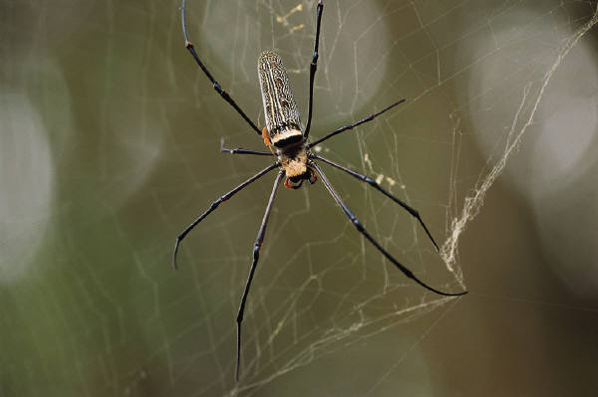
Recognize Two Kinds of Errors
Problems with external data/conditions
  User/operator should be informed; don’t crash!
Erroneous internal usage …rare conditions
    Module A calls module B with bad arguments
    Out of memory/disk space
    Unexpected error return/result from library function call
Notes:
Testing/debug phase: Let programmers know before crashing
Production phase: Keep running, recover gracefully if possible

Slide 13

Recognize Three Severities
“Fatal” errors
“Nonfatal” errors now, but potentially “fatal” later
“Nonfatal” errors
Q8
Notes:
“Fatal” errors:
Meaningless to continue execution e.g., out of memory, nonsensical value of critical variable
Best to abort, but inform if possible, Otherwise, how will anyone find the bug?
“Nonfatal” errors now, but potentially “fatal” later:
Put recovery strategy in motion and inform before it is too late
“Nonfatal” errors:
Recovery possible, may want to inform
Q8: What are the three key Error Severities to keep in mind when considering an Error Handling Strategy?

Slide 14
When to Reflect Errors Upward
Best: reflect error status up to caller
  Caller applies “handle error in context” principle to suit nature of application
Utility packages are the exception!
  Can detect errors, but may not know how to handle in way acceptable to application
Notes:
We normally handle errors in place… but when do we want to reflect them upward to the caller or caller’s caller?
Utility packages are the exception!
Can detect errors, but may not know how to handle in way acceptable to application
E.g., utility printing error message usually not appropriate
Application may have special use of stdout/stderr streams
May be running in GUI

Slide 15
Defensive Programming Techniques
Assertions
Exception handling
Code Insertion
Note:
These techniques can also be used elsewhere besides defensive programming

Slide 16
Assertions
Assertions are code used to check if everything is operating as expected
  Assertion takes an input that’s supposed to be true, and a message to display if it isn’t
assert (denominator != 0) : “Denominator not zero”
Use to document assumptions made in code
and flush out error conditions
Assertions are intended to always be silent
Notes:
Assertions are lines of code that can be used to check if everything is operating as expected
Otherwise an error results and the program terminates
For errors that should never occur in the code
Usually a routine to allows a program to check itself as it runs
Assertion takes an input that’s supposed to be true, and a message to display if it isn’t
assert (denominator != 0) : “Denominator not zero”
Use to document assumptions made in code and flush out error conditions
Assertions are intended to always be silent – only use for conditions that should never occur
Avoid putting executable code into assertions
Use to document/verify pre-/post-conditions

Slide 17
Exceptions
Use exceptions to notify other parts of the program about errors that should not be ignored
Throw an exception only for conditions that are “truly exceptional”
Don’t use an exception to pass the buck
  If can handle it locally, do it
Notes:
Use exceptions to notify other parts of the program about errors that should not be ignored
Strength of exceptions is they are un-ignorable; if you want the possibility to ignore then use status codes
Throw an exception only for conditions that are truly exceptional
Tradeoff for complexity and exception strength; exceptions weaken encapsulation by require calling code to know which exceptions might be thrown
Don’t use an exception to pass the buck
If can handle it locally, do it

Slide 18
Exceptions (continued)
Avoid throwing exceptions in constructors and destructors
Throw exceptions at the right level of abstraction
class Employee {
…
public TaxId GetTaxId() throws EOFException {
…
}
}
Notes:
Avoid throwing exceptions in constructors and destructors
Usually not caught anywhere
Throw exceptions at the right level of abstraction
Routine should present a consistent abstraction in its interface and so should a class

Slide 19
What are Alternatives to Exceptions?
Handling the error locally
Propagating error with appropriate error code
Logging debug information to a file
Extremes: Shutdown or Ignoring it
“Sometimes the best response to a serious run-time error is to release all acquired resources and abort. Let the user rerun the program with proper input.” Bjarne Stroustrup
Notes:
Some programmers use exceptions because that is what the language supports for errors
Again, you should consider the full range of error handling alternatives

Slide 20
Code Insertion: Debugging Aids
Common Assumption: Developer version can be slow, but production version must be fast (stingy with resources)
Microsoft Word
  Code in the idle loop that checks the integrity of the Document object
  Helps detect data corruption more quickly and easier error diagnosis / recovery
Notes:
Assumption not always true…
Does your production application really need the extra speed?
What’s the tradeoff with speed in removing error condition checks?

Slide 21
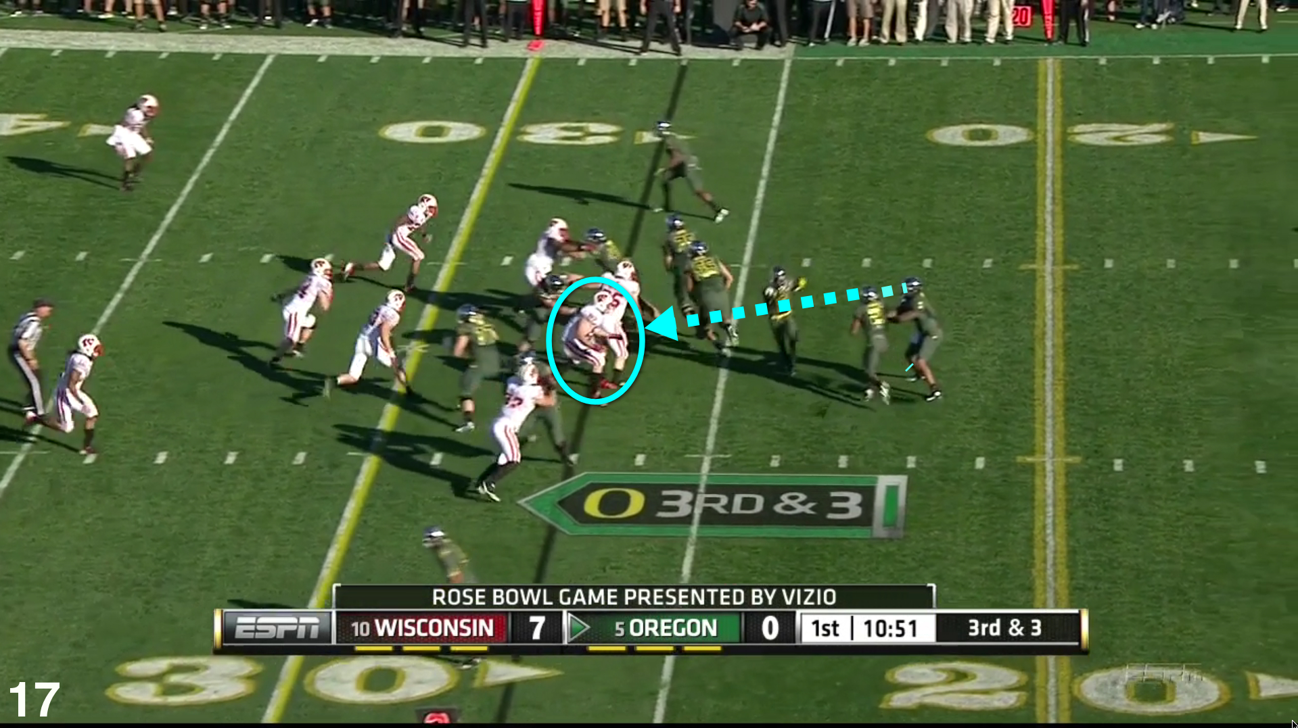
Offensive Programming
Exceptional cases should be handled in a way that makes them obvious during development and recoverable when production code is running
Make sure asserts abort the program
  Don’t allow programmers to get in the habit of hitting enter to bypass known problems, make it painful so it will get fixed
Completely fill any
memory allocated
  So you can detect
  memory allocation
  errors
Notes:
Make sure asserts abort the program
Don’t allow programmers to get in the habit of hitting enter to bypass known problems, make it painful so it will get fixed
Completely fill any memory allocated
So you can detect memory allocation errors
Image: Offensive play depicted, from American football. From http://fishduck.com/2012/08/oregons-most-important-offensive-play/.

Slide 22
Offensive Programming (continued)
Completely fill any files or streams allocated
  To flush out file format errors
Ensure code in case statement’s default clause fails hard or is impossible to overlook
Fill an object with junk before it is deleted
Email error log files to yourself

Slide 23
How much defensive code to Leave?
Leave in code that
  Checks for important errors
  Helps the program crash gracefully
Remove code that
  Checks for trivial errors
  Hard crashes as a “signal” to testers
    Replace with graceful crash :-)
Log errors for technical support

Slide 24
Social Defensive Programming
Idea: Documentation might be ignored, but invoking the function name or variable can’t
  ReferenceType MyClass::GetPointerDoNotDelete()
  SafeHandle.DangerousGetHandle()
  m_dontUseMe
Notes:
Not seen in public API’s but can be used internally
ReferenceType MyClass::GetPointerDoNotDelete()
Tells the user not to delete this object because it is deleted elsewhere
SafeHandle.DangerousGetHandle()
Actual example from the CLR (Common Language Runtime)where the developers thought it important enough to call out a function that can be dangerous if misused (and hopefully make the users read the docs to figure out why it’s dangerous)
m_dontUseMe
A class member was often misused as an ID (because it seemed to be unique while it wasn’t really) -- causing endless problems
A mere name change to m_dontUseMe reduced the misuse considerably…

