Slide 1
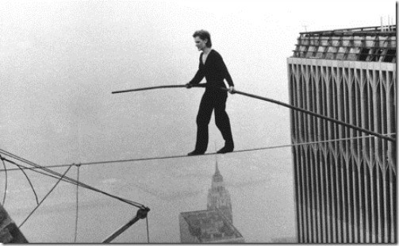

Big Refactorings
Steve Chenoweth, RHIT
Ch 12 in Fowler
Above – Man on wire – Big refactorings feel just as dangerous, even if they are not, because you may hit intermediate stages during which you can’t immediately test if the system still works, or not.
Notes:
Image of Philippe Petit walking between the World Trade Center towers, Aug 7, 1974, from http://simpleprogrammer.com/2010/10/01/living-dangerously-refactoring-without-a-safety-net/.

Slide 2
This is the big win
Make better sense of big chunks of code.
Consider them first, not last!
Typical situations:
  Big inheritance mess.
  Small parts of something that became big parts.
  Dependencies that grew and grew.
  Areas you know are hard to maintain.
Q1
Notes:
Q1: Fowler says that usually you are “refactoring to some purpose.” Why does that mean you should consider Big Refactorings before all the little ones we’ve studied so far ?

Slide 3
Teasing apart inheritance
A hierarchy that does two different jobs.
Pick the important job – keep in current hierarchy.
Use Extract Class to get rid of subsidiary job.
  Decide if subclasses are needed for these.
  Use Move Method to move the behavior over,
    Till the offending subclass has no more code!
Q2
Notes:
Q2: Ok, teasing apart inheritance does look like a big refactoring which would take time. What’s the most likely situation where you would want to take time to do it, anyway? What’s the next most likely situation?

Slide 4
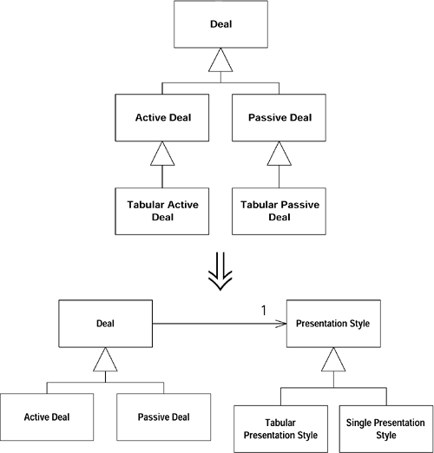
Fowler’s example:
The trick is to know the basis for pulling it apart:
Like, “Are we going to add yet another presentation style?”
Notes:
From http://sourcemaking.com/refactoring/tease-apart-inheritance

Slide 5
Converting Procedural Designs to Objects
Common in C, C++, etc. systems.
People bad at OO also write Java, C# this way!
Record types become dumb data objects with accessors.
Start with a single class.
Use Extract Method on long procedures.
  Move to the proper dumb data class.
Try to pull all the code from the original class or module.
Q3, 4, 5
Notes:
Q3: In converting procedural designs to OO, what do “functions” turn into?
Q4: In converting to OO, why do you start with making record types into the start of new classes?
Q5: Why do you try to remove all the code from the original class or module?

Slide 6
Separate Domain from Presentation
The most common offender – a “freshman” design style.
Create a design class for each window.
Represent complex data presented, like rows of a grid.
Decide if data is UI or domain, separate!
Examine logic and use Extract Method to separate.
Q6
Notes:
Q6: Ok, you’re now a junior, not a freshman. How could you fall into the trap of mixing domain code with presentation?

Slide 7
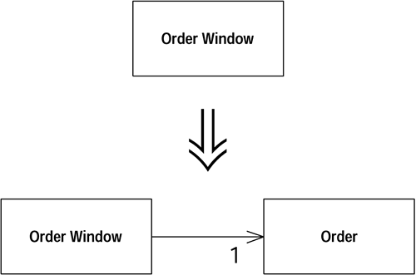
Fowler’s example:
Great questions for any system might be:
“Can we add an iOS interface?” Or,
“Can we test just the domain part?”
Notes:
From http://sourcemaking.com/refactoring/separate-domain-from-presentation

Slide 8
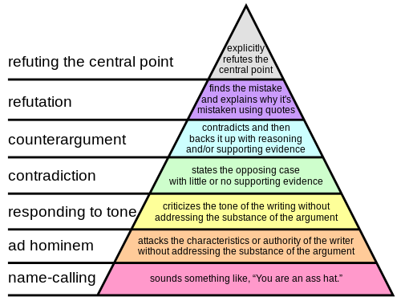
Extract Hierarchy
Take the class that’s one giant conditional, and create a hierarchy of subclasses based on the logic.
This one is done
like you’ve
already been
doing them.
Right – Programmer Paul Graham’s “Hierarchy of disagreement.” He claims that, the higher you can go in the hierarchy, when disagreeing with someone, the less likely you are to offend them personally.
Q7
Notes:
Image from http://en.wikipedia.org/wiki/Paul_Graham_%28computer_programmer%29.
Q7: Suppose you wanted to represent, as OO classes, the “Hierarchy of Disagreement” shown on slide 6. Why would the bottom level, name-calling, most likely be close to the highest level parent in your class hierarchy, and the top level, “refuting the central point,” be close to the lowest-level child in the hierarchy?

