Slide 1
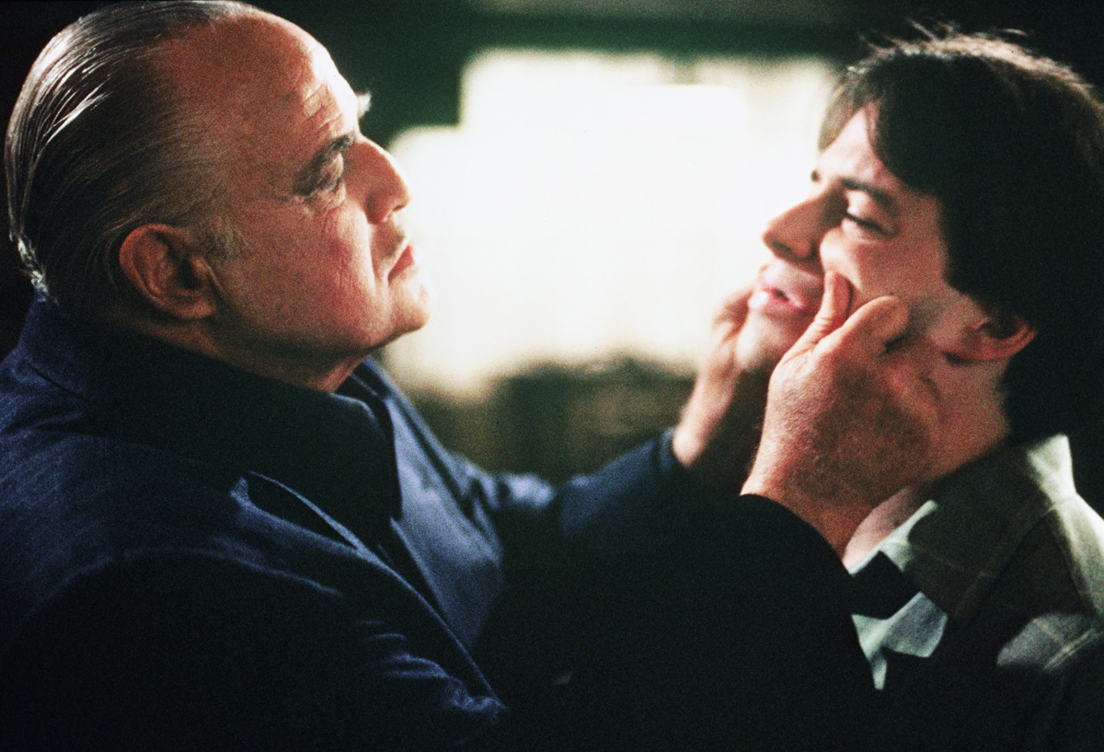

Software Construction and Evolution - CSSE 375
Dealing with Generalization
Steve and Shawn
Left – In the 1990 movie “The Freshman,” Matthew Broderick, the freshman, asks Marlon Brando, a gangster, “Isn’t everything we’re doing here illegal?” Brando replies, “Now you’re just speaking in generalities.”
Notes:
Image from http://www.sonymoviechannel.com/movies/freshman.

Slide 2
Dealing with Generalization
Generalization → Inheritance
Some Bad Code Smells
  Duplicate Code, Inappropriate Intimacy, Large Class, Lazy Class, Middle Man, Refused Bequest, Speculative Generality
Pull Up Field
Pull Up Method
Pull Up Constructor Body
Push Down Method
Push Down Field
Extract Subclass
Extract Superclass
Extract Interface
Collapse Hierarchy
Form Template Method
Replace Inheritance with Delegation
Replace Delegation with Inheritance
Q1
Notes:
Generalization produces its own batch of refactorings, mostly dealing with moving methods around a hierarchy of inheritance.
Q1: Dealing with Generalization suggests what element of Object-Oriented development is addressed?

Slide 3
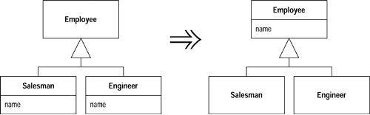
Pull Up Field
Situation: Two subclasses have the same field
Solution: Move the field to the superclass
Push Down Field for opposite situation…
  If a field is used only by some subclasses, move to those subclasses
Q2
Notes:
If subclasses are developed independently, or combined through refactoring, you often find that they duplicate features like fields
Reduces duplication in 2 ways: 1) It removes the duplicate data declaration and
2) allows you to move from the subclasses to the superclass behavior that uses the field
Q2: When two subclasses have the same field, you should consider moving the ______________ to the _____________.

Slide 4
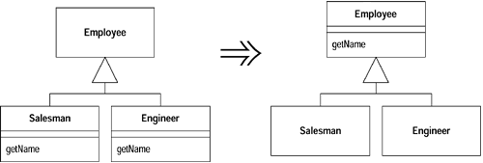
Pull Up Method
Situation: You have methods with identical results on subclasses
Solution: Move the them to the superclass
Push Down Method for opposite situation…
  If behavior on a superclass is relevant only for some of its subclasses, move it to those subclasses
Q3
Notes:
Eliminating duplicate behavior is important.
Although two duplicate methods work fine as they are, they are a breeding ground for bugs as changes are introduced.
Q3: When do you consider using the “Pull Up Method” refactoring technique?

Slide 5
Pull Up Constructor Body
Situation: You have constructors on subclasses with mostly identical bodies
Solution: Create a superclass constructor; call this from the subclass methods
class Manager extends Employee...
public Manager (String name, String id, int grade) {
_name = name;
_id = id;
_grade = grade;
}
public Manager (String name, String id, int grade) {
super (name, id);
_grade = grade;
}
Q4
Notes:
This is the reverse of Parameterize Method.
Q4: What is the solution that “Pull Up Constructor Body” provides?

Slide 6
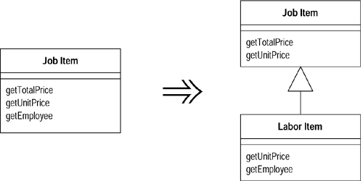
Extract Subclass
Situation: A class has features that are used only in some instances
Solution: Create a subclass for that subset of features
Notes:
Trigger for use of Extract Subclass is when a class has behavior used for some instances of the class and not for others.

Slide 7
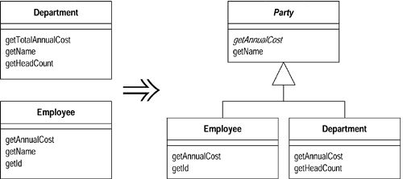
Extract Superclass
Situation: You have two classes with similar features
Solution: Create a superclass and move the common features to the superclass
Q5
Notes:
Remember, duplicate code is #1 on the stink parade. If you say things in multiple places, then when it comes time to change what you say, you have more things to change than you should
Q5: If you have two classes with similar features, you should create a superclass and move the _____________ ________________to the superclass.

Slide 8
Extract Superclass: Mechanics
Create a blank abstract superclass; make the original classes subclasses of this superclass.
One by one, use Pull Up Field, Pull Up Method, and Pull Up Constructor Body to move common elements to the superclass.
  It’s usually easier to move the fields first.
  With subclass methods that have different signatures but the same purpose, rename them and then use Pull Up Method.
  If you have methods with the same signature but different bodies, declare the common signature as an abstract method on the superclass.
Compile and test after each pull.
Examine the methods left on the subclasses. See if there are common parts, if there are you can use Extract Method followed by Pull Up Method on the common parts. If the overall flow is similar, you may be able to use Form Template Method.
After pulling up all the common elements, check each client of the subclasses. If they use only the common interface you can change the required type to the superclass.
Q6
Notes:
Q6: What is the first thing you do when extracting a superclass?

Slide 9
Exercise: Extract Superclass (1 of 7)
class Employee...
public Employee (String name, String id, int annualCost) {
_name = name;
_id = id;
_annualCost = annualCost;
}
public int getAnnualCost() {
return _annualCost;
}
public String getId(){
return _id;
}
public String getName() {
return _name;
}

Slide 10
Exercise: Extract Superclass (2 of 7)
private String _name;
private int _annualCost;
private String _id;
public class Department...
public Department (String name) {
_name = name;
}
public int getTotalAnnualCost(){
Enumeration e = getStaff();
int result = 0;
while (e.hasMoreElements()) {
Employee each = (Employee) e.nextElement();
result += each.getAnnualCost();
}
return result;
}
Q7
Notes:
Q7: What are the two key areas of commonality in the code with respect to Employee and Department ?

Slide 11
Exercise: Extract Superclass (3 of 7)
public int getHeadCount() {
return _staff.size();
}
public Enumeration getStaff() {
return _staff.elements();
}
public void addStaff(Employee arg) {
_staff.addElement(arg);
}
public String getName() {
return _name;
}
private String _name;
private Vector _staff = new Vector();

Slide 12
Exercise: Extract Superclass (4 of 7)
Create superclass with existing superclasses as subclasses
abstract class Party {}
class Employee extends Party...
class Department extends Party...
Pull Up Features to Superclass (start with fields)
class Party...
protected String _name;
…
public String getName() {
return _name;
}
Notes:
2 areas of commonality: 1) both employees and departments have names. 2) both have annual costs, although the methods for calculating them are slightly different.
Extract a superclass for both of these features.
First step is to create the new superclass and define the existing superclasses to be subclasses of this superclass…

Slide 13
Exercise: Extract Superclass (5 of 7)
class Party...
protected Party (String name) {
_name = name;
}
private String _name;
class Employee...
public Employee (String name, String id,
int annualCost) {
super (name);
_id = id;
_annualCost = annualCost;
}
class Department...
public Department (String name) {
super (name);
}
Notes:
Make field private using “Pull Up Constructor Body” to assign name

Slide 14
Exercise: Extract Superclass (6 of 7)
class Department extends Party {
public int getAnnualCost(){
Enumeration e = getStaff();
int result = 0;
while (e.hasMoreElements()) {
Employee each = (Employee) e.nextElement();
result += each.getAnnualCost();
}
return result;
}
abstract public int getAnnualCost()
Notes:
The methods Department.getTotalAnnualCost and Employee.getAnnualCost, do carry out the same intention, so they should have the same name.
First use Rename Method to get them to the same name.
Their bodies are still different, so I cannot use Pull Up Method; however, I can declare an abstract method on the superclass:

Slide 15
Exercise: Extract Superclass (7 of 7)
class Department extends Party {
public int getAnnualCost(){
Enumeration e = getStaff();
int result = 0;
while (e.hasMoreElements()) {
Party each = (Party) e.nextElement();
result += each.getAnnualCost();
}
return result;
}
Notes:
Now I can use the superclass Party …

Slide 16
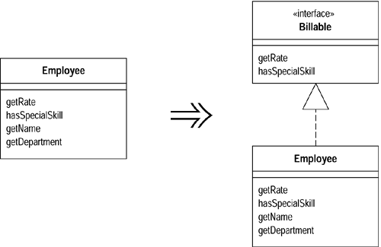
Extract Interface
Situation: Several clients use the same subset of a class’s interface, or two classes have part of their interfaces in common
Solution: Extract the subset into an interface
Q8
Notes:
Classes use each other in several ways. Use of a class often means ranging over the whole area of responsibilities of a class.
Another case is use of only a particular subset of a class’s responsibilities by a group of clients.
Q8: When would the “Extract Interface” refactoring be useful?

Slide 17
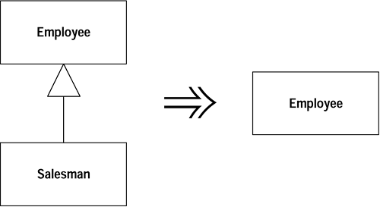
Collapse Hierarchy
Situation: A superclass and subclass are not very different
Solution: Merge them together
Q9
Notes:
If you have been working for a while with a class hierarchy, it can easily become too tangled for its own good.
Refactoring the hierarchy often involves pushing methods and fields up and down the hierarchy.
You may have a subclass that isn’t adding any value, so you need to merge the classes together.
Q9: Refactoring the hierarchy often involves pushing methods and fields up and down the hierarchy. What is a common situation where you could employ Collapse Hierarchy to refactor a subclass into its superclass ?

Slide 18
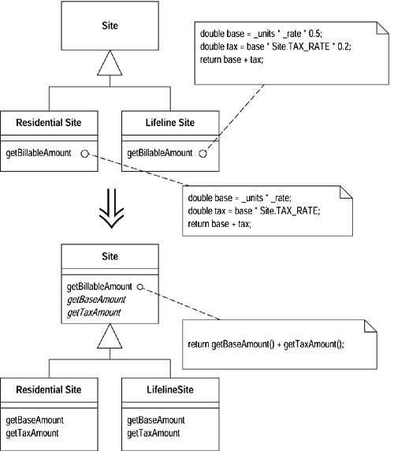
Form Template Method
Situation: You have two methods in subclasses that perform similar steps in the same order, yet the steps are different.
Solution: Get the steps into methods with the same signature, so that the original methods become the same. Then you can pull them up.
Q10
Notes:
Inheritance is a powerful tool for eliminating duplicate behavior.
Whenever we see two similar methods in a subclass, we want to bring them together in a superclass.
But what if they are not exactly the same? What do we do then? We still need to eliminate all the duplication we can but keep the essential differences.
Q10: When you have methods in subclasses that perform similar steps in the same order, but the steps are different, what is a reasonable refactoring technique ? Why?

Slide 19
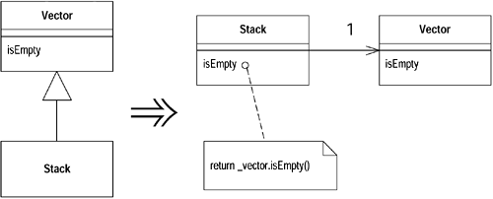
Replace Inheritance with Delegation
Situation: A subclass uses only part of a superclasses interface or does not want to inherit data
Solution: Create a field for the superclass, adjust methods to delegate to the superclass, and remove the subclassing
Q11
Notes:
Often you start inheriting from a class but then find that many of the superclass operations aren’t really true of the subclass.
In this case you have an interface that’s not a true reflection of what the class does.
By using delegation, you make it clear that you are making only partial use of the delegated class.
Q11: In terms of CSSE374 and patterns, what is the situation that “Replace Inheritance with Delegation” refactoring addresses?

Slide 20
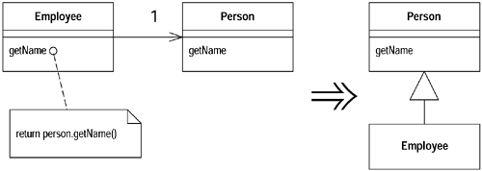
Replace Delegation with Inheritance
Situation: You’re using delegation and are often writing many simple delegations for the entire interface
Solution: Make the delegating class a subclass of the delegate
Notes:
This is the flip side of Replace Delegation with Inheritance.
If you find yourself using all the methods of the delegate and are sick of writing all those simple delegating methods, you can switch back to inheritance pretty easily.
Caveat: If you aren’t using all the methods of the class to which you are delegating, you shouldn’t use Replace Delegation with Inheritance, because a subclass should always follow the interface of the superclass.

