Slide 1
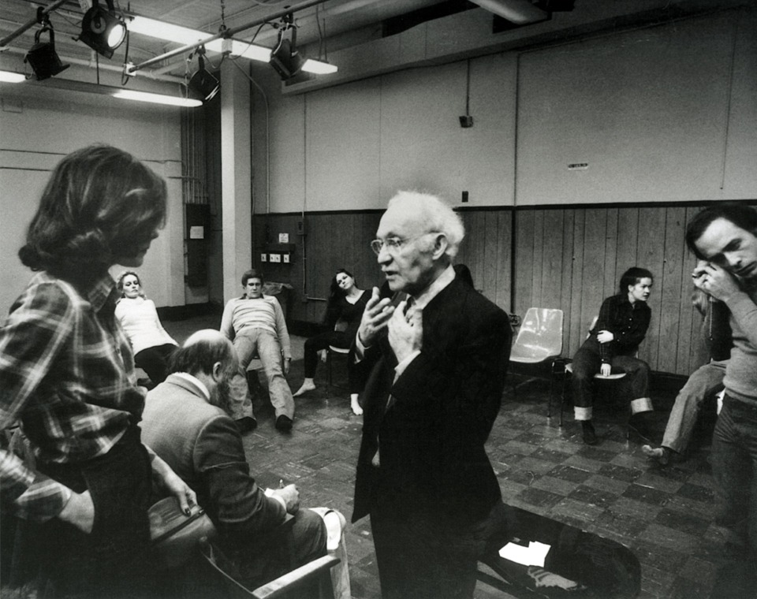

Software Construction and Evolution - CSSE 375
Making Method Calls Simpler
Below – “Be the character!” The late acting teacher Lee Strasberg coaches a student into the role. We can do that, too. “Be the software class!” What would you do next?
Shawn and Steve
Notes:
Image from http://www.methodactingstrasberg.com/methodacting.

Slide 2
Making Method Calls Simpler
Some Bad Code Smells
  Alternative Classes with Different Interfaces, Data Clumps, Long Parameter List, Primitive Obsession, Speculative Generality, Switch Statements
Rename Method
Add Parameter
Remove Parameter
Separate Query from Modifier
Parameterize Method
Replace Parameter with Explicit Methods
Preserve Whole Object
Replace Parameter with Method
Introduce Parameter Object
Remove Setting Method
Hide Method
Replace Constructor with Factory Method
Encapsulate Downcast
Replace Error Code with Exception
Replace Exception with Test

Slide 3
Why Make Method Calls Simpler?
Objects are all about interfaces
Need easy to understand and use interfaces in developing good object-oriented software
Chapter 10 explores refactorings that make interfaces more straightforward
Q1
Notes:
Q1: Why are “Making Method Calls Simpler” refactorings needed?

Slide 4

Rename Method
Situation: The name of a method does not reveal its purpose.
Solution: Change the name of the method.
Similarly, Add/Remove Parameter are simple and effective refactorings
Q2
Notes:
The simplest and most important thing you can do is to change the name of a method.
Naming is a key tool in communication. If you understand what a program is doing, you should not be afraid to use Rename Method to pass on that knowledge.
You can (and should) also rename variables and classes.
Q2: True/False: Often, the simplest and most important thing you can do to improve the understandability of method is to change the name of the method to better reflect its purpose.

Slide 5

Separate Query from Modifier
Situation: You have a method that returns a value but also changes the state of an object
Solution: Create two methods, one for the query and one for the modification
Q3
Notes:
A good rule to follow is to say that any method that returns a value should not have observable side effects.
You can move the call to other places in the method or call this function as often as you like.
If you come across a method that returns a value but also has side effects, you should try to separate the query from the modifier.
Q3: If you come across a method that returns a value but also has side effects (changes the state of the object), you should try to separate the ________ from the ________.

Slide 6
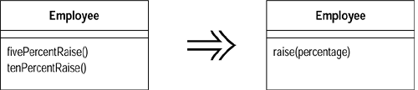
Parameterized Method
Situation: Several methods do similar things but with different values contained in the method body
Solution: Create one method that uses a parameter for the different values

Slide 7
Replace Parameter with Explicit Methods
Situation: You have a method that runs different code depending on the values of an enumerated parameter
Solution: Create a separate method for each value of the parameter
void setValue (String name, int value) {
if (name.equals("height"))
_height = value;
if (name.equals("width"))
_width = value;
Assert.shouldNeverReachHere();
}
void setHeight(int arg) {
_height = arg;
}
void setWidth (int arg) {
_width = arg;
}
Q4
Notes:
This is the reverse of Parameterize Method.
Q4: What is the solution that “Replace Parameter with Explicit Methods” provides?

Slide 8
Preserve Whole Object
Situation: You are getting several values from an object and passing these values as parameters in a method call
Solution: Send the whole object instead
Similar idea in “Introduce Parameter Object”
int low = daysTempRange().getLow();
int high = daysTempRange().getHigh();
withinPlan = plan.withinRange(low, high);
withinPlan = plan.withinRange(daysTempRange());
Notes:
Common dilemma – interact with parts or deal with the whole…
Similar idea in “Introduce Parameter Object”…
You have a group of parameters that naturally go together → Replace them with an object.

Slide 9
Replace Parameter with Method
Situation: An object invokes a method, then passes the result as a parameter for a method. The receiver can also invoke this method.
Solution: Remove the parameter and let the receiver invoke the method
int basePrice = _quantity * _itemPrice;
discountLevel = getDiscountLevel();
double finalPrice =
discountedPrice(basePrice, discountLevel);
int basePrice = _quantity * _itemPrice;
double finalPrice =
discountedPrice(basePrice);
Q5
Notes:
This goes along with allocation of responsibilities… move the responsibility to the lowest level where the information is needed.
Q5: After the refactoring in the example on slide, what method invokes getDiscountLevel()?

Slide 10

Remove Setting Method
Situation: A field should be set at creation time and never altered
Solution: Remove any setting method for that field
Similarly, “Hide Method” makes a public method private…

Slide 11
Replace Constructor with Factory Method
Situation: You want to do more than simple construction when you create an object
Solution: Replace the constructor with a factory method
Employee (int type) {
_type = type;
}
static Employee create(int type) {
return new Employee(type);
}
Q6
Notes:
This goes along with allocation of responsibilities… move the responsibility to the lowest level where the information is needed.
Q6: What problem/situation does the “Replace Constructor with Factory Method” refactoring address?

Slide 12
Encapsulate Downcast
Situation: A method returns an object that needs to be downcasted by its callers
Solution: Move the downcast to within the method
Object lastReading() {
return readings.lastElement();
}
Reading lastReading() {
return (Reading) readings.lastElement();
}
Notes:
Look for cases in which you have to downcast the result from calling a method.
These cases often appear with methods that return a collection or iterator.

Slide 13
Replace Error Code with Exception
Situation: A method returns a special code to indicate an error
Solution: Throw an exception instead
int withdraw(int amount) {
if (amount > _balance) return -1;
else {
_balance -= amount;
return 0;
}
}
void withdraw(int amount) throws BalanceException {
if (amount > _balance) throw new BalanceException();
_balance -= amount;
}
Q7
Notes:
When things go wrong, you need to do something about it. In the simplest case, you can stop the program with an error code.
This is the software equivalent of committing suicide because you miss a flight.
The part of a program that spots an error isn’t always the part that can figure out what to do about it. Hence, exception handling…
Q7: What is the problem that “Replace Error Code with Exception” solves?

Slide 14
Replace Exception with Test
Situation: You are throwing a checked exception on a condition the caller could have checked first
Solution: Change the caller to make the test first
double getValueForPeriod (int periodNumber) {
try {
return _values[periodNumber];
} catch (ArrayIndexOutOfBoundsException e) {
return 0;
}
}
double getValueForPeriod (int periodNumber) {
if (periodNumber >= _values.length) return 0;
return _values[periodNumber];
}
Q8
Notes:
Exceptions should be used for exceptional behavior—behavior that is an unexpected error. They should not act as a substitute for conditional tests.
If you can reasonably expect the caller to check the condition before calling the operation, you should provide a test, and the caller should use it.
Q8: What is the problem that “Replace Exception with Test” solves?

