Slide 1


CSSE 375
Organizing Data – Part 2
Shawn and Steve
Continue the same quiz!
Notes:
Image, above – Organizing a program often feels “disorganized,” in itself, like this stack of folders.
From http://www.flyingrutabagaworks.com/workshops/capturing-and-organizing-data-for-gaps-organic-certification-and-other-endeavors.

Slide 2
Mathematics: Factor
fac·tor
  One of two or more quantities that divides a given quantity without a remainder, for example:
    2 and 5 are factors of 10
    a and b are factors of ab
    (a+1) and (a+3) are factors of a² + 4a + 3
fac·tor·ing
  To determine or indicate explicitly the factors of
Reconsidering Q1…

Slide 3
Software Engineering: Factoring
fac·tor
  Individual items that combined together form a complete software system:
    identifiers
    contents of function
    contents of classes and place in inheritance hierarchy
fac·tor·ing
  Determining the items, at design time, that make up or compose a software system
Q9
Notes:
Q9: Briefly write your own, reasonable definition of Software Factoring. What does this say about refactoring?
Hence, refactoring is a process or organizing SE factors for the purpose of improved structure.

Slide 4
Organizing Data
Refactorings that make working with data easier – Lots of them!
Self Encapsulate Field
Replace Data Value with Object
Change Value to Reference
Change Reference to Value
Replace Array with Object
Duplicate Observed Data
Change Unidirectional Association to Bidirectional
Change Bidirectional Association to Unidirectional
Replace Magic Number with Symbolic Constant
Encapsulate Field
Encapsulate Collection
Replace Record with Data Class
Replace Type Code with Class
Replace Type Code with Subclasses
Replace Type Code with State/Strategy
Replace Subclass with Fields

Slide 5
Replace Array with Object
Situation: You have an array in which certain elements mean different things
Solution: Replace the array with an object that has a field for each element
Similarly, Replace Record with Data Class
String[] row = new String[3];
row [0] = "Liverpool";
row [1] = "15";
Performance row = new Performance();
row.setName("Liverpool");
row.setWins("15");
Q10
Notes:
Arrays, a common data structure, should be used only to contain a collection of similar objects in some order.
Sometimes, however, you see them used to contain a number of different things.
Similarly, Replace Record with Data Class:
Situation: You need to interface with a record structure in a traditional programming environment
Solution: Make a dumb data object for the record
Q10: What is the problem that “Replace Array with Object” solves?

Slide 6
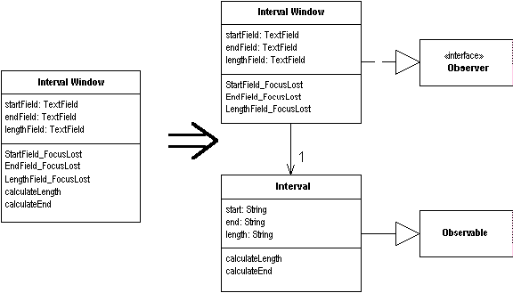
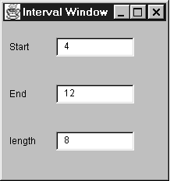
Duplicate Observed Data
Situation: You have domain data available only in a GUI control, and domain methods need access.
Solution: Copy the data to a domain object. Set up an observer to synchronize the two pieces of data.
Q11
Notes:
Do you remember the Observer GoF pattern?
Q11: What GoF pattern does Duplicate Observed Data technique reflect?
The behavior is very simple. Whenever you change the value in one of the text fields, the other ones update.
If you change the start or end fields, the length is calculated; if you change the length field, the end is calculated.

Slide 7
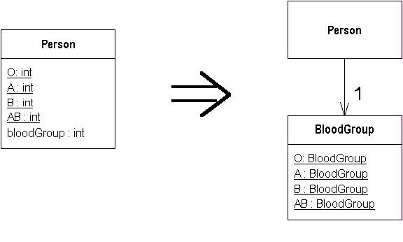
Replace Type Code with Class
Situation: A class has a numeric type code that does not affect its behavior
Solution: Replace the number with a new class
Q12
Notes:
Must consider other type code replacements.
Replace type code with a class only if the type code is pure data.
i.e., it does not cause different behavior inside a switch statement.
Java switches on an integer, not an arbitrary class, so the replacement will fail.
Moreover, switch must be removed w/Replace Conditional with Polymorphism.
Q12: What is the problem that “Replace Type Code with Class” addresses?

Slide 8
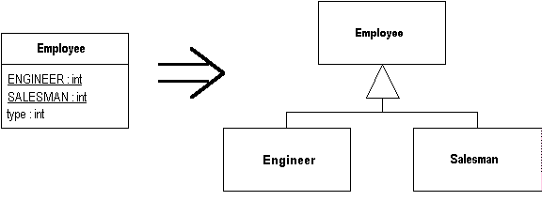
Replace Type Code with Subclasses
Situation: You have an immutable type code that affects the behavior of a class
Solution: Replace the type code with subclasses
Q13
Notes:
If you have type code that doesn’t affect behavior, you can use this refactor.
However, if the type code affects behavior, the best thing to do is to use polymorphism to handle the variant behavior.
Primarily scaffolding move to enable Replace Conditional with Polymorphism.
- Conditional statements a trigger to use Replace Type Code with Subclasses.
Q13: What is the problem that “Replace Type Code with Subclasses” addresses?

Slide 9
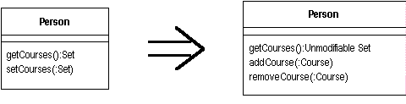
Encapsulate Collection
Situation: A method returns a collection
Solution: Make it return a read-only view and provide add/remove methods
Q14
Notes:
Often a class contains a collection of instances. This collection might be an array, list, set, or vector.
Such cases often have the usual getter and setter for the collection
Q14: Beyond encapsulation, what object oriented programming principle is addressed with Encapsulate Collection?

Slide 10
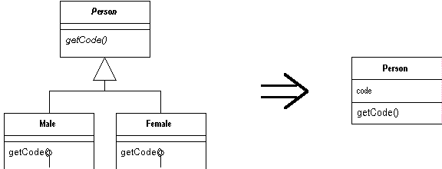
Replace Subclass with Fields
Situation: You have subclasses that vary only in methods that return constant data
Solution: Change the methods to superclass fields and eliminate the subclasses
Notes:
You create subclasses to add features or allow behavior to vary.
One form of variant behavior is the constant method. A constant method is one that returns a hard-coded value.
This can be very useful on subclasses that return different values for an accessor.
You define the accessor in the superclass and implement it with different values on the subclass.

Slide 11
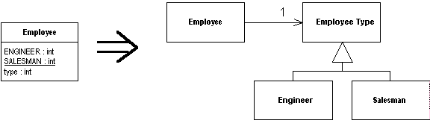
Replace Type Code with State/Strategy
Situation: You have a type code that affects the behavior of a class, but you cannot use subclassing
Solution: Replace the type code with a state object
Notes:
This is similar to Replace Type Code with Subclasses, but can be used if the type code changes during the life of the object or if another reason prevents subclassing.
It uses either the State or Strategy pattern (they are very similar)

Slide 12
Mechanics
Self-encapsulate the type code
Create a new class, and name it after the purpose of the type code. This is the state object.
Add subclasses of the state object, one for each type code
  It’s easier to add subclasses all at once, rather than one at a time
Create an abstract query in the state object to return the type code. Create overriding queries of each state object subclass to return the correct type code
Compile
Create a field in the old class for the new state object
Adjust the type code query on the original class to delegate to the state object
Adjust the type code setting methods on the original class to assign an instance of the appropriate state object subclass
Compile and test

Slide 13
Replace Type Code with State/Strategy
class Employee {
private int _type;
static final int ENGINEER = 0;
static final int SALESMAN = 1;
static final int MANAGER = 2;
Employee (int type) {_type = type;) }
int payAmount() {
switch (_type) {
case ENGINEER: return _monthlySalary;
case SALESMAN: return _monthlySalary +
_commission;
case MANAGER: return _monthlySalary + _bonus;
default: throw new Exception("Incorrect Code");
}
}
Q15
Notes:
Q15: What is a good place to start refactoring the Type Code into a State/Strategy in this example?

Slide 14
First Self Encapsulate Type code …
Employee (int type) { setType (type);}
int getType() { return _type;}
void setType(int arg) { _type = arg;}
int payAmount() {
switch (getType()) {
case ENGINEER:
return _monthlySalary;
case SALESMAN:
return _monthlySalary + _commission;
case MANAGER:
return _monthlySalary + _bonus;
default:
throw new RuntimeException("Incorrect Employee");
}
}
Self-Encaps
Notes:
Assume this is a progressive company that allows promotion of managers to engineers.
Thus the type code is mutable, and I can’t use subclassing. My first step, as ever, is to self-encapsulate the type code:

Slide 15
Declare State Class and Subclasses…
abstract class EmployeeType {
abstract int getTypeCode();
}
class Engineer extends EmployeeType {
int getTypeCode () {
return Employee.ENGINEER;
}
}
class Manager extends EmployeeType {
int getTypeCode () {
return Employee.MANAGER;
}
}
class Salesman extends EmployeeType {
int getTypeCode () {
return Employee.SALESMAN;
}
}
Abstract Class
Subclasses
Notes:
declare this as an abstract class and provide an abstract method for returning the type code

Slide 16
Hook Subclasses into Employee…
class Employee...
private EmployeeType _type;
int getType() {
return _type.getTypeCode();
}
void setType(int arg) {
switch (arg) {
case ENGINEER: _type = new Engineer();
break;
case SALESMAN: _type = new Salesman();
break;
case MANAGER: _type = new Manager();
break;
default: throw new Exception("Incorrect Code");
}
}
Employee Type Set via Accessors
Notes:
Hook the subclasses into the employee by modifying the accessors for the type code

Slide 17
Create a factory method for employee types…
class Employee...
void setType(int arg) {
_type = EmployeeType.newType(arg);
}
class EmployeeType...
static EmployeeType newType(int code) {
switch (code) {
case ENGINEER: return new Engineer();
case SALESMAN: return new Salesman();
case MANAGER: return new Manager();
default: throw new Exception("Incorrect Code");
}
}
static final int ENGINEER = 0;
static final int SALESMAN = 1;
static final int MANAGER = 2;
Factory Method
For Employee Type
Notes:
Now only place in code for decision, and it will be executed only when the type is changed.
Finish Replace Type Code with State/Strategy by moving all knowledge of the type codes and subclasses over to the new class.
First I copy the type code definitions into the employee type, create a factory method for employee types, and adjust the setting method on employee:

Slide 18
Remove the type code definitions …
class Employee...
int payAmount() {
switch (getType()) {
case EmployeeType.ENGINEER:
return _monthlySalary;
case EmployeeType.SALESMAN:
return _monthlySalary + _commission;
case EmployeeType.MANAGER:
return _monthlySalary + _bonus;
default:
throw new Exception("Incorrect Code");
}
}
Exercise: Now ready to use Replace Conditional with Polymorphism on payAmount
Q16
Notes:
Remove the type code definitions from the employee and replace them with references to the employee type
Q16: What is the result of using “Replace Conditional with Polymorphism” on PayAmount?

Slide 19
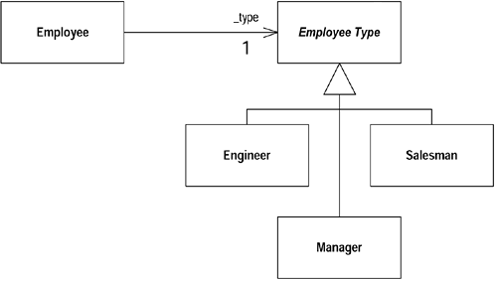
Replace Conditional with Polymorphism on payAmount
class Salesman...
int payAmount(Employee emp) {
return emp.getMonthlySalary() + emp.getCommission();
}
class Manager...
int payAmount(Employee emp) {
return emp.getMonthlySalary() + emp.getBonus();
}
…
class EmployeeType...
abstract int payAmount(Employee emp);
Declare superclass method abstract
Q16 - cntd
Notes:
Remove the type code definitions from the employee and replace them with references to the employee type

