Slide 1
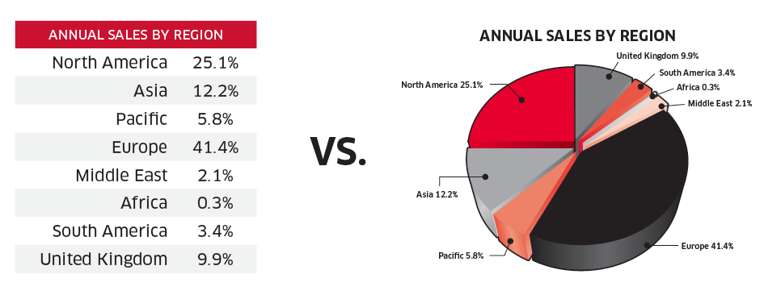

CSSE 375
Organizing Data – Part 1
Shawn and Steve
Q1
Notes:
Picture above – Everyone knows that “data” is easier to understand, toward some end, in one form versus another. Like “pie charts” on the right, when your goal is to show what things make up the biggest pieces of that pie. Picture from http://graphicdesign.stackexchange.com/questions/17985/how-to-beautifully-incorporate-tables-in-texts-documents.
Q1: In the same way that mathematical factors help organize algebra, software factoring determines the items at design time, that make up or compose a software system. What does this say about refactoring ?

Slide 2

A Basic Rule of Refactoring
“Refactor the low hanging fruit”
  http://c2.com/cgi/wiki?RefactorLowHangingFruit
Low Hanging Fruit: “The thing that gets you most value for the least investment”
Probably judged mostly by, “What do you need to change next?”
Q2
Notes:
In other words, don’t spend more time on it than is productive in some forseable way.
There are ways to improve any design incrementally
Q2: Expanding on a question from your last quiz, how do you decide what to spend time on, in refactoring?

Slide 3
Recall: Composing Methods
Some Bad Code Smells
  Long method
  Duplicated code
  Comments to explain hard-to-understand code
Representative Refactorings
  Extract Method
    Turn a code fragment into a method whose name explains the purpose of the method
  Introduce Explaining Variable
    Put the result of an expression in a temporary variable with a name that explains the purpose
  Remove Assignments to Parameters
    Use a temporary variable

Slide 4
Recall: Moving Features Between Objects
Some Bad Code Smells
  Data class
    Class with only get / set methods, and nothing else
  Feature envy
    Method more interested in other classes methods than in it own class’ methods
  Large class
Representative Refactorings
  Move Method/Field
    Move a method/field from one class to another
  Extract class
    Create a new class and move field & methods to the new class
  Inline class
    Move fields & methods to another class

Slide 5
Organizing Data
Refactorings that make working with data easier – Lots of them!
Self Encapsulate Field
Replace Data Value with Object
Change Value to Reference
Change Reference to Value
Replace Array with Object
Duplicate Observed Data
Change Unidirectional Association to Bidirectional
Change Bidirectional Association to Unidirectional
Replace Magic Number with Symbolic Constant
Encapsulate Field
Encapsulate Collection
Replace Record with Data Class
Replace Type Code with Class
Replace Type Code with Subclasses
Replace Type Code with State/Strategy
Replace Subclass with Fields
Q3
Notes:
Q3: What does the “Organizing Data” refactoring category address in general? [[Refactorings that make working with data easier.]]

Slide 6
Organizing Data
Some Bad Code Smells
  Explaining comments
  Public fields
Representative Refactorings
  Replace magic number with symbolic constant
    Area = 3.14159265 * r * r; // bad
    Static final int PI = 3.14159265;
    Area = PI * r * r; // better
  Encapsulate field
    Public fields are bad
    Use private field & get / set methods
Q4
Notes:
Q4: What are some bad code smells that are addressed by organizing data refactorings?

Slide 7

Replace Magic Number with Symbolic Constant
Motivation
  Magic numbers are one of oldest ills in computing
  Nasty when you need to reference the same logical number in more than one place
    Change is a nightmare
    Difficult to understand in code
Most languages allow you to declare a constant
  No cost in performance
  Great improvement in readability

Slide 8
Replace Magic Number with Symbolic Constant
Situation: You have a literal number with a particular meaning
Solution: Create a constant, name it after the meaning, and replace the number with it
double potentialEnergy(double mass, double height) {
return mass * 9.81 * height;
}
double potentialEnergy(double mass, double height) {
return mass * GRAVITATIONAL_CONSTANT * height;
}
static final double GRAVITATIONAL_CONSTANT = 9.81;
Q5
Notes:
For this refactoring a symbolic constant is used, which is the most common Java idiom.
However an alternative is the constant method, which is a method of this form
public static double gravitationalConstant() { return 9.81; }
Q5: What is the solution that “Replace Magic Number with Symbolic Constant” supplies? Add your own ideas beyond what’s on the slide!

Slide 9
Replace Magic Number … Mechanics
Declare a constant and set it to the value of the magic number
Find all occurrences of the magic number
See whether the magic number matches the usage of the constant
  If it does, change the magic number to use the constant
Compile
When all magic numbers are changed, compile and test
At this point all should work as if nothing has been changed
  A good test is to see whether you can change the constant easily

Slide 10
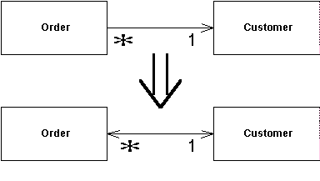
Change Unidirectional Association to Bidirectional
Situation: You have 2 classes that need to use each other's features, but there is only a one-way link
Solution: Add back pointers, and change modifiers to update both sets
Change Bidirectional Association to Unidirectional
Notes:
Note that Change Bidirectional Association to Unidirectional reverses this process.

Slide 11
Organize Data Exercise
class Order...
Customer getCustomer() {
return _customer;
}
void setCustomer (Customer arg) {
_customer = arg;
}
Customer _customer;
Note that customer Class has no reference to order
Change Unidirectional Association to Bidirectional
Q6
Notes:
Think – pair – share exercise…
Q6: What is the first thing you should do to start to change the unidirectional association to a bidirectional?

Slide 12
Add Field to Customer for Uniqueness
class Customer {
private Set _orders = new HashSet();
…
}
class Order...
Customer getCustomer() {
return _customer;
}
void setCustomer (Customer arg) {
_customer = arg;
}
Customer _customer;
Uniqueness

Slide 13
Get “Order” to Take Charge
class Customer...
Set friendOrders() {
/** should only be used by Order when modifying the association */
return _orders;
}
class Order...
void setCustomer (Customer arg) ...
if (_customer != null)
_customer.friendOrders().remove(this);
_customer = arg;
if (_customer != null)
_customer.friendOrders().add(this);
}
Signal Special Case
Update Modifier to update back pointer…
Notes:
* If both objects are reference objects and the association is one to many, then the object that has the one reference is the controller. (That is, if one customer has many orders, the order controls the association.)
* If one object is a component of the other, the composite should control the association.
* If both objects are reference objects and the association is many to many, it doesn’t matter whether the order or the customer controls the association.

Slide 14
Changed Bidirectional Association to Bidirectional
class Order... //controlling methods
void addCustomer (Customer arg) {
arg.friendOrders().add(this);
_customers.add(arg);
}
void removeCustomer (Customer arg) {
arg.friendOrders().remove(this);
_customers.remove(arg);
}
class Customer...
void addOrder(Order arg) {
arg.addCustomer(this);
}
void removeOrder(Order arg) {
arg.removeCustomer(this);
}
Reference Customer
Reference Order

Slide 15
Self Encapsulate Field
Situation: You are accessing a field directly, but the coupling to the field is becoming awkward
Solution: Create getting and setting methods for the field and use only those to access the field
private int _low, _high;
boolean includes (int arg) {
return arg >= _low && arg <= _high;
}
private int _low, _high;
boolean includes (int arg) {
return arg >= getLow() && arg <= getHigh();
}
int getLow() {return _low;}
int getHigh() {return _high;}
Notes:
Two schools of thought and hotly debated…
access variables directly/freely within class – readability
Always use accessors (indirect access) – protection

Slide 16
Encapsulate Field
Situation: There is a public field.
Solution: Make it private and provide accessors.
public string _name;
private String _name;
public String getName() {return _name;}
public void setName(String arg) {_name = arg;}
Q7
Notes:
One of the principal tenets of object orientation is encapsulation, or data hiding
Should never make your data public
When you make data public, other objects can change and access data values without the owning object's knowing about it
This separates data from behavior
Note that this is different than Self Encapsulate Field…
Q7: What is the difference between Encapsulate Field and Self Encapsulate Field?

Slide 17
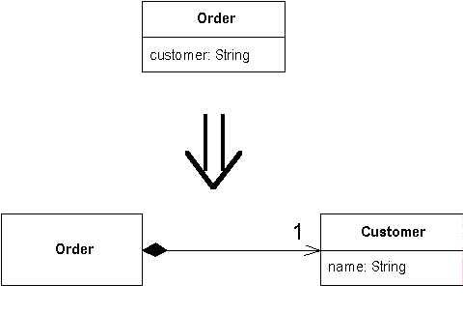
Replace Data Value with Object
Situation: You have a data item that needs additional data or behavior
Solution: Turn the data item into an object
Q8
Notes:
Q8: What is the problem that “Replace Data Value with Object” addresses?

Slide 18
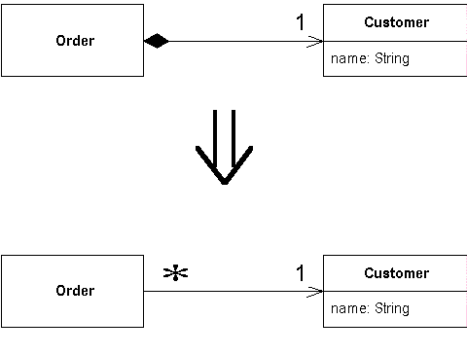
Change Value to Reference
Situation: You have a class with many equal instances that you want to replace with a single object
Solution: Turn the object into a reference object
Change Reference to Value
Notes:
Note that Change Reference to Value reverses this process.

