Slide 1
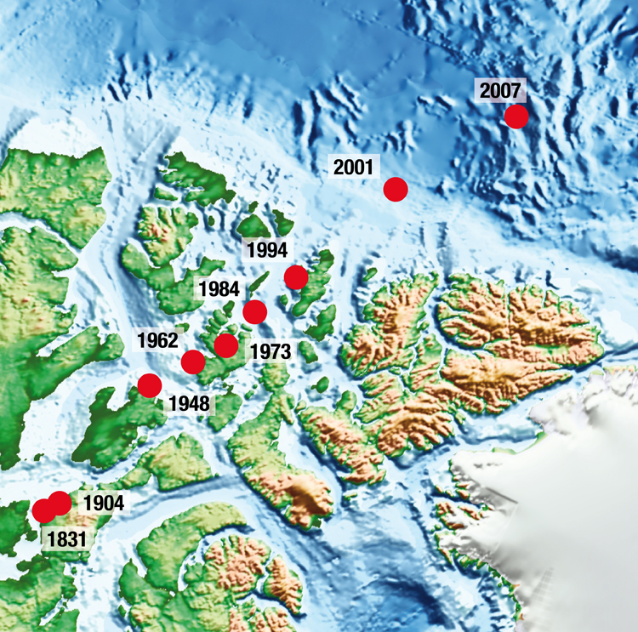

CSSE 375
Moving Features Between Objects
Shawn and Steve
Fowler Ch 7
Q1
Notes:
Above – A “moving feature” in action – the geomagnetic north pole. From http://www.ngdc.noaa.gov/geomag/GeomagneticPoles.shtml.
Q1: Deciding where to put responsibilities when designing objects is often difficult the first time out. How does refactoring help this problem ?

Slide 2
Moving Features Between Objects
One of the most fundamental decisions in object design is deciding where to put responsibilities
Can often resolve responsibility problems by moving the behaviors/features around
Move Method
Move Field
Extract Class
Inline Class
Hide Delegate
Remove Middle Man
Introduce Foreign Method
Introduce Local Extension
Q2
Notes:
A lot of method’s information gets buried by their complex logic
Q2: What does the Moving Features Between Objects refactoring category address in general?

Slide 3
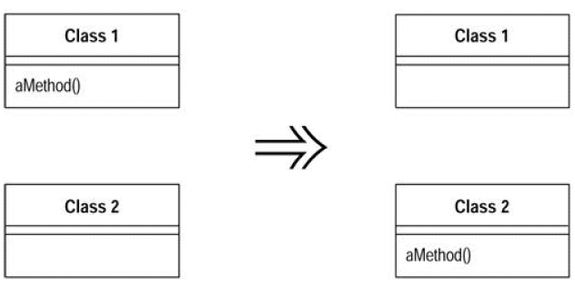
Move Method
Situation: A method is using more features or is used by more methods of another class than the class on which it is defined
Solution: Create a new method with a similar body in the class it uses most
  Either turn the old method into a simple delegation, or remove it altogether
Notes:
“The bread and butter of refactoring.”
Think about doing this after you’ve moved some fields between classes. Warning: watch for polymorphism on the original class. That can make the move impossible.

Slide 4
Move Method Mechanics (1 of 2)
Examine all class attributes used by the source method that are defined on the source class and consider whether they also should be moved
  If attribute used only by the method being moved, move it too
  If attribute used by other methods, consider moving them too
Declare the method in the target class
  Can rename it to one that makes sense in the target class
Copy the code from the source method to the target
Compile the target class
Determine how to reference correct target object from source
Q3
Notes:
Declare the method in the target class
May choose to rename it to one that makes more sense in the target class
Copy the code from the source method to the target
Adjust method to make it work in its new home
If the method uses its source, you need to determine how to reference the source object from the target method
If there is no mechanism in the target class, pass the source object reference to the new method as a parameter
Determine ho w to reference correct target object from source
There may be an existing field or method that will give you the target
If not, see whether you can easily create a method that will do so
If not, you need to create a new field in the source that can store the target
Turn the source method into a delegating method
Determine how to reference correct target object from source
Existing field or method may give you the target
If not, see whether you can easily create a method that will do so
If not, you need to create a new field in the source that can store the target
Turn the source method into a delegating method
Q3: When examining class attributes used by the source method in the source class, if the attribute is used only by the method being moved, what should you do?

Slide 5
Move Method (2 of 2)
Compile and test (1st time)
Decide whether to remove the source method or retain it as a delegating method
  Leaving the source as a delegating method is easier if you have many references
If you remove the source method, replace all the references with references to the target method
Compile and test (2nd time)
Notes:
If you remove the source method, replace all the references with references to the target method
You can compile and test after changing each reference, although it is usually easier to change all references with one search and replace

Slide 6
Move Method: Example (1 of 5)
class Account...
double overdraftCharge() {
if (_type.isPremium()) {
double result = 10;
if (_daysOverdrawn > 7)
result += (_daysOverdrawn - 7) * 0.85;
return result;}
else
return _daysOverdrawn * 1.75;
}
double bankCharge() {
double result = 25;
if (_daysOverdrawn > 0) result += overdraftCharge();
return result;
}
private AccountType _type;
private int _daysOverdrawn;
}
Need to move
Notes:
Suppose there are several new account types - Each has its own rule for computing the overdraft charge
Hence, we need to move the overdraftCharge method over to the AccountType class
Start by looking at the features that the overdraftCharge method uses and consider whether to move a batch of methods together
We need the daysOverdrawn field to remain on the account class
Will vary with individual accounts
Copy the method body over to the account type and get it to fit
What is wrong with this Class code fragment?

Slide 7
Move Method: Example (2 of 5)
Suppose there are several new account types
  Each has its own rule for computing the overdraft charge
Hence, we need to move the overdraftCharge method over to the AccountType class
Start by looking at the features that the overdraftCharge method uses and consider whether to move a batch of methods together
We need the daysOverdrawn field to remain on the account class
  Will vary with individual accounts
Copy the method body over to the account type and get it to fit

Slide 8
Move Method: Example (2 of 5)
Moving to…
class AccountType...
double overdraftCharge(int daysOverdrawn){
if (isPremium()) {
double result = 10;
if (daysOverdrawn > 7)
result += (daysOverdrawn -7) * 0.85;
return result;}
else
return daysOverdrawn * 1.75;
}

Slide 9
Move Method: Example (3 of 5)
When we need to use a feature of the source class we can do one of the following:
  Move this feature to the target class as well
  Create or use a reference from the target class to the source
  Pass the source object as a parameter to the method
  If the feature is a variable, pass it in as a parameter
Q4
Notes:
Q4: Which one of these 4 options on the slide is a good match for this case and why?

Slide 10
Move Method: Example (4 of 5)
class Account...
double overdraftCharge() {
return _type.overdraftCharge(_daysOverdrawn);
}
double bankCharge() {
    double result = 4.5;
    if (_daysOverdrawn > 0)
      result += _type.overdraftCharge(_daysOverdrawn);
    return result;
  }
  private AccountType _type;
  private int _daysOverdrawn;
Simple delegation
Directing to AccountType
Notes:
Let’s look at Account …
Once we’ve replaced all the callers, we can remove the method declaration in account

Slide 11
Move Method: Example (5 of 5)
class AccountType...
double overdraftCharge(Account account){
if (isPremium()) {
double result = 10;
if (account.getDaysOverdrawn() > 7)
result += (account.getDaysOverdrawn() -7) * 0.85;
return result;}
else
return account.getDaysOverdrawn()* 1.75;
}
Notes:
The final form of AccountType is here.
Note the isPremium is now in scope of the method.
Note the account.getDaysOverdrawn is from account class.

Slide 12
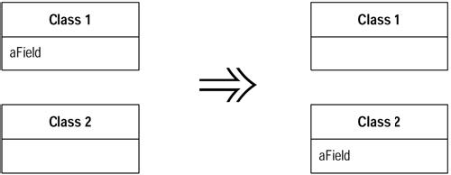
Move Field
Situation: A field is, or will be, used by another class more than the class on which it is defined
Solution: Create a new field in the target class, and change all its users
Q5
Notes:
Q5: What is the situation where Move Field refactoring would be applied?

Slide 13
Move Field Mechanics
If field is public, make it private and create a setter and a getter
Compile and test
Create a field in the target class with a getter and setter methods
Compile the target class
Determine how to reference the target object from the source
Notes:
Determine how to reference the target object from the source
An existing field or method may give you the target
If not, see whether you can easily create a method that will do so
If not, you may need to create a new field in the source that can store the target

Slide 14
Exercise: Move Field
class Account...
  private AccountType type;
  private double interestRate;
  double interestForAmountDays(double amount, int days) {
    return interestRate * amount * days / 365;
  }
Move the interest rate field to the account type
Assume there are several methods with that reference, of which interestForAmountDays is one example
Q6-1
Notes:
Think Pair Share
This is short so you don’t need to have code…
Q6: In the exercise, what did you do to move the field interest rate?

Slide 15
Move Field: Example
class AccountType...
  private double interestRate;
  void setInterestRate (double arg) {
    interestRate = arg;
  }
  double getInterestRate () {
    return interestRate;
  }

Slide 16
Move Field
Redirect the methods from the account class to use the account type and remove the interest rate field in the account
private double interestRate;
  double interestForAmountDays (double amount, int days){
    return type.getInterestRate() * amount * days / 365;
  }
Q6-2

Slide 17
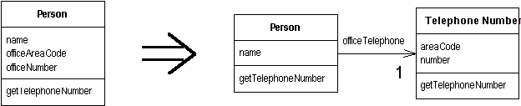
Extract Class
Situation: You have a class doing the work that should be done by two
Solution: Create a new class and move the relevant fields and methods from old class to new one
Q7
Notes:
Q7: When you have a class that is doing enough for multiple classes, what should you do?

Slide 18
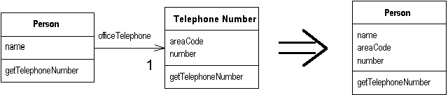
Inline Class
Situation: A class isn't doing very much
Solution: Move all its features into another class and delete it
Q8
Notes:
Q8: What is the opposite refactoring method of this Inline Class?

Slide 19
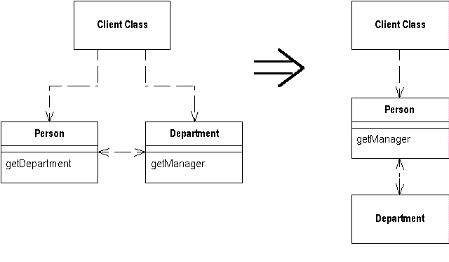
Hide Delegate
Situation: A client is calling a delegate class of an object
Solution: Create methods on the server to hide the delegate

Slide 20
Introduce Foreign Method
Situation: A server class you are using needs an additional method, but you can't modify the class
Solution: Create a method in client class with an instance of the server class as its first argument
Date newStart = new Date (previousEnd.getYear(),
previousEnd.getMonth(), previousEnd.getDate() + 1);
Date newStart = nextDay(previousEnd);
private static Date nextDay(Date arg) {
return new Date (arg.getYear(),arg.getMonth(),
arg.getDate() + 1);
}
Q9
Notes:
Q9: What is the solution that Introduce Foreign Method supplies? Try to expand on the answer given on the slide.

Slide 21
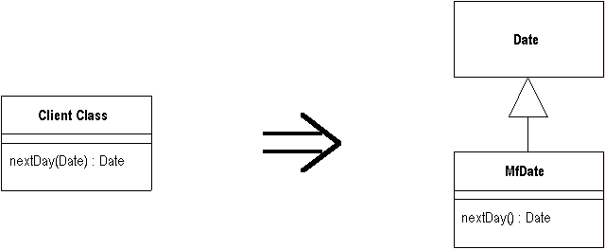
Introduce Local Extension
Situation: A server class you are using needs several additional methods, but you can't modify the class
Solution: Create a new class that contains these extra methods. Make this extension class a subclass or a wrapper of the original

