Slide 1


Software Construction and Evolution
CSSE 375: Course Introduction
How is our stuff like this? Or not?
Steve Chenoweth
Office: Meonch Room F220
Phone: (812) 877-8974
Email: chenowet@rose-hulman.edu
Notes:
Image from http://www.mun.ca/biology/scarr/Progressive_Evolution.html.

Slide 2
Agenda
Introductions
Software – A Problem of Change
Course Outcomes
Guidelines and Expectations
Term Schedule
Homework Reminders
Notes:
A lot to cover today…

Slide 3
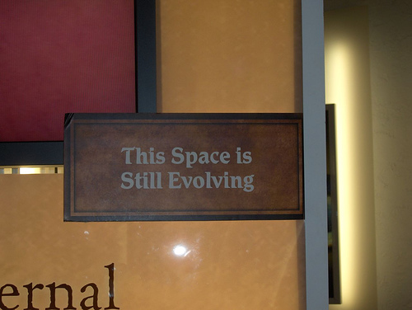
Introductions – Tell us About Yourself…
Name
Major
System Maintenance Experience
  Oldest system you have made changes to
  (either individually or with a team)
  Weirdest Software Change
  or Change Request
Q1
Candid shot from the Creation Museum, Hebron, KY
Notes:
Note that this space is evolving… like most software!
Q1: What is the oldest system that someone in your class has worked on?
Let’s go around the room… move along

Slide 4
What is Software?
The source code and the software artifacts…
Software is part of a computer system that is intended to change
Intangible
Engineered,
not manufactured
Complex
Software is suppose to change…
otherwise it would in the hardware!
Q2
Notes:
We typically say the code or the composite of the software artifacts… but this is a narrow mindset.
For maintenance and evolution we need something more… something that reflect change!
Need a systematic engineering discipline to “ensure maintenance doesn’t eat your software”
Q2: What are some aspects about software that make it hard to change? [[intangibility, Engineering it, complexity]]

Slide 5
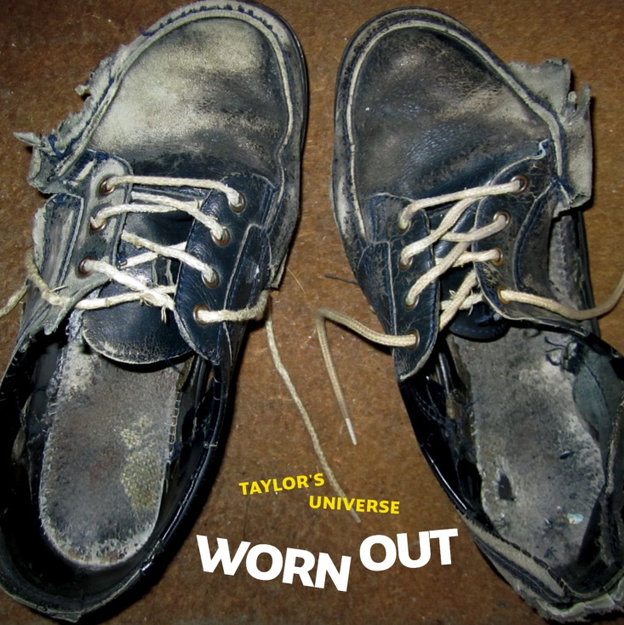
Software Doesn’t Wear Out
Software doesn’t change with age
or “wear out” with use!
Software “ages” or
becomes “obsolete”
with a changing
environment
Software deteriorates or
“degrades” with
continued changes
Q3
Notes:
Q3: Why does software become obsolete (name two reasons)?
[[New requirements are introduced… Competitors introduce new features… new technology]]
Shoes from http://astoundedbysound.blogspot.com/2013/05/taylors-universe-worn-out.html.

Slide 6
Problem: Software Degradation
The Original Software Design...
Easy to Understand
Components well isolated to facilitate change
Isolation supports change validation
...Plus a few “Changes”
Increased size and complexity
...but it works (for awhile)
Reliability of system degrades, errors creep in
At some point, it’s unmaintainable ...effort to make the next change becomes prohibitive
Q4
Notes:
Q4: What causes the software to deteriorate and degrade? Continuous changes

Slide 7
Information Lose Due to Relentless Change
Change
Set 1
Change
Set 2
Baseline
Change
Set N
Code
Design
Spec’s
Notes:
What two things are lost as changes are made to the software system? Structure and people…

Slide 8
Course Theme – Art of avoiding That!
Basic principles of software change
Program understanding and tools
Detecting bad smells
Applying software refactoring
Exception handling for fault tolerance
Software maintenance
Software modernization (reengineering)
Software configuration management
Software user and system documentation
Adv. Topics: Impact Analysis, code tuning
Course Topics

Slide 9


Learning Outcome 1 :
Practicing software change
Work with your (“big”) junior project team to complete and deliver the junior project to the client. In doing so, demonstrate the ability to work within a team.
Woah, client!
Q5

Slide 10

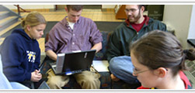
Learning Outcome 2:
Smells, Refactor to Solve Problems
Select appropriate refactoring techniques to resolve design problems “smelt” in the code.
Q5

Slide 11
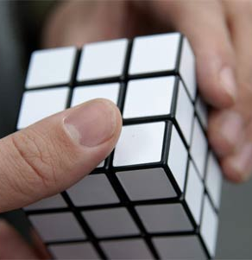
Learning Outcome 3: Program understanding and tools
Apply common construction and maintenance heuristics to enhance existing code.
Q5

Slide 12

Learning Outcome 4: Really Needed Documentation
Organize and
develop software stakeholder documentation.
Who are these guys,
on your project, anyway?
Q5

Slide 13

Learning Outcomes 5 : Basic principles of software change
Construct software so that it
meets delivery and
deployment objectives
specified by the
project.
Stop coding – here he comes!
Q5
Notes:
Traffic officer from http://www.animationlibrary.com/sc/296/Police/?page=8.

Slide 14

Learning Outcomes 6: Maintenance Planning
…and
Apply impact analysis and other software source analysis to understanding existing software.
How many ducks to we have to line up here?
Q5

Slide 15

Learning Outcomes 6: Maintenance Process
Apply the corrective, perfective, adaptive and preventive types of software changes and maintenance types.
Wait – Footprints are supposed to be depressions?
Q5

Slide 16

Learning Outcome 7: Change Impacts
Apply impact analysis and other software source analysis to understanding existing software.
Q5
Notes:
If something changes, what are the ripple-effects?
How do we find them?
What is the precision and recall?

Slide 17

Learning Outcome 8: Exception handling for fault tolerance
Use systematic exception handling and other techniques in promoting fault-tolerance.
Wait – what letter was I on?
Q5

Slide 18
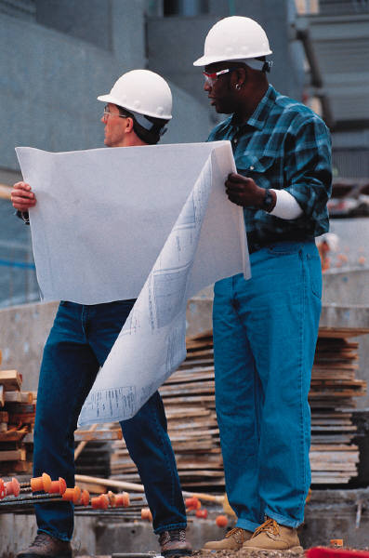
Learning Outcome 9: Reengineering
Describe software modernization approaches such as reverse engineering, reengineering, salvaging, and restructuring.
It says here to connect it to the building across the street…
Q5
Notes:
Refactoring is a form

Slide 19
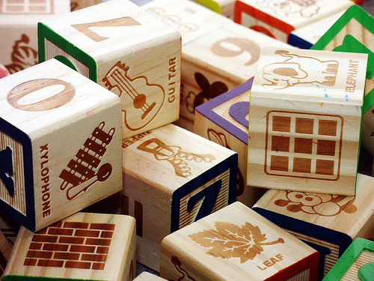
Learning Outcome 10: Software configuration management
Describe the ways configuration management is used in production systems.
I can actually prove that rearranging these blocks is NP-hard.
Q5

Slide 20
Course Mechanics
Taught in 3 Sections, Sec 1 (Shawn), Sec 2 & 3 (Steve)
Find most material:
http://www.rose-hulman.edu/class/csse/csse375/
Grades and assignment drop boxes will be on Moodle
  Put Q 1 for today there, by the end of class.
See syllabus and schedule
Q6,7
Notes:
Q6: What day and time is the first homework in this course due? March 16th at 5pm
Q7: What day and time is the first project milestone in this course due? March 12th at 11:59pm

