Slide 1
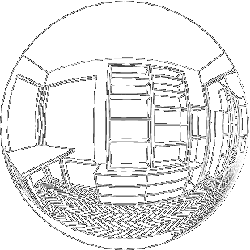


CSSE 374:
Final Perspectives on Software Architecture and Design
Steve Chenoweth
Office: Moench Room F220
Phone: (812) 877-8974
Email: chenowet@rose-hulman.edu
Chandan Rupakheti
Office: Moench Room F203
Phone: (812) 877-8390
Email: rupakhet@rose-hulman.edu
These slides derived from Shawn Bohner, Curt Clifton, Alex Lo, and others involved in delivering 374.
Notes:
Fisheye perspective from http://mathworld.wolfram.com/FisheyePerspective.html

Slide 2
Plan for Today
We’ll gloss-over the last topic - UML Component Diagrams
Course Recap
Go Over the One Document Together
Rehearsal for Client Meeting
Course evaluations
Notes:
Quiz questions – we did not key these to the pages this time – You are on your own!

Slide 3
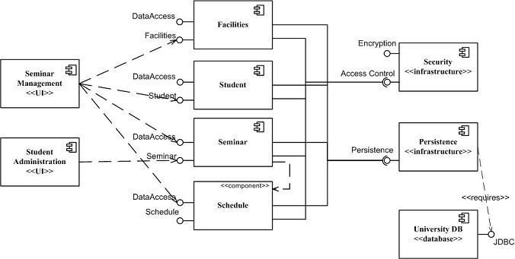
One more UML diagram!
UML Component Diagrams
Here’s an example:
Show high-level reliance on components in a way that guides development.
Here, especially “Who has to have what connections to persistence.”
Notes:
From http://www.agilemodeling.com/artifacts/componentDiagram.htm.

Slide 4
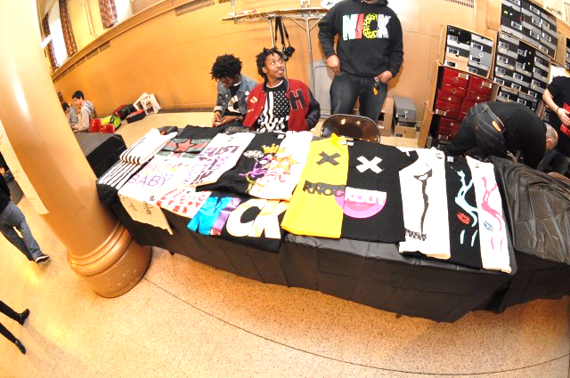
Course Recap
Or, what should the T-shirt say?
Notes:
Picture from “Sneaker Con 2011” in NYC, from http://solecollector.com/Sneakers/News/Recap--Sneaker-Con-2011-NYC-The-Setup/

Slide 5
Course Themes
Object-oriented design as assignment of responsibilities
Using design principles and patterns to
think about object-oriented designs
Using design principles, patterns, and notations to communicate design ideas
Begin practicing the art and science of
object-oriented design
Course Recap

Slide 6

Notations Used
Analysis
Domain models (DM)
System sequence diagrams (SSD)
Operation Contracts
Logical architecture diagrams
Package diagrams
Design class diagrams (DCD)
Interaction diagrams (ID)
  Sequence diagrams (SD)
  Communication diagrams (CD)
Activity diagrams
Deployment diagrams
Architecture
Logical Design
Bus. Process Modeling
Physical Design
Course Recap
Notes:
• Build in call-outs

Slide 7
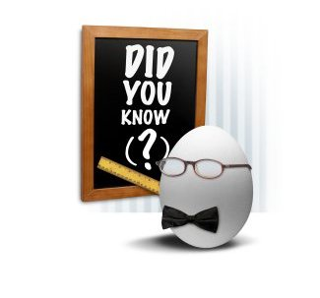
GRASP Principles
Low Coupling
High Cohesion
Information Expert
Creator
Controller
Polymorphism
Pure Fabrication
Indirection
Protected Variations
Course Recap

Slide 8
Gang of Four (GoF) Design Patterns
Behavioral
  Strategy
  Observer
  Template Method
  State
  Command
Creational
  Factory Method
  Abstract Factory
  Singleton
Structural
  Adapter
  Composite
  Façade
  Proxy
Others: Interpreter, Chain of Responsibility, Iterator, Mediator, Memento, Visitor, Builder, Bridge, Prototype, Flyweight, Decorator
Course Recap

Slide 9

Learning Outcomes:
Teamwork
Work effectively with a team of software project stakeholders, including customers and members of your development team:
Customer communications
Delivery
Team responsibilities
Coordinating with other teams
Course Recap
Q3
Notes:
Upon completing this course, a student should be able to: …
Software is a team sport! Few significant software designs are done by an individual – maybe led by an individual…
Teams are now multi- and interdisciplinary to solve today’s problems
The professional software system designer is often called an architect today…

Slide 10

Learning Outcomes:
Object-Oriented Design
Demonstrate object-oriented design basics –
Domain models expanded,
Class diagrams,
Interaction (sequence and communication) diagrams.
Course Recap
Q3
http://enterprisegeeks.com/blog/2009/07/
Notes:
UML is used to convey key software design principles.
However, UML is only a medium to demonstrate the principles – design and architecture are the important bits!
UML is to design as good penmanship is to authoring a book…

Slide 11

Learning Outcomes:
Problems and Solutions
Recognize the differences between problems and solutions, and deal with their interactions:
What can’t change
How to make up the rest!
http://www.geekologie.com/2007/02/rubiks_cube_for_the_lazy_perso.php
Course Recap
Q3
Notes:
Design is often the demarcation point for transitioning from the problem space to the solution space.
Designs must reflect the solution to a problem and its domain. This is especially true with software since software changes.

Slide 12
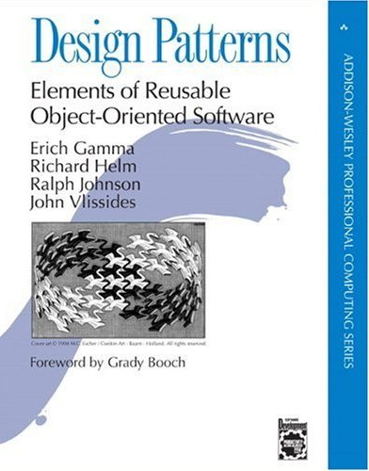
Learning Outcomes:
Fundamental Design
Use fundamental design principles, methods, patterns and strategies in the creation of a software system and its supporting documents.
http://www.amazon.com/Design-Patterns-Elements-Reusable-Object-Oriented/dp/0201633612
Course Recap
Q3
Notes:
Design patterns and the design principles go hand in hand to form a basis for predictable design solutions.
We examine GRASP and GoF patterns as they pertain to today’s software development.

Slide 13

Learning Outcomes:
Patterns, Tradeoffs
Identify criteria for the design of a software system and select patterns, create frameworks, and partition software to satisfy the inherent trade-offs.
Q3
Course Recap
http://www.autocult.com.au/NewsDetail.aspx?id=372
Notes:
Selecting the right design constructs and communicating to key stakeholders in a development effort is central to effective design.
We examine canonical criteria that have served designers for generations as well as new one specific to software.
You may recognize some of the concepts from programming, as they apply equally well to software design.

Slide 14
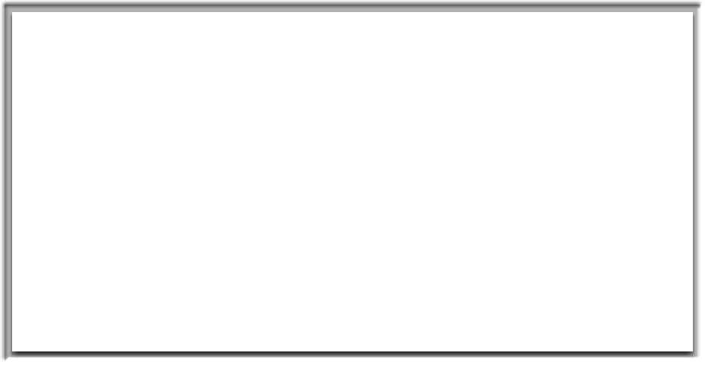

You’ve come a long way
You’re beginning to talk and think like software designers and architects!
Course Recap
Notes:
It has been my pleasure teaching this class. I learned a lot right along with you.

Slide 15
Starting back in the fall…
371 – You learned to understand problems:
  Figure out how to talk to strangers!
    We give you practice at this social confrontation
  Determine how to manage their requirements
    What happens when they change their mind?
  Turn that into a prototype & test usability
374 – You converted that to a solution:
  Solved a bigger problem that a 1-course project
  Learn the role design plays in that creation
  What are the ways people do software design?
  Partial solution, if you’re not yet delivering, or
  Complete solution, if this is it

Slide 16
What else is left to study, work on?
CSSE375 – Software Construction & Evolution – this spring
  Wrestling with evolving the current system
  Good practices for building systems in industry
CSSE 477 – Software Architecture – next fall
  A bigger picture
  Bigger patterns
  Bigger problems
Senior Project – next year
  Try to build an even bigger system!
  Even “more real” customers
Heading for industry
  Become change agents
  Convince customers your designs will work!
  Move into technical leadership roles

Slide 17
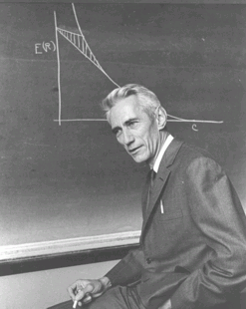
Course Evaluations
A Mechanism for Improvement
Claude Shannon: “The goal of information is to reduce uncertainty.”
Notes:
Picture of Claude Shannon from http://chronicle.com/blognetwork/castingoutnines/2008/02/17/an-end-to-course-evaluations/.

Slide 18
What are Course Evaluations used for?
Improve Courses and Curriculum
Improve Your Learning Methods (& Our Teaching Methods)
Rose Uses These as Input for Promotion and Tenure
Course Evals

Slide 19
1. Improve Courses and Curriculum
Course Assessment Plan
Course
New Ideas & People
Learning Outcomes
Course Assessment Report
Your Course
Evaluations
Industry Standards
Your Success

Slide 20
How do we measure your success?
How everyone did in the class
  We use “industry standards” for grading
    Try to predict if you can do things they want you to do
  We look at individual success and the whole group in the course
  We apply grading standards across instructors
    E.g., Chandan and I work together
  We consider how successful the projects were
    We also ask your clients, etc.
  We asked for your opinion on success!
    As promised, I’ve not looked at what anyone said
    I did have these averaged – see next page for your class results (Sec 1 & 2) →

Slide 21
What you said on yesterday’s survey
Averages of 33 results, for sec 1 & 2:
Teamwork: Work effectively with a team of software project stakeholders, including customers and members of the development team.
  Result – 1.55 Between choices 1 & 2, where 1 = “I can work effectively with a diverse team…”
OO Design methods: Demonstrate object-oriented design basics like domain models, class diagrams, and interaction (sequence and communication) diagrams.
  Result – 1.62 Where 1 = “I can use the main UML figures to create a design that ends up with a software system…”

Slide 22
What you said on yesterday’s survey, cntd
Requirements vs design: Recognize the differences between problems and solutions and deal with their interactions.
  Result – 1.59 Where 1 = “I have gotten good at analyzing what’s needed before jumping into solution mode.”
GoF and GRASP: Use fundamental design principles, methods, patterns and strategies in the creation of a software system and its supporting documents.
  Result – 1.95 Where 1 = “I can use a majority of the GRASP patterns and many of the GoF patterns in developing software…”

Slide 23
What you said on yesterday’s survey, cntd
Picking strategies: Identify criteria for the design of a software system and select patterns, create frameworks, and partition software to satisfy the inherent trade-offs.
  Result – 2.30 Where 1 = “I could go through a list of patterns and other strategies… and find some important things to use in a system I was building.”
Design validation and SOLID: Analyze and explain the feasibility and soundness of a software design.
  Result – 1.74 Where 1 = “I can investigate code and test how a system runs, and find whether it has various kinds of design issues, like dependencies…”

Slide 24

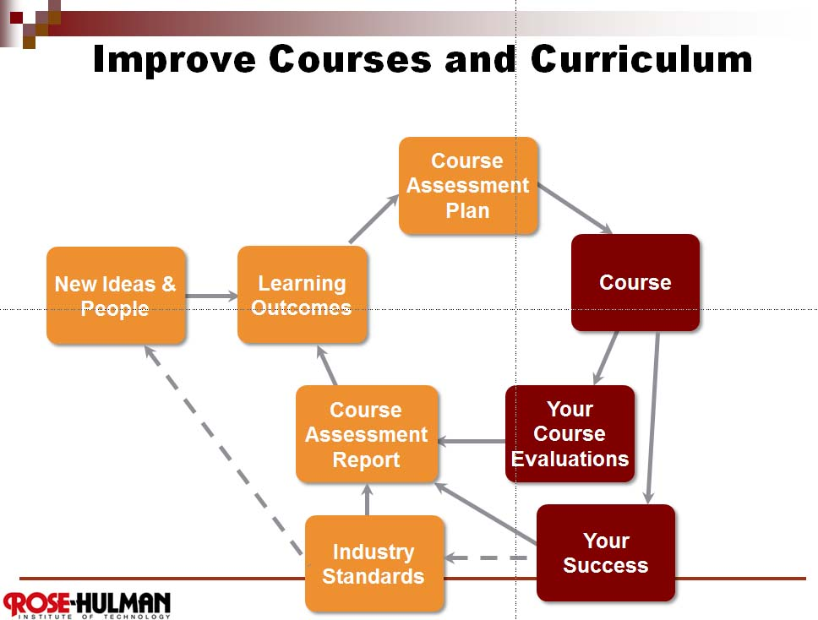
So, for example, with CSSE 374…
Where did the course we’re teaching come from?
It evolves – Who taught 374?
2003-4 2004-5 2005-6 2006-7 2007-8 2008-9
Steve – Steve – Mark Ardis – Lisa Kaczmarczyk – Steve – Steve –
2009-10 2010-11 2011-12 2012-13
Shawn & Curt – Shawn & Steve – Alex & Steve Chandan & Steve
Your feedback from each of these classes!
How well you did when we tried different projects, etc.
Shawn – taught a course like this at Virginia Tech
Curt – had a graduate course like this!
Larman – we picked a good OO book using
industry standard terminology
The above people all did all these things in industry
We model the teamwork we want you to learn
Course
Your Course
Evaluations
Your Success
New Ideas & People
Industry Standards
Course Evals
Mount Olympus, from http://commons.wikimedia.org/
wiki/File:Mount_Olympus-JP2.jpg.

Slide 25
2. Improve Learning / Teaching Methods
Framework – This course is ambitious…
  Most CS programs don’t have an undergrad course like this
  Only about 20 US schools have an undergrad SE program
  In very few undergrad software design courses, do you actually get to build a system!
  This year, we tried more stuff for the first time
So, we’re open to ideas about how to do it even better…
Course Evals
Source: Curt Clifton

Slide 26
3. Promotion and Tenure Input
Full set of course evaluations (and 200+ pages of supporting information) goes to Department, Dean and to the Promotion & Tenure Committee
Department, Dean and Committee make separate recommendations to President
President has final decision on promotion an tenure
Course Evals
Source: Curt Clifton

Slide 27
How You Can Be Most Helpful?
TO ROSE-HULMAN, TO FUTURE STUDENTS, TO PROFS…
Consider your audience
  Instructor (primary)
  Department head
  Dean
  PTR committee
Give specific and constructive feedback
  New ideas for us!
  What worked well, and why
  What didn’t work, and how that could be fixed
  Make the feedback actionable
  – a few key, better than a long list
Course Evals
Notes:
Avoid venting – if that is a need come see me or use the anonymous feedback.

