Slide 1


CSSE 374:
Domain Model Refinements and Iteration 3 Preparations
Steve Chenoweth
Office: Moench Room F220
Phone: (812) 877-8974
Email: chenowet@rose-hulman.edu
Chandan Rupakheti
Office: Moench Room F203
Phone: (812) 877-8390
Email: rupakhet@rose-hulman.edu
These slides and others derived from Shawn Bohner, Curt Clifton, Alex Lo, and others involved in delivering 374.
Q1
Notes:
Q1 is a book reading question!
Iteration 3 – that would be what’s leftover for next term, if anything! We’ll discuss that part in class.

Slide 2
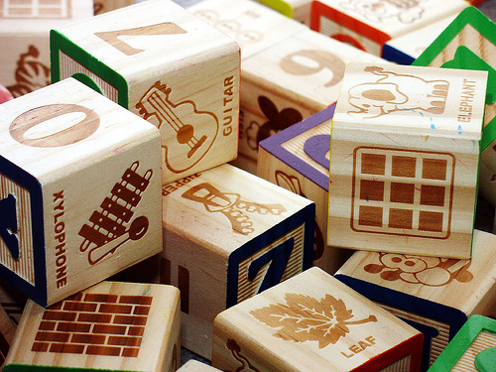
Learning Outcomes: O-O Design
Demonstrate object-oriented
design basics like domain
models, class diagrams, and
interaction (sequence and
communication) diagrams.
Final Exam - Thoughts
Domain Model Refinement
Conceptual Classes - review
http://enterprisegeeks.com/blog/2009/07/
Notes:
UML is to design as good penmanship is to authoring a book…

Slide 3
Additional Design Studio Topic Ideas
Look for problems where there are lots of “which class should be responsible for X” questions
Challenging design problems you’ve already faced and how you solved them
Current design problems that you haven't solved yet
Future extensions that will need to be considered

Slide 4
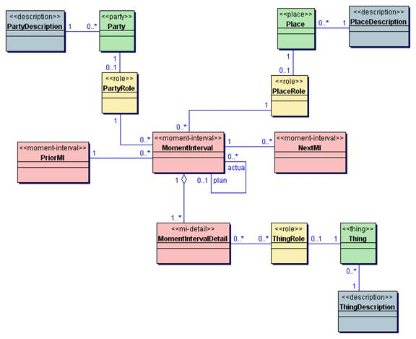
More on Domain Modeling
Above – New ideas for system modeling are proposed frequently. This figure illustrates an idea for doing domain models in color, used by Peter Coads in 1999.
Notes:
Figure is from http://conferences.embarcadero.com/article/32095.

Slide 5


Modeling Changing States
Suppose a concept X has multiple states
  Draft vs. Sent Email
  Purchase Request vs. Order
Do not model the states as subclasses of X!
Instead:
  Define a State hierarchy and associate X with State
  or,
  Ignore showing the states in the domain model
Notes:
Doesn’t make sense to have a draft email and a sent email as two types of email

Slide 6
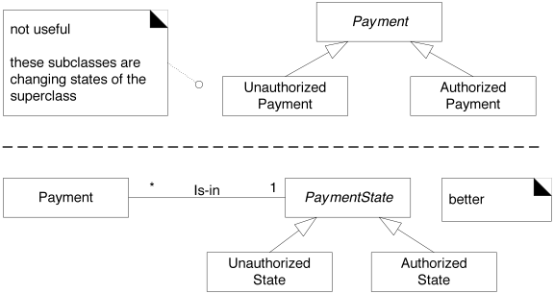
State Example
Notes:
• red X

Slide 7


Association Classes: Consider…
In NextGen POS:
  Authorization Services assign a merchant ID to each store
  Payment Authorization Request from store to service must use the merchant ID
  A store has a different merchant ID for each service
Where should the merchant ID appear in the domain model?
Notes:
This is a typical design problem about how to represent some complication in an otherwise straightforward part of the structure. Some possibilities are in Figures 31.14–31.16. [See the book]

Slide 8


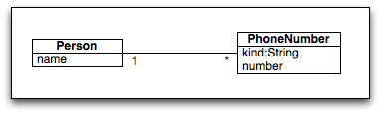
Guideline
If a class C can simultaneously have many values for the same attribute A, put A in another class associated with C

Slide 9

Association Class Guideline
Association class might be useful in a domain model if:
  The association has a related attribute
  Instances of the association class can only last as long as the association does
  There is a many-to-many association between two concepts and information is needed to distinguish the pairs
Q2
Notes:
Q2: Which of these are reasons for creating an association class (check all that apply):

Slide 10
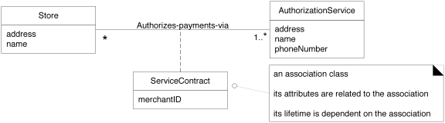
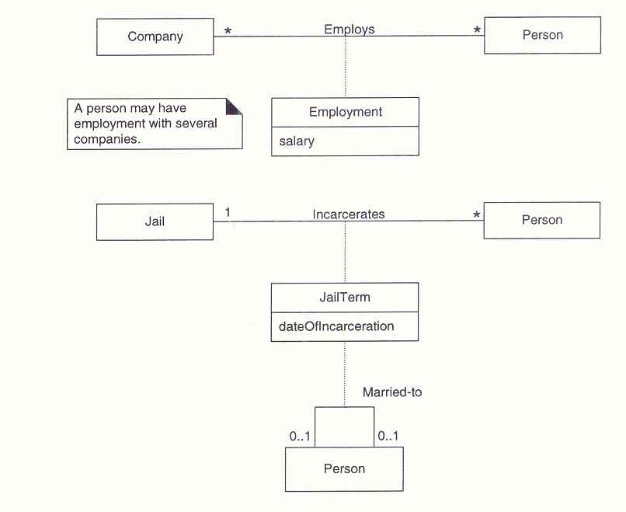
Association Class Examples
Q3
Notes:
ServiceContract may be modeled as an association class related to the association between Store and AuthorizationSerice.
In the UML,this is illustrated with a dashed line from the association to the association class.
Visually communicates that a ServiceContract and its attributes are related to the association between Store and AuthorizationService, and that the lifetime of the ServiceContract is dependent on the relationship.
Q3: Sketch how we could use an association class to show that a Person is employed by a Company for a particular salary.

Slide 11
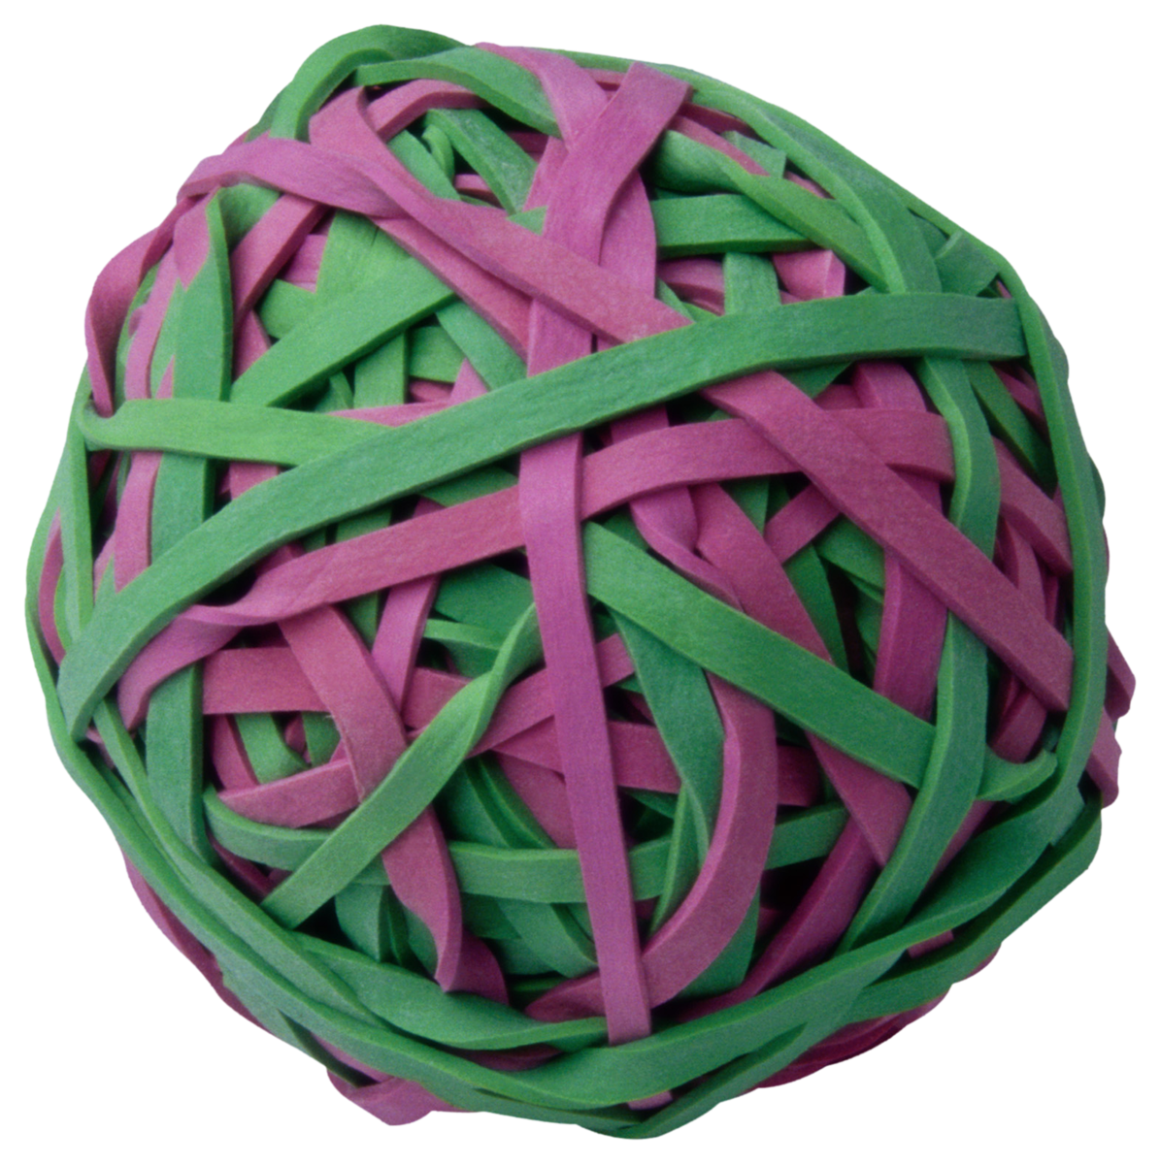

Recall, Composition
A composition relationship implies:
  An instance of the part belongs to only one composite instance at a time
  The part must always belong to a composite
  The composite is responsible for creating/deleting the parts
Not to be confused with the composite pattern, which is similar. (sigh)
Notes:
Aggregation is a kind of association used to model whole-part relationships between things (e.g., bag of marbles)
2 types Composition and Shared
Composition is a strong form of aggregation…(e.g., fingers in a hand – can’t detach a finger and put it on another hand)
- solid diamond on composite end
“Shared” aggregation depicted by hollow diamond, means that the multiplicity at the composite end may be more than one
- Implies that the part may be simultaneously in many composite instances

Slide 12
Composition in Domain Models
Guideline: If in doubt, leave it out.
But, consider showing composition when:
  Lifetime of part is bounded within lifetime of composite
  An obvious whole-part physical assembly exists
  Composite properties propagate to the parts
  Composite operations propagate to the parts
Q4
Notes:
Q4: The first guideline for showing composition in a domain model is, “If in doubt, __[[leave it out]]__.”

Slide 13
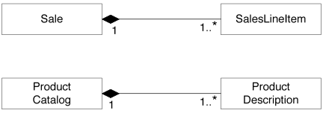
Examples of Composition in NextGen Domain Model

Slide 14
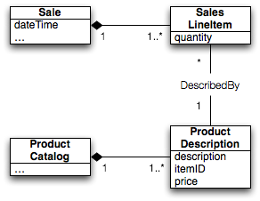
Problem: What happens to old Sales when a product’s price changes?
Solutions?
Notes:
Walk through how Sale total is calculated from SalesLineItems and their references to ProductDescriptions.

Slide 15

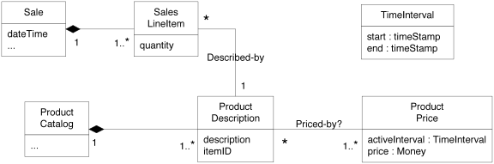
Time Intervals
Q5
Notes:
ProductPrice with activeInterval lets us set future pricing as well!
Q5: How can we solve the problem of prices changing over time for things like returns?

Slide 16
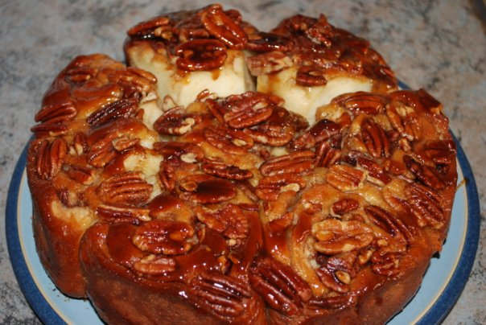
Rolls… I’m HHUUUNNNNGRY!
Notes:
Icing has taken on a whole new meaning to me with “Icepocalypes 2011!!!”

Slide 17
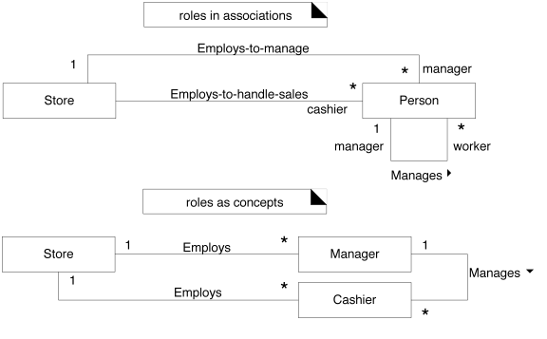
Er, Roles…
Pros and cons?
Notes:
Roles as associations: person can change roles
Roles as concepts: separate attributes and associations
Better: Why not have separate ManagerRole and CashierRole classes, each associated with a Person fulfilling the role.

Slide 18
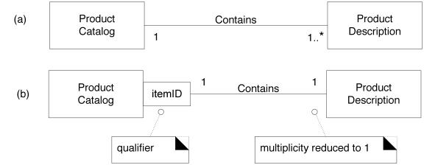
Qualified Associations
Don’t overdo it…
Q6
Notes:
Q6: In our Video Store example from the homework, suppose the VideoStore tracks Videos by barcodes on their cases. Redraw this portion of the domain model to use a qualified association.

Slide 19
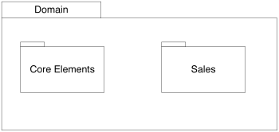
Splitting Domain Model into Packages
Supports parallel analysis work
NextGen POS example:

Slide 20
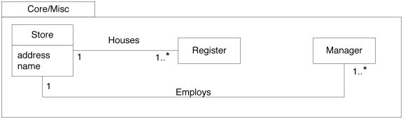
NextGen POS Core Package

Slide 21
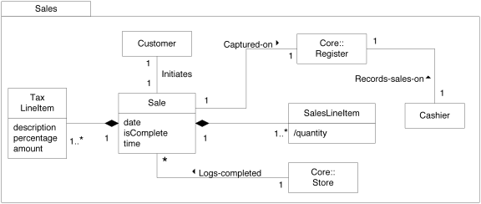
NextGen POS Sales Package with Assocations from Core Package
Store is “owned” by Core package, but also shown here to illustrate associations
Q7
Notes:
Q7: In the indicated conceptual class, what does the “Core Elements::” portion of the label indicate?

Slide 22
If Domain is big enough to partition into packages, Group conceptual Classes that:
Are in the same subject area
Are in the same class hierarchy
Participate in the same use cases
Are strongly associated
Q8
Notes:
Q8: If Domain is big enough to partition into packages, Group conceptual Classes that are in the same subject area, are in the same class hierarchy, are strongly ________________, and/or participate in the same ________________.

