Slide 1



CSSE 374:
UML Activity Diagrams
Left - The system has to DO things.
How do you show, at a high level,
What it does?
Steve Chenoweth
Office: Moench Room F220
Phone: (812) 877-8974
Email: chenowet@rose-hulman.edu
Chandan Rupakheti
Office: Moench Room F203
Phone: (812) 877-8390
Email: rupakhet@rose-hulman.edu
These slides and others derived from Shawn Bohner, Curt Clifton, Alex Lo, and others involved in delivering 374.
Notes:
Cyclist image from http://health.usnews.com/health-news/family-health/brain-and-behavior/slideshows/protect-against-alzheimers/2.

Slide 2

Learning Outcomes: Patterns, Tradeoffs
Identify criteria for the design of a software system and select patterns, create frameworks, and partition software to satisfy the inherent trade-offs.
Examine the use of UML Activity Diagrams
  This will not be a part of any HW or
  documentation for Milestone 5.
  Likely a question on final exam
Q3

Slide 3
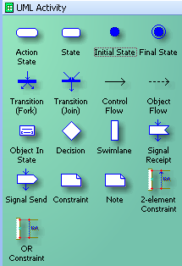
UML Activity Diagrams
Essentially Modern Version of Flowcharts and/or Data Flow Diagrams
  Easy to understand
Used to model:
  Business processes
  Workflows
  Data Flows
  Complex algorithms/UCs
Symbols
Notes:
Key advancement is showing parallel activities
Underutilized UML model

Slide 4
Activity Diagram UML
Syntax
Notes:
Q1: Label the parts on the UML activity diagram below:
Walk through diagram
• Start
• End
• Action
• Transition
• Fork
• Join
• Partitions
• Object

Slide 5
Old Data Flow Diagrams…
Notes:
DFDs NOT a part of UML, and largely obsolete

Slide 6
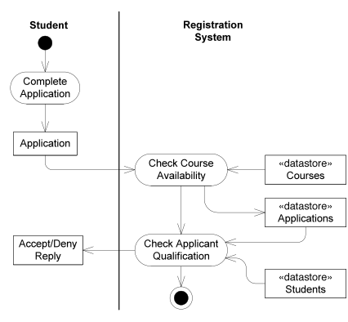
Now done as Activity Diagrams
Notes:
Walk through noting the objects being sent around (not necessarily software objects).
Point out datastore nodes.

Slide 7
Hierarchy Representation:
Rake Symbol
Notes:
Q2: In a UML activity diagram, what does this symbol,<the RAKE> , represent?

Slide 8
Expanded Delivery Order
Activity Diagram
Notes:
Q3: What is the difference in meaning between the following two symbols:
Fork vs Decision?

Slide 9
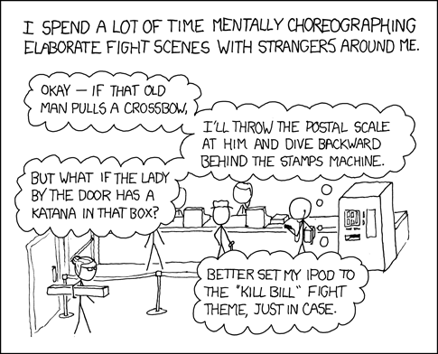
Post Office Showdown
Think that he might be watching too many martial arts films?
Notes:
• Note the “secondary punch line”.

Slide 10
Signal Notation
Notes:
Key concepts:
• Time signal highlight (hourglass) vs. Send Signal
• Accept signal highlight

Slide 11
NextGen POS: Reducing Complexity
NextGen Process Sale UC benefits from activity diagram due to its complexity

Slide 12

Activity Diagram Guidelines
Use when need to depict processes with complex flow
  Conditional or iterative
Use rake notation for sub-activity diagrams
  Keeps parent diagram simple
Maintain a consistent level of abstraction within a diagram

Slide 13

Exercise on Activity Diagrams
We’ll do in class –
Break up into your teams
Sketch an activity diagram for
creating an account, with username
& password, on a website.
Be sure to include swim lanes for
the User, the System, and an
external CAPTCHA Service.
Your diagram should include:
  a check that the password is valid,
  a check that the username has not already been used
  a check that user entered CAPTCHA text correctly
Decide what order these checks should be done in, and do those in parallel that make sense!
Notes:
Q4: Bring this to class, and we’ll discuss it in a class exercise:
Sketch an activity diagram for creating an account, with username and password, on a website. Be sure to include swim lanes for the User, the System, and an external CAPTCHA Service. Your diagram should include
a check that the password is valid,
a check that the username has not already been used, and
a check that the user entered the CAPTCHA text correctly.
The last two checks should be done in parallel, the first by the System and the second by the CAPTCHA Service. Here’s an example of a CAPTCHA, or Completely Automated Public Turing test to tell Computers and Humans Apart:

Slide 14
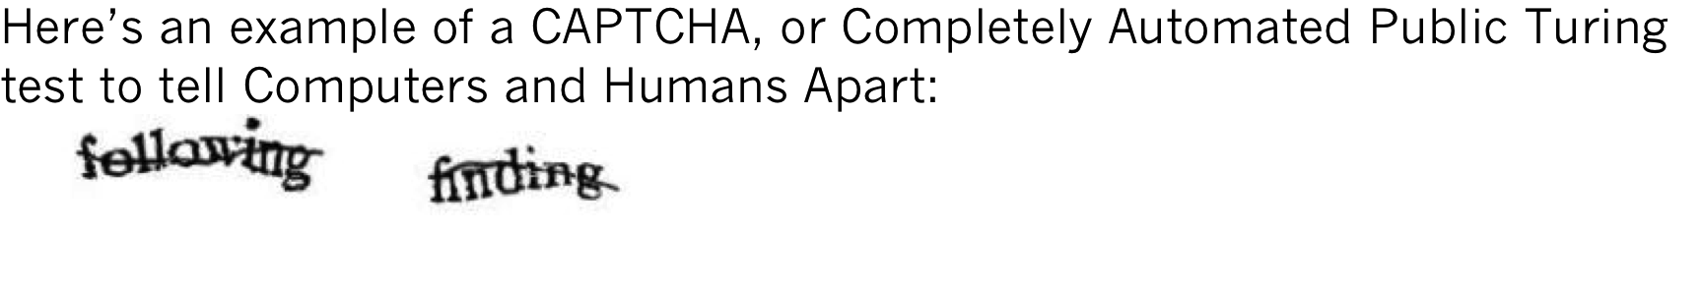
Go for it…
Notes:
Sketch an activity diagram for creating an account, with username and password, on a website. Be sure to include swim lanes for the User, the System, and an external CAPTCHA Service. Your diagram should include
a check that the password is valid,
a check that the username has not already been used, and
a check that the user entered the CAPTCHA text correctly.
The last two checks should be done in parallel, the first by the System and the second by the CAPTCHA Service. Here’s an example of a CAPTCHA, or Completely Automated Public Turing test to tell Computers and Humans Apart:

