Slide 1

CSSE 374:
Object-Oriented Design Exercise
Steve Chenoweth
Office: Moench Room F220
Phone: (812) 877-8974
Email: chenowet@rose-hulman.edu
Chandan Rupakheti
Office: Moench Room F203
Phone: (812) 877-8390
Email: rupakhet@rose-hulman.edu
These slides and others derived from Shawn Bohner, Curt Clifton, Alex Lo, and others involved in delivering 374.
Notes:
Q1 – 4 on the quiz are questions from Ch 19 of the book.

Slide 2

Learning Outcomes: Patterns, Tradeoffs
Identify criteria for the design of a software system and select patterns, create frameworks, and partition software to satisfy the inherent trade-offs.
Object visibility
Apply OOD to an Extended Example
Experience OOD on some aspect
of Extended Example

Slide 3
Object Visibility
An object B is visible to an object A … if A can send a message to B
Related to, but not the same as:
  Scope
  Access restrictions (public, private, etc.)
There are four common ways that
B can be visible to A

Slide 4
Attribute Visibility
Object A has attribute visibility to object B if… A has an attribute that stores B
Quite permanent
Most common
Notes:
Register needs visibility to ProductCatalog (Attribute visibility: Relatively long-term visibility)
Q2: Object A has attribute visibility to object B if object A has a(n) ________________________________that stores B .
Here’s one if no one comes through:
public class Register {
private ProductCatalog catalog;
…
}

Slide 5
Parameter Visibility
Object A has parameter visibility to object B if …
B is passed in as an argument to a method of A
  Not permanent, disappears when method ends
  Second most common
  Methods often convert parameter visibility to attribute visibility
Register has method-
return visibility to
ProductDescription
Notes:
Parameter visibility: Relatively short-term
Exists only within scope of method
Parameters used to ‘pass around’ visibility to objects needing it
Commonly converted to attribute visibility by message receiver (method)
ProductDescription parameter becomes an attribute of SalesLineItem
Q3: Object A has parameter visibility to object B if object B is passed in as a(n) _____________________ to a method of A .
Here’s one if no one comes through:
public class Sale {
…
void makeLineItem(ProductDescription desc, int quantity) {…}
}
Sketch a UML communication diagram.

Slide 6
Local Visibility
Object A has local visibility to object B if …B is referenced by a local variable in a method of A
Not permanent, disappears when leaving variable’s scope
Third most common
Methods often convert local visibility to attribute visibility
Notes:
Q4: Please list two common ways to establish local visibility.

Slide 7
Local Visibility Examples
Call a constructor and store new object in local var
  InterestCalculator calc = new InterestCalculator()
  calc.getInterest(...)
Call a method and store returned object in local var
  ItemDescription id = productCatalog.getItem(itemID)
  price = id.getPrice()
Chained method calls
  productCatalog.getItem(itemID).getPrice()
  very transient visibility to the ItemDescription returned by getItem. Essentially same as #2.

Slide 8
Global Visibility
Object A has global visibility to object B if …
B is stored in a global variable accessible
from A
Very permanent
Least common (but highest coupling risk)
Notes:
Q5: Rank the four types of visibility below from most common (1) to least common (4).
Example:
public class ProductCatalog {
public static final ProductCatalog catalog = new ProductCatalog();
private ProductCatalog() {…}
}
Show on a Design Class Diagram

Slide 9
Visibility Review
Attribute Visibility(Association/Aggregation)
B is an attribute of A
Parameter visibility (Dependency)
B is a parameter of a method of A
Local visibility (Dependency)
B is a local object in a method of A
Global visibility (Dependency)
B is globally visible

Slide 10
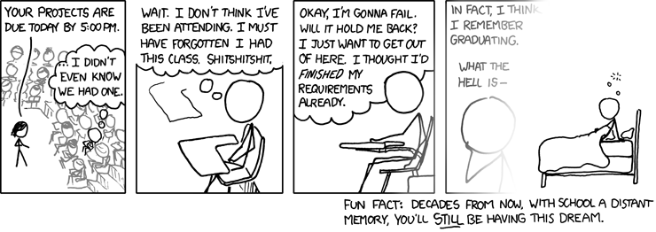
Students
YIKES!!!!!!!
HECK IS

Slide 11
Extended Example:
Grading System
Notes:
Note that we will spend more class time to work out the examples.

Slide 12
Problem Statement
The system will help instructors and teaching assistants provide thorough, timely feedback to students on assignments. The system will make grading more efficient, allowing students to more quickly receive feedback and course staff to devote more time to improving instruction.
The system will take a collection of student solutions to an assignment as PDF files or some other convenient, open standard. It will allow the grader to “write” feedback on student submissions. It will keep track of the grader's place in each assignment so that he or she can grade every student's answer to question 1, then question 2, and so on. Finally the application will create new PDF files including comments for return to the students.
Besides feedback, the system will help with calculating grades. The grader can associate points with each piece of feedback, so that the application can calculate points earned on the assignment. The grader will be able to drag remarks from a “well” of previous feedback to give the same feedback to multiple students (and deduct or add the same number of points). The points associated with a particular piece of feedback can be edited, causing the system to update the score calculations for every student that received that feedback.

Slide 13
A Sampling of Use Cases
Create assignment
Import student submissions
Create feedback item
Edit feedback item
Add feedback to a submission
Export graded student submissions

Slide 14
Domain Model for Grading System
Notes:
There is potential confusion between the notion of an assignment as set by an instructor and a student's work, which is sometimes also ambiguously referred to as their "assignment". To minimize this confusion, we use Assignment to refer to the description of the work assigned by the instructor. Submission refers to the work turned in by a student to fulfill the Assignment.
A Rubric provides a more detailed description of the evaluation criteria for an assignment. A FeedbackItem is an annotation calling out a particular mistake or point of excellence. It can be attached to one or more submissions during the grading process. A FeedbackItem that is attached to multiple systems allows a Grader to edit the feedback on multiple graded submissions at once, for example, to reduce the number of points deducted for a particular mistake.

Slide 15
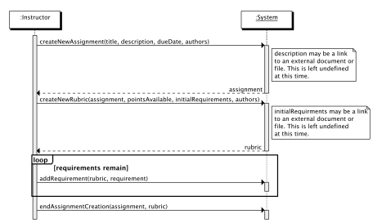
Create Assignment Scenario SSD

Slide 16
Create New Assignment
Operation | createNewAssignment(title, description, dueDate, authors)
Cross References | Use Case: Create Assignment
Preconditions | none
Postconditions | an Assignment instance, assignment, was created the attributes of assignment were set from the corresponding arguments a list, instructors, of new Instructor instances were created for each author in authors for each instructor in instructors, instructor.name was set to the corresponding author in authors assignment was associated with instructors
Q5,6
Notes:
Sketch communication diagram for the found message on one side of the board. Begin sketching the design class diagram on the other.
Keep in mind:
- Don’t rush!
- Get them to suggest what to do next.
- Keep asking about GRASP patterns.
- Briefly discuss notions of visibility when they arise.
- Ask about cohesion and coupling in each design, either during or after sketching
Give them time to draw.
Q5: Sketch a communication diagram for the found message, createNewAssignment(title, description, dueDate, authors). Label each message with the GRASP pattern(s) that support(s) that assignment of responsibility. Update your design class diagram on the back as needed.
Q6: Sketch a (partial) design class diagram for the grading system, based on the interaction diagrams you drew above (and any others that we drew together in class).

Slide 17
Create New Rubric
Operation | createNewRubric(assignment, pointsAvailable, initialRequirements, authors)
Cross References | Use Case: Create Assignment
Preconditions | assignment is an existing Assignment in the system
Postconditions | a Rubric instance, rubric, was created the attributes of rubric were set from the corresponding arguments a list, instructors, of new Instructor instances was created for each author in authors for each instructor in instructors, instructor.name was set to the corresponding author in authors rubric was associated with instructors rubric was associated with assignment
Q6 cont.
Notes:
Sketch communication diagram for the found message on one side of the board. Continue sketching the design class diagram on the other.
Q6, to try before class: Sketch a (partial) design class diagram for the grading system, based on the interaction diagrams you drew above (and any others that we drew together in class). Any tool that works is ok to do this!

Slide 18
Add Requirement
Operation | addRequirement(rubric, requirement)
Cross References | Use Case: Create Assignment
Preconditions | rubric is an existing Rubric in the system
Postconditions | requirement was appended to rubric.requirements
Q6 cont.
Notes:
Sketch communication diagram for the found message on one side of the board. Continue sketching the design class diagram on the other.
Q6, to try before class: Sketch a (partial) design class diagram for the grading system, based on the interaction diagrams you drew above (and any others that we drew together in class).

Slide 19

Exercise on Design Examples
Break up into your
project teams
Given the following:
  The interaction diagrams you drew above, etc.
Draw a partial Design Class
Diagram to represent createNewAssignment, AddSubmission, etc.
Notes:
We’ll extend what you did on your own, in class.

