Slide 1
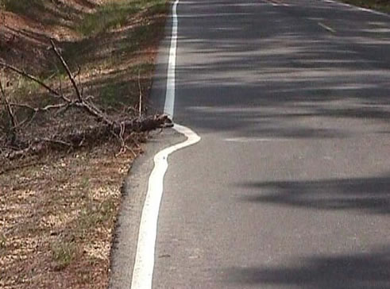

CSSE 374:
Getting a Grasp on GRASP
Left – Whose responsibility is it? Always a tough question, and the results vary!
Steve Chenoweth
Office: Moench Room F220
Phone: (812) 877-8974
Email: chenowet@rose-hulman.edu
Chandan Rupakheti
Office: Moench Room F203
Phone: (812) 877-8390
Email: rupakhet@rose-hulman.edu
→
These slides and others derived from Shawn Bohner, Curt Clifton, Alex Lo, and others involved in delivering 374.
Q1
Notes:
GRASP is Craig Larman’s group of the “most basic patterns” that are useful in OO.
Q1: What UML diagram types have we studied so far? (Write down as many as you can remember; we’ll discuss them briefly.)
Image from http://chuparustam.blogspot.com/2007/07/not-my-job.html.

Slide 2

In the flow of programming…
It’s a lot like playing music –
  Combines effortless logic
  With intuition
  And “it” loves for us to do it!
But…
  “The flow” suppresses self-
  consciousness
  Which is the part of the brain
  that’s supposed to remember
  what you did!
So, when you come back to your own code –
  You need to rely on its being logical, conceptual, and coherent!
  Thus – OO… and Patterns!
And anyone else reading it surely needs this, too!
↓
Notes:
Studies by Rafael Malach et al (at the Weizmann Institute in Israel) shed that, when subjects are absorbed in an experience, the parts of the brain associated with self-consciousness are actually shut down by the rest of the brain. The “self” disappears. Which is why, after such an experience, you have trouble remembering what you did, even though it was totally intense at the time.
Image from http://parentingbeyondbelief.com/blog/?p=2449.

Slide 3
Mastering Object-Oriented Design
A large set of soft principles
It isn’t magic. We learn it with:
  Patterns (named, explained, and applied)
  Examples
  Practice
“The critical design tool for software development is a mind well-educated in design principles.”
→
Q2
Notes:
• “Blech! I like technology because it’s rigorous and doesn’t involve rote memorization!”
Q2: List three things that can help us develop object-oriented design mastery:
• call-out on this slide:
- You won’t be a master when you finish the course—after many years I’m not a master—but you’ll be positioned to practice.
- You’ll be conversant in OO design, so you can work with others and learn together.
Dr Bohner says there’s a good Merlin Mann’s story of the new butcher and the experienced butcher, embedded in the rant video here: http://www.43folders.com/2009/10/22/who-you-are

Slide 4
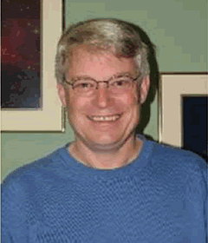
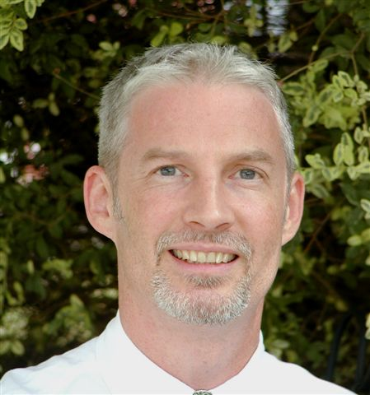
Today SOLID → GRASP
(From Uncle Bob back to Larman)
SRP specifically – The basis for the Cohesion pattern, that we’ll study today
SRP more generally – basis for today’s “Responsibility Driven Design” ideas →
Bob Martin –
Popularized SRP
Craig Larman –
Your Book’s Author
↓
Notes:
Bob Martin talks about SRP as the “S” in “SOLID” – his basic methods for handling dependency management. His description of SRP can be found at http://butunclebob.com/ArticleS.UncleBob.PrinciplesOfOod.
SRP = “Single Responsibility Principle” – Due originally to Tom DeMarco and Meilir Page-Jones.
From http://www.oodesign.com/single-responsibility-principle.html :
Motivation
In this context a responsibility is considered to be one reason to change. This principle states that if we have 2 reasons to change for a class, we have to split the functionality in two classes. Each class will handle only one responsibility and on future if we need to make one change we are going to make it in the class which handle it. When we need to make a change in a class having more responsibilities the change might affect the other functionality of the classes.
The Single Responsibility Principle is a simple and intuitive principle, but in practice it is sometimes hard to get it right.
Intent
A class should have only one reason to change.
Bob Martin pic from http://skillsmatter.com/go/agile-expert-series.
Craig Larman pic from http://www.technologytransfer.eu/speaker/12/Craig_Larman.html.

Slide 5
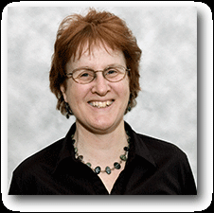
Responsibility-Driven Design
Responsibility Driven Design (RDD)
  Pioneered by Rebecca Wirfs-Brock in early 1990s
Think of objects in terms of:
  What they do
  or
  What they know
  …the human worker metaphor!
An object’s obligation or contract that it offers to other objects
→
Notes:
Object-Oriented Design (OOD) is a Complex Activity
Experience is the real teacher -- Using patterns, we can learn from experience
Must understand proven design principles for effective OOD
Picture of Wirfs-Brock from http://www.oopsla.org/oopsla2008/program-overview/invited-speakers.html.

Slide 6
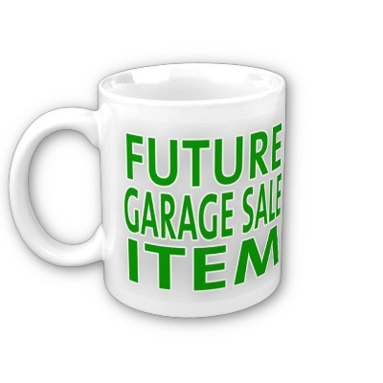
Responsibilities for an Object
Doing
  a Sale is responsible for creating instances of SalesLineItem
Knowing
  a Sale is responsible for
  knowing its total cost
→
Notes:
The “doing” is done by a class’s methods. And the “knowing” is done by its attributes.

Slide 7
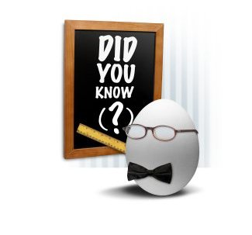
Knowing and Doing Responsibilities
“Doing” Responsibilities
  Create another object
  Perform a calculation
  Initiate an action in an object
  Control/coordinate activities
  of objects
“Knowing” Responsibilities
  Knowing it’s own encapsulated data
  Knowing about other objects
  Knowing things it can derive or calculate
→
Q3,4
Notes:
Q3: What are some things an object might be responsible to do?
Q4: What are some things an object might be responsible to know?

Slide 8
Responsibilities Come in All Sizes
BIG: provide access to a relational database
small: create a Sale
A responsibility is not the same thing as a method
↓
Notes:
Small scale: A single object fulfills the responsibility
Medium scale: A group of objects collaborate
Large scale: An entire system or sub-system required

Slide 9
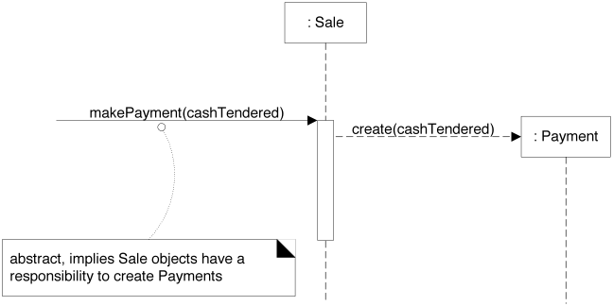
When Do We Assign Responsibilities?
While coding
While modeling
  UML is a low-cost modeling tool
  Can assign responsibilities with minimal investment
→
Notes:
• figure: What responsibility decisions were made when this seq. diagram was drawn?
Someone sends Sale a message telling it to make a payment
Implies Sale has the responsibility to create a Payment object
Doesn’t necessarily mean Sales creates Payment directly …
- Sale objects are responsible for creating Payment objects
- Implicit in that, Sale objects collaborate with Payment objects

Slide 10

General Responsibility Assignment Software Patterns (GRASP) 1/2
General Responsibility Assignment Software Patterns (or Principles)
  A set of patterns for assigning
  responsibilities to software objects
What is a Pattern?
  A pattern is a named and
  well-known problem-solution pair
  that can be applied in a new context
→
Notes:
GRASP: General Responsibility Assignment Software Patterns (or Principles)
Fundamental techniques for effective Responsibility Driven Design (RDD)
What is a Pattern? A named solution to a commonly occurring problem
Effectiveness confirmed by prior experience
Eliminates ‘reinvention of the wheel’
Facilitates communication
Indicates limitations & trade-offs
5 GRASPs discussed in this chapter – another 4 covered in Chapter 25
Creator Information Expert
Low Coupling Controller
High Cohesion

Slide 11
General Responsibility Assignment Software Patterns (GRASP) 2/2
Five Covered In Chapter 17
  Creator
  Information Expert
  Controller
  Low Coupling
  High Cohesion
Four Later In Chapter 25
  Polymorphism Pure Fabrication
  Indirection Protected Variations
→
Notes:
Fundamental techniques for effective Responsibility Driven Design (RDD)
What is a Pattern? A named solution to a commonly occurring problem
Effectiveness confirmed by prior experience
Eliminates ‘reinvention of the wheel’
Facilitates communication
Indicates limitations & trade-offs

Slide 12
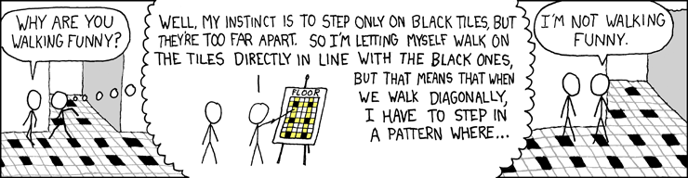
Design: Floor Tiles
The worst part is when sidewalk cracks are out-of-sync with your natural stride.
→
Notes:
• the punchline perhaps relates to the OCD we all experienced when we are about 10 years old!

Slide 13
Information Expert Pattern
Names Matter!
Pattern Name | Information Expert
Problem | What is a basic principle by which to assign responsibilities to objects?
Solution | Assign a responsibility to the class that has the information needed to fulfill it.
“New pattern” is an oxymoron!
→
Q5,6
Notes:
Yes, this is trivial. We’ll add much more interesting patterns to our repertoire.
• Names matter: support “chunking” for memorizing, facilitate communication
• New pattern: patterns codify/describe long standing practice
Q5: Low-coupling and high-cohesion are key principles in developing maintainable code. How does Information Expert support Low-Coupling in design for more maintainable systems?
Q6: Why do the names of patterns matter?

Slide 14
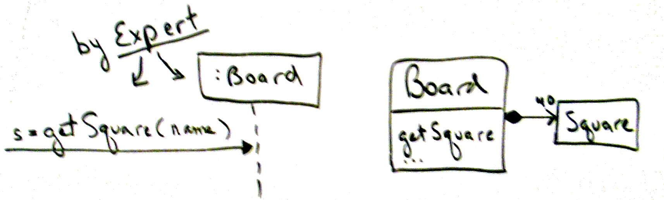
Information Expert and Unique IDs
Basic principle of RDD: Assign responsibility to the object that has the required information
  “Tell the expert to do it!”
Who should get a square given a unique ID?
  Let the Board do it because it knows about the squares
→

Slide 15
Creator Pattern
Who should create object A?
Solution (advice):
    Let B do it if:
      B contains or aggregates A
      B records A
      B closely uses A
      B has the initializing data for A
Monopoly Board Example
  When you start a game, who creates the squares for the board?
  Let Board create them since it contains the squares
→
Q7
Notes:
Q7: An object can be created by another if the other object does what?

Slide 16
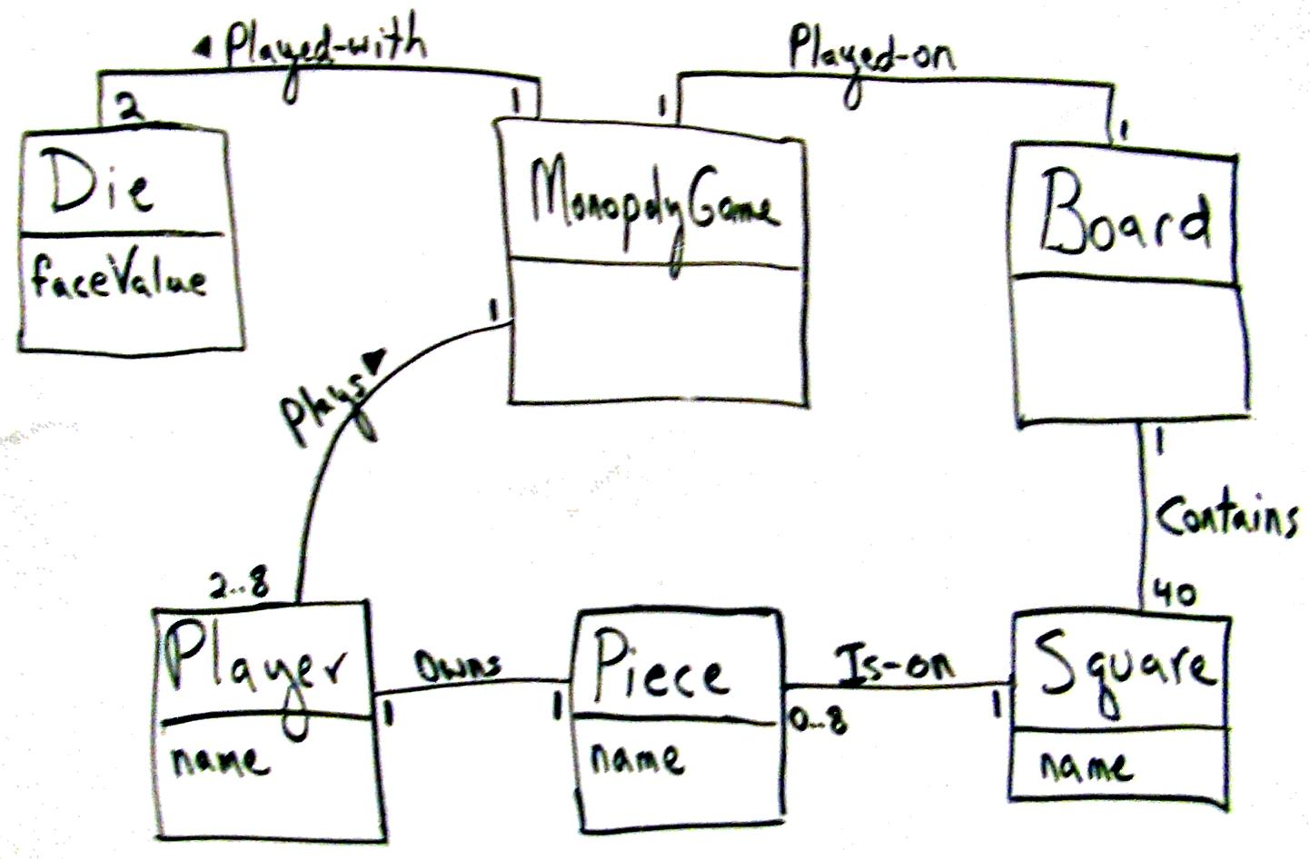
Monopoly Example
↓

Slide 17
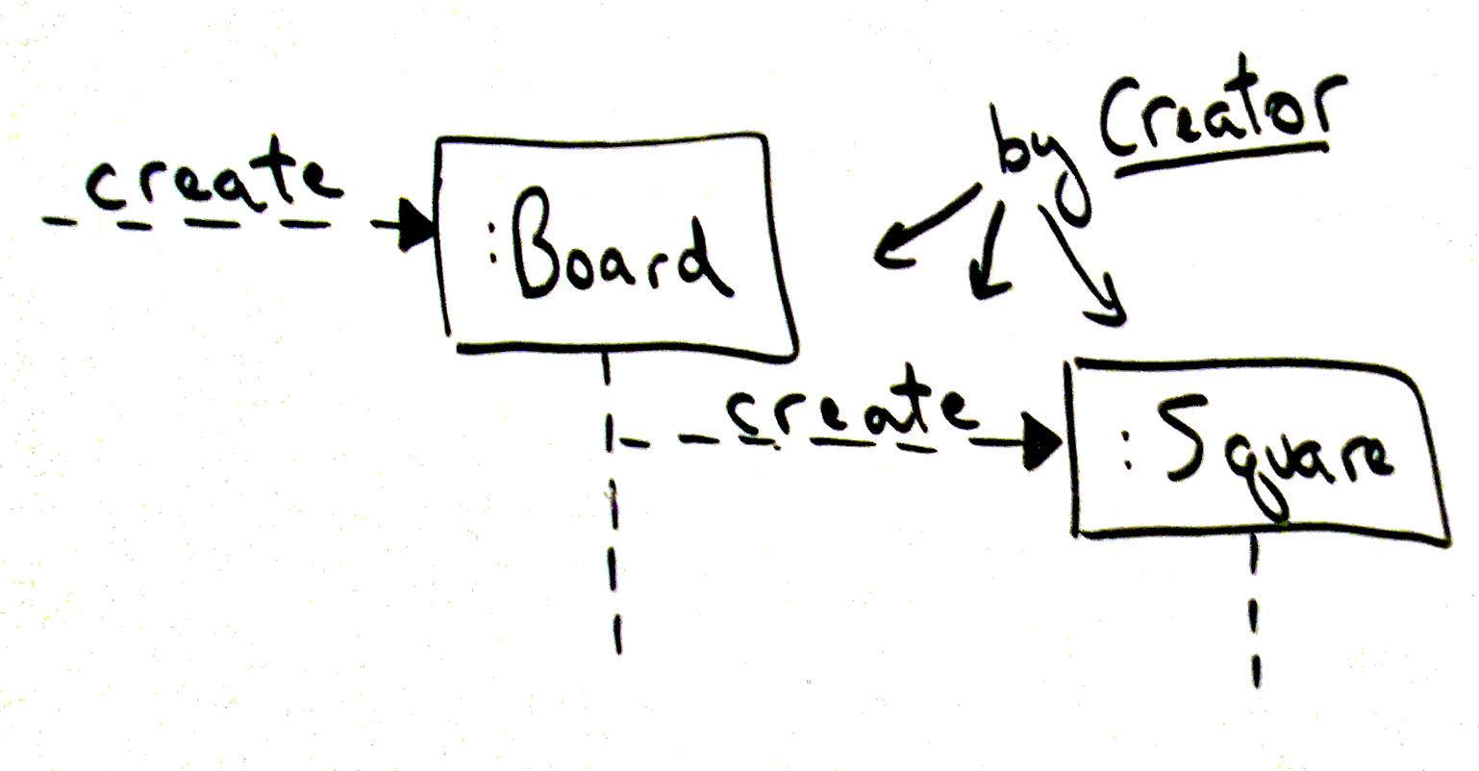
Create “in Action”
↓

Slide 18
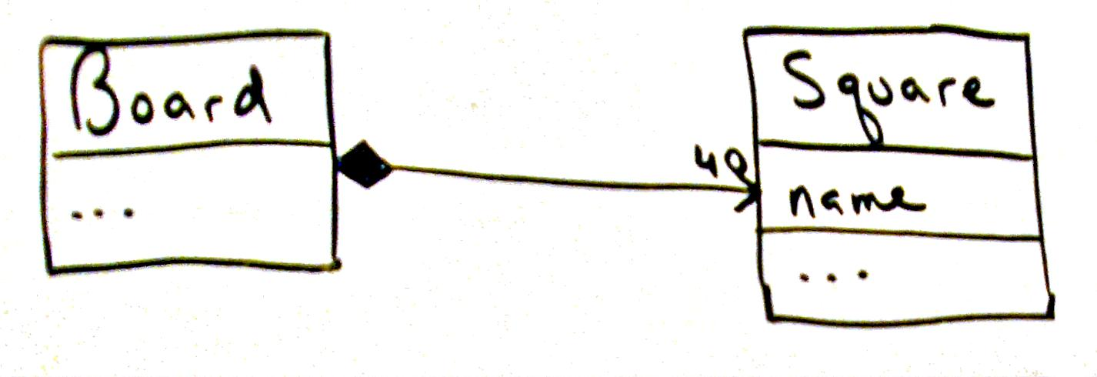
Composition
↓
Notes:
Board has a composition relationship with a set of squares

Slide 19

Exercise on Creator Examples
Break up into your
project teams
Given the following:
  Domain Model for BBVS
Identify Creator pattern
examples
(hint)
  B contains or aggregates A
  B records A
  B closely uses A
  B has the initializing data for A
↓
Q8
Notes:
Q8: What are some Creator pattern examples in the BBVS Domain Model?
We’ll do this exercise in class, as a team.

Slide 20
Contains➔
0..*
VideoDescription
title
subjectCategory
VideoSupplier
address
name
newVideos
1
1
1
Basket
0..*
⬅Provides
1
⬆
Provides
⬆
Holds-
videos-in
Describes➔
Selects ➔
1
1
1
Customer
name
address
phone#
Rents-from,
Buys-from
➔
*
*
1
Store
Address
Phone#
Stocks
➔
Video
ID
*
1
1
*
*
1
1
1
*
*
1
1
1
1
Membership
ID
startDate
⬇
Maintains
⬆
Stores-
video-on
Shelf
location
stock
1
*
*
⬆
Contains
Obtains➔
⬆
Defines
Makes-
Authorizes
⬇
*
PricingPolicy
perDayRentalCharge
perDayLateCharge
Determines-
rental-charge
➔
1
⬆
Records-
rental-of
Initiates ➔
0..*
*
Payment
/amount: Money
type
authorization
Transaction
date
Rental
dueDate
ReturnDate
ReturnTime
Pays-for
➔
Transacts
➔
1..*
1
1
1
1..*
↓
Notes:
Here’s a shot at a part of the Homework 1 Domain Model for BrickBusters Video Store…
Notice that not everything is covered: no video return, no shopping class, …
Many models would satisfy … this is only one

Slide 21
GRASP Fits in with the Goals of Software Design
In many areas of engineering:
In software:
Gather Requirements
Design for Production
Build & Sell
It / Them
Decide What to Do Next
Short engineering cycle.
Gather Requirements
Design & Deliver Rel 1
…
Design & Deliver Rel 10
Decide What to Do Next
Maintenance is most of the engineering cycle.
So, we need to keep coming back to the design.
↓

Slide 22
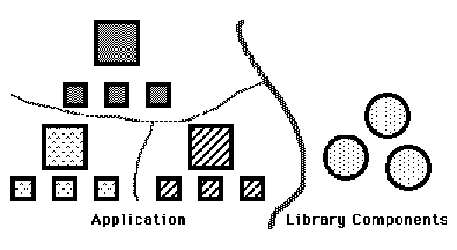
GRASP Fits in with Systems Engineering Principles
Like top-down design that minimizes interface complexity:
And having an understandable “design” to build the pieces into.
↓
Notes:
Image from http://laputan.org/dfc/discussion.html.

