Slide 1

CSSE 374:
GRASP’ing at the First Five Patterns Principles
Steve Chenoweth
Office: Moench Room F220
Phone: (812) 877-8974
Email: chenowet@rose-hulman.edu
Chandan Rupakheti
Office: Moench Room F203
Phone: (812) 877-8390
Email: rupakhet@rose-hulman.edu
These slides and others derived from Shawn Bohner, Curt Clifton, Alex Lo, and others involved in delivering 374.

Slide 2

Learning Outcomes: Patterns, Tradeoffs
Identify criteria for the design of a software system and select patterns, create frameworks, and partition software to satisfy the inherent trade-offs.
Examine GRASP Patterns:
Creator
Information Expert
Controller
Low Coupling
High Cohesion
Q3
Pattern – math style. See http://www.alfredo-haeberli.com/products/pattern/1.html.

Slide 3
On Design
There is no “one true correct design”
There are wrong designs
  Inflexible
  Unreliable
  “Ugly”
GRASP and other OO guidelines (SRP, etc) are meant to help make decisions but are not rules that must be followed. There are good reasons to break them occasionally.

Slide 4
Recall GRASP: Creator
Problem: Who should be responsible for creating a new instance of some class?
Solution: Make B responsible for creating A if…
  B contains or is a composition of A
  B records A
  B closely uses A
  B has the data to initialize A
Most important
The more matches the better.

Slide 5
Question --
How generic is the “creator” pattern? It sounds like an object either is injected with properties by whatever makes it, gets properties or creates properties. This term just did not feel well-defined.
The “creator” pattern gives some basic heuristics on which object should create which other objects. It is very basic and perhaps obvious but in a system of interacting objects it’s not always easy to determine.
Refer to Monopoly example: Text 17.8, p282

Slide 6
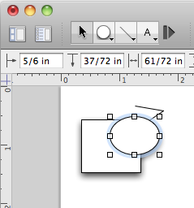
Creator Contraindications
Complex creation scenarios
  Recycling instances
    Ex: memory performance oriented systems
  Conditional creation
    Create X or Y depending
    on context (perhaps some
    other object’s state)
Q1
Notes:
Contraindication: A factor that renders the carrying out of a (medical) procedure inadvisable
This simply means that the heuristics don’t apply
Q1: What is a contraindication for the Creator pattern?

Slide 7
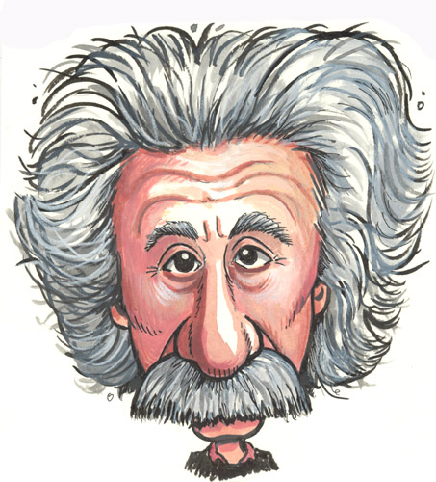
Recall GRASP: Information Expert
Problem: What is a general principle of assigning responsibilities?
Solution: Assign a responsibility to the class that has the necessary information
Q2
Notes:
Q2: Briefly, what solution does the Information Expert pattern suggest?

Slide 8
Information Expert Contraindications
Sometimes Information Expert will suggest a solution that leads to coupling or cohesion problems
Consider: Who should be responsible for saving a Sale in a database?
Q3
Notes:
Q3: What is a contraindication for the Information Expert pattern?

Slide 9

GRASP: Controller
Problem: What is the first object beyond the UI layer that receives and coordinates a system operation?
Solution: Assign the
responsibility to either…
  A façade controller, representing the overall system and handling all system operations, or
  A use case controller, that handles all system events for a single use case
Control
Q4
Notes:
Q4: Briefly, what solution does the Controller pattern suggest?
- What’s a system operation again?
- On-board: “Model-View separation”

Slide 10
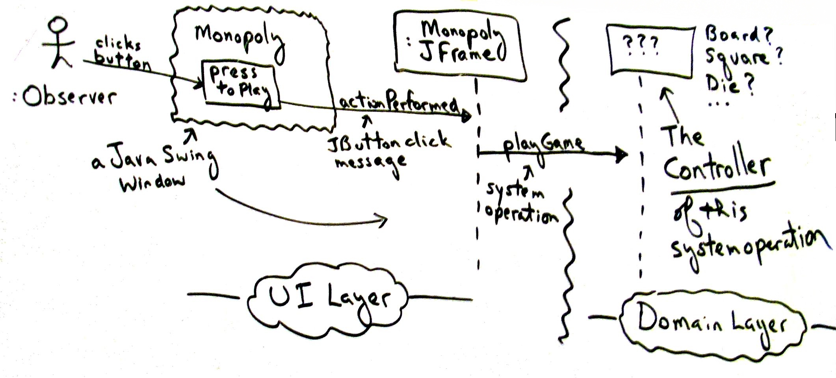
Layered view of Monopoly Game
Who mediates between UI and Domain layers?
Notes:
Must translate UI event into system operation…

Slide 11
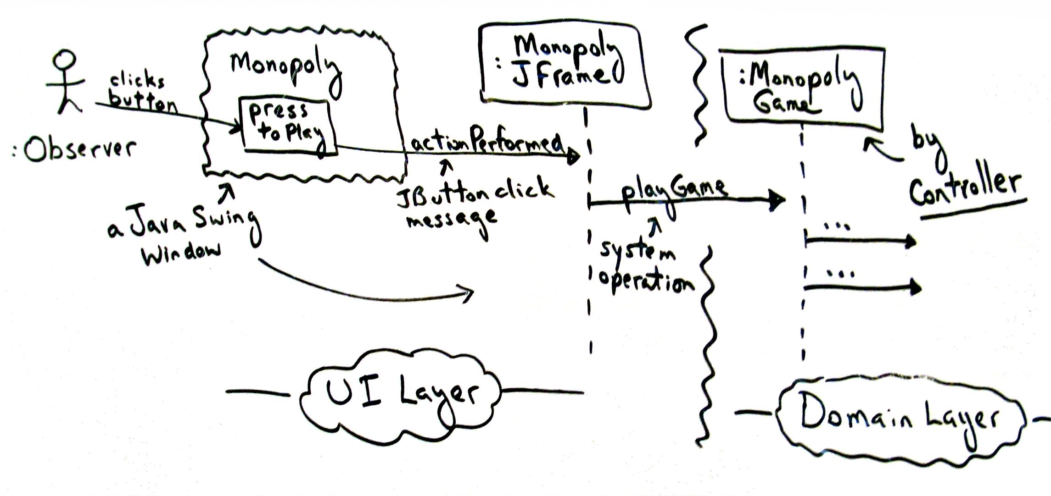
More on Monopoly
Let MonopolyGame be the controller …
Notes:
It represents the system and there aren’t many system operations!

Slide 12
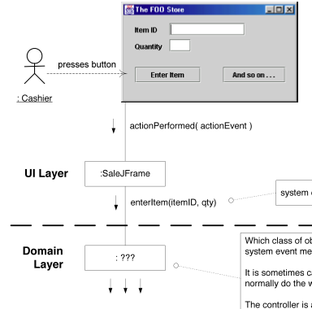
Controller Example
What Domain Layer class should own handling of the enterItem system operation?
Notes:
Facade says: Register, POS System
Use case controller says: ProcessSaleHandler or ProcessSaleSession

Slide 13
Guidelines
Controller should delegate to other domain layer objects
Use façade controller when…
  There are a limited number of system operations, or
  When operations are coming in over a single “pipe”
Use use case controller when a façade would be bloated (low cohesion!)
Q5
Notes:
Q5: When should you consider a façade controller?

Slide 14
Controller Benefits and Issues
Switch from
façade to use case controllers
Benefits:
  Increased potential for reuse
  Can reason/control the state of a use case
    e.g., don’t close sale until payment is accepted
Issues:
  Controller bloat—too many system operations
  Controller fails to delegate tasks
  Controller has many attributes
Delegate!

Slide 15
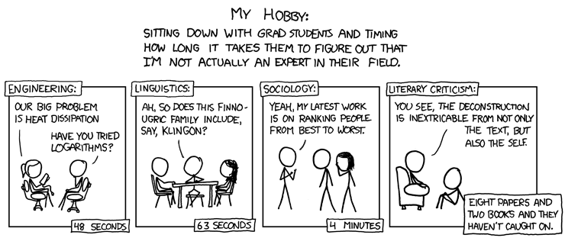
Imposter
The problem is that, if you are willing to see things in new ways, almost anything sounds good at first. Need to test out these ideas! (See for example, http://en.wikipedia.org/wiki/Deconstruction for different thoughts on Derrida, et al.)

Slide 16
Coupling
An
Evaluative Principle
A measure of how strongly
one element:
  is connected to,
  has knowledge of, or
  relies on other elements
Goal: Low (or weak) coupling
What are some problems with high coupling?
Q6
Notes:
Q6: Please list some problems that arise when a class is strongly coupled to many other classes.
We want low dependency, low impact change, and high potential for reuse…
What is a design Equivalent of a Global Variable - the uber class?
- Changes to coupled class force local changes
- Local class is harder to understand in isolation
Local class is harder to reuse (must cart along coupled classes)

Slide 17
Common Couplings
Very strong coupling
A is a subclass of B
A implements an interface B
A has a method with a parameter
or variable of type B
A calls a static method of B
A has an attribute of type B
(List in order from high to low coupling)
Q7
Notes:
Note that these are all represented as arrows on a design class diagram!
Q7: What is an example of a very strong coupling between Classes?
• call-out: consider example of implementing persistence by subclassing a PersistentObject method, tightly couples many classes in domain layer to a particular technical service

Slide 18

GRASP: Low Coupling
Problem: How do you support low dependency, low change impact, and increased reuse?
Solution: Assign a responsibility so that coupling remains low. Use this principle to evaluate alternatives.
Notes:
Degree of Isolation from other object’s changes

Slide 19
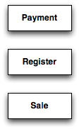
Low Coupling Example
Suppose we need to create a Payment instance and associate it with a Sale
Who should be responsible?

Slide 20
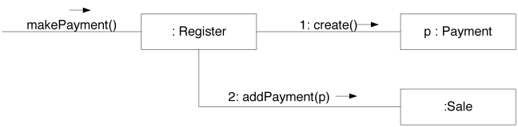
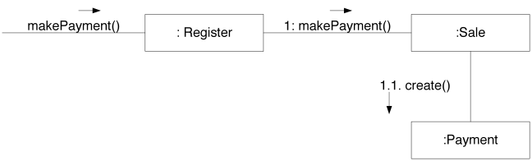
Which option has Lower Coupling?
Notes:
Which has lower coupling? Neither?
Bottom one is lower. Register must know the concept of a Payment, but isn’t coupled to the Payment class.

Slide 21
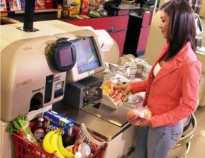
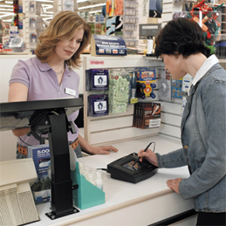
Need to see it from different angles
Self-serve checkout: Usually you pick the type of payment on the main screen, then interact mostly with other attached gadgets.
Cashier checkout: Credit is separate, but the cashier handles cash on the register.
So – should “Sale” drive “Payment” in the OO model?

Slide 22
Some real coupling no-no’s
“Coordinating coupling” – A passes a parameter to B that is used in B to determine the actions of B (like “flag passing”)
“Common environment coupling” – A and B contain references to some shared data area that incorporates knowledge about its structure and organization. Any change to the format of the block requires that all the modules using it must also be modified.
From Software Design, by David Budgen, 2nd ed, 2003, p. 77.

Slide 23
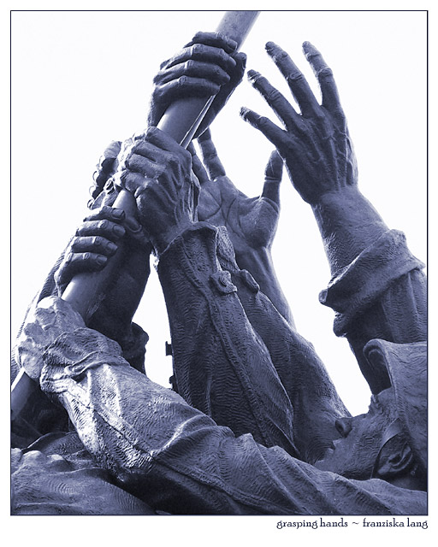
Advice: Pick Your Battles
Coupling to stable, pervasive elements
isn’t a problem
  e.g., java.util.ArrayList
Coupling to unstable elements can be a problem
  Unstable interface, implementation, or presence
Clearly can’t eliminate coupling completely!
Q8
Notes:
Q8: What is the primary goal of the Low Coupling GRASP?

Slide 24
Common Couplings … Revisited
Very strong coupling
A is a subclass of B
We might want to use subclassing in OO design, so this warning means “pick your parent classes carefully.” They may change, but these changes shouldn’t require rewriting the child classes!
Notes:
Note that these are all represented as arrows on a design class diagram!
Q7: What is an example of a very strong coupling between Classes?
• call-out: consider example of implementing persistence by subclassing a PersistentObject method, tightly couples many classes in domain layer to a particular technical service

Slide 25
Cohesion
Another
Evaluative Principle
A measure of how
strongly related and focused
the responsibilities of a class
(or method or package…) are
Goal: high (strong) cohesion
What are some problems with low cohesion?
Q9
Notes:
Q9: Please list some problems that arise when a class has low cohesion.

Slide 26

GRASP: High Cohesion
Problem: How do you keep objects focused, understandable, and manageable, and as a
side-effect, support low coupling?
Solution: Assign a responsibility so that cohesion remains high.
Use this principle to evaluate alternatives.
Rosie recommends focused objects that work well together.
From http://lottabruhn.typepad.com/lotta_bruhn_illustration/patterns/.
Notes:
Degree of Isolation from other object’s changes

Slide 27
Which option has higher Cohesion?
Notes:
Which leads to higher cohesion? Neither?
Bottom one is higher. Register just delegates payments.

Slide 28
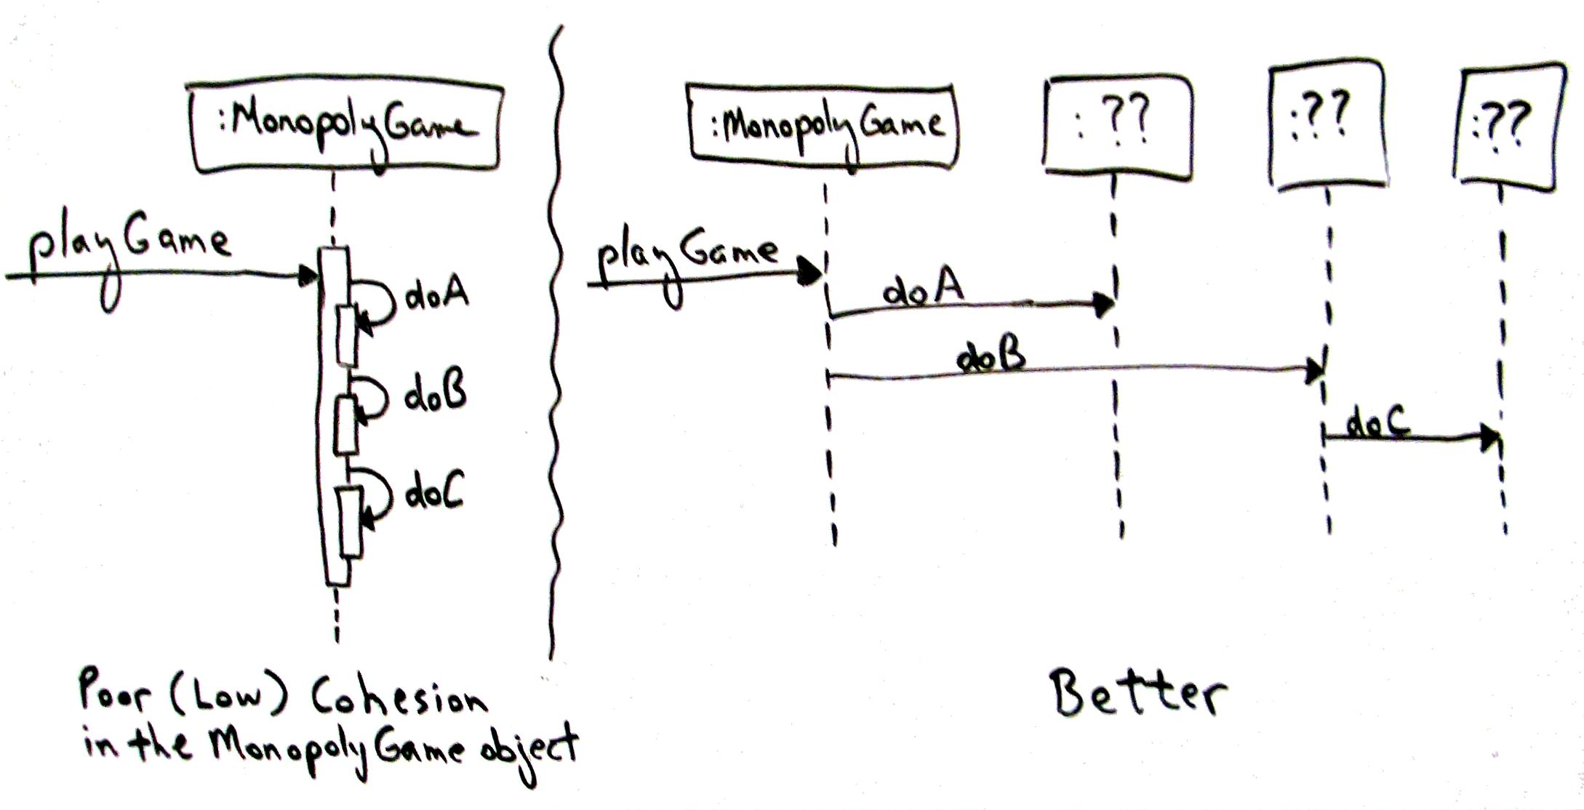
Design Alternatives for High Cohesion

Slide 29
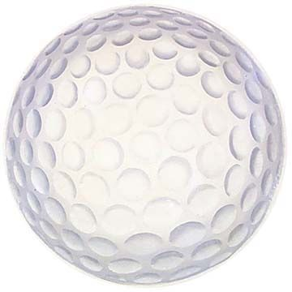
Cohesion Guidelines
A highly cohesive class has small number of highly related operations/methods
  Does not do “too much” work
Inherent trade-offs of Cohesion and Coupling
  To minimize coupling, a few
  objects have all responsibility
  To maximize cohesion, a lot of
  objects have limited responsibility
  Trade-off from alternative designs
Notes:
- one metric for cohesion is the number of methods per class. If it goes up, cohesion is probably going down.
- real-world analogy: experts typically excel at a limited number of things (think Michael Jordan’s baseball career)

Slide 30
There are cohesion no-no’s as well!
Don’t do the following:
“Logical cohesion” – Operations put together because they are logically similar, but which involve very different actions internally.
  Like system startup or shutdown operations
“Coincidental cohesion” – Putting things together just to avoid more coding tasks, but the things have no conceptual link.
  Often relates to filling up one large class with stuff, to avoid having to create new classes and call their methods.
From Software Design, by David Budgen, 2nd ed, 2003, p. 79.

Slide 31

Exercise on Creator Examples
Break up into your
project teams
Given the following:
  Domain Model for BBVS
Identify a couple potential
Controller Patterns
Identify a couple potential
Information Expert Patterns
Notes:
We’ll also do this as a team exercise in class.
Q10: What are some Creator pattern examples in the BBVS Domain Model?

Slide 32
Contains➔
0..*
VideoDescription
title
subjectCategory
VideoSupplier
address
name
newVideos
1
1
1
Basket
0..*
⬅Provides
1
⬆
Provides
⬆
Holds-
videos-in
Describes➔
Selects ➔
1
1
1
Customer
name
address
phone#
Rents-from,
Buys-from
➔
*
*
1
Store
Address
Phone#
Stocks
➔
Video
ID
*
1
1
*
*
1
1
1
*
*
1
1
1
1
Membership
ID
startDate
⬇
Maintains
⬆
Stores-
video-on
Shelf
location
stock
1
*
*
⬆
Contains
Obtains➔
⬆
Defines
Makes-
Authorizes
⬇
*
PricingPolicy
perDayRentalCharge
perDayLateCharge
Determines-
rental-charge
➔
1
⬆
Records-
rental-of
Initiates ➔
0..*
*
Payment
/amount: Money
type
authorization
Transaction
date
Rental
dueDate
ReturnDate
ReturnTime
Pays-for
➔
Transacts
➔
1..*
1
1
1
1..*
Notes:
Here’s a shot at the Homework 1 Domain Model for BrickBusters Video Store…
Notice that not everything is covered: no video return, no shopping class, …
Many models would satisfy … this is only one
Q10: What are some Creator pattern examples in the BBVS Domain Model?

Slide 33
UC4: Videos returned to stock
Preconditions: Returned videos have accumulated behind counter at front of store.
Actors: Store associate.
Main flow:
Actor asks system for map of how to return videos to proper places in store.
System prints a map for each video returned, showing path to follow and shelf location of each video.
Actor takes map and box of videos around the store, returning to the places shown, following the map.
Actor returns to tell system that this was completed as directed.
Alternate flows:
3a. Missing videos: Actor indicates which ones are missing or surplus, on paper map. Then,
4a. Actor tells system about which videos turned up missing or surplus.
Postconditions: Videos are back in proper places for re-rental.
Notes:
This is the one to do in class!~

Slide 34
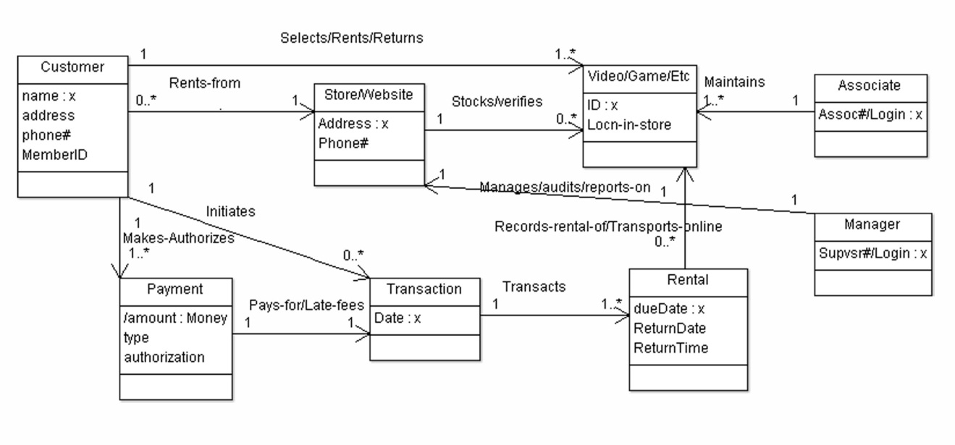
Alternative domain model (from HW’s)

