Slide 1



Single Responsibility Principle
Steve Chenoweth
Office: Moench Room F220
Phone: (812) 877-8974
Email: chenowet@rose-hulman.edu
Chandan Rupakheti
Office: Moench Room F203
Phone: (812) 877-8390
Email: rupakhet@rose-hulman.edu
These slides and others derived from Alex Lo’s 2011 material on SRP.
Q1
Notes:
The reference article is an e-book due to the Los Techies blog, http://lostechies.com/wp-content/uploads/2011/03/pablos_solid_ebook.pdf

Slide 2
SRP: Single Responsibility Principle
“A class should have only one reason to change” – Martin
SRP is a design principle, a goal. Not a rule.
Notes:
Alex says, When you violate SRP I will not pop out of nowhere and hit you with a surprise quiz. But I’d like to.

Slide 3
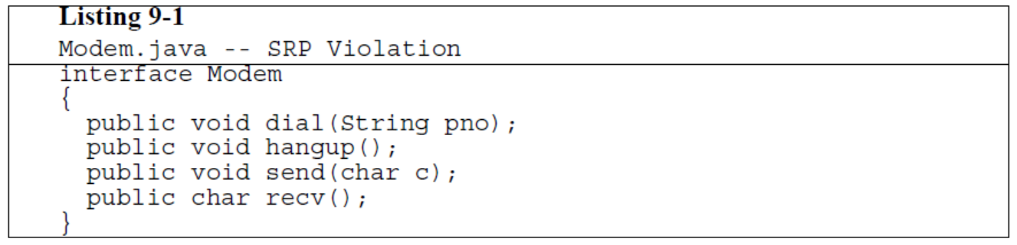
Q2
Notes:
What if you want to implement a fax service too? You would want the connection part but not the data channel part.

Slide 4
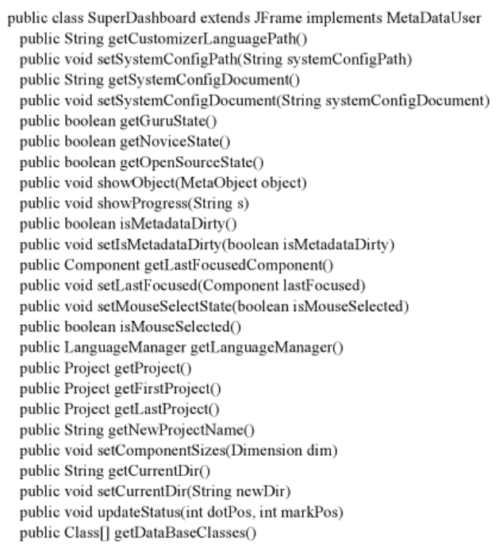
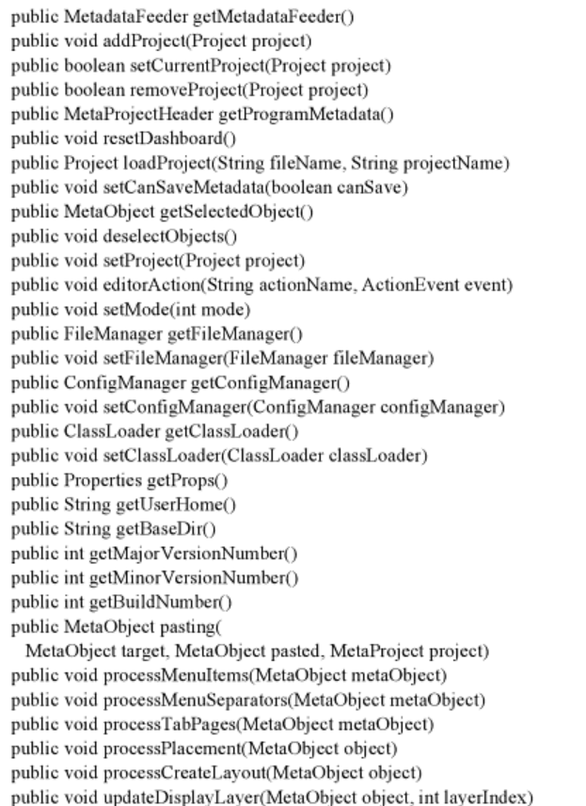
Clean Code (p136-137)
Robert C. Martin
Q3
Notes:
Example of a large class. Sometimes called “kitchen sink”, “god class” or just “mess”

Slide 5
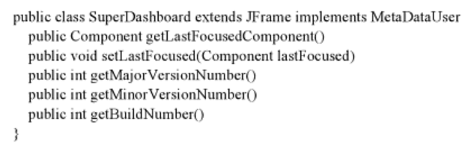
Clean Code (p138-139)
Robert C. Martin
Notes:
Here’s a try at pulling out just the main things that SuperDashboard needs to do, from the previous slide. Even this class has too many responsibilities

Slide 6
Clean Code (p138-139)
Robert C. Martin
Notes:
Here’s a subset of that, which makes much more sense as having a single purpose.

Slide 7
Heuristics
Write a brief but accurate description of what the class does. If the description contains the word "and" then it needs to be split.
  http://stackoverflow.com/a/317294/443871
Notes:
Here’s how to know if your class qualifies as having the “SRP” quality.

Slide 8
Example Troubling Description: “KillerAppServer contains main() and is responsible for parsing flags AND initializing filters chains and servlets AND mapping servlets for Google Servlet Engine AND controlling the server loop…”
http://misko.hevery.com/code-reviewers-guide/flaw-class-does-too-much/
Some Google engineer
Q4

Slide 9
Example Troubling Description: “SyndicationManager caches syndications AND implements complex expiration logic AND performs RPCs to repopulate missing or expired entries AND keeps statistics about syndications per user.” (In reality, initializing collaborators may be a separate responsibility, independent from the work that actually happens once they are wired together.)
http://misko.hevery.com/code-reviewers-guide/flaw-class-does-too-much/
Some Google engineer
Notes:
Another one, equally bad…

Slide 10
public class User {
  public String getName() { …}
  public void setName(String name) { }
  public Permissions getPermissions() { …}
  public void setPermissions() {}
  public static double calculateInterest(
  double balance) {}
  public void saveToMySQL() {}
  public void saveToDisk() {}
  public static List<User> getUsersFromMySql() {}
  public static List<User> getUsersFromDisk() {}
}
Q5
Notes:
Ok, this one is all about “User” but it does different things for the user – close enough for SRP, or not? (The “…” parts are where we left out a bunch of the code to focus on the structure of the class.)

Slide 11
Classes with too many responsibilities
Hard to understand
Hard to test and debug
(why are these related?)
Hard to re-use
  Other app might not need the extra stuff
Hard to extend (inherit)
Q6
Notes:
All the reasons to keep class functionality simple!

Slide 12
public class SavingsAccount {
  private double _balance;
  public double getBalance() { return _balance; }
  public void setBalance(double newBalance)
  { _balance = newBalance; }
  public void Process() {
    double interest = calculateInterest();
    setBalance(interest + _balance);
  }
  private double calculateInterest()
  {
  // complex APR compounding calculation
  }
}
Notes:
This should demonstrate why it’s harder to test. Imagine that the APR has multiple test cases needed. You could get around it by exposing it, but that’s not pretty. If it was broken out it would be easier to test, this class would have less responsibility and it would be easier to test.

