Slide 1


CSSE 374:
Persistent Frameworks with GoF Design Patterns & Deployment Diagrams
These slides derived from Shawn Bohner, Curt Clifton, and others involved in delivering 374.
Steve Chenoweth
Office: Moench Room F220
Phone: (812) 877-8974
Email: chenowet@rose-hulman.edu
Notes:
Persistence is a big deal with OO – and it’s easy to mess it up here!

Slide 2

Learning Outcomes: Patterns, Tradeoffs
Identify criteria for the design of a software system and select patterns, create frameworks, and partition software to
satisfy the inherent trade-offs.
Using GoF Patterns in
Iteration 3
  Finish up Template Pattern
  State Pattern
  Command Pattern
Deployment Diagrams
Q3

Slide 3

Persistence Framework – a service to provide object to record mapping
In a Persistence Framework a record is to an object, as a _________ is to a graphical object in a
GUI Framework.
  Think for 15 seconds…
  Turn to a neighbor and discuss
  it for a minute
Notes:
Materialization xforms records into objects; Dematerialization xforms objects into records…
Lazy materialization is when instance of object is materialized when needed…

Slide 4
Recall: A Persistence Framework
Domain Layer
Persistence Framework
Relational Database
PersistenceFaçade
Name City
:University
name = Butler
city = Indianapolis
get(OID, class):Object
put(OID, object)
RHIT Terre Haute
Purdue W. Lafayette
Indiana U. Bloomington
Butler U. Indianapolis
University object
Store object in RDB
University Table
Retrieve from RDB
put(OID, Butler U.)
get(OID, University)
(Really)
Store as Relations
(Pretend to)
Store as Objects
Use Objects
Notes:
Slide has lot’s of builds to show ordering…

Slide 5
Recall: Maps between Persistent
Object & Database
University Table
OID name city
1
:University
XI001 RHIT Terre Haute
wxx246 Purdue W. Lafayette
xxz357 Indiana U. Bloomington
xyz123 Butler U. Indianapolis
name = Butler
city = Indianapolis
oid = xyz123
Notes:
Object Identifier pattern: OID is primary key…1
Representing objects as tables pattern…

Slide 6
Recall: Façade Design Pattern w/Brokers
PersistenceFacade
<<interface>> DBMapper
getInstance( ): PersistenceFacade
class
get(OID, class) : Object
put(OID, Object)
get(OID):Object
put(OID, Object
ProductSpecification RDBMapper
ProductSpecification FlatFileMapper
Manufacturer RDBMapper
get(OID):Object
put(OID, Object)
get(OID):Object
put(OID, Object
get(OID):Object
put(OID, Object
Each mapper gets and puts objects in its own unique way, depending on the kind of data store and format.
Notes:
Qualified association for Class => a hash.
DBMapper is a pure fabrication

Slide 7
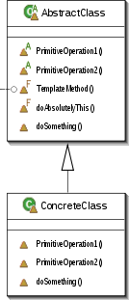
Recall: Template Method Pattern
Problem: How can we record the basic outline of an algorithm in a framework (or other) class, while allowing extensions to vary the specific behavior?
Solution: Create a template method for the algorithm that calls (often abstract) helper methods for the steps. Subclasses can override/implement these helper methods to vary the behavior.

Slide 8
Recall Example: Template Method used for Swing GUI Framework
GUIComponent
framework class
//unvarying part of algorithm
public void update {
clearBackground( );
//call the hook method
paint( );
}
update( )
paint( )
Template Method
Hook Method
MyButton
Programmer’s Class
Hook method overridden to supply class specific detail
paint( )

Slide 9
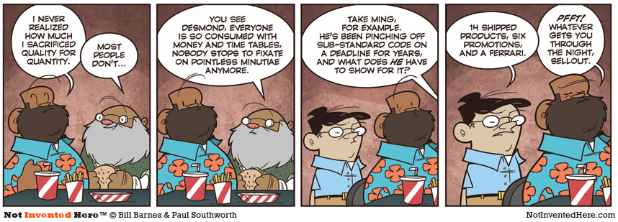
Sacrificing Quality for Quantity…
It’s a bit like all you can eat fast food!

Slide 10
Template Method in NexGen POS 1/2
<<interface>> DBMapper
get(OID):Object
put(OID):Object
Abstract PersistenceMapper
+get(OID):Object {leaf}
#getObjectFromStorage( ):Object
template method
hook method {abstract}
Q1
Notes:
Q1: True or False (circle one): The method getObjectFromStorage() for AbstractPersistenceMapper, is abstract because it will be overridden when instantiated by the concrete method.

Slide 11
Template Method in NexGen POS 2/2
DBMapper
//template method
public final Object get(OID oid) {
obj = cachedObjects.get(oid);
if (obj == null) {
//hook method
obj = getObjectFromStorage(oid);
cachedObject.put(oid, obj); }
return obj; }
AbstractPersistenceMapper
+ get(OID):Object {concrete}
# getObjectFromStorage(OID):Object
{abstract}
//hook method override
protected Object getObjectFromStorage(OID oid) {
String key = oid.toString( );
dbRec = SQL execution result of
“Select* from PROD_DESC where key =“ +key
ProductDescription = new ProductDescription();
pd.setPrice(dbRec.getColumn(“PRICE”);
…etc
ProductDescription RDBMapper
# getObjectFromStorage(OID):Object

Slide 12
Persistence Framework
NextGen Persistence
ProductDescription RDBMapper
ProductDescription FileWithXMLMapper
SaleRDBMapper
ProductDescription InMemoryTestDataMapper
Persistence
PersistenceFacade
<<interface>> DBMapper
1
class
Abstract RDBMapper
Abstract PersistenceMapper
Notes:
Note that we have our Persistence Façade to the DB Mapper (AKA Database Broker pattern).
This enables us to have the NextGen Persistence Framework that maps to RDB and File/XML, and InMemoryTest (a test vehicle when no database connection)…
Note that RDBMappers call getObjectFromRecord(OID) while others call getObjectFromStorage(OID) …

Slide 13
Transactional States & the State Pattern
[new (not from DB)]
[from DB]
save
commit / insert
New
Old
Clean
rollback / reload
OldDirty
commit / update
delete
delete
Database transactions need:
insert, delete, modify
Delayed updates
/Explicit Commits
(rollback)
OldDelete
rollback / reload
Deleted
commit / delete
Notes:
So what happens when we do transactions on a database?

Slide 14
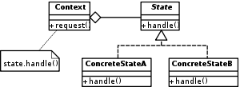
State Pattern
Problem: When the
behavior of an object,
obj, changes depending
on its state, how can we avoid complicated conditional statements?
Solution: Create state classes implementing a common interface. Delegate state-dependent methods from obj to the current state object.
Q2,3
Notes:
Q2: Briefly, what problem does the State pattern solve?
Q3: Briefly, what solution does the State pattern suggest?

Slide 15
Example: State Pattern in TCP
TCPState
TCPConnection
Open( )
Close( )
Acknowledgement( )
Open( )
Close( )
Acknowledgement( )
state → open( )
TCPEstablished
TCPListen
TCPClosed
Open( )
Close( )
Acknowledgement( )
Open( )
Close( )
Acknowledgement( )
Open( )
Close( )
Acknowledgement( )
Notes:
Example in Transport Control Protocol (TCP)

Slide 16
State Pattern in Persistence Framework
PersistentObject
PObjectState
oid: OID
state: PObjectState
commit (PersistentObject obj);
delete (PersistentObject obj);
rollback (PersistentObject obj);
save (PersistentObject obj);
*
1
commit( )
delete( )
Rollback( )
save( )
setState(PObjectState)
state → commit( this );
OldDirty State
OldClean State
New State
commit( …)
delete(…)
rollback(…)
delete(…)
save (…)
commit( …)
Q4
Notes:
Q4: For which, if any, objects in your team project would it make sense to vary their behavior based on the state that they are in?

Slide 17
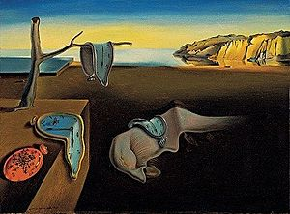
Your project and persistence
What values are you storing in your system?
Where are these being stored?
What would happen if you actually tried to store “objects” as these are used in your program?
Most famous example of persistence? Salvador Dali’s “limp watches” painting, officially called “Persistence of Memory.”

Slide 18
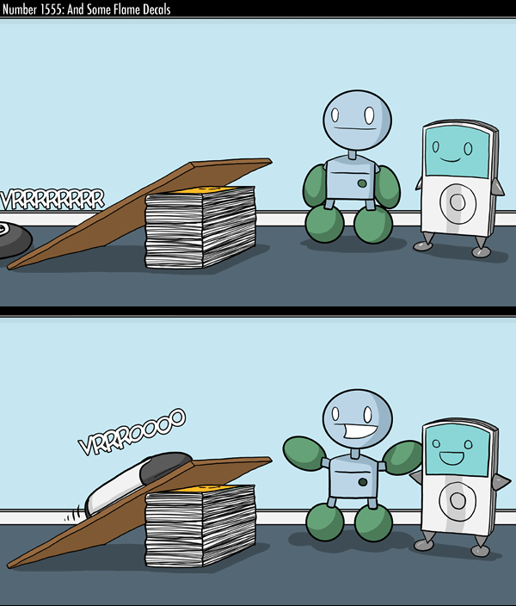
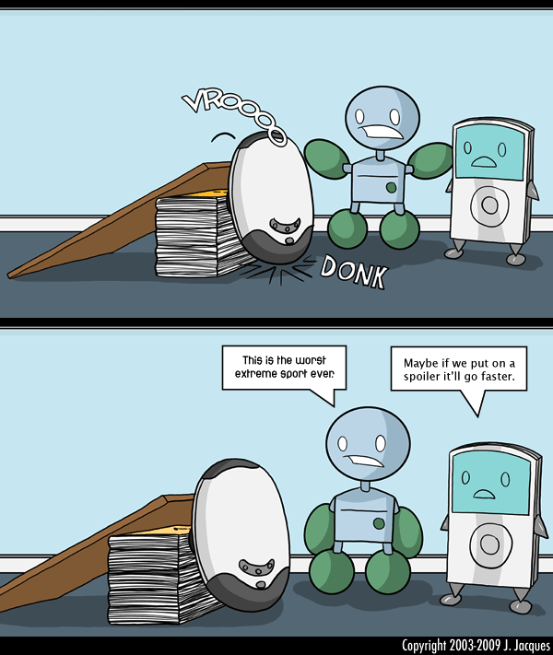
A 2nd Cartoon of the Day
Used by permission. http://www.questionablecontent.net/view.php?comic=1555
Notes:
Something like stripes on your go-faster cross trainers…
• Slide builds in second column

Slide 19
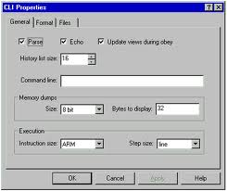
Command Pattern
Problem: When we need to record operations so we can undo them, or execute them later, what should we do?
Solution: Define a Command interface that represents
all possible operations.
Create subclasses of it for each kind of operation and instances for each actual operation.
Q5,6
Notes:
Q5: Briefly, what problem does the Command pattern solve?
Q6: Briefly, what solution does the Command pattern suggest?

Slide 20

Uses for the Command Pattern
Undo/redo
Prioritizing and Queuing operations
Composing multi-part operations
Progress bars
Macro recording
Q7
Notes:
Q7: Where might it make sense to use the Command pattern in your team project?
- execution by a separate thread- SQL transactions
- have commands estimate their duration, total is length of bar; as each command executes, bar advances
- remember command sequences

Slide 21
Command Pattern in NextGen POS
Notes:
This becomes a virtual proxy with the commands… a proxy for another object (real) that materializes the real object when it is 1st referenced (i.e., lazy materialization)
This is fairly involved, so I just mention it here in class – the book gives a fairly good explanation.

Slide 22
Command pattern in your system
Got any commands you need to save, like in a linked list?
  May need to undo later?
  May need to turn them into a script?
  May want to see them “reenacted” in some model?

Slide 23

Deployment Diagrams
Recall two key Architectural views:
  Logical Architecture
  Deployment Architecture
Deployment Diagrams provide the means to express how the physical components
of the system are organized
Notes:
Q8: Do deployment diagrams usually show classes or instances? Why? [Instances, since they often reflect existing, physical objects on platforms]
Recall when we talked about Architecture we mentioned two key views
1. Logical Architecture – Reflects Logical Design (platform independent)
2. Deployment Architecture – reflects Physical design with platforms
These two views are key, but in CSSE 377 you will discover more… show Green Book…
Deployment and Component Diagrams provide the means to express how the physical components of the system are organized

Slide 24
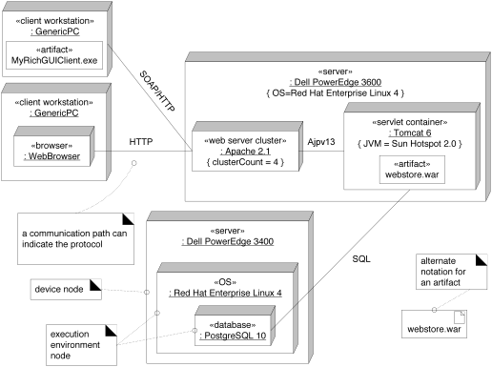
Outer boxes represent machines
Software artifact
Lines represent communication
Can label with protocols
Nested boxes show “execution environment nodes”
Notes:
• Machines: Note various stereotypes and labels on machines
• Execution Environment Node (EEN): Software that contains or hosts other software. Note variety of EENs shown.
Note use of property string to show OS on top-right server.
Note other uses of property tags.
• Communication: both between machines and between execution environments
• Protocol labels
• Deployed software artifacts

Slide 25
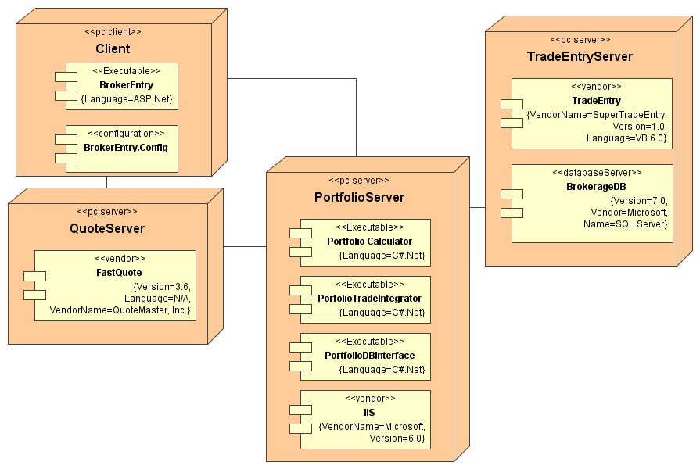
Deployment Diagrams
On the board, draw a deployment diagram of your project system, as it will run.
Explain what equipment issues could relate to your plan for deployment.
Deployment diagram for a system combining in-house and 3rd party software. From http://www.devx.com/enterprise/Article/27899/0/page/3.

