Slide 1


CSSE 374:
Even More Object Design with Gang of Four Design Patterns
These slides derived from Shawn Bohner, Curt Clifton, and others involved in delivering 374.
Steve Chenoweth
Office: Moench Room F220
Phone: (812) 877-8974
Email: chenowet@rose-hulman.edu
Chandan Rupakheti
Office: Moench Room F203
Phone: (812) 877-8390
Email: rupakhet@rose-hulman.edu
Notes:
***Hand out/back the new/old quizzes
Mention Milestone 5 and remind teams about tomorrow’s review
CLARIFICATION
Variation points: points of change in the existing system or requirements (e.g., multiple tax calculators)
Evolution points: points of change that may arise in the future but not currently present (e.g., hand-held POS devices)

Slide 2
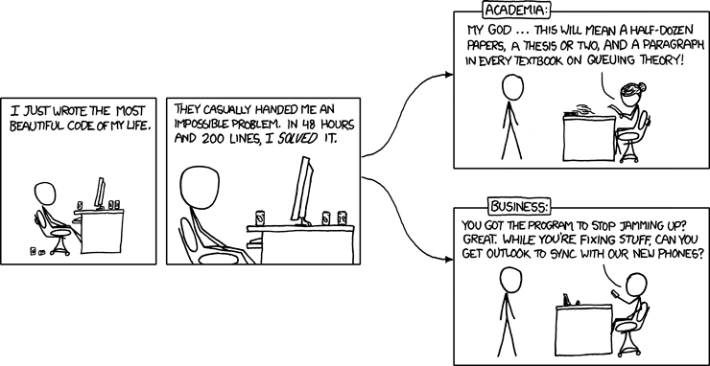
Problem Solved…
Some engineer out there has solved P=NP and it's locked up in an electric eggbeater calibration routine.
For every 0x5f375a86 we learn about, there are thousands we never see.

Slide 3
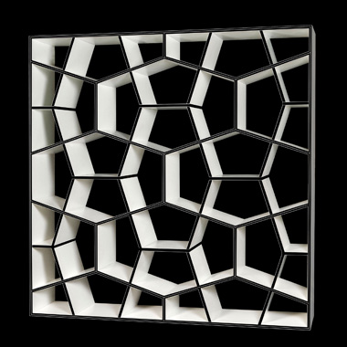
Learning Outcomes: Patterns, Tradeoffs
Identify criteria for the design of a software system and select patterns, create frameworks, and partition software to satisfy the inherent trade-offs.
Using GoF Patterns in Iteration 3
  Support for third-party
  POS devices
  Handling payments
What’s coming up…
Q3
Notes:
NOTE: New approach to Design Studio…

Slide 4
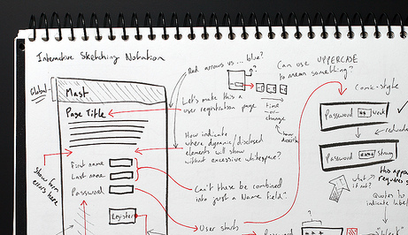
Design Studios – other ideas
What you did to act on problems
  New success stories
  Patterns that worked / didn’t
http://www.mabishu.com/blog/2010/08/23/some-valuable-user-interface-patterns-resources/

Slide 5
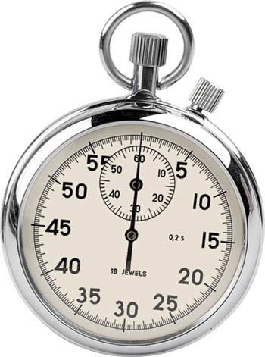
Supporting 3rd Party Devices:
How would you handle external, 3rd party devices / services that have largely the same function, but they might
operate differently and have
different interfaces?
  Think for 15 seconds…
  Turn to a neighbor and discuss
  it for a minute
Notes:
Façade?
Adapter?
We’ll discuss in class.

Slide 6
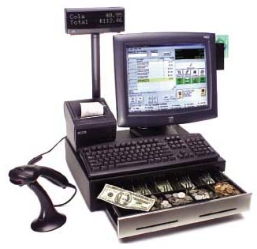

Accessing External Physical Devices
POS devices include cash drawer, coin dispenser, digital signature pad, & card reader
They must work with devices from a variety of vendors
like IBM, NCR, Fujitsu …
UnifiedPOS: an industry standard OO interface
  JavaPOS provides a Java mapping as a set of Java interfaces
Notes:
So the question is, “with so many permutations how do we support these?”
• Build in last bullet
• Build in call-out and circle
Note: Architect would document decision to use these in a technical memo

Slide 7
Standard JavaPOS Interfaces for Hardware Device Control
Notes:
JavaPOS Adapter pattern or proxy provides this interoperability variation point needed to support multiple vendors devices
Let’s look at how this is done…

Slide 8
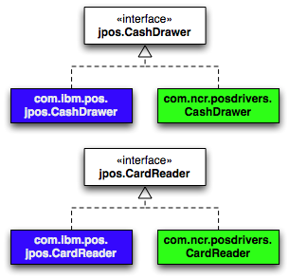
Manufacturers Provide Implementations
Device driver for hardware
The Java class for implementing JavaPOS interface
Notes:
Java Class uses Java Native Interface to talk to device driver

Slide 9
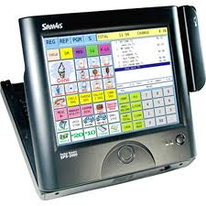
What does this mean for NextGen POS?
What types does NextGen POS use to communicate with external devices?
How does NextGen POS get the appropriate instances?
Assume: A given store uses a single manufacturer
Notes:
For most of NextGen, we just use the JavaPOS interface types.
This protects against variation in the hardware used.
- Getting the appropriate instances requires a new pattern… An Abstract Factory

Slide 10
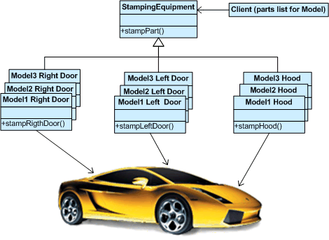
Closer look at Abstract Factory
Problem: How can we create
families of related classes
while preserving the
variation point of
switching between
families?
Solution:
Define an abstract factory interface.
Define a concrete factory for each family.
Q1,2
Notes:
Q1. Briefly, what problem does the Abstract Factory pattern solve?
Q2. Briefly, what solution does the Abstract Factory pattern suggest?
So, what does this look like for NextGen POS?

Slide 11
Abstract Factory Example
Abstract Factory
Concrete Factories
Methods create vendor-specific instances, but use standard interface types.
Notes:
• Abstract Factory
• Concrete Factories
• Methods create…

Slide 12
1st Attempt at Using Abstract Factory
class Register {
…
public Register() {
IJavaPOSDevicesFactory factory =
new IBMJavaPOSDevicesFactory();
this.cashDrawer =
factory.getNewCashDrawer();
…
}
}
Constructs a vendor-specific concrete factory
Uses it to construct device instances
What if we want to change vendors?
Notes:
• Build in bottom call-out. Get ideas.
We could have a factory of factories…
Next slide just adds solution name…

Slide 13
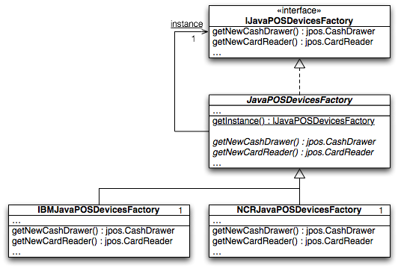
Use an Abstract Class Abstract Factory
// A factory method that returns a factory
public static synchronized
IJavaDevicesFactory getInstance() {
if (instance == null) {
String factoryCN =
System.getProperty(“jposfactory.classname”);
Class c = Class.forName( factoryCN );
instance = (IJavaPOSDevicesFactory) c.newInstance();
}
return instance;
}
Notes:
In other words, a Factory Factory… Abstract Factory contains singleton factory method that returns concrete factories for specific device types
How this works is that by changing external system property “jposfactory.classname” which is the string in the properties file, the POS will use a different family of JavaPOS drivers.
Protected Variations is achieved via a changing factory using a data-driven “system properties file” and reflective programming design – c.newInstance()

Slide 14
Using a Factory Factory
Gets a vendor-specific concrete factory singleton
class Register {
…
public Register() {
IJavaPOSDevicesFactory factory =
JavaPOSDevicesFactory.getInstance();
this.cashDrawer =
factory.getNewCashDrawer();
…
}
}
Uses it to construct device instances
Q3
Notes:
What problem is solved by using a factory method to generate an Abstract Factory instance, rather than hard coding the device vendor? [allows configuration of vendors by changing a data file rather than editing code and recompiling]
Q3: True or False (circle one): By using a factory method to generate an Abstract Factory instance, rather than hard coding the device vendor, we can configure the family of devices used without recompiling the system.

Slide 15
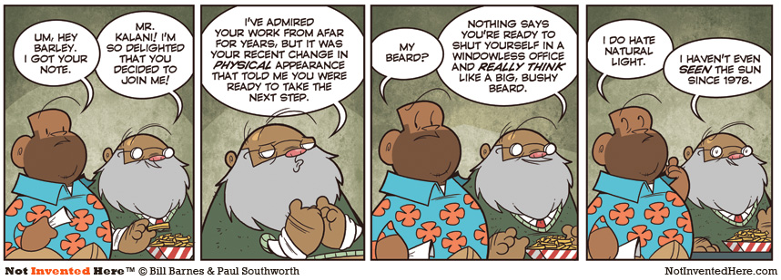
Politics in the Software Organization

Slide 16

Handling Payments
What do we do with different
payment types?
Cash, Credit, a Check?
  Need authorization for
  credit and check…
Follow the “Do It Myself”
Guideline:
  “As a software object, I do those things that are normally done to the actual object I represent.”
A common way to apply Polymorphism
and Information Expert
Notes:
Let look at an example…

Slide 17
“Do It Myself” Example
Real world: payments are authorized
OO world: payments authorize themselves
Q4
Notes:
Q4: Both of the following design decisions might be reasonable, but which one would be suggested by the “do it myself” guideline.
[Having RentableItem implement a returnItem() method. Or,
Having Customer implement a returnItem() method. ]
Think of a graphical object – circle, square – move myself… or text object – spellcheck myself!
By Polymorphism and “Do it Myself”, each payment type should authorize itself…
What does the “do it myself” guideline suggest? Information expert, Low representational gap, [[[p. 608]]]

Slide 18
Creating a CheckPayment
Fine-grained objects
Notes:
Big arrow points at the example of Do It Myself guideline
• Fine-grained objects: DriversLicense and Check are an initially may seem like overkill…
However, they often end up having useful behavior and being reusable (think CreditCard), p. 611.

Slide 19

Frameworks with Patterns
Framework: an extendable set of
objects for related functions, e.g.:
  GUI framework
  Java collections framework
Provides cohesive set of interfaces & classes
  Capture the unvarying parts
  Provide extension points to handle variation
Relies on the Hollywood Principle:
  “Don’t call us, we’ll call you.”
Framework from http://www.starlumber.com/buildinganewhomewichita.html
Notes:
Used by extending provided classes
Frameworks are reusable… can increase productivity hence are valuable to an organization.

Slide 20
Designing a Persistence Framework
Domain Layer
Persistence Framework
Relational Database
PersistenceFaçade
Name City
:University
name = Butler
city = Indianapolis
get(OID, class):Object
put(OID, object)
RHIT Terre Haute
Purdue W. Lafayette
Indiana U. Bloomington
Butler U. Indianapolis
University object
Store object in RDB
University Table
Retrieve from RDB
put(OID, Butler U.)
get(OID, University)
Notes:
Lots of builds to show ordering…

Slide 21
Accessing Persistence Service via Façade
Unified interface to set of interfaces in a subsystem
Façade defines a higher-level interface that makes the subsystem easier to use
Façade Applications:
  Layer the subsystem using Facade to define an entry point to each subsystem level
  Introduce a Facade to decouple subsystems from clients and other subsystems
    Promotes independence and portability
  Façade produces simple default view of subsystem
Notes:
Clients communicate with the subsystem by sending requests to Façade, which forwards them to the appropriate subsystem object. Clients that use facade do not have to access subsystem objects directly.

Slide 22

The Façade Pattern for Object ID
Need to relate objects to database records and ensure that repeated materialization of a record does not result in duplicate objects
Object Identifier Pattern
  assigns an object identifier (OID) to each record
  Assigns an OID to each object (or its proxy)
  OID is unique to each object
Notes:
Materialization transforms a non-object (data) like a record from a persistent store into objects. Dematerialization reverses this.
Every table will have an OID as primary key to retain uniqueness of objects

Slide 23
Maps between Persistent Object & Database
University Table
OID name city
1
:University
XI001 RHIT Terre Haute
wxx246 Purdue W. Lafayette
xxz357 Indiana U. Bloomington
xyz123 Butler U. Indianapolis
name = Butler
city = Indianapolis
oid = xyz123
The OID may be contained in proxy object instead
Notes:
OID is primary key…1

Slide 24
The Persistence Façade
:DBProductAdapter
:PersistenceFaçade
PersistenceFaçade
pd = get(…)
getInstance():
PersistenceFacade
get(OID, class)
put(OID,Object)
//example use of the facade
OID = new OID(“XYZ123”);
ProductDescription pd = (ProductDescription) PersistenceFacade.getInsance().get(oid, ProductDescription.class);

Slide 25
Façade Design Pattern with Brokers
PersistenceFacade
<<interface>> DBMapper
getInstance( ): PersistenceFacade
class
get(OID, class) : Object
put(OID, Object)
1
get(OID):Object
put(OID, Object
ProductSpecification RDBMapper
ProductSpecification FlatFileMapper
Manufacturer RDBMapper
get(OID):Object
put(OID, Object)
get(OID):Object
put(OID, Object
get(OID):Object
put(OID, Object
Each mapper gets and puts objects in its own unique way, depending on the kind of data store and format.
Notes:
Qualified association for Class => a hash.
DBMapper is a pure fabrication

Slide 26
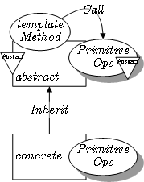
Template Method Pattern
Problem: How can we record the basic outline of an algorithm in a framework (or other) class, while allowing extensions to vary the specific behavior?
Solution: Create a template method for the algorithm that calls (often abstract) helper methods for the steps. Subclasses can override/implement these helper methods to vary the behavior.
Q5,6
Notes:
Q5: Briefly, what problem does the Template Method pattern solve?
Q6: Briefly, what solution does the Template Method pattern suggest?

Slide 27
Example: Template Method used for Swing GUI Framework
GUIComponent
framework class
//unvarying part of algorithm
public void update {
clearBackground( );
//call the hook method
paint( );
}
update( )
paint( )
Template Method
Hook Method
MyButton
Programmer’s Class
Hook method overridden to supply class specific detail
paint( )

Slide 28
Question to do in class
What would your system look like as a template?
What would the possible end systems have been (varying in some way)?
How could you put “enough” in the general part of the system that it would be valuable to do that?
How much harder would it have been to do it that way?
End System
# 1
Your Template System
End System
# 2

Slide 29




Milestone 2+ Themes --
Main focus
Requirements
Design
Implementation
Test
Delivery
Used GoF?
Integration Tests
OK?
Acceptance Tests
OK?
(Some former
customers!)
Customer
happy?
…
Notes:
We’ll discuss this slide in class!

