Slide 1

CSSE 374:
Design Class Diagrams
Steve Chenoweth
Office: Moench Room F220
Phone: (812) 877-8974
Email: chenowet@rose-hulman.edu
Chandan Rupakheti
Office: Moench Room F203
Phone: (812) 877-8390
Email: rupakhet@rose-hulman.edu
These slides and others derived from Shawn Bohner, Curt Clifton, Alex Lo and others involved in delivering 374.
Notes:
These are a main event, and you’ve been doing these since what, CSSE 120?

Slide 2
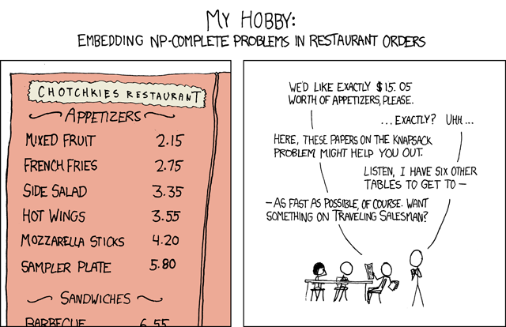
CS humor…
General solutions get you a 50% tip
Notes:
The author actually “wrote a Perl script to generate a set of prices with only one solution, but the script had a bug (you can’t compare IEEE floats for equality) so there are actually two, and one is easy (7 mixed fruits).

Slide 3

Plan for the Day, when we get to class
Initial course comments – a fun exercise!
Design Class Diagrams
Design exercise that should help with Homework #2

Slide 4

Help Me Help You help me help you…
Initial course comments –
take out a piece of paper!
List one helpful idea about the course:
  Especially good, fun or useful thing
  Especially need fixing thing
  New idea for us to try
Then…
Notes:
Look for this in class…

Slide 5
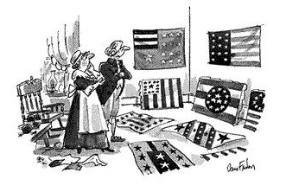
UML Class Diagrams
…George Washington & Betsy Ross realizing that design matters!
http://www.cartoonbank.com/1993/betsy-ross-and-george-washington-looking-over-a-variety-of-flag-designs/invt/107338/

Slide 6
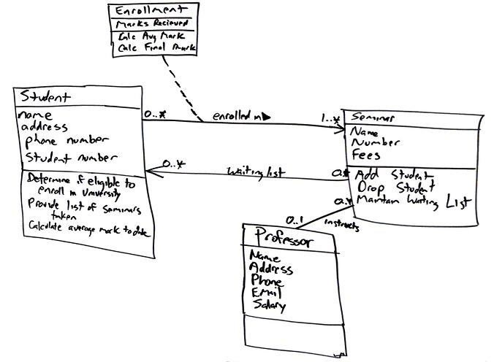
Design Class Diagrams (DCD) 1/2
Creation of DCDs builds on prior:
  Domain Model (+detail to class definitions)
  Interaction diagrams (identifies class methods)
Creation of DCDs and interaction diagrams are usually created in parallel
Q1
Notes:
Q1: While the creation of Design Class Diagrams (DCD) builds on prior information from the Domain Model and Interaction Diagrams, it is also done in parallel with the creation of what?

Slide 7
Design Class Diagrams (DCD) 2/2
DCDs illustrates the specifications for software classes and interfaces including:
Classes, associations, and attributes
Interfaces, with their operations and constants
Methods
Attribute type information
Navigability
Dependencies

Slide 8
Common UML
Class Notation
Notes:
It’s good to note the dependencies in the accompanying text with the DCD

Slide 9
Recipe for a Design Class Diagram
Identify all the classes participating in the software solution by analyzing the interaction diagrams
Draw them in a class diagram
Duplicate the attributes from the associated concepts in the conceptual model
Add method names by analyzing the interaction diagrams
Add type information to the attributes and methods
Add the associations necessary to support the required attribute visibility
Add navigability arrows to the associations to indicate the direction of attribute visibility
Add dependency relationship lines to indicate non-attribute visibility

Slide 10
Class Diagrams Do Double Duty
Multiplicity only at target end
Navigability arrow
Role name only at target end
Call them Domain Models when used for analysis at the conceptual level
Call them Design Class Diagrams when used for design
No association name
Q2
Notes:
Q2: Larman uses the term _____ ______ for a class diagram used in analysis.
This is in contrast with a class diagram used in design, which he shockingly class a _____ _____ _____.

Slide 11
Attribute Text vs. Association Line Notation
Avoid
Role name is attribute name
Preferred
Avoid
Q3
Notes:
••• call-outs
The notation chosen affects the story we’re trying to tell, either emphasizing or suppressing the connections.
Q3: Attributes in a DCD can be shown textually (in the attributes section) or visually (using an association line).
What’s the rule of thumb for which notation to use?

Slide 12
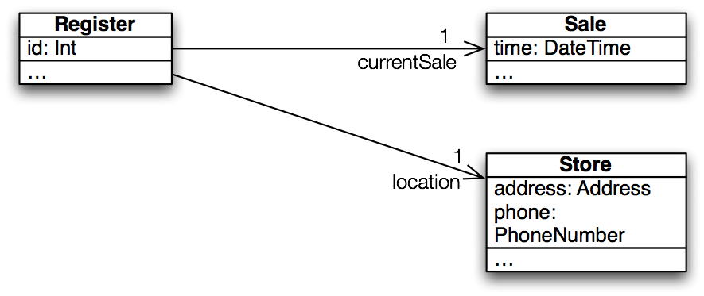
Guideline Good Practice: Example
Q4
Notes:
Showing Sale & Store attributes as associations visually emphasizes relationships important in object collaboration
Q4: How many attributes does Register have according to this DCD?

Slide 13
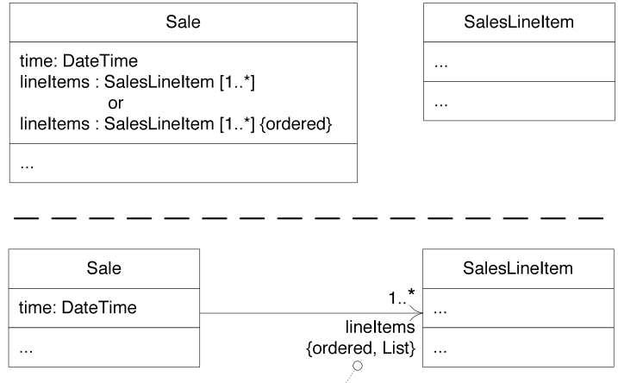
Showing Collection Attributes
Multiplicities
1
2
Preferred, less visual clutter
Constraints
Q5
Notes:
note 3 different ways that lineItems are represented
Q5: Sketch a DCD showing that a PokerHand has between zero and five Cards, stored in an ordered collection.

Slide 14
Operations
Syntax:
  visibility name(paramName:type, …) : returnType {properties}
  + getPlayer(name:String) : Player {exception IOException}
Also use syntax of implementation language
  public Player getPlayer(String name) throws IOException
Operation vs. operation contract vs. method
Notes:
- operation gives method header
- operation contract gives constraints on operation
- method gives implementation of operation

Slide 15
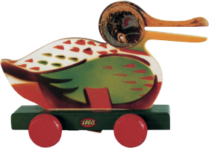
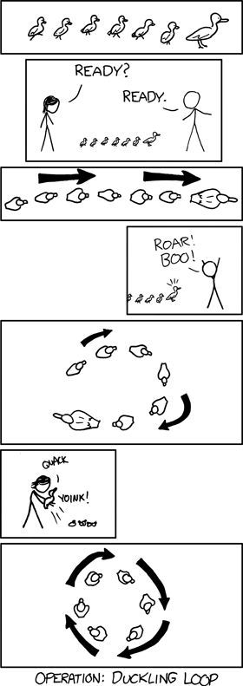
Cartoon of the Day
http://www.brickfetish.com/toys/duck.html
Notes:
• Animated duck rolling through. This is an obscure internet meme reference.
See http://www.urbandictionary.com/define.php?term=duckroll for more information.
The idea is:
Duckroll -> Duck on Wheels – without a leader sometimes you get something different than you expected…

Slide 16
Keywords Categorize Model Elements
Keyword | Meaning | Example Usage
«actor» | classifier is an actor | shows that classifier is an actor without getting all xkcd ☺
«interface» | classifier is an interface | «interface» MouseListener
{abstract} | can’t be instantiated | follows classifier or operation
{ordered} | set of objects has defined order | follows role name on target end of association
{leaf} | can’t be extended or overridden | follows classifier or operation
Notes:
• «actor» Cashier
• Payment {abstract}
• saw this one on collections slide earlier
• What keyword means the same thing in Java? final
e.g., String {leaf}

Slide 17
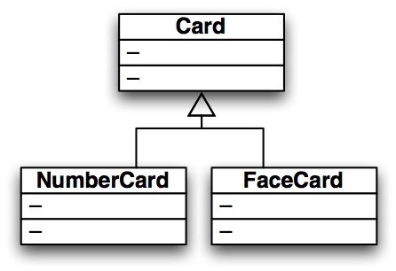
Generalization
In Domain Model:
  Says that the set of all NumberCards is a subset of the set of all Cards
In DCD:
  Says that, and that NumberCard inherits
  from Card

Slide 18
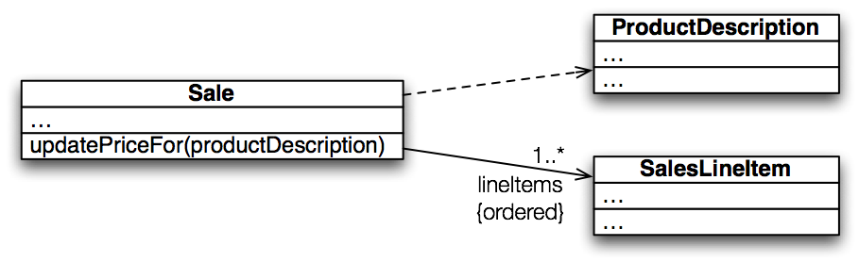
Dependencies
Dependency lines are dashed
Attribute association lines are solid
Use dependency lines when a more specific line type doesn’t apply.
Can label dependency arrows: e.g. «call», «create»
Q6
Notes:
A dependency is a “using relationship” that states a change in specification of one thing may affect another thing that uses it
>>>On board (and quiz): global variable, parameter, local variable, static method call
[Which of these are we showing here? Parameter]
• labels
Q6: List some situations where we should we use a dependency line in a DCD.

Slide 19
Interfaces in UML
Q7
Notes:
UML has several ways to show interface implementations
Q7: When would we use the “lollipop” interface notation instead of an implements arrow and a dependency line?
Both the socket line notation and the dependency line notation used curved lines not common in drawing tools
So, most people use a dependency arrow and the «interface» stereotype
• Socket line notation: Window1 has an attribute of type Timer
• Dependency line notation: Clock2 implements Timer and Window2 has a transitory dependency on type Timer
• Socket line notation: Clock3 implements Timer and Window3 has an attribute of type Timer

Slide 20

Composition
More powerful than an attribute arrow
Describes “whole-part” relationship
Implies
  Instance of part belongs to only one composite at a time
  Part always belongs to a composite
  Composite creates/deletes parts
Association name in composition is always implicitly some “has-part” relation. So, it’s common to omit association or role name with compositions
Q8
Notes:
Composition is a part-whole relationship where the “part” can only be part of one composite at a time
The composite has sole responsibility for the management of its parts (particularly creation and deletion)
Composition is the strong form of aggregation → Aggregation is not a distinctive term and hence avoided.
Q8: What three conditions does a composition line imply?

Slide 21
Interaction Diagrams and
Class Diagrams (DCD’s)
Interaction diagrams show dynamic behavior
Class diagrams show static behavior
Tips:
  Draw concurrently
  Use two adjacent whiteboards, one for static and one for dynamic
  Sketch communication diagrams, document using sequence diagrams
Notes:
This is why we need both!

Slide 22

Exercise on DCD’s
Break up into your
project teams
Given the following:
  Domain Model and a
  Sequence Diagram
Draw Design Class Diagram
showing a Customer and the classes in a Rental package and a Video package for BrickBusters Video Store. Try to minimize dependencies.
Q9
Notes:
Changes to the “depended on” thing may necessitate changes to the dependent thing. So we want to (1) minimize dependencies and (2) structure dependencies to point to the more stable pieces.
We’ll do these in class.

Slide 23
Contains➔
0..*
VideoDescription
title
subjectCategory
VideoSupplier
address
name
newVideos
1
1
1
Basket
0..*
⬅Provides
1
⬆
Provides
⬆
Holds-
videos-in
Describes➔
Selects ➔
1
1
1
Customer
name
address
phone#
Rents-from,
Buys-from
➔
*
*
1
Store
Address
Phone#
Stocks
➔
Video
ID
*
1
1
*
*
1
1
1
*
*
1
1
1
1
Membership
ID
startDate
⬇
Maintains
⬆
Stores-
video-on
Shelf
location
stock
1
*
*
⬆
Contains
Obtains➔
⬆
Defines
Makes-
Authorizes
⬇
*
PricingPolicy
perDayRentalCharge
perDayLateCharge
Determines-
rental-charge
➔
1
⬆
Records-
rental-of
Initiates ➔
0..*
*
Payment
/amount: Money
type
authorization
Transaction
date
Rental
dueDate
ReturnDate
ReturnTime
Pays-for
➔
Transacts
➔
1..*
1
1
1
1..*
Notes:
Here’s a shot at the Homework 1 Domain Model for BrickBusters Video Store…
Notice that not everything is covered: no video return, no shopping class, …
Many models would satisfy … this is only one

Slide 24
An SD Solution for Rent Video Example
:Video
Description
:Customer
:Video
rentVideos
Loop
[more items]
findVideoToRent(ID,duration)
getVideoInfo(ID,duration)
videoTitle, desc, availabilty
videoTitle, availability
selectVideoToRent(ID)
selectedVideos(video List)
Checkout
updateAvailability(ID,duration)
totalWithTaxes
Notes:
This is one example, but even this one is a simplification to fit on slide (could also have Shelf, Store, and Basket)

Slide 25
+/∂ Feedback
On a separate piece of paper –
Please give us some team-level-anonymous feedback!
Possible topics –
  Class
  Quizzes
  Homework
  Book
  Projects
  Schedule
  …
  Anything else
  + = things going well
  ∂ = things to fix
Thanks –
We’ll show results next class!

Slide 26
A CD Solution for Rent Video Example
1: FindVideoToRent(ID,duration)➔
2: selectVideoToRent(ID)➔
rentVideos➔
:Customer
3: Checkout➔
:Video
1.3: videoTitle, availability⬅
3.1: selectedVideos(video List)⬅
3.2: totalWithTaxes⬅
1.1: getVideoInfo(ID,duration)⬇
1.2: videoTitle, desc, availabilty⬆
2.1: updateAvailability(ID,duration)⬇
:Video
Description
Notes:
This is one example, but even this one is a simplification to fit on slide (could also have Shelf, Store, and Basket)

