Slide 1
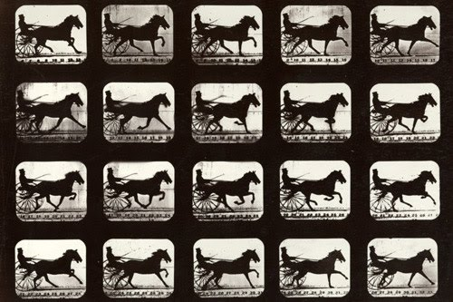

CSSE 374:
Interaction Diagrams
How does a horse really run? Photo sequence in which Eadweard Muybridge proved a horse lifts all four feet off the ground as it runs.
Steve Chenoweth
Office: Moench Room F220
Phone: (812) 877-8974
Email: chenowet@rose-hulman.edu
Chandan Rupakheti
Office: Moench Room F203
Phone: (812) 877-8390
Email: rupakhet@rose-hulman.edu
These slides and others derived from Shawn Bohner, Curt Clifton, Alex Lo and others involved in delivering 374.
Notes:
Gosh, didn’t we already have interaction diagrams? How could these be different?
Image from http://virtualvictorian.blogspot.com/2010_01_01_archive.html.

Slide 2


From last time –
Prefer Design Skill over UML Skill
UML is only a tool for object design
The real skill is the design,
…NOT the diagramming
Fundamental object design requires knowledge of:
  Principles of responsibility assignment
  Design patterns
And design in the real world takes domain knowledge, too…
→
Notes:
But we need some notation to discuss and practice these, so the next couple of sessions will be notation focused.
Seeking a software design job because you are good at UML diagrams is like …
seeking a career as a novelist because you have good penmanship!

Slide 3
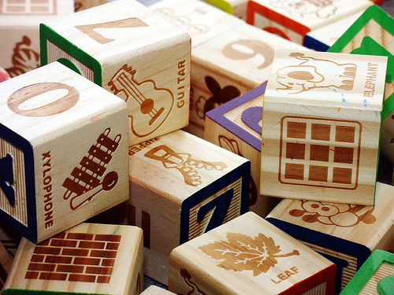
Learning Outcomes: O-O Design
Demonstrate object-oriented
design basics like domain
models, class diagrams, and
interaction (sequence and
communication) diagrams.
Outline Dynamic/Behavior Design concepts
Introduce Interaction Diagrams
Describe Key Sequence Diagram Concepts
Describe Key Communications Diagram Concepts
http://enterprisegeeks.com/blog/2009/07/
Notes:
UML is to design as good penmanship is to authoring a book…

Slide 4
Interaction Diagrams
Used for dynamic object modeling
  Answer questions about behavior
  (i.e., events, sequencing)
Two common types:
  Sequence diagrams
  Communication diagrams
Don’t confuse with System Sequence Diagrams (SSDs), which use a subset of the notation
Spend time on interaction diagrams, not just class diagrams
→
Q1,2
Notes:
We are doing design! Let’s use UML to learn more about it.
While we talk UML syntax specifics, please pay attention to principles…
>>>Larman starts with Interaction Diagrams – to indicate that it behavior and modeling dynamics should be a first class activity.
Q1: Interaction diagrams are used for static/dynamic (circle one) object modeling.
Q2: The two most common interaction diagrams are ________ diagrams and ________ diagrams.

Slide 5
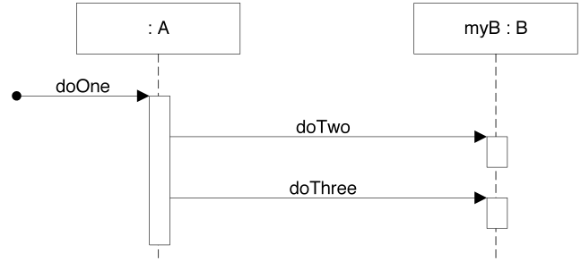
Sequence Diagram Example
public class A {
private B myB = new B();
public void doOne() {
myB.doTwo();
myB.doThree();
}
}
→
Notes:
We’ll get into the details in a bit.

Slide 6
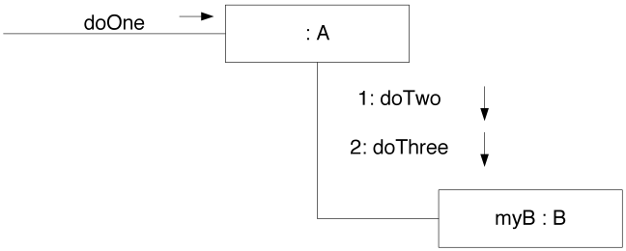
Communication Diagram Example
public class A {
private B myB = new B();
public void doOne() {
myB.doTwo();
myB.doThree();
}
}
→
Notes:
Ditto.

Slide 7
Relative Strengths
Sequence Diagrams (SD)
  Clearer notation & semantics
  Better tool support
  Easier to follow
  Excellent for documents
Communication Diagrams (CD)
  Much more space efficient
  Easier to modify quickly
  Excellent for UML as sketch
→
Notes:
A lot more people use the SD’s! Why do you think that is?

Slide 8
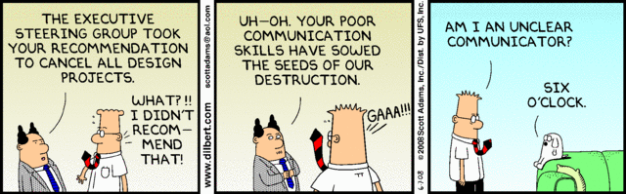
Common Notation
Notes:
Except maybe for Dilbert’s boss…

Slide 9
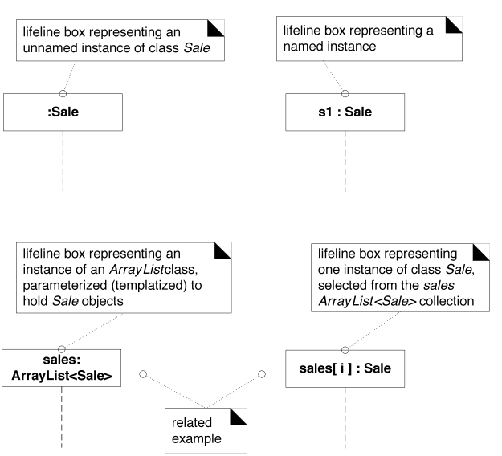
Lifeline Boxes
Q3
Notes:
Note that there are various ways to represent lifeline boxes
1) unnamed instance, 2) Named instance, 3) ArrayList, 4) ArrayList Instance
Q3: Draw a lifeline box representing a named instance of a class Video.

Slide 10
Basic Message Expression Syntax
id = message(parameter : parameterType) : returnType
Much is optional, for example:
initialize(register)
initialize
d = getProductDescription(id)
d = getProductDescription(id:ItemID)
d = getProductDescription(id:ItemID) : ProductDesc
→
Notes:
The main idea is to draw arrows with identifying information on them!

Slide 11
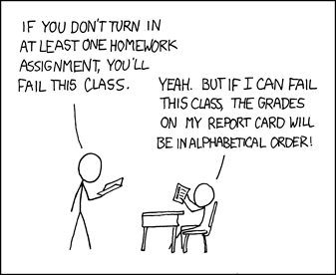
Sequence Diagrams (SD)
(when order is key)
Notes:
This looks like an easier school!

Slide 12
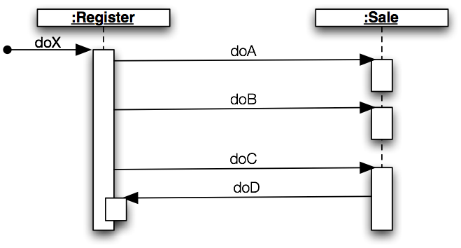
Basic SD Terminology
Found message
Synchronous messages
Execution specification bars
→
Q4
Notes:
••• call-outs
What are the bars for? See the book…
Q4: Label the parts of the sequence diagram below:

Slide 13
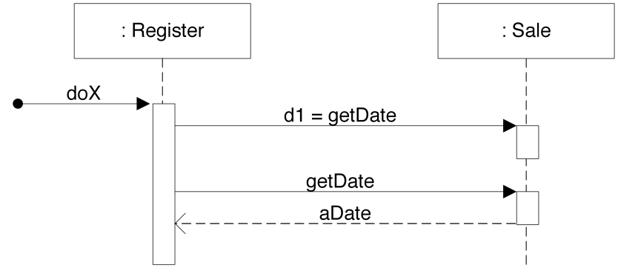
Two Ways of Illustrating Return Values
returnVar = message(parameter)
Using return or reply message
→
Notes:
d1 = getDate using returnVar = message(parameter)
Using return or reply message

Slide 14
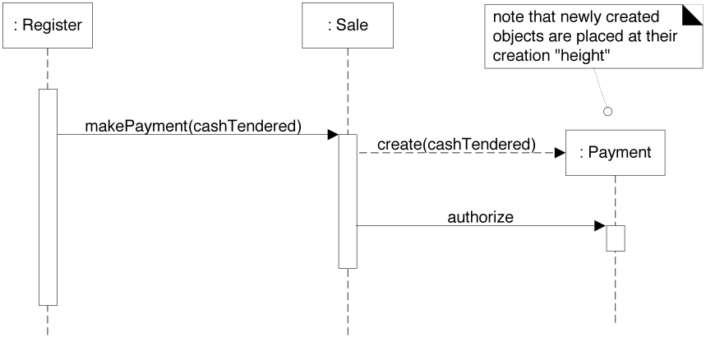
Instance Creation
Conventional message name
Instance of… Note dashed line!
→
Notes:
Remember, time runs down the page, so lower box indicates later allocation
Dashed line is a UML convention – means create Instance, hence “create” text not needed. Clearer if text used…

Slide 15
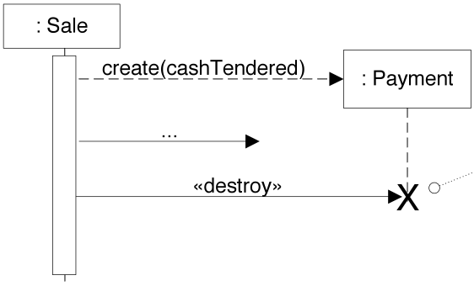
Instance Destruction
“stereotype”
→
Notes:
Again, time runs down the page, so lower box indicates later allocation

Slide 16
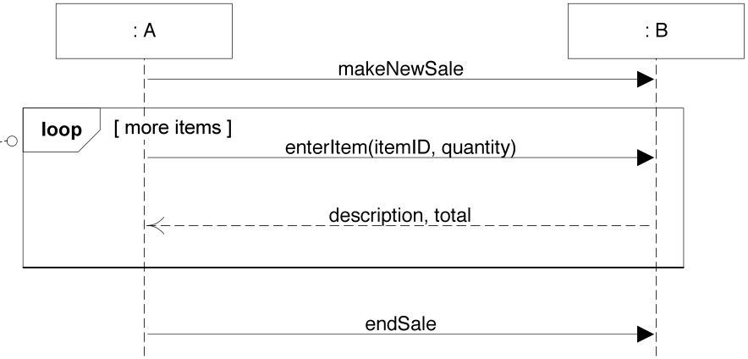
Speaking of Sales…
Recall Interaction Frames
Frame operator
Guard
→
Notes:
Remember, from SSD’s, things like:
• frame operator
• guard

Slide 17
Common Frame Operators
Operator | Meaning
alt | “alternative”, if-then-else or switch
loop | loop while guard is true, or loop(n) times
opt | optional fragment executes if guard is true
par | parallel fragments
region | critical region (single threaded)
ref | a “call” to another sequence diagram
sd | a sequence diagram that can be “called”
Notes:
Only in formal documentation would you use all of these variations!

Slide 18
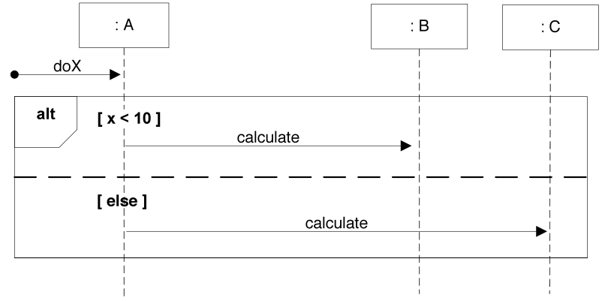
Mutual Exclusion “alt” Frame
Divides sections of frame
Q5
Notes:
Q5: What interaction frame operator is used to represent an if-then-else control flow?

Slide 19
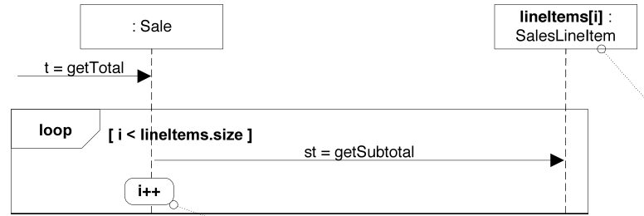
Iterating Over a Collection—Version 1
One instance from a collection
Action box contains arbitrary statements from implementation language – increment i
→
Notes:
Lifeline box SalesLineItem is one instance from a collection of SalesLineItem objects
“i” is the increment value for keeping track of how many object instances…
The summing of the st values is implicit

Slide 20
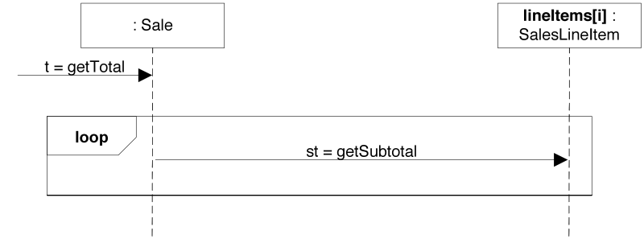
Iterating Over a Collection—Version 2
Leaves the loop implicit.
Notes:
Left implicit is the summing of the st values.

Slide 21
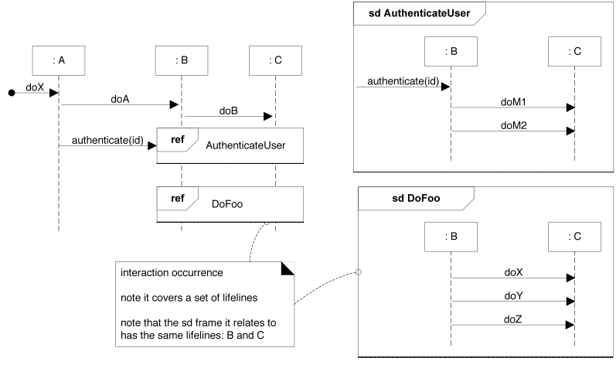
Abstracting Interaction
sd frames
Interaction occurrence ref frames
→
Q6
Notes:
• ref
• sd
Q6: What two interaction frame operators are used to show that one sequence diagram uses another?

Slide 22
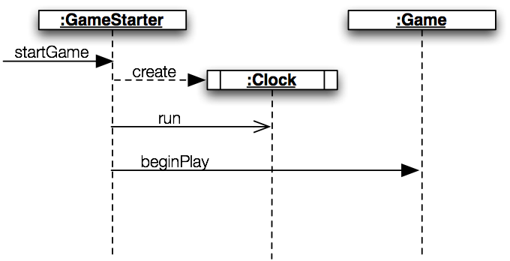
Asynchronous Calls
Asynchronous (non-blocking) call
Active object has its own thread
Synchronous (blocking) call
→
Notes:
• sync
• async
• active object

Slide 23

Exercise on Sequence Diagrams
Break up into your
project teams
Given the following:
  Select a number of videos in
  preparation to purchase and
  put them in a list (cart)
  Involve Classes/Lifeline Boxes:
  Customer, Video, and Video Description
  Invent other classes if you need them!
Draw an SD for Rent Video example
Q7
Notes:
Q7: Sketch a sequence diagram for the Rent Video Example. We’ll also do this as a team, in class.

Slide 24
Contains➔
0..*
VideoDescription
title
subjectCategory
VideoSupplier
address
name
newVideos
1
1
1
Basket
0..*
⬅Provides
1
⬆
Provides
⬆
Holds-
videos-in
Describes➔
Selects ➔
1
1
1
Customer
name
address
phone#
Rents-from,
Buys-from
➔
*
*
1
Store
Address
Phone#
Stocks
➔
Video
ID
*
1
1
*
*
1
1
1
*
*
1
1
1
1
Membership
ID
startDate
⬇
Maintains
⬆
Stores-
video-on
Shelf
location
stock
1
*
*
⬆
Contains
Obtains➔
⬆
Defines
Makes-
Authorizes
⬇
*
PricingPolicy
perDayRentalCharge
perDayLateCharge
Determines-
rental-charge
➔
1
⬆
Records-
rental-of
Initiates ➔
0..*
*
Payment
/amount: Money
type
authorization
Transaction
date
Rental
dueDate
ReturnDate
ReturnTime
Pays-for
➔
Transacts
➔
1..*
1
1
1
1..*
Notes:
Here’s a shot at the Homework 1 Domain Model for BrickBusters Video Store…
Notice that not everything is covered: no video return, no shopping class, …
Many models would satisfy … this is only one

Slide 25
An SD Solution for Rent Video Example
:Video
Description
:Customer
:Video
rentVideos
Loop
[more items]
findVideoToRent(ID,duration)
getVideoInfo(ID,duration)
videoTitle, desc, availabilty
videoTitle, availability
selectVideoToRent(ID)
selectedVideos(video List)
Checkout
updateAvailability(ID,duration)
totalWithTaxes
Notes:
This is one example, but even this one is a simplification to fit on slide (could also have Shelf, Store, and Basket)

Slide 26
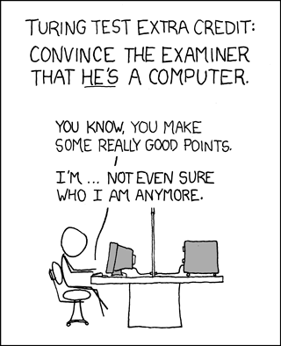
Communi- cation
Diagrams
(CD)
Notes:
This is the other, less used kind of interaction diagram.

Slide 27
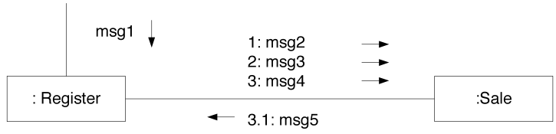
Links vs. Messages
Multiple messages traverse links
Single link connects two objects
Sequence number gives ordering
→
Q8
Notes:
• link
• messages
• sequence number (more details on next slide)
Q8: Labels the parts of the communication diagram below:

Slide 28
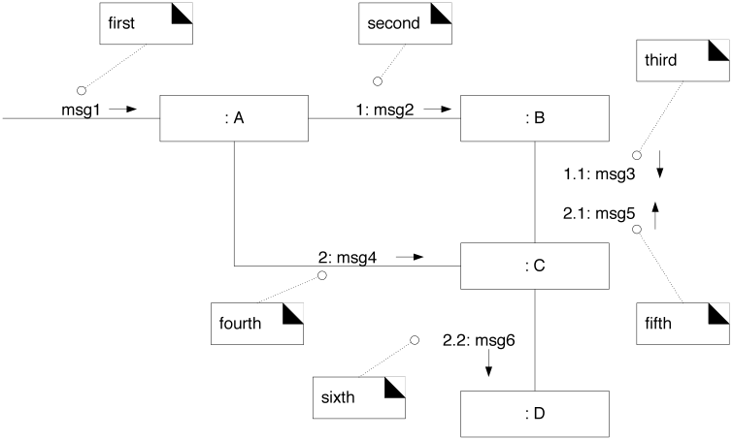
Sequence Numbering – Following Flow
No number on “found” message
Nested messages use “legal” style
→
Notes:
This is how you know what’s done first.

Slide 29
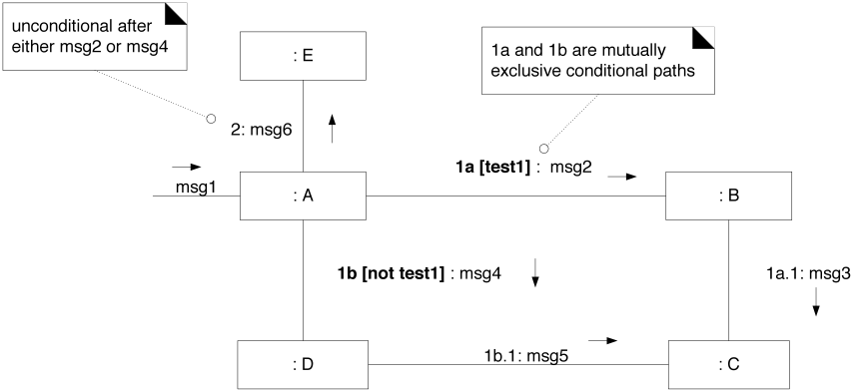
Conditional Messages Use Guards
Take different paths based on Test and ~Test conditions
Q9a
Notes:
Q9: What do we write after the sequence number to show…
… conditional execution: _________
… iteration: ______________

Slide 30
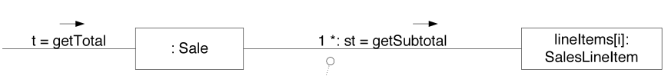
Iteration Uses Stars (splats ☺ ***)
Iteration is indicated with “*”
Note: 1 * [i=1..n]: st = getSubtotal
→
Q9b
Notes:
Looping in general
Iteration over a collection in the example
Q9: What do we write after the sequence number to show…
… conditional execution: ________________
… iteration: ___________

Slide 31
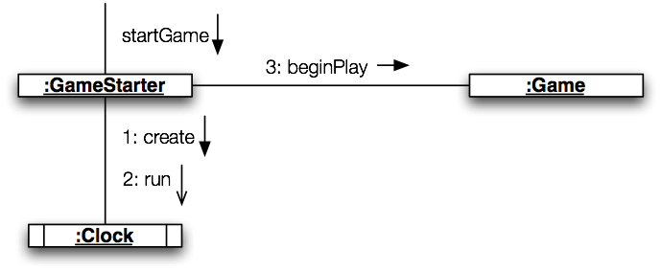
Asynchronous Calls
Synchronous (blocking) call
Active object
Asynchronous (non-blocking) call
→
Q10
Notes:
Q10: Sketch a communication diagram for an ATM withdrawal …

Slide 32
Exercise on Communications Diagrams
Break up into your
project teams – if time
Given the following:
  Select a number of videos in
  preparation to purchase and
  put them in a list (cart)
  Involve Classes/Lifeline Boxes:
  Customer, Video, and Video Description
Draw an CD for Rent Video example
Q10
Notes:
Q10: Sketch a communications diagram (CD) for the Rent Video Example on Slide. We’ll also do as a team exercise in class.

Slide 33
A CD Solution for Rent Video Example
1: FindVideoToRent(ID,duration)➔
2: selectVideoToRent(ID)➔
rentVideos➔
:Customer
3: Checkout➔
:Video
1.3: videoTitle, availability⬅
3.1: selectedVideos(video List)⬅
3.2: totalWithTaxes⬅
1.1: getVideoInfo(ID,duration)⬇
1.2: videoTitle, desc, availabilty⬆
2.1: updateAvailability(ID,duration)⬇
:Video
Description
Notes:
This is one example, but even this one is a simplification to fit on slide (could also have Shelf, Store, and Basket)

