Slide 1
Software Design CSSE 374
Srum & Trello Intro
Chandan R. Rupakheti & Steve Chenoweth
Week 1, Day 4

Slide 2
Today
These are the slides I used to intro Scrum today
Also have, after that, a short intro to Trello

Slide 3
Scrum Process
Read http://www.mountaingoatsoftware.com/agile/scrum to refresh your memory on Scrum
We will use Trello boards to plan and monitor development
  Section 03: https://trello.com/junior_13_14_03
  Section 04: https://trello.com/junior_13_14_04

Slide 4
Main Roles 1/3
Product Owner
  One member from the team who shares the client’s vision for the product and will act on the client’s behalf in the project
  Closely monitors interactions with the client during meetings, on GoogleGroup conversations, or any other communication medium to understand and implement the client’s wishes
  Creates and prioritizes product backlog (set of features) and sprint backlog on Trello

Slide 5
Main Roles 2/3
Scrum Master
  One member from the team who will remove impediments to the ability of the team to deliver the sprint deliverables
  Ensures that the Scrum process is used as intended and challenges the team to improve
  Checks if all of the product and scrum backlogs are in correct format on Trello

Slide 6
Main Roles 3/3
Development Team
  Is responsible for delivering potentially shippable product increments at the end of each Sprint
  Do the actual work (analyze, design, develop, test, technical communication, document, and so on)
  The Development Team in Scrum is self-organizing , they will choose features to implement and see them through

Slide 7
Trello
It’s an electronic implementation of “Kanban.” The original version used post-it notes on a board. You moved them from left to right to show project progress, feature by feature.

Slide 8
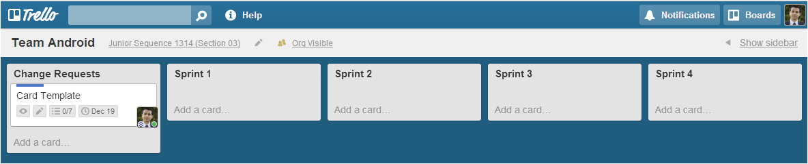
Sample Trello Board
Lets take a closer look
Sprint Backlogs
A Feature (Trello Card)
Product Backlog

Slide 9
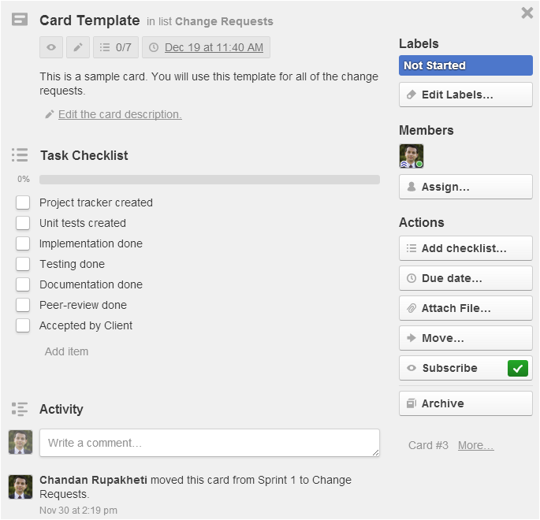
Title of the Feature
Feature description
Work flow:
check them
as you go
Cards
can be
assigned
Use due
date
of the Sprint
Subscribe
for getting
notifications
Log each activity here.
Discuss and associate
project artifacts to this
card.

Slide 10
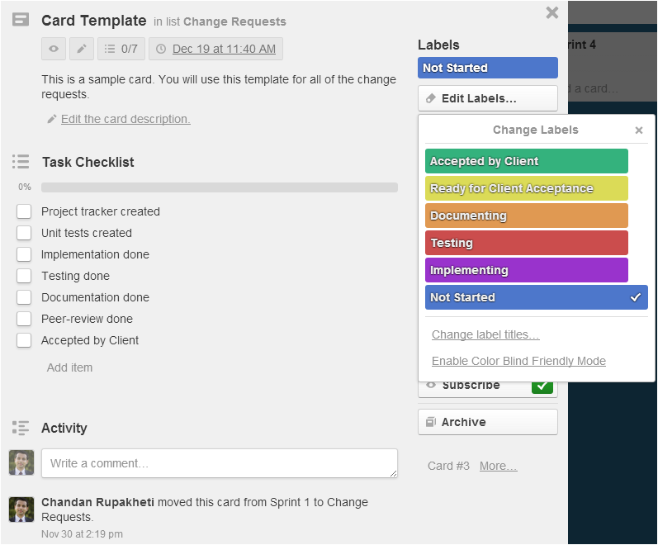
Use labels to color-code the cards for quickly assessing the overall status of a Sprint

