Slide 1

CSSE 374:
Operations Contracts and Logical Architectures
Steve Chenoweth
Office: Moench Room F220
Phone: (812) 877-8974
Email: chenowet@rose-hulman.edu
Chandan Rupakheti
Office: Moench Room F203
Phone: (812) 877-8390
Email: rupakhet@rose-hulman.edu
These slides and others derived from Shawn Bohner, Curt Clifton, Alex Lo, and others involved in delivering 374.
Notes:
What could possibly come next after SSD’s?

Slide 2
Contains➔
0..*
VideoDescription
title
subjectCategory
VideoSupplier
address
name
newVideos
1
1
1
Basket
0..*
⬅Provides
1
⬆
Provides
⬆
Holds-
videos-in
Describes➔
Selects ➔
1
1
1
Customer
name
address
phone#
Rents-from,
Buys-from
➔
*
*
1
Store
Address
Phone#
Stocks
➔
Video
ID
*
1
1
*
*
1
1
1
*
*
1
1
1
1
Membership
ID
startDate
⬇
Maintains
⬆
Stores-
video-on
Shelf
location
stock
1
*
*
⬆
Contains
Obtains➔
⬆
Defines
Makes-
Authorizes
⬇
*
PricingPolicy
perDayRentalCharge
perDayLateCharge
Determines-
rental-charge
➔
1
⬆
Records-
rental-of
Initiates ➔
0..*
*
Payment
/amount: Money
type
authorization
Transaction
date
Rental
dueDate
ReturnDate
ReturnTime
Pays-for
➔
Transacts
➔
1..*
1
1
1
1..*
Notes:
Here’s a shot at a Homework 1 Domain Model for BrickBusters Video Store…
Notice that, in this one, not everything is covered: no video return, no shopping class, …
Many models would satisfy … this is only one

Slide 3

Learning Outcomes: O-O Design
Demonstrate object-oriented
design basics like domain
models, class diagrams, and
interaction (sequence and
communication) diagrams.
Introduce Operations Contracts (OCs)
Do an Operations Contracts Exercise
Transitioning from Requirements to Design
Introduce Logical Architecture
http://enterprisegeeks.com/blog/2009/07/
Notes:
UML is used to convey key software design principles.
However, UML is only a medium to demonstrate the principles – design and architecture are the important bits!
UML is to design as good penmanship is to authoring a book…

Slide 4
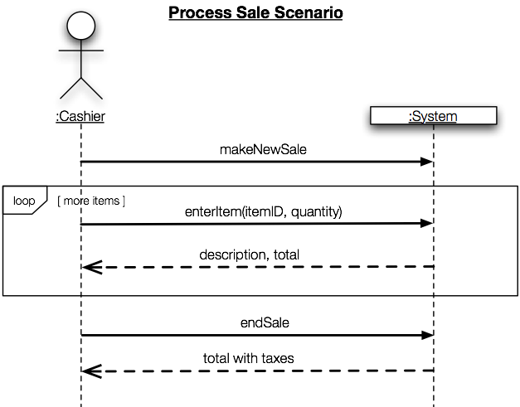
Where are the Operations in the SSD?
System Events => System Operations
Notes:
[Tread lightly and quickly. They know this now…just reminding them of the path we’ve taken, so they can consider operation contracts in context.]
These input system events invoke system operations
The system event enterItem invokes a system operation called enterItem, and so forth
Think OOP and messages invoking methods…

Slide 5
Operation Contracts (OC)
From SSDs, messages coming into the system
Used to give more details for system operations
Together, all the system operations from all the use cases give the public system interface
Conceptually, it’s like the whole system is a single object and the system operations are its public methods

Slide 6
Parts of the Operation Contract
Operation: Name Of operation, and parameters.
Cross-
References: (optional) Use cases this can occur within.
Preconditions: Noteworthy assumptions about the state of the system or objects in the Domain Model before execution of the operation.
Postconditions: The state of objects in the Domain Model after completion of the operation.
Q1
Notes:
Q1: True or false (circle one): An operation contract details an entire use case.

Slide 7
Example OC:
(At most) one OC per System Operation
Contract CO2: enterItem
Any uses cases where this operation appears
Operation: | enterItem(itemID: ItemID, quantity: Integer)
Cross Refs: | Use Cases: Process Sale
Preconditions: | There is a sale underway
Post-conditions: | a SalesLineItem instance, sli, was created sli was associated with the current Sale sli.quantity became quantity (attribute modification) sli was associated with ProductDescription based on itemID match
Noteworthy assumptions
Most important section
Q2
Notes:
•••••• [If you do this as a slide show, the contract builds by row with a call-out for each row]
Q2: Which section of an operation contract is the most important?
Details on postconditions coming up…

Slide 8

Pre & Post-Conditions in Your Mind’s Eye
Envision the system and it’s objects on an Extreme Makeover set…
Before the operation, take a picture of the set
The lights go out, and apply the system operation
Lights on and take the after picture
Compare the before and after pictures, and describe state changes as post-conditions
Notes:
Hey, no sleeping with the lights off ☺

Slide 9

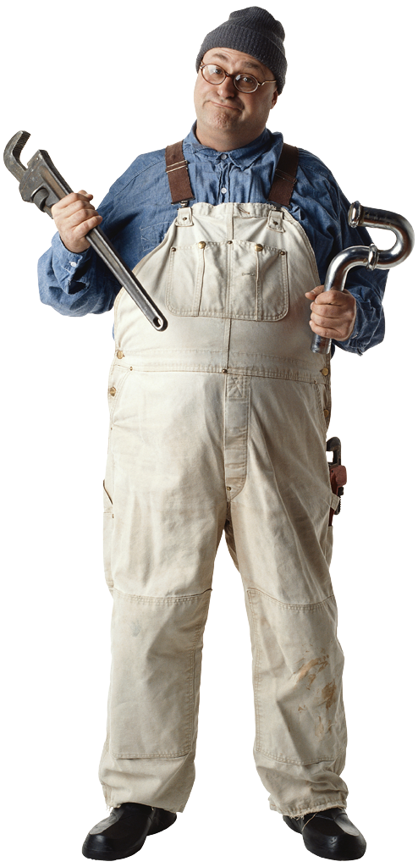
Pre- and Post-Conditions
Pre-Conditions are what
must be in place to invoke
the operation
Post-conditions are declarations about the Domain Model objects that are true when the operation has finished
Notes:
And the frog says he’s a prince… poof! … well, he should be a prince (bad table lookup got a plumber!!!)
Or was it the kiss?!?

Slide 10
Postconditions
Describe changes in the state of objects in the Domain Model
Typical sorts of changes:
  Created instances
  Deleted instances
  Form associations
  Break associations
  Change attributes
Not actions performed during the operation.
Rather, observations about what is true after the operation.
Q3,4
Notes:
All kidding aside, Since Postconditions are the most important thing – let’s spend a little time on them…
Q3: List four sorts of state changes to the domain model that are most likely to be described in an operation contract:
• Call-out
Q4: True or false (circle one): Post-conditions give step-by-step details of the actions to be performed to implement a system operation.
If you answered “false”, explain why the statement is false.

Slide 11
Postconditions (continued)
Express post-conditions in the past tense to emphasize they are declarations about a state change in the past
Give names to instances
Capture information from system operation by noting changes to domain objects
Can be informal (somewhat)
a SalesLineItem instance, sli, was created
sli was associated with the current Sale
sli.quantity became quantity
sli was associated with a ProductDescription based on itemID match
Q5
Notes:
The way this slide shows is to reinforce the “observation, not action” idea
[It refers back to Larman’s stage analogy here, §11.4]
Q5: What tense should the post-condition be written in?
• Note that we captured the quantity parameter in an attribute and the itemID parameter in a new association
• … as in last postcondition

Slide 12

Why OC Post-Conditions?
Domain model
=>objects attributes and associations
OC links a system
operation to specific
objects in the domain
model
Indicates which objects are affected by the operation
Will help with assignment of responsibilities
Notes:
The post conditions should all sound like things you could make happen in code, and test for when you are done!

Slide 13
Contracts Lead to
Domain Model Updates
New Domain Model classes, attributes, and associations are often discovered while writing contracts
Elaborate Domain Model as you think through the operation contracts
Notes:
Key UML concept – these activities are iterative with other activities and they are synergistic!

Slide 14
Use Operation Contracts When
Detail and Precision are Important
When details would make use cases too verbose
When we don’t know the domain and want a deeper analysis (while deferring design)
OCs help to validate the domain model
Notes:
• Call-out
Not more detail in the design direction, … more precision or detail in the problem domain!!!
This is what makes for better validation
Object Constraint Language (OCL) can be used to express constraints in models
System::makeNewSale()
pre: <statements in OCL>
post: …

Slide 15
Creating Operation Contracts
Identify System Operations from SSDs
Make contracts for System Operations that are:
  Complex and perhaps subtle in their own results
  Not clear in the use case
Again, in describing post-conditions use:
  Instance creation and deletion
  Attribute modification
  Associations formed and broken
Most frequent mistake in creating contracts:
Forgetting to include forming of associations
Q6
Notes:
Forgetting to include forming of associations is the most frequent mistake in creating contracts
When new instances are created, it is very likely that associations to several objects need be established
Don’t forget to include all the associations formed and broken
Q6: True or false (circle one): We should write an operation contract for every system operation in every system sequence diagram of our requirements.
If you answered “false”, explain why the statement is false:

Slide 16

Class Exercise on Operations Contracts
Break up into your project teams
Look over the SSD from Tuesday looking for system operations and Read the Use Case again referring to the Domain Model
Write an Operations Contract for MakePayment (method, amount)
Notes:
We’ll do this in class.

Slide 17
SSD for Use Case 1
:Customer
:System
Loop
[more items]
selectVideoToRent(ID,duration)
availability, videoList
checkout
totalWithTaxes, availableMethodsOfPayment
makePayment(method, amount)
changeDue, videos, returnInstructions, receipt
Notes:
We already did this…

Slide 18
Homework 1: Basic Use Case 1/2
UC1: Customer rents videos
  Preconditions: Customer has a membership, has selected videos they want, and made system aware of their choices.
Main flow:
  Actor indicates to rent first item (e.g., clicking "rent" on a networked device, or scanning it physically in a store)
  System verifies immediate availability, and waits to make next option
  Actor indicates they are done selecting
  System shows total, prompts for payment
  Actor selects method of payment, entering additional data if needed (e.g., credit card number)
  System verifies the payment has gone through, schedules the goods for rental (e.g., sets up a window to click on to view the video remotely, or tells the store clerk where to find the DVD)…
Postcondition: Rental transaction is complete
Notes:
This you’ve seen, too.

Slide 19
Concise DM For Video Store
Rents
➔
1
1..*
Customer
name
address
phone#
Store
Address
Phone#
1
Rents-from
➔
Stocks
➔
Video
ID
*
1
1
*
1
1
⬆
Records-
rental-of
Makes-
Authorizes
⬇
Initiates ➔
0..*
*
Payment
/amount: Money
type
authorization
Rental
dueDate
ReturnDate
ReturnTime
Transaction
date
X-acts
➔
Pays-for
➔
1..*
1
1
1
1..*
Notes:
And this is familiar…

Slide 20
Exercise: Complete the OC
Operation: makePayment(method, amount)
Cross references: Use Cases: UC1: Customer rents videos
Preconditions: Customer has a membership, Customer has selected videos, and system aware of the customer choices
Postconditions: Rental Transaction Complete, …Verified payment was received, receipt was printed, rented videos were readied for taking
Q7
Notes:
You probably have to do this one as a slide show to see it!
Cross references: Use Cases: UC1: Customer rents videos
Preconditions: Customer has a membership, Customer has selected videos, and system aware of the customer choices
Postconditions: Verified payment was received, receipt was printed, rented videos were readied for taking

Slide 21
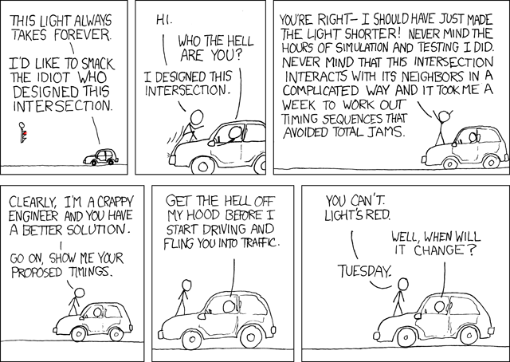
You can look at practically any part of anything manmade around you and think “some engineer was frustrated while designing this.” It's a little human connection.

Slide 22
Leaving Analysis Behind?
Unknown/unusual activities are high risk
Not really
We’ll learn more about the problem while designing (and implementing) a solution
  Refine the requirements when that happens
  Choose high risk activities for early iterations to provoke changes to the requirements
“Just enough” analysis is often useful
Notes:
Transitioning from Requirement to Design – Recall:
Analysis: Do the right thing
Design: Do the thing right
*** call-out
• Just enough: enough changes as we learn more, and varies with the problem domain

Slide 23

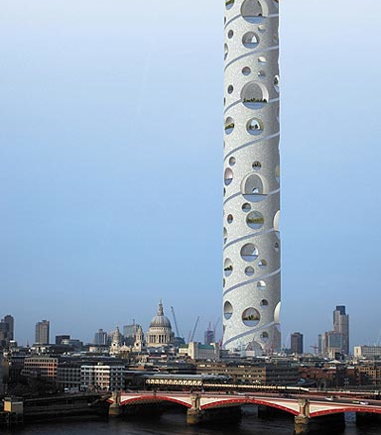
Logical Architecture
A very short introduction
www.lostateminor.com
Notes:
[picture is illogical architecture – it’s a supertower proposed for London.]
More details on architecture Monday, and many more details later in the term

Slide 24
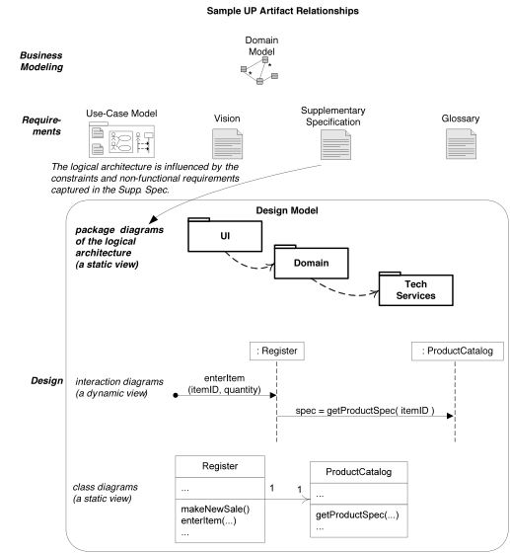
Where Are We?
Domain Model
Use Case Model including System Sequence Diagrams and Operation Contracts
Package Diagram/Logical Architecture
Design Model
Notes:
•••• call-outs animated

Slide 25
Logical Architecture
Large-scale organization of the software classes into:
  Packages (a.k.a., namespaces)
  Subsystems
  Layers
Logical, since implementation/deployment decisions are deferred
Q8
Notes:
Q8: The large-scale organization of software classes into packages, subsystems, and layers is called the system’s logical _what?__.

Slide 26
Layered Architectures
Very common for object-oriented systems
Coarse-grained grouping of components based on shared responsibility for major aspects of system
Typically higher layers call lower ones,
but not vice-versa
Notes:
The layers usually are based on some general kind of functionality that you can picture as you work on the system, to keep it straight whether a function belongs in your layer or not.

Slide 27
Three Typical Architectural Layers
User Interface
Application Domain Layer
Technical Services:
  Persistence
  Logging
  Rules Engine
Heavily influenced by domain model
Reusable across systems
Q9
Notes:
Q9: List some layers that typically occur in object-oriented systems

Slide 28
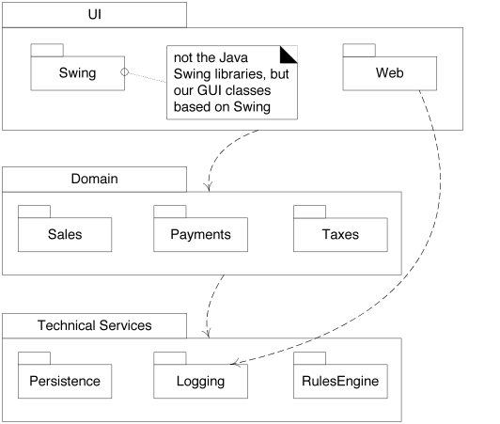
Strict vs. Relaxed Layered Architectures
Strict: only calls next layer down
Relaxed: can call any layer below
Q10
Notes:
- Which is this? (relaxed, Web calls Logging)
Eventually we’ll see that “call” is an overstatement. We really mean “depend on”. Different patterns will let us have lower levels communicate to higher ones without depending on them.
Q10: What’s the difference between a strict and a relaxed layered architecture?

Slide 29
Payment
/amount: Money
type
authorization
Rental .
1
Transaction .
Transacts
Makes-
Authorizes
⏏
Selects
Buys-from,
Store .
1..*
1
★
★
1
1
Provides
Stores-
video-on
⏏
Contains
Provides ⏏
Obtains
1
1..*
1
VideoSupplier
address
name
newVideos
1
Shelf
location
stock
⏏ Holds-videos
Basket
Contains
PriciingPolicy
Describes ⏏
Notes:
Here’s our domain model for the video store, again.

Slide 30
System Operation Contracts
Notes:
Domain Model connected to the Use Case,
Use Case connected to the SSD,
SSD connected to the Operation Contracts, … iterate until done, then all set up for design!

