Slide 1

CSSE 374:
Introduction to Object-Oriented Analysis and Design
Steve Chenoweth
Office: Moench Room F220
Phone: (812) 877-8974
Email: chenowet@rose-hulman.edu
Chandan Rupakheti
Office: Moench Room F203
Phone: (812) 877-8390
Email: rupakhet@rose-hulman.edu
These slides and others derived from Shawn Bohner, Curt Clifton, Alex Lo, and others involved in delivering 374.
Q1
Notes:
Today we bridge our way into Software Architecture and Design from CSSE 371…
We’ll do the same approach as in 371 – limited lecturing, and (as in Steve’s sections of 371) you turn in the quiz before class!
Q1 – You need to look up the answer in the book! See the readings, in the schedule.

Slide 2

Learning Outcomes: O-O Design
Demonstrate object-oriented
design basics like domain
models, class diagrams, and
interaction (sequence and
communication) diagrams.
Understand OOA to OOD
transition
Examine elaboration & refinement in design
Walkthrough OOD example
Explain model structure for UML
http://enterprisegeeks.com/blog/2009/07/
Notes:
UML is used to convey key software design principles.
However, UML is only a medium to demonstrate the principles – design and architecture are the important bits!
UML is to design as good penmanship is to authoring a book…

Slide 3

As we discussed yesterday, design organizes things for implementation.
So, what makes software design different than other engineering disciplines?
Again, think for 15 seconds…
Turn to a neighbor and discuss
it for a minute
Notes:
Planning is to execution…
Requirements are to designing

Slide 4
Why is Software Design Important?
Needs, Features, & Requirements
Abstract & Incomplete
Software System
Concrete & Complete
Size
Complexity
Constraints
Performance
Communication
Q2
Notes:
Q2: Why is Software Design Important? We won’t actually give the answers to these! But here are some related thoughts…
Is design important? 75%-80% of system errors are created in the analysis and design phases.
Analysis and design phases account for about only 10% of the overall system cost. (Perhaps you get what you pay for.)
Software Size – Sometimes too big to fit in any one head, …Volume
Software Complexity – Volume complexity, & # and intricacy of interactions
Software Constraints – Within the constraints of the existing environment
Performance – Technology impacts on system performance (1, 2, .. N tier).
Communication – Multidisciplinary nature of systems (Stakeholders), & Allocation of tasks to individuals

Slide 5

Thinking at the Right Level
Abstraction - hiding irrelevant details to focus attention at right level
Process of component identification is top-down, decomposing the system into successively smaller, less complex components
Process of integration, which is bottom-up, building (composing) the target system by combining components in useful ways
Q3
©2000-2002 McQuain WD & Keller BJ
Notes:
Q3: What is abstraction and why is it important to design? Again, some interesting thoughts to consider:
Einstein said, you cannot solve a problem at the same level that it was created.
He also, you need to keep it as simple (elegant) as possible, but not too simple.
Remember everything is a model in software – all models are wrong, but some are useful! How can you make design models useful for solving problems?

Slide 6
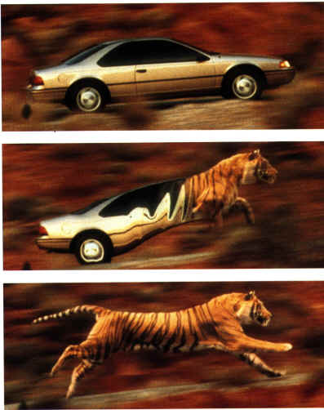
Elaboration and Refinement…
Starting with Abstract Requirements
Successively Elaborate and
Refine them into specifications, models, and ultimately
implementation
Notes:
We elaborate the specifications with more and more detail – adding reality to a vision of how things should work
We refine the specifications through activities like refactoring – integrating structure and optimizing for efficiencies
Systematically, we reduce uncertainties as more concrete information is realized through the development process

Slide 7
Key Questions for
Object-Oriented Design
Responsibility-Driven Design
What classes do we get from the application domain?
How should responsibilities be allocated to classes?
What classes should do what?
How should objects collaborate?
Guided by design patterns
Q4
Notes:
Q4: In object-oriented design, what is a “pattern”? You will need a pretty specific answer to this one!

Slide 8

Topics Covered in Book
Q5
http://www.craiglarman.com/wiki/images/4/43/Craig_larman_head.JPG
Notes:
Q5: On which four of the six topics covered in the book will we focus in this class? This one’s kind of a giveaway.
Blend OO with iterative software processes
Prepare UML-compliant models
Learn from other good designs
Examine 2 case studies
Follow good OO design practices
Skillful assignment of object responsibilities
GRASP guides responsibility assignment
Use Patterns
Codify reusable design idioms
Bolsters architectural integrity
Map OOD artifacts to code
Write tests prior to writing code

Slide 9
Assigning responsibilities to software objects is a critical ability in Object-Oriented development. Why?
Again, think for 15 seconds…
Turn to a neighbor and discuss
it for a minute
Q6
Notes:
Q6: Why is assigning responsibilities to software objects a critical skill in OO development? Again, this is related to the exercise, above.
We’ll think-pair-share on answers to quiz question, so you can compare, after doing the quiz, your answer to what others thought.

Slide 10
Analysis versus Design
O-O Design
Classes/Objects
Operations/Methods
Data/Attributes
Patterns
Analysis
  Investigation of the problem
  and requirements, rather
  than a solution
  Do the right thing…
Design
  A conceptual solution,
  rather than its implementation
    Excludes low level details
  Do the thing right…
Q7
Notes:
Basically, we need to decide “What is excluded and the need to relax precision as we design away from the code.”
Q7: Do the right thing – ?
Do the thing right – ?

Slide 11
Analysis and Design Concepts
Analysis Concept
Design Concept
Notes:
Analysis: What are some concepts in the problem domain?
Design: What are some attributes and methods that a Plane object might have?

Slide 12
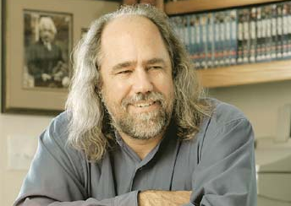
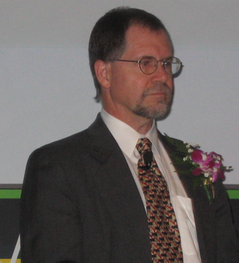

Unified Modeling Language (UML)
Grady Booch
Ivar Jacobson Jim Rumbaugh
Notes:
These are the UML guys – all now famous OO pioneers. The miracle is that they decided to work together, to come up with one system for doing design and such. Thus, we got “unified.”

Slide 13
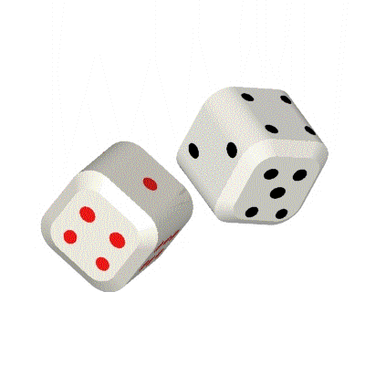
Let’s do a Quick Example: Dice
Define Use Cases
  Play a dice game: Players requests to roll the dice. System presents results: If the dice face value totals seven, player wins; otherwise player loses
Define a Domain Model
Assign Object Responsibilities,
Draw Interaction Diagrams
Define Design Class Diagrams
Notes:
We’ll do a lot of examples like this in class, probably referring to the slides you see.
No reason you can’t check them out ahead of time, too!
For this one, consider:
Okay, what are the key actors/objects in the domain?
What actions/operations do they do?
What information must be preserved?

Slide 14
Domain Model for a Dice Game
Notes:
This is a reasonable static representation, but what dynamic behavior occurs in a game? We need events and sequences…
Play roles dice
Someone/thing records face values

Slide 15
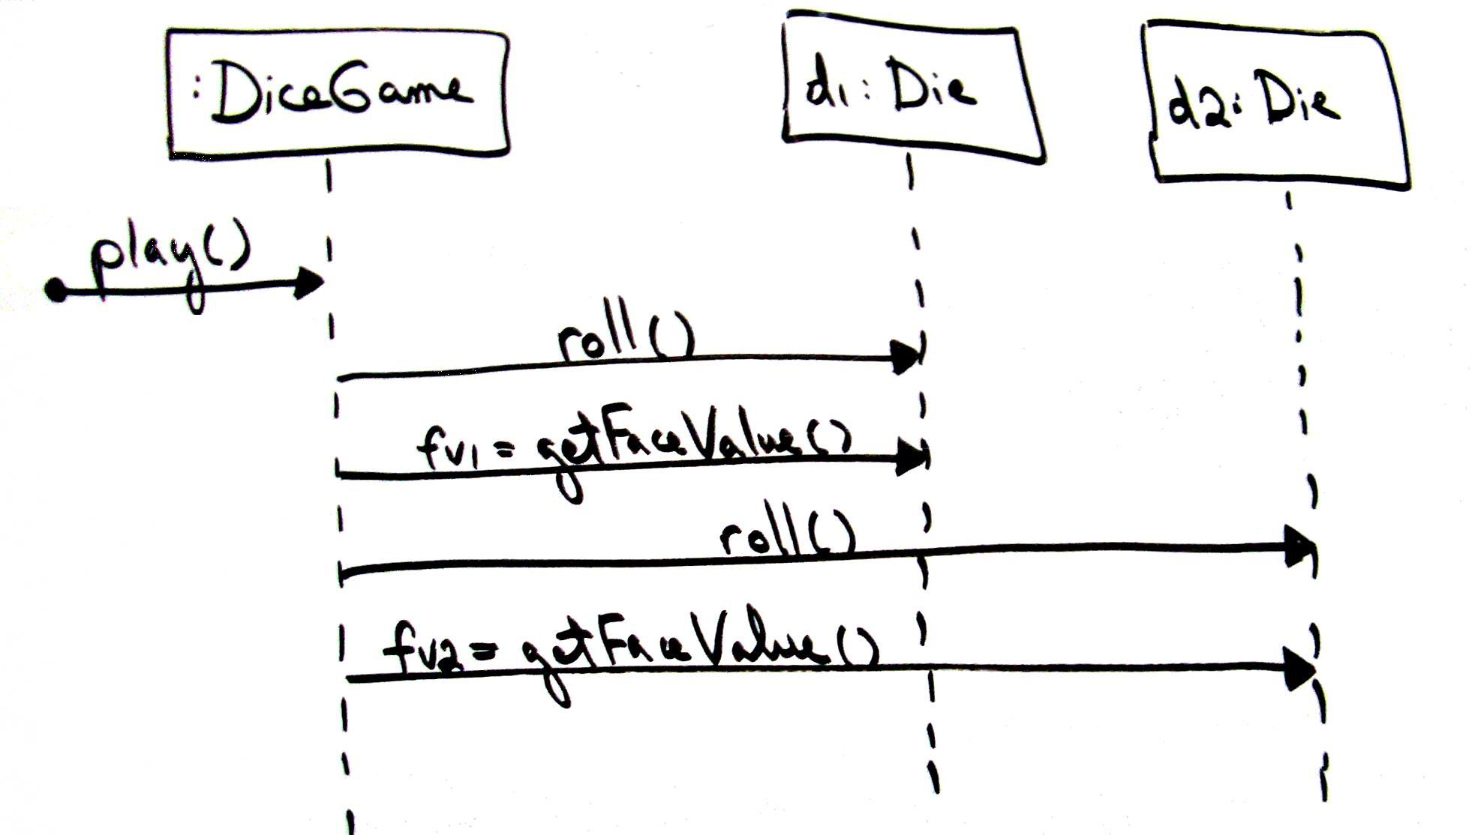
Sequence Diagram for Play Dice Game
Notes:
Player is modeled as external actor, therefore not part of sequence diagram

Slide 16
Design Class Diagram for Dice Game
How does it differ from the domain model?
Q8
Notes:
Q8: How does the design model (design class diagram) differ from the domain model? This is a good one!

Slide 17
Three Perspectives to Apply UML
Conceptual perspective (Sketch)
Software specification perspective (Blueprint)
Software implementation perspective (Executable programming language)
Q9
Notes:
Q9: What are the three perspectives to apply UML? And, think about it, why would you want to choose one as the way to go, for doing some design work?
Conceptual perspective: real-world concepts in the problem domain
Software specification perspective: not committed to a particular implementation language
Software implementation perspective: technology specific (e.g., Java access modifiers, etc.)

Slide 18
Abstract Requirements to Concrete Systems
Concrete
Implementation
Implementation
Classes
(Language)
Software
Classes
(Design Class
Diagrams)
Platform
Specific
Model
Analysis/
Conceptual
Classes
(Domain Model)
Platform
Independent
Model
Computational
Independent
Model
Abstract
Requirements
Notes:
Conceptual class is a real-world concept or thing.
Software class represents a specification or implementation perspective of a software component, but isn’t specific to an implementation.
Implementation class is what you’re used to.

Slide 19
The Case Studies
NextGen Point of Sale (POS) System
Monopoly Game
The case study is organized in three iterations
  Each iteration conducts analysis and design on the features for that current software release
Notes:
Larman uses the NextGen Point of Sale (POS) System and the Monopoly Game as case studies to demonstrate object oriented software development
A POS system is a new fangled version of the traditional cash register
The case study is organized in three iterations
Each iteration delivers a usable product to the customer
Subsequent iterations add features to the earlier ones
Each iteration conducts analysis and design on the features for that current software release

Slide 20
Reading, Homework, Project, …
See the course schedule!
Notes:
In class, we’ll discuss team meetings and get initial commitments
On Moodle – Do the pre-course assessment survey.

