Slide 1
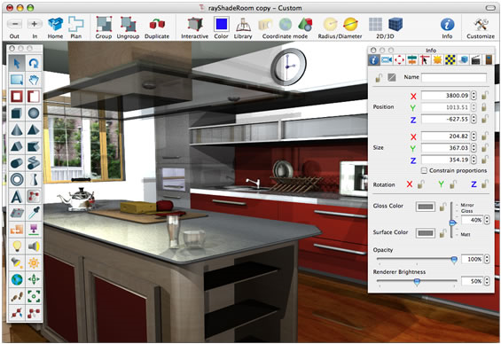

CSSE 374
Software Design:
Introduction
Right – Software is inherently “about” something else! Here, it’s “about” designing a house. From web site http://homesdesigns.net/design-exterior/exterior-home-design-software.php.
Steve Chenoweth
Office: Moench Room F220
Phone: (812) 877-8974
Email: chenowet@rose-hulman.edu
Chandan Rupakheti
Office: Moench Room F203
Phone: (812) 877-8390
Email: rupakhet@rose-hulman.edu
These slides and others derived from Shawn Bohner, Curt Clifton, Alex Lo, and others involved in delivering 374.
Notes:
Quizzes - We’ll do the same approach as in 371 – limited lecturing, and (as in Steve’s sections of 371) you turn in the quiz before class!
Today’s the exception – turn in the quiz by 11:55pm tonight!
Notice that we will include special notes in this notes area of the lectures / discussions. However, we expect you to read the actual book and will not be repeating that content.
Electronic Distraction Policy: We expect you to listen and interact during this part of class, and, in general, you do not need to be working on your computer, so we expect you not to do that. If you believe there is a special exception needed, please alert us ahead of time!

Slide 2
Agenda for Today
Those long-lost colorful portraits!
Re-introductions and Re-forming Teams
Software Design - What is it?
Guidelines and Expectations
The Term Schedule, Big View
Course Outcomes and Related Goals
Resources – Web Site & Combined Moodle
Project and Homework Assignments
Time to Discuss With Your New Team

Slide 3
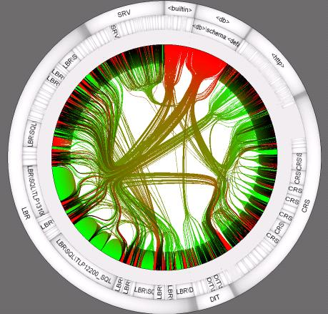
Re-Introductions – Tell us About Yourself
Name
Major
Favorite elective course, so far…
Hobby
http://www.laquso.com/services/analysis/sourcecode.html

Slide 4
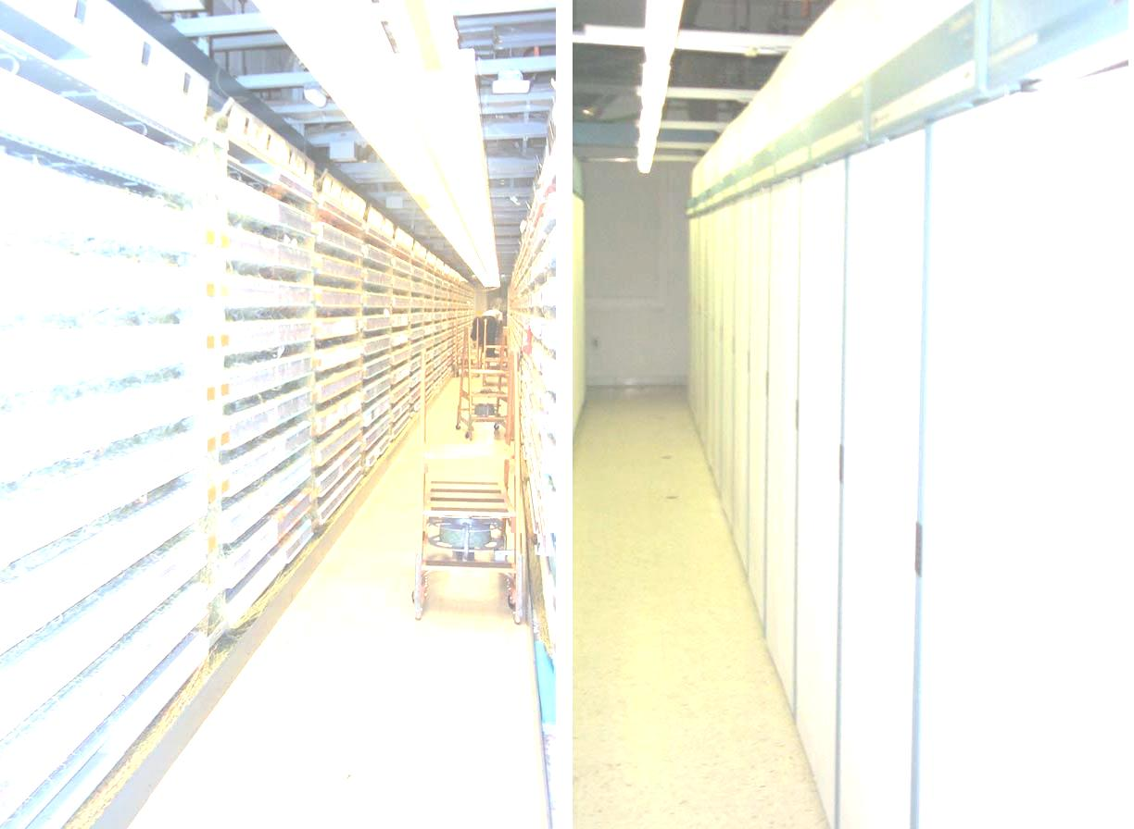
Something about Steve…
I came to Rose from industry
  NCR – a computer vendor
  AT&T / Lucent – a telecom / vendor
  Designed & built software systems
  Taught the same subjects there – like systems architecture
Worked on big systems like 5E switch
Fun fact about me: I live in 2 places, here and Dayton, OH
http://www.wap.org/journal/cotour/default.html
Notes:
If you are in Chandan’s section, he’ll fill you in on his background.
The background is the inside of a Lucent 5ESS telephone switch – something I worked on. One machine is typically housed in a large building that looks like this on the inside. The machine connects all the local lines in a good sized city, into the whole network.

Slide 5
Something About Chandan
Research Experience
  Software Engineering
  Static Analysis
  Formal Methods
Industry Experience
  Data Analysis and Software Solutions (DASS)
  Environmental System Research Institute (ESRI)
Others
  Likes to play musical instruments, watch NOVA and BBC documentaries, and talk about Physics. (By the way, he is originally from Nepal!)

Slide 6
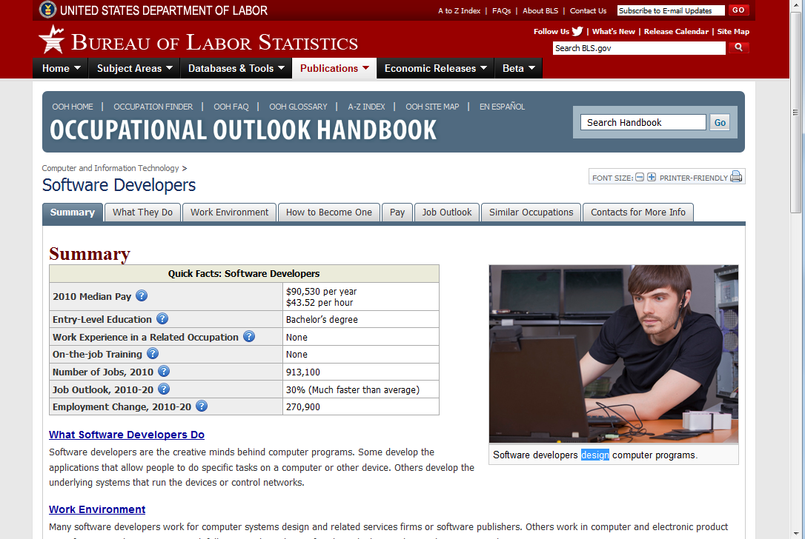
And something about this course…
Key
Word!
Notes:
Is designing software fun? It’s great! In addition to slinging code to the computer’s satisfaction, you have the job satisfaction of being a technical inventor and leader, inventing systems that development people build as a project and which get deployed to customers who use it for something they didn’t have before.

Slide 7
Reforming the teams – Section 1
We have 21 students in the class
Sounds like 5 teams of 4/5
Two main goals:
  The pre-registration survey
    Highest priority in terms of timing
  The graduation planner
    Most complex
Your clients would like to divide and conquer, for this term.
But…
  The two projects are closely related, and
  The second one also is related to Section 2’s work!
We expect to have a client meeting 5:15 tonight, F-230.
How about an initial division now, with reps for that meeting?

Slide 8
Reforming the teams – Section 2
We have 15 students in the class
Sounds like 4 teams of 3/4
Here are the major tasks, around which to organize:
  Completing the Wiki itself (design?)
  Adding query and reporting (probably design)
  Adding graphical features (design!)
  Scraping data from other places to populate the wiki (design!)
  Semantic MediaWiki Feature 1 – Query redesign
  Semantic MediaWiki Feature 2 – Stress test
First client meeting will be Wed, 10th hour, this room.- could prioritize all the above!
We’ll decide what class hour to give up, for that.

Slide 9
Goals – In both sections
Turn out an initial real product this term
Do lots of design work in the process
Have a “maintainable” product for 375 in the spring, and beyond.
Have documentation that will enable new people to join.
  We have 14 SE majors listed in Sec 1
  We have 3 SE majors listed in Sec 2

Slide 10


So, what is Design?
Art?
Engineering?
Mix of the both?
Think for 15 seconds…
Turn to a neighbor
and discuss it for a minute
Notes:
Design is as old as human needs to solve problems.
Design involves organizing concepts (often abstract) into plans for implementation towards a goal or state.
Design organizes these descriptions into refinements and elaborations that show how the system will be implemented using people, facilities, computers, communications, and the like.

Slide 11
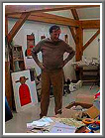
Is Design Creative like Artists?
“Design is directed toward human beings. To design is to solve human problems by identifying them and executing the best solution.”
Ivan Chermayeff
Notes:
Chermayeff is the quintessential businessman’s designer … logos, Bauhaus Couple - 1995
Creative navigation of trade-offs
Aesthetics

Slide 12
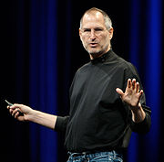
Is Design what Innovators do?
“In most people's vocabularies,
design means veneer. It's interior
decorating. It's the fabric of the
curtains, of the sofa. But to me,
nothing could be further from
the meaning of design.
Design is the fundamental soul of
a human-made creation that ends up expressing itself in successive outer layers of the product or service.”
The late Steve Jobs,
in action introducing a new product
Notes:
Recognizing the need and potential service/market
Responding to the complexities of today’s solutions
- Can you imagine designing the internet as it works today back when Mosaic came out in 1992?

Slide 13
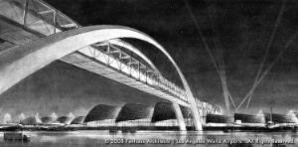
Is Design what Architects do?
Some architects have a preconceived notion of what a building should be — they design from the outside like the building is a piece of sculpture. I prefer to patiently search through extensive discovery until I ﬁnd a seam somewhere, crack it open and discover the art inside of the process.
Curtis W. Fentress
http://www.businesswire.com/multimedia/home/20090106005735/de/1739565
Notes:
It is about discovery and expression of potential solutions – large systems like airports require considerable tradeoff navigations.
Arguably the foremost airport designer in the world, Fentress’ DIA (Denver International Airport), Incheon International Airport (Seoul, South Korea) and his anticipated modernization of LAX (Los Angeles International Airport)

Slide 14
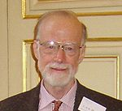
Software Design Perspective
"There are two ways of constructing a software design: One way is to make it so simple that there are obviously no deficiencies, and the other way is to make it so complicated that there are no obvious deficiencies. The first method is far more difficult."
-C.A.R. Hoare
Notes:
"A designer knows he's achieved perfection not when there is nothing left to add, but when there is nothing left to take away."
-A. de Saint-Exupery, author of “The Little Prince”
The Null Reference: “I call it my billion-dollar mistake. It was the invention of the null reference in 1965. At that time, I was designing the first comprehensive type system for references in an object oriented language (ALGOL W). My goal was to ensure that all use of references should be absolutely safe, with checking performed automatically by the compiler. But I couldn't resist the temptation to put in a null reference, simply because it was so easy to implement. This has led to innumerable errors, vulnerabilities, and system crashes, which have probably caused a billion dollars of pain and damage in the last forty years.”

Slide 15

Engineering Design – Simple Definition
“Design” specifies the strategy of “how” the Requirements will be implemented
Design is both a “Process” and an “Artifact”
Notes:
Recall from CSSE 371 that “Requirements” specify the External description of “What” will be Produced

Slide 16
Where do Designs Come From?
Intuition/Evolution
Adoption
Engineering
Notes:
Intuition/Evolution
Conceived without conscious reasoning
Reliance on intuition increases the risk
Adoption
Previous similar systems
From literature
Engineering
Systematic and conscious
Possibly documented
Design is derived from requirements via transformations and heuristics

Slide 17
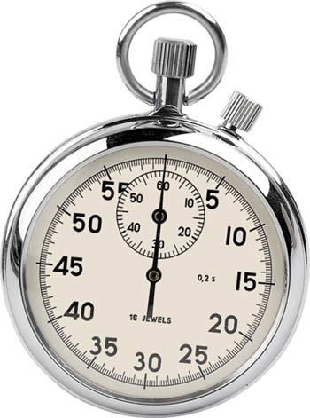
“Design” is to “coding” as _________ is/are to _________?
Again, think for 15 seconds…
Turn to a neighbor and discuss
it for a minute
Notes:
Planning is to execution…
Requirements are to designing

Slide 18

Learning Outcomes:
1. Teamwork
Work effectively with a team of software project stakeholders, including customers, users and members of the related development teams.
Assess team effectiveness!
Notes:
Upon completing this course, a student should be able to: …
Software is a team sport! Few significant software designs are done by an individual – maybe led by an individual…
Teams are now multi- and interdisciplinary to solve today’s problems
The professional software system designer is often called an architect today…

Slide 19

Learning Outcomes:
2. Problems and Solutions
Recognize the differences between problems and solutions,
and deal with their interactions.
http://www.geekologie.com/2007/02/rubiks_cube_for_the_lazy_perso.php
Notes:
Design is often the demarcation point for transitioning from the problem space to the solution space.
Designs must reflect the solution to a problem and its domain. This is especially true with software since software changes.

Slide 20

Learning Outcomes:
3. Agile Methods
Use agile methods to develop a real system for a customer!
The Yoga Position of the Day – Kak Asana. From http://yogaanywhere.org/blog/2012/04/yoga-pose-of-the-day-kak-asana-crow-posture-and-bak-asana-crane-pose/
Notes:
Agile is where it’s at, these days!
Bend the methodologies to better achieve the goals.

Slide 21
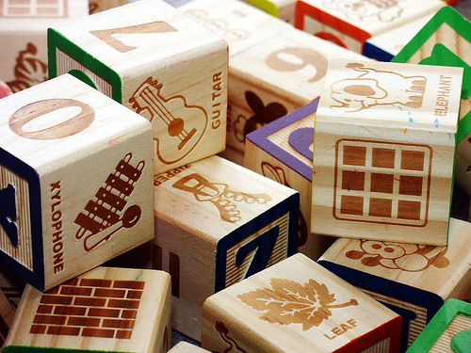
Learning Outcomes:
4. Object-Oriented Design
Demonstrate object-oriented design basics
like domain models, class diagrams,
and interaction (sequence and communication) diagrams.
http://enterprisegeeks.com/blog/2009/07/
Notes:
UML is used to convey key software design principles.
However, UML is only a medium to demonstrate the principles – design and architecture are the important bits!
UML is to design as good penmanship is to authoring a book…

Slide 22
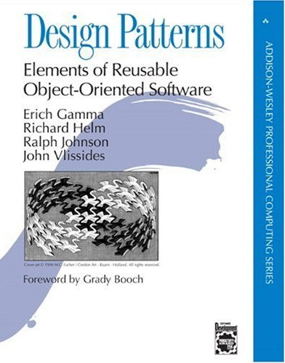
Learning Outcomes:
5. Fundamental Design
Use fundamental design principles, methods, patterns and strategies in the creation of a software system and its supporting documents.
http://www.amazon.com/Design-Patterns-Elements-Reusable-Object-Oriented/dp/0201633612
Notes:
Design patterns and the design principles go hand in hand to form a basis for predictable design solutions.
We examine GRASP and GoF patterns as they pertain to today’s software development.

Slide 23

Learning Outcomes:
6. Patterns, Tradeoffs
Identify criteria for the design of a software system and select patterns, create frameworks, and partition software to satisfy the inherent trade-offs.
Above – First use of an airbrake in competition – Mercedes-Benz 300 SLR at Le Mans, 1955. From http://justacarguy.blogspot.com/2010/04/air-brakes-were-first-deployed-at-1955.html.
Notes:
Selecting the right design constructs and communicating to key stakeholders in a development effort is central to effective design.
We examine canonical criteria that have served designers for generations as well as new one specific to software.
You may recognize some of the concepts from programming, as they apply equally well to software design.

Slide 24
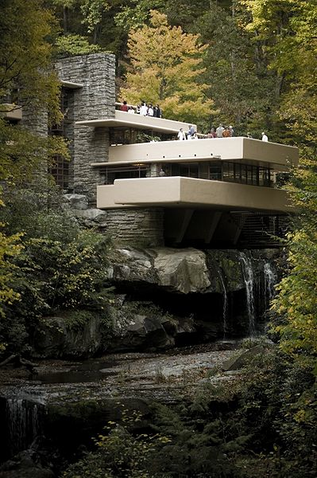
Learning Outcomes:
7. Analysis of Design
Analyze and explain the feasibility and soundness of a software design.
http://en.wikipedia.org/wiki/File:Wrightfallingwater.jpg
Notes:
In order so select good designs, you need to have some means to reason about the designs.
We will examine feasibility and soundness among other factors in good software design.

Slide 25

Course Textbook and Readings
Required Textbook
  Applying UML and Patterns: An Introduction to Object-Oriented Analysis and Design and Iterative Development (3ed)”
  by Craig Larman
  Prentice Hall PTR (2004)
  ISBN-13: 978-0131489066
Readings will be also be
assigned from relevant papers

Slide 26
Course Mechanics
Taught in 3 Sections (2nd , 3rd and 4th periods)
  Class meetings: Monday, Tuesday, & Thursday
  Project Team Meetings: Friday
Find most material (all sections):
http://www.rose-hulman.edu/class/csse/csse374/
Grades and Drop boxes will be on Angel / Moodle
  Steve’s Section: Use the new merged Angel section
  Chandan’s Section: Use Moodle
Daily Quizzes
Notes:
Daily quizzes are to test your knowledge of the theory – a warm-up for applying it in homeworks and your projects.

Slide 27

Guidelines and Expectations
Demanding Course:
  8+ hours/week outside of class expected
  Multiple deliveries to your real customer
Read the assigned material before class
Check Rose email & Angel / Moodle course website daily
Participation – Teams and Class activities
  You will be working in teams on some assignments
  Be fair to your team members…they will be evaluating you!
Be mindful of the CSSE Honesty Policy
Electronic Distraction Policy - don’t
Notes:
We respect that you have a lot to do, but we would be remise as a teach if I didn’t encourage you to read the book too.

Slide 28
Grading and Evaluation
35% Theory
  Examinations (25%)
  Quizzes/Discussion/Class Partic’n. (10%)
65% Practicum
  Homework (15%),
  Junior Project Deliverables & Partic’n. (40%)
  Project Meetings/Peer Evals (10%)
Grade Scale
The usual point scale will apply, e.g., 90 – 100 = A
Statute of Limitations
Any questions (or concerns) about the evaluation of an assignment must be raised within two weeks of the posting of score information.
Notes:
Familiar sort of mix from prior CSSE courses, like 371.
The point is to attain skill in applying the theory, not just knowing it.

Slide 29
Rewarding Contributions
Teamwork Principles
  Reward extraordinary teamwork practices
    Reward sharing responsibilities
    Reward developing a personal area of excellence
  Discourage both freeloading and heroics
    Why discourage the latter?
Notes:
We did this last year and it worked well. I had a few questions…
Heroics are discouraged because large projects can’t work that way! It’s a bad habit to learn in school. Goes with trying to do everything the night before.

Slide 30

Late Work
Legitimate reasons for late work --
  Must be acknowledged before due date
  Expected to explain ahead of time
We do not have late days, etc.
  It’s like industry:
Deadlines
  Deadlines are temperamental beasts,
  … you hug one too close and it’s liable bite you!
Notes:
We encourage you to stay ahead of the wave…

Slide 31
Very Rough Winter Term Timeline
Class Begins
Intro.
OOA/D
Logical
Arch. &
Obj. Design
More
Design
Patterns
Exam 1
1/13
Activity
Diagrams
Final
Exam
(Finals
week)
Mapping
Design to
Code
Package
Design
GoF
Design
Patterns
(Lots!)
Class
Diagrams
SOLID
Principles
Dec
Jan
Feb
General Patterns -
GRASP
Operation
Contracts
DM
Refinement
Deployment
& Components
Interaction
Diagrams
10 weeks, 30 2-hour sessions…
So much to do and so little time…
Notes:
Note that the book covers topics in the lingua franca of UML – the design principles are broader and do not show up specifically in the titles.
TAKE A LOOK AT MOODLE …
The homework Survey assignment will be due Tomorrow, Tuesday at 5:00pm.
The milestone will be due Friday, at 11:59pm.
Abbreviations: Type acronyms/abbreviations here
Research Reference: Type Delta/research references here

Slide 32
“Homework” Assignment for Tomorrow
See the course schedule!
Notes:
See pre-course assessment on Moodle.
Turn in today’s quiz!

Slide 33
The rest of today…
Let’s make best use of our new 3 x 2 format!
Goal 1: Respond to all the comments and questions your clients had about the combined requirements document.
  At the end of class, we’ll ask them to go have a second look this week.
Goal 2: Identify what we feel are the most important first features to do.
  In as much detail as possible.
  And estimating effort and feasibility.
  Be ready for our first client meeting.
    In Sec 1 – That’s tonight!
    In Sec 2 – That includes contacting our new, outside clients on Semantic Media Wiki ASAP.

