Slide 1


Tips on Assignment 4
Notes:
Image from http://www.paperhelp.org

Slide 2

In addition to the personal advice sent to your team
Advice from seniors –
  Try to cast it in terms of what they are doing.
Processes mostly good
  Try to get crazier, more creative
  Need “what if’s”
Lack of clarity on requirements gathering
  How do you know you have good
  requirements?
Team overall project velocity
  Needs to be compared to overall need
  What’s the minimum viable product
Conflicts between merged processes
  E.g., up-front requirements vs YAGNI?
  If you take out some of XP, how are you accomplishing the intent?
Getting crazy…
Notes:
Morphed Mona Lisa from https://www.youtube.com/watch?v=rqRFiTtMq40

Slide 3

Trust?
Lots of trust in teammates
implied.
  Most likely predictor of how they’ll act?
    How they acted on projects before.
Not willing to lie?
  “Hey, Dave, is that done yet?”
    “Sure, but my computer just crashed.”
  What if everyone tries to subvert the process?
    “I didn’t have time to make it test-first.”
  Is secret development always suspicious?
    “This can’t be on GitHub because…”
Do you need initial ground rules?
  Or training?
Need team consensus on everything?
Notes:
Image from http://blog.ketchum.com/consumers-losing-trust-in-brands/

Slide 4
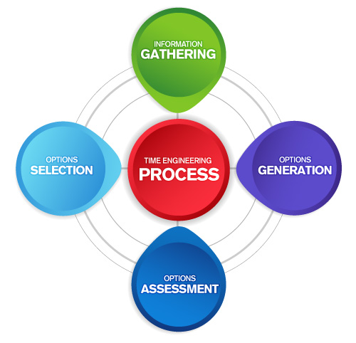
Mechanics
You are defining a process.
  A great way to organize:
    List issues
    List solutions
    List issues with solutions
Do references
  We want ideas based on something
  What works / doesn’t won’t be a matter of opinion
Did you include what stakeholders would accept?
Did you include assessing whether it’s working?
Notes:
Process image from http://www.canatal.net/time-engineering/time-eng-process/

