Slide 1


Reflection 2 – Team Project
And a preview of next year!
Notes:
Image from http://www.seniorproject.net

Slide 2
What’s in this reflection?
Look at the handout.
  Should say “senior project” almost everywhere, not “junior project.”
A preview of next year.
  We will try to have at least one SE major on each real team of 4.
  You could actually employ what you invent here.

Slide 3
Highlights
In this class,
  Build a software process for working on the senior project to use.
Inspiration –
  Enter senior project with some thought about process.
  Give you some independent control.
    Versus the adviser having to tell you how to do it.

Slide 4
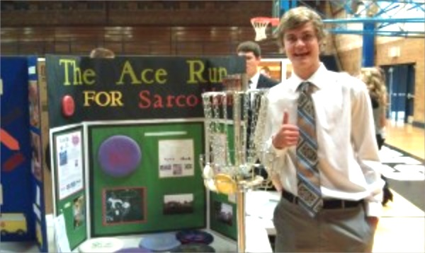
Immovable deadlines
“Senior project fair” – end of 2nd term.
Last term – “done polishing” a production system.
  A real hand-off of a working system can be done.
  They have documentation, instead of you.
Done it before? Here’s a senior project presentation at Twin Falls High School.
Notes:
Image from http://www.tfhsbruins.com/?p=597

Slide 5
Issues to consider
How to have the client keep confidence in what you are doing, and
  Actually use it when you are done, vs
  Redoing the whole thing!
Consider what the process is, that the client uses for their own development.
How to make visibility and also not have a heavyweight process burdened with extra stuff to make that happen.

Slide 6
The examples on p 2
You are delivering the product to an IT department like Rose-Hulman's, who will use the system with their other services on a regular basis.
You are delivering to a nonprofit who will use the system, and who will have to find a volunteer to support and enhance it. Or,
You wrote this as a speculative project for a customer who produces real products; that customer thought this wouldn't turn out to be important, but, early in the project, they discover it could be the proof of concept for their next generation of real product!
All these have actually happened to teams I advised!

Slide 7

And
The client tries to see how the project is going!
You also want the increased visibility.
You can use examples from how this is being handled in your junior project.
  But describe how you would improve on that,
  Or adjust it for a different situation.
  E.g., Tim Ekl has you develop on his actual GitLab development repository, but this is unusual.

Slide 8

Word count, etc.
We don’t care, but,
See the guidance in the
last paragraph, “The Nitty Gritty.”
Teams of 3 or 4
  Final wrinkle for teams of 4 – “You must talk about Trello.”
Notes:
Image from http://matthewdicks.com/2011/08/stop-counting-words.html

Slide 9
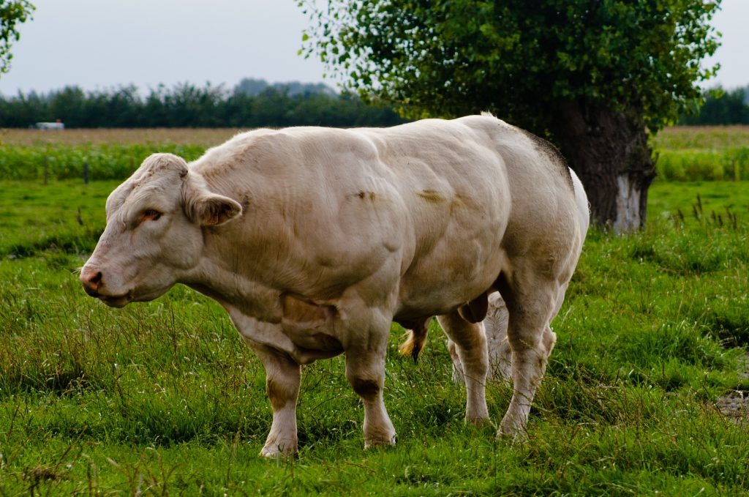
Form teams!
3 or 4
  Who’s not here?
Due 11:59 pm on Sunday Nov 9th.
Draft due Wednesday, Nov 5th.
  Doesn’t have to be complete.
  Should be reasonably beefy.
  Goal is to get feedback.
Notes:
Cow image from http://raphaelkessler.com/2/netherlands.html.

