Slide 1
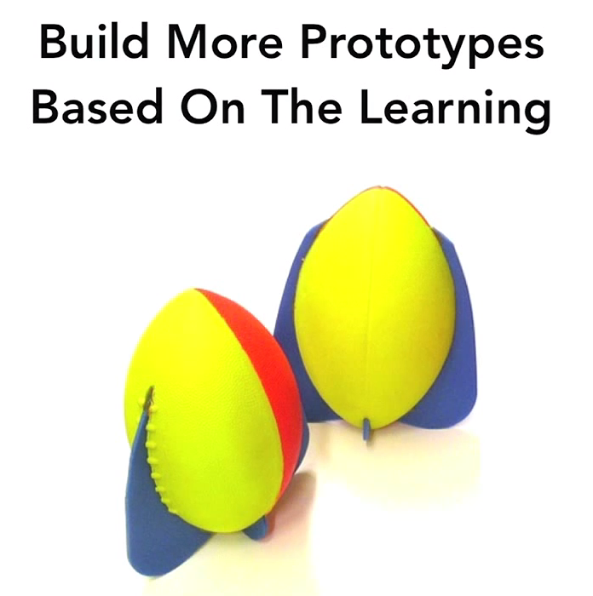

Integration and Design – Part 5
Bonus at the end of the hour – how to invent a foam football… using the “spiral” process.
Notes:
Aerobie football prototypes from IDEO TEDx talk.

Slide 2
Work on your drafts!
Talk over with others who did the same assignment.
Work on your own.
We’ll bring up some specifics for each group, in a few minutes…
AND – we’ll finish off Design with a short Video at the end of the hour.
The rest of this week – project management and testing!

Slide 3
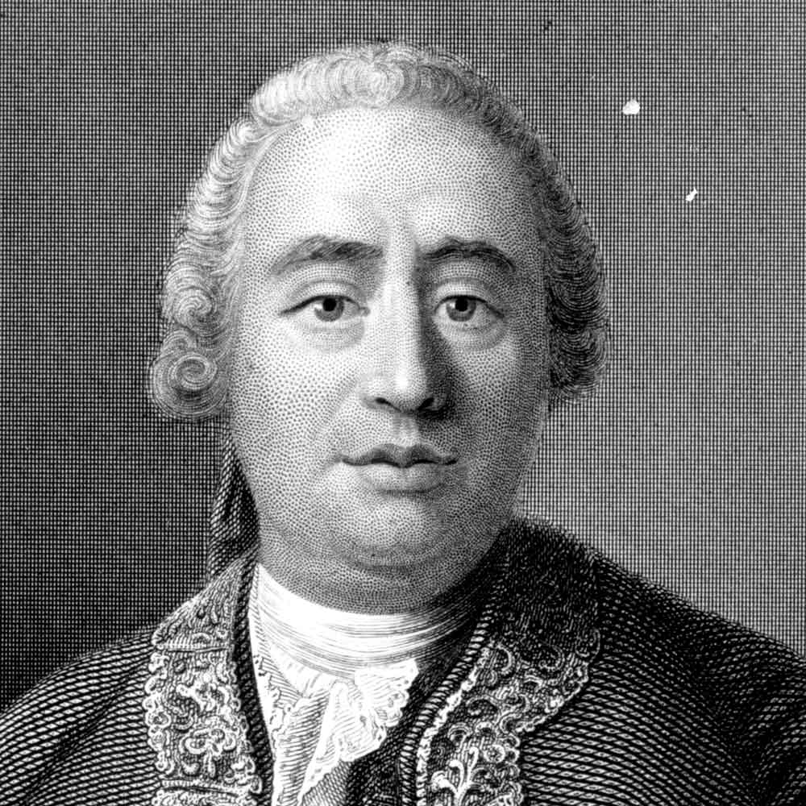

Comments on your drafts – 1
“Be less innovative?”
From Buffalo and Steve: Common issues with the proposals.
“I started with the assumption that no one had ever thought of a good idea about this before…”
There are many experts, some of whom likely agree with you.
They have argued for their reasons at length.
Their view has been tested a lot by others.
An adaptation is itself a contribution.
You’ll naturally develop your own style.
Try to be David Hume, not Rene Descartes!
Hume, the empiricist – If you haven’t tried it out, it probably doesn’t work!
Descartes, the rationalist – I have all these wonderful, true ideas in my head!

Slide 4
Comments on your drafts – 2
Be prepared to argue:
You must argue that your context is different.
  Which it is!
Or that the expert is dumb.
  But you need equal ammunition for this.
You could do this maybe once in your papers… but not 10 times…
Most common issue -- Developing stuff out of whole cloth rather than using what the experts think without justification.
  Solution – Quote something from somebody, to show it’s a proven method for this problem.
  And – List any assumptions you make!
Also – Why would the solution you pick work and others not?

Slide 5

Comments on your drafts – 3
Notes for Question 1:
Misunderstanding of the scenario – confusion of customer teams vs. development teams, view of XP vs. scrum as important, not identifying the key difficulty of single customer, skimming of relevant solutions
Custom built elicitation without justification
What process tricks either author recommends would work best to resolve issues?
How opposite are your two client
departments?
  Perhaps there are some different
  situations?
Notes:
Image from http://hollynagel.com/wp/unpoppable-unstoppable/nonverbal-communication-customer-service-staying-calm/.

Slide 6
Comments on your drafts - 4
From Buffalo and Steve, continued:
Notes on Question 2:
Acquiring additional knowledge of risks is easy because the customer is on-site, or about stuff not getting implemented…focus on the real risks
  And identify what you think those risks are!
Tracking mechanism does not reference Philips when it probably should
Notes for Question 3:
PSP sort of quickly dismissed, rather than discussed in detail
No distinction between outcome/output metrics
Over-focusing on metrics mentioned (good)
Just listing metrics, rather than focusing on problems with metrics*
Custom-built metrics without justification

Slide 7
Design at IDEO
See Chris Milne’s TEDx video at https://www.youtube.com/watch?v=YzET-qlE1kQ
How is this like Agile?
How is it like “Old school”?
How is it like Spiral?

Slide 8
Summary for requirements and design
“Old school”
Agile
Trust people in charge of:
  Requirements gathering
  Design creation
Trust things you hand off using documents:
  People sign-off on these.
Don’t trust the code, unless verified vs documents.
Hierarchies of people coordinate the info flows.
  Delegate responsibilities.
Get it right the first time.
Trust nobody, unless:
  They are standing right in front of you! And,
  They are the right person.
Don’t trust your own documents:
  People guess on those, and
  You’re stuck with updating!
Except for the code, which is always before the customer.
Flatten the hierarchies.
  Empowered teammates move fast.
Get it right eventually.

