Slide 1
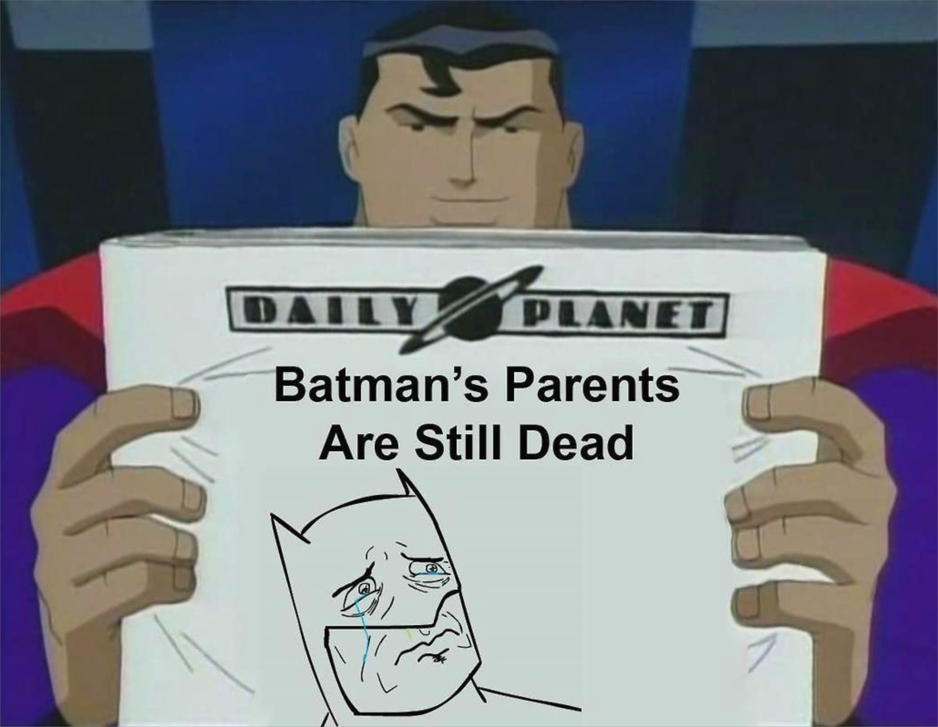

Integration and Design: Part 4
Gutsy opening image, and I apologize if it’s too strong: The issue is how much early design success adversely affects later attempts to change it. Here, Superman wonders, “If Bruce Wayne’s parents’ death is the hinge causing all his Batman behavior, then is that the only important part of his story, doomed to be retold till we’re all tired of it? And how does that affect me, as another comic superhero?”
Is Design continuing to be Dead?
Notes:
Image from http://knowyourmeme.com/photos/558031-my-parents-are-dead-batman-slapping-robin

Slide 2

Cookie Clicker Design
Design this silly game.
  In groups of 3-5.
  Put an OO design on paper.
Then we’ll all discuss issues.
Assume your game works like the online one.
  Except – you can login and retrieve state.
Do you need to do aggregate queries?
How long would you want to design, before you started coding?

Slide 3

Fowler and Fowler…
One way to deal with changing requirements is to build flexibility into the design so that you can easily change it as the requirements change.
  However this requires insight into what kind of changes you expect.
A design can be planned to deal with areas of volatility,
  while that will help for foreseen requirements changes,
  it won't help (and can hurt) for unforeseen changes.
So you have to understand the requirements well enough to separate the volatile areas, and
Our observation is that
this is very hard.
Can the egg know how the chicken is going to turn out?
Notes:
Chicken and egg image from http://www.swamij.com/chicken-egg-nondualism-god.htm

Slide 4
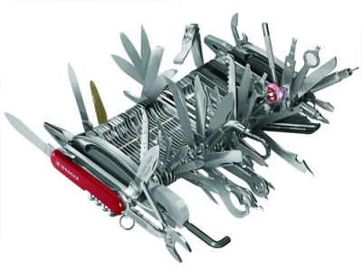
Does Refactoring Violate YAGNI
No, because we have a more
complex definition of
“simplicity”
Simple = the easiest to work
with code, overall.
If the product lives for 10 years, better-written code really pays off.
E.g., living with a big, messy case statement, versus a set of subclasses that do those cases.
Pocket knife, after 10 years
Notes:
Image of gold plating in action, from http://blog.thescrumster.com/?tag=yagni.

Slide 5
Design Patterns?
Knowing them is good, Fowler thinks (we agree)
But just the slightest bit dangerous
Using design patterns always has a cost
  Good in that everyone knows them.
  Maybe not so good if coding to them takes a lot of effort.

Slide 6
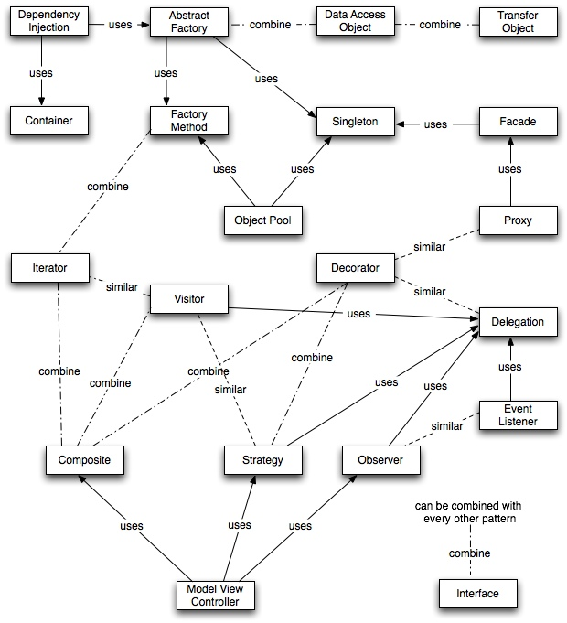
Design Patterns?
And here they are…
Lots more in 374
Notes:
Relationships of the patterns – image from http://best-practice-software-engineering.ifs.tuwien.ac.at/patternmap.html

Slide 7
Can Refactoring Lead You To Patterns?
Maybe –
More often, programmers refactor to patterns. Like,
To get rid of a talking to some interface that keeps changing, I consolidate where I have to do that, into an “interface” class. Or,
To get make a bunch of little variations on a class, I “decorate” it with these separate additions as wrappers.
Lots more on refactoring in 375!
Notes:
Refactor to the strategy pattern -> students sorted by name, students sorted by grade, students sorted by birthday

Slide 8
First keep in mind what you're drawing the diagrams for. The primary value is communication.
  Effective communication means selecting important things and neglecting the less important…
  Don't draw sequence diagrams for all use cases and scenarios – only [the important ones]..
A common problem with the common use of diagrams is that people try to make them comprehensive.
  The code is the best source of comprehensive information, as the code is the easiest thing to keep in sync with the code.
  For diagrams, comprehensiveness is the enemy of comprehensibility.
Notes:
From Fowler’s article

Slide 9
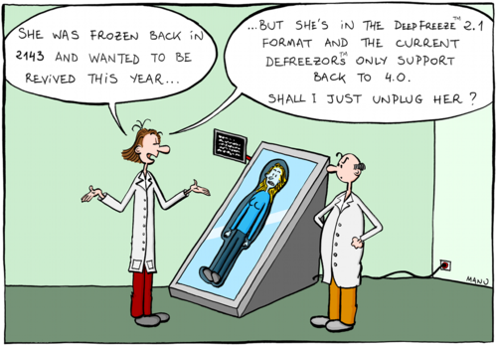
Are there things worth “planning in”?
Desires of the customer
Technical Risk
Ability to get it right “up front”
Notes:
Cartoon from http://myitforum.com/myitforumwp/2012/08/20/application-compatibility-think-holistically-to-get-it-right-the-first-time/

Slide 10

Personalities weigh in
What role does an architecture play when
you are using evolutionary design?
Again, XPs critics state that XP ignores
architecture, that XP's route is to go to
code fast and trust that refactoring that
will solve all design issues.
Interestingly they are right, and that may well be weakness.
Certainly the most aggressive XPers - Kent Beck, Ron Jeffries, and Bob Martin - are putting more and more energy into avoiding any up front architectural design.
Don't put in a database until you really know you'll need it. Work with files first and refactor the database in during a later iteration.
“Uncle Bob” Martin
Notes:
Bob Martin’s picture from http://scna2012.softwarecraftsmanship.com/speakers
Text is from Fowler’s article.

Slide 11
Revisiting the tension
In general, however [Architect] conveys a certain gravitas, as in "I'm not just a mere programmer - I'm an architect".
This may translate into "I'm an architect now - I'm too important to do any programming".
The question then becomes one of whether separating yourself from the mundane programming effort is something you should do when you want to exercise technical leadership.
This question generates an enormous amount of emotion
Notes:
Text is from Fowler’s article.

Slide 12
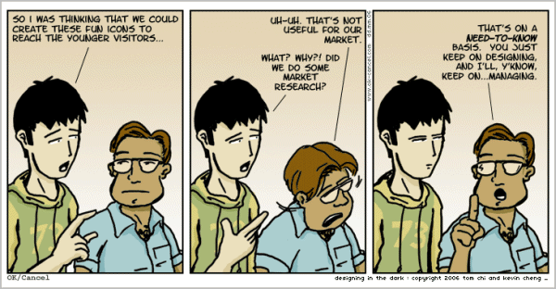
Any time you distinguish roles, you have similar problems…
Notes:
Cartoon from http://www.hongkiat.com/blog/comic-strips-designers/

Slide 13
What’s an architect have to do? - 1
Desired qualities for a software architect include the following:,
The artistic skill to make seemingly simple designs that are easy to grasp and yet which solve complex problems.
Analytical skills, such as an ability to find root causes for high-level problems in existing designs, like why a system runs too slowly or is not secure.
A systems engineer's understanding of the business, social, and operational environment in which a system needs to operate. An understanding of the domain in which a system will live, as well as technical knowledge.
Ability to relate to a wide range of stakeholders, including the client, users, system administrators and suppliers.
Communication skills - explaining to a design to the people who need to implement it.
A working knowledge of the capabilities of the development organization, and of how to explain to them what to do. This normally includes a high-level of adeptness at using the required technologies. The architect often writes a framework, which is developed further by others on the team.
Notes:
List is from a current paper being authored by Chenoweth and Rupakheti.

Slide 14
What’s an architect have to do? - 2
And,
Knowledge of multiple technologies, from which to choose the right ones for the next job.
Ability to conceptualize the strategic requirements for a project, which translate into needed design features.
Negotiation skills, so as to stand up for technical decisions that require change by developers and stakeholders.
Teamwork skills, such as listening to opinions of other developers and testers.
Technical leadership skills, during development and delivery of a system. These include also the selling skills used to convince stakeholders and developers of the soundness of a technical approach.
Lots more about this in CSSE 477 !

Slide 15
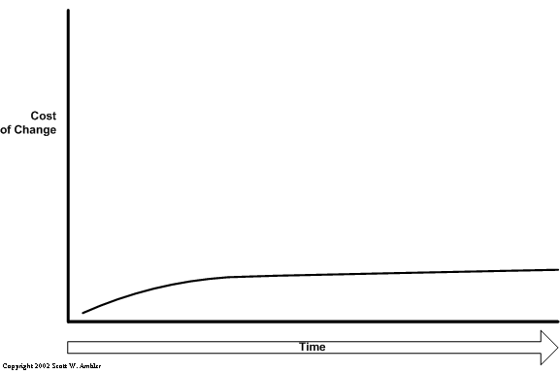
Living in Flatland
The fundamental assumption underlying XP is that it is possible to flatten the change curve enough to make evolutionary design work. This flattening is both enabled by XP and exploited by XP. This is part of the coupling of the XP practices: specifically you can't do those parts of XP that exploit the flattened curve without doing those things that enable the flattening.
Notes:
Text is from Fowler’s article.

Slide 16

Flat is a state of mind?
In his XP 2000 paper, Josh Kerievsky points out a good example of this. He looks at possibly the most public XP code of all - JUnit.
  JUnit uses decorators to add optional functionality to test cases, such things as concurrency synchronization and batch set up code.
  By separating out this code into decorators it allows the general code to be clearer than it otherwise would be.
  But you have to ask yourself if the resulting code is really simple. For me it is, but then I'm familiar with the Decorator pattern. But for many that aren't it's quite complicated.
Notes:
Image of Kerievsky from http://agiles2010.agiles.org/lang/en/2010/04/keynote-speaker-joshua-kerievsky/
His XP 2000 paper is at http://www.industriallogic.com/wp-content/uploads/2005/09/PatternsAndXP.pdf
Text is from Fowler’s article.

