Slide 1
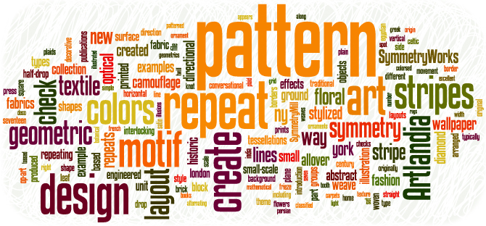

Design and Integration: Part 2
Notes:
Image from http://www.artlandia.com/wonderland/glossary/

Slide 2
Plus Delta Feedback
Reading and lecture repeat
Ambiguous questions on quizzes
Attendance quizzes
Boring white lecture slides

Slide 3
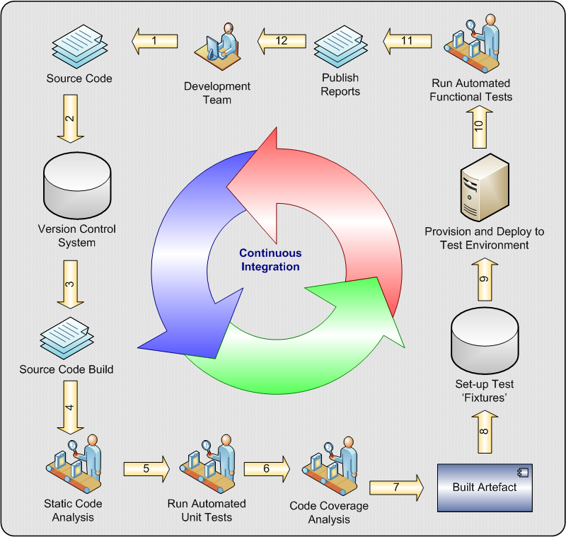
From Yesterday –
Continuous Integration
What is the corresponding old-school practice for continuous integration?
Why is testing (ideally automated testing) so important in continuous integration?
When does continuous integration fail?
Notes:
Image from http://cse360fall14.wikispaces.asu.edu/Continuous+Integration

Slide 4
So - How would you integrate this?
Imagine you’re working with a company that’s building a deployment process. You’ve got several “services” each of which maintains content. The deployment consists of 3 steps:
Prepare
Deploy
Rollback (maybe)
Managed by a “Deployment Manager” (DM) service. Both the services and the DM are under development. The final deployment can’t be tested unless every service has correctly deployed.
Say each service and the DM are developed by a different person. How do you handle integration?
Say each service and the DM are developed by a different team. How would you handle integration?
In groups of 3-5, write down ideas that would reduce the risk of this integration process.
(Building and delivering the DM itself, AND new versions of the services.)

Slide 5
Section 1’s ideas
Have a fake place to deploy it to, etc.:
  Fake the deployment manager (mock it). Or,
  Fake the services.
    Getting one to fail is tricky. Like, sending garbage data.
Make a big fancy spec document.
  Provides visibility.
Find a way to build it piecemeal.
  Do something serially.
  How do you test the DM if there’s nothing to deploy?

Slide 6
Related tips - Build repeatability
Crucial for continuous integration
  Requires that multiple people know how to build, and
  You can avoid subtle bugs
Can you “build any version” as you come out with new ones?
  E.g., existing features customers are using
    How to patch these?
    They used an old version of the operating system

Slide 7
Related to continuous integration
Continuous delivery
Harder
Typical desired scenario
  Code – build – test today
  Deliver tonight
Gives you a continuous flow of features to your customers
Works a lot better with SOA’s
Notes:
SOA = Service-Oriented Architecture. I.e., you have the system for every customer, running on your servers, not theirs. Your product is a service, to them.

Slide 8
Opportunistic Refactoring
What do you refactor your code to do?
  Rule 1: Enable whatever you know best comes next!
  Rule 2: Make your code easy to use:
    Reduce duplication
    Be more explanatory (note: agile equivalent of documentation here)
    Improve the “smell”
    Improve the design is of course the goal, but this can be a tricky business
We’ll have a full look at refactoring in CSSE 375…

Slide 9

Phillips: A strategic quote
There are morale issues. Many creative people are offering solutions or parts of solutions, yet the business may be dictating significant design parameters such as language, operating system, hardware, and user interface.
Notes:
Phillips’ picture from http://dwaynephillips.net

Slide 10
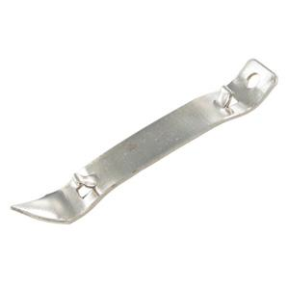
And
Another frustration of design is that sinking feeling that you are reinventing the wheel. The current design is similar to the design of last year’s project. It is just different enough to cause us to repeat the entire design process. If only we had made the last design more general-purpose.
“Let’s make a better one of these…”
Notes:
“Church key” bottle/can opener from http://www.thebarsupplydepot.com/servlet/the-35/church-key-Bottle-opener/Detail.

Slide 11
“Old school” Design
Some other key thoughts from Phillips:
Design is about finding foresight with the same 20/20 vision as hindsight. (p 259)
Design is a visibility technique and a visibility product.
  It’s both a process and an artifact. (p 259)
It’s creating many solutions to a problem, then choosing one according to a set of criteria,
  And then socializing that solution. (p 260)

Slide 12
More Phillips
Some people do not make good designers because they cannot work with design’s sloppy nature.
  Iteration is one way to work through design frustration. (p 261)
Find at least 3 major deficiencies in your first design.
  If you can’t find them, have someone else take a look. (p 261)

Slide 13
And more
Designing without abstraction leads to failure. (p 262)
Most customers are tired of developers after the grueling requirements activities. (p 264)
Writing requirements in English only is a mistake. (p 265)
Loose coupling means that the implementation of one unit does not depend on the implementation of another. (p 265)
  Decoupling is often “social.”

Slide 14
More
The most common design secrets to hide are items that have a high probability of changing. (p 266)
The most important step in designing for reuse is to decide to design for reuse. (p 267)
The first step in evaluating design decisions is to base those decisions on criteria you selected ahead of time. (p 268)

Slide 15

Why talk about design now?
You’ll get this, in depth, in 374 and 477!
Had bits and pieces in every CSSE class.
Don’t say:
Because it’s the
heart of creating
software.
Notes:
Image from http://en.wikipedia.org/wiki/Heard_It_All_Before:_Live_at_the_Hi_Fi_Bar

Slide 16
And
You need the big picture of software projects.
  This is the course where you get it.
And – You have to do design and planning how to run the project, at the same time.
  Like, who you need on the project depends on:
  What skills you need to pull it off, which
  Depends on the design.

Slide 17
The standard design sequence
In all of engineering, it goes like this.
You at least need a good problem statement.
  It should cover functional and non-functional requirements in generality.
You do the high-level design from that.
  Top-down, with lots of alternatives.
  Then pick from those, based on lots of criteria.
  This is Phillips’ “Abstraction” (p 262)
Then you use the detailed requirements to fill-in the detailed design.
  Bottom-up.
  Do you need to express this, beyond coding?
Like?
Why?

Slide 18
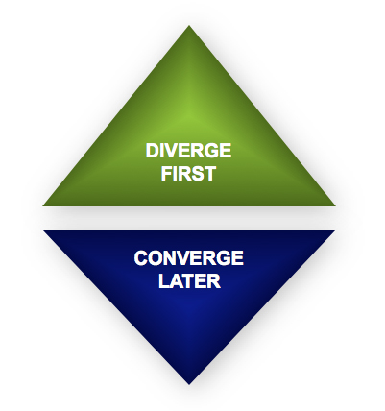
High-level design looks like good brainstorming
Try not to mix these two:
  Coming up with new ideas.
  Picking one, and focusing on how to do it well.
But,
  For everything beyond coding, you have to maintain it forever!
  So – Is it throwaway?
Notes:
Image from http://www.creativerealities.com/innovationist-blog/bid/103494/Let-s-not-confuse-good-brainstorming-with-the-new-Groupthink

