Slide 1
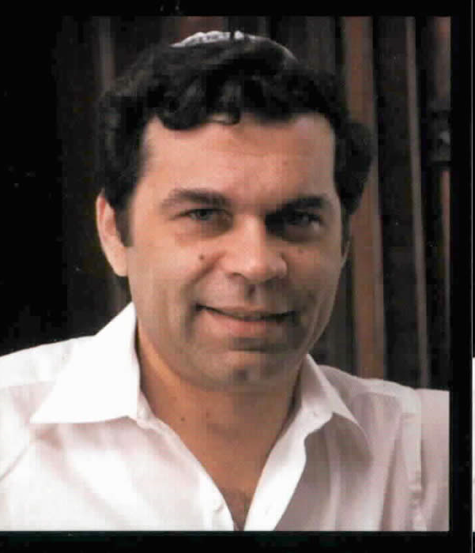

Critical Chain
From “Theory of Constraints” Developed by Elihu Goldratt in 1984
Goldratt – Many of his key ideas were first explained via “business novels” like The Goal: A Process of Ongoing Improvement.

Slide 2
What is the “Theory of Constraints”?
The theory of constraints (TOC) is a management paradigm that views any manageable system as being limited in achieving more of its goals by a very small number of constraints.
Based on “how people really behave.”
Includes lots of ideas to turn that into project productivity!
“Critical chain” is one of these ideas…

Slide 3
The worst thing you can do for your process is try to make every step complete on time.

Slide 4
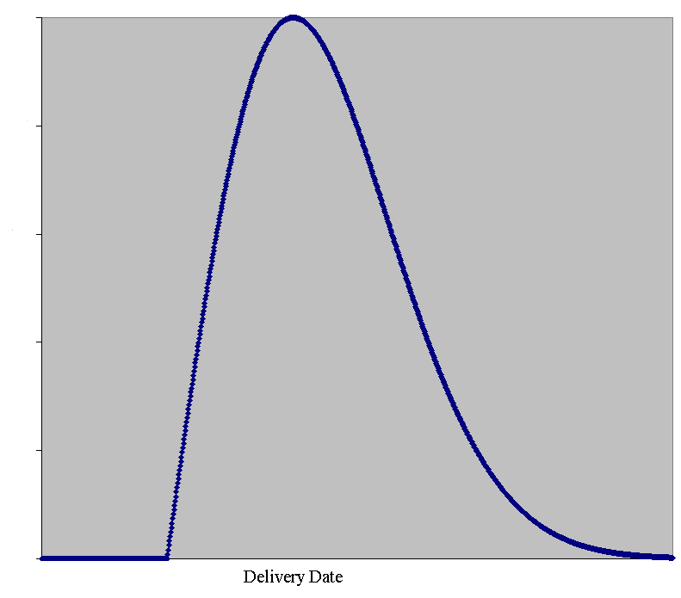

How long does it take you to get home for Thanksgiving?
Notes:
Turkey image from http://www.catbehaviorassociates.com/thanksgiving-safety-tips/
Rayleigh curve image from http://www.ganssle.com/articles/liesandschedules.htm

Slide 5
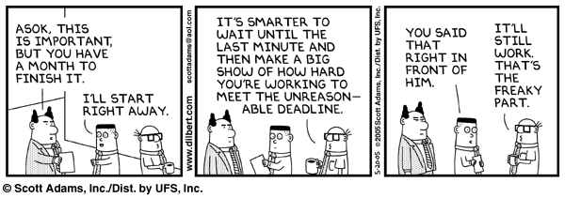
How much safety do our estimates contain?
Notes:
Key insight – it depends on the probability
Image from http://www.danehomenick.com/productivity/parkinsons-law/

Slide 6
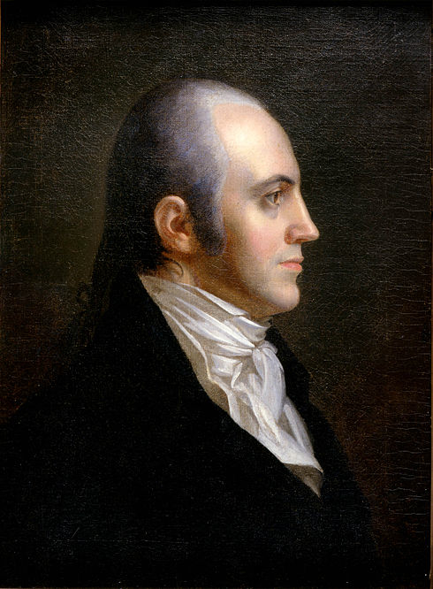
What causes Parkinson’s Law?
Parkinson’s Law: Work expands to fill the time available
Benefits of finishing early
Student syndrome
Multitasking
“And if you finish memorizing the names of all the presidents, go ahead and memorize the names of all the vice-presidents.”
Notes:
Aaron Burr portrait from http://en.wikipedia.org/wiki/Aaron_Burr

Slide 7
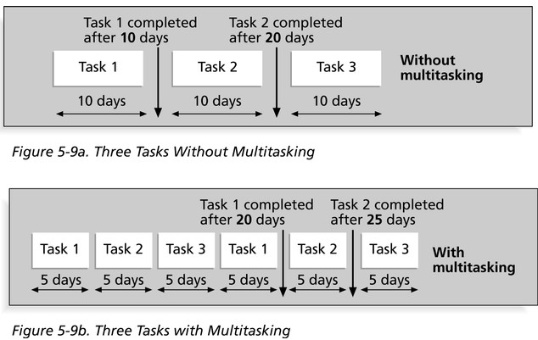
Multitasking’s effects

Slide 8
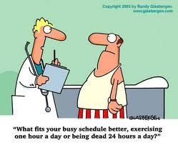
What can we do?
Notes:
Cartoon from http://www.lisalesliefitnessblog.com/my-solution-to-the-current-economic-crisis-an-alternative-work-schedule-do-you-agree

Slide 9
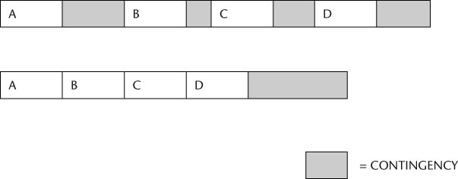
Goldratt’s solution –
Reduce the estimate of everything by half (approximately) and move the buffer to the end
Why is this better?

Slide 10
“Project buffer”
Encourages folks to finish early
Makes problems more visible
Focuses attention on the real goal of the process

Slide 11
What about situations where there are complex dependencies?
A 8
C 5
B 6
D 10
F 5
H 10
“Project buffer”
E 3
G 5
“Feeding buffer”
Notes:
The critical path, B-D-F-H is in orange.
It works just like A-B-C-D on previous slide.
Accumulate project buffer at the end of B-D-F-H.
The other paths need their own “Feeding buffers” for feeding into the critical path at the right time.

Slide 12
Student syndrome & large projects
Student syndrome: tendency of people to waste “safety buffer” without starting tasks – reintroducing risk no matter how generous the buffer
A real problem on student projects with interdependencies
You’ve seen how critical chain handles this problem
Can we solve this problem at Rose?

Slide 13
Please don’t confuse critical path and critical chain
Critical path is the longest path through a PERT chart
Critical chain is this thing, with reduced estimation time and buffers
  Within the overall methodology, there is also a smaller thing called “critical chain” involving a critical path that takes into account certain resource contentions. Don’t worry about it.

Slide 14
Interesting issues with “student syndrome” here at Rose:
Students work in a multi-assignment environment. It may even be true that "trying to balance the workload of all project resources is far too complex." Therefore, something like critical chain still may not work in the student context because balancing activities, sports, and other assignments.
It may solve the "student syndrome" , but it may not work for students. It is really common that if a professor has a "buffer" (a professor is easy on their deadline), student will take advantages of it and keep pushing and missing deadline.
It may not work because deadlines are put in place so that the student can complete the assignment before moving on to the next chunk of material to learn. If you did implement the chain process students would feel rushed to learn the material and complete the assignment in unrealistic time periods leading to confusion on the material they are learning.

