Slide 1
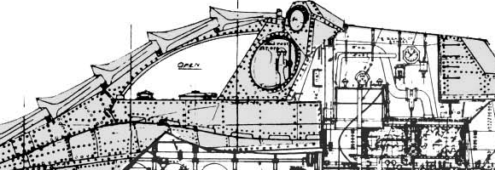

Constructing and Analyzing the Project Network Diagram → PERT Chart
CSSE 372
Week 6 Day 2
PERT was invented for the Nautilus submarine project. Ok, maybe not this Nautilus…
Notes:
In Steve’s section, we previewed this in Week 3, Day 2 (Slide 6).
Nautilus submarine cutaway is from http://xirdalium.net/2008/01/15/nemos-gear/.
The real Nautilus was the first atomic-powered submarine.

Slide 2
Outline
Definitions
Starts
Critical path
Slack
MR
Activity
Notes:
We have seen how to build a WBS and how to estimate time, duration, cost and resources. The WBS provides an accurate representation of the number of tasks that you need to complete in order to complete the project. The next task is to determine the order in which these tasks are to be performed. The basic idea is to figure out the earliest a particular activity can be started and the earliest completion date for the project. This is critical information for the project manager. Ideally, the required resources must be available at the times established in the plan.

Slide 3
What is a network diagram?
“A pictorial representation of the sequence in which the project work can be done.”
What is needed to construct diagram?
  Tasks
  Task Duration
  Earliest time to start task
  Earliest expected completion date for the project
Notes:
A project network diagram is a pictorial representation of the sequence in which the project work can be done. Remember that a project is a sequence of interconnected tasks. You can perform the tasks one at at time until they are all complete, but in all but the most trivial projects this approach would not result in an acceptable completion date. Any ordering that allows even one pair of tasks to be worked on concurrently results in a shorter project completion date. There are two ways to go about finding this interconnection of tasks
What tasks must be complete before another task can begin?
You can take a set of tasks and look backward through the project. Now that a set of tasks is complete, what task or tasks could come next?
It helps to look at it from both approaches One can be a check on the completeness of the other. The relationship between the tasks in the project are represented in a flow diagram called a network diagram or logic diagram.
There are two ways to build a project schedule:
Gantt Chart
Network diagram
The Gantt chart is the oldest of the two and is used effectively in simple , short-duration type of projects. To build a Gantt chart, typically you associate next to each task, the duration of the activity. The PM then places the bars horizontally along a timeline such that they are worked on concurrently with other tasks. The sequencing is often driven more by resource availability than any other consideration. There are two drawbacks to using the Gantt Chart
It does not contain detailed information. It reflects only the order imposed by the managers and in fact hides much of that information. Unless you are intimately familiar with the project tasks, you cannot tell from the Gantt chart what must come before and after what.
The Gantt chart does not tell the project manager whether the schedule that results from the Gantt chart completes the project in shortest possible time or even uses the resources most effectively. The Gantt chart reflects only when the manager would like to have the work done.
The network diagram provides a visual layout of the sequences in which the project work flows. It includes detailed information and serves as an analytical tool for the project scheduling and resource management problems as they arise during the life of the project. In addition the network diagram allows you to compute the earliest time at which a project can be completed. The information does not follow from a Gantt Chart

Slide 4
Uses
Planning
Implementation & Control
Notes:
Network diagrams can be used for detailed project planning, during implementation as a tool for analyzing schedules alternatives and as a control tool.
Planning: Even for large projects, the project network diagram gives a clear graphical picture of the relationship between project task. It is at the same time, a high level and detailed level view of the project.
Implementation: For those project managers who use automated project management software tools, update the project file with task status and estimate to completion data. The network diagram is then automatically updated and can be printed or viewed. The need for rescheduling and resource allocation decisions can be determined from the network diagram, although some argue that this method is too cumbersome because of the project size. Even a modest project with about 100 tasks can produce a large and awkward diagram.
Control: While the updated network diagram retains the status of all tasks, the best graphical report for monitoring and controlling project work is the Gantt chart view of the network diagram. This chart cannot be used for control purposes unless you have done network scheduling or incorporated the logic into the Gantt chart. You can compare the actual schedule with the planned schedule and discover variances and depending on the severity, you can put a get well plan in place.

Slide 5
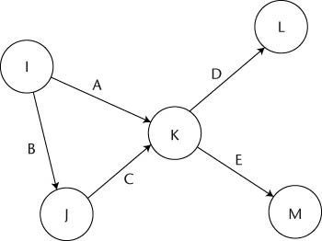
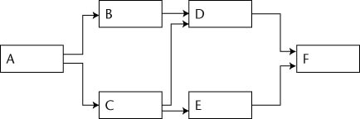
Types
Task-On-the-Arrow (TOA)
Precedence Diagramming Method (PDM)
Notes:
One early method for representing project tasks as a network dates back to the early 1950s and the Polaris missile program. It is called the task-on-the arrow(TOA) method. An arrow represents each task. The node at the let edge of the arrow is the even “begin the task”, while the node at the right edge of the arrow is the event “end the task”. Every task is represented by this configuration. Nodes are numbered sequentially and the sequential ordering had to be preserved.This task on the arrow approach, has since been replaced by the task on the node approach more commonly known as project network diagramming.

Slide 6
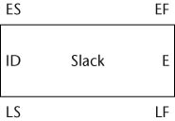
Using PDM
Earliest start time
Earliest finish time
Expected duration
Task ID
Add peoples’ names?
Latest start time
Latest finish time
The other info is all calculated later
Notes:
The basic unit of analysis is represented by a rectangle called a task node. Arrows represent the predecessor/successor relationship between tasks. Every task in the project will have its own node. The entries in the task node describe the time-related properties of the task. Some of the entries describe characteristics of the task, such as its expected duration (E), while others describe calculated values (ES, EF, LS, LF) associated with the task. In order to create the network diagram using the PDM, you need to determine the predecessors and successor for each task. To do this you ask, “what tasks must be complete before I can begin the task?”. Here, you are looking for the technical dependencies between tasks.. Once a task is complete, it will have produced an output, a deliverable which becomes input to its successor tasks. Work on the successor tasks requires only the output from the previous tasks.
The network diagram is logically sequenced to be read from left to right. Every task in the network, except the start and the end tasks, must have at least one task that comes before it and one task that completes after it. A task begins when its predecessor have been completed. The start task has no predecessor, and the end task has no successor. These networks are called connected.

Slide 7
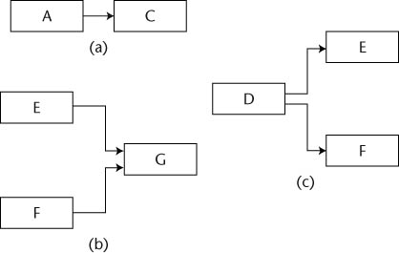
Using PDM (cont.)
What depends on what?
Notes:
A dependency is simply a relationship that exists pairs of tasks. To say that task B depends on task A means that task A produces a deliverable that is needed in order to do the work associated with task B. There are four types of dependencies
a) Finish to Start: the finish to start dependency says that task A must be complete before task B can begin. It is the simplest and most risk averse of the four types. During the initial round go with FS dependency. The finish to start dependency is displayed with arrow emanating from the right edge of the predecessor task and leading to the left edge of the the sucessor task.

Slide 8
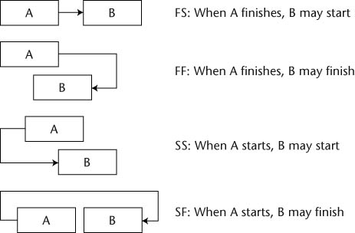
Starts…
Most common
Notes:
Start to Start: The start to start (SS) dependency says that task B may begin once Task A has begun. Note that there is a no-sooner than relationship between A and B. Task B may begin no sooner than task A begins. An arrow from the left edge of the predecessor (A) and leading to the left edge of the successor node (B)
Start to Finish: The start to finish dependency is a little more complex than the FS and SS dependencies. Here task B cannot be finished sooner than task A has started. You don’t want to turn off the old system until the new one is ready. The start to finish dependency is displayed with an arrow from the left edge of A to the right edge of B.
Finish - Finish: The finish to finish dependency states that B can finish after A has finished. Data entry cannot finish until data collection has finished. It is displayed with an arrow emanating from the right edge of the task A to to right edge of task B.

Slide 9
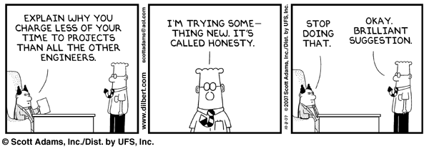
CotD
Notes:
“Cartoon of the Day” - Dilbert, Oct 8, 2007, from http://search.dilbert.com/comic/Project%20Charge.

Slide 10
Constraints
Technical
  Discretionary
  Best-practices
  Logical
  Unique
Management
Interproject
Date
Notes:
The type of dependency that describes the relationships between the tasks is determined as a result of the constraints that exist between those tasks. Technical dependencies between tasks are those that arise because one task requires output from another before work can begin on it. If a project can be completed by the request date using only FS dependencies, there is no need to complicate the plan by introducing other more complex and risk prone dependencies.
Discretionary: Judgment calls by the project managers that result in the introduction of dependencies.
Best Practices: based on past experiences that have worked well for the project manager or know to the project manager based on the experiences of others in similar situations.
Logical: Like discretionary constraints that arise from the project managers way of thinking about logical way to sequence a pair of tasks. This could be based on past experience or just plain common sense to sequence tasks a particular way. But try not to manufacture a sequence out of convenience. As long as there is a good logical reason that is sufficient justification.
Unique requirements: These constraints occur in situations where a critical resource - say an irreplaceable expert or a one-of a kind piece of equipment is involved on several project tasks.
Management - Imposed by the management - for example a rival is going to introduce a product to the market. Rather than follow a concurrent design build strategy, management might decide to do a concrete design to ensure a product that will compete with the rival when released. The big difference between technical and management is that management can usually be reversed, while technical dependencies are not.
Inter-project - Deliverables from one project are needed by another project.
Date Constraints: Bob Wysocki recommends against it. They impose start and finish dates on a task, forcing it to occur according to a particular schedule. While they are tempting to use they tend to conflict with a schedule that is calculated and driven by dependencies. Data constraints are usually of 3 types
No earlier than- The earliest date a task can be completed
No later than- This date constraint specifies a date by which a task must be completed
On this date - This date constraint specifies the exact date on which a task must be completed.
On this date is the worst, followed by No later than ….
Pauses or delays between tasks are indicated in the network diagram through the use of lag variables.

Slide 11
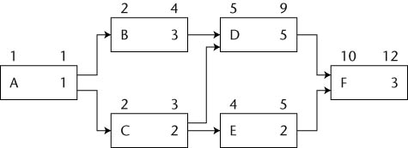
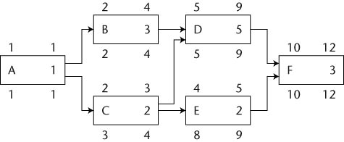
Putting it together…
Forward pass
Backward pass
Notes:
To establish the project schedule, you need to compute two schedules: the early schedule which you calculate using the forward pass and the late schedule which you calculate using the backward pass.
The early schedule consists of the earliest times at which a task can start and finish These are calculated numbers derived from the dependencies between all the tasks in the project. The late schedule consists of the latest times at which a task can start and finish without delaying the completion date of the project. The combination of these two schedules gives you two additional pieces of information about the project schedule:
The window of time within which each task must be started and finished in order for the project to complete on schedule
The sequence of tasks that determine the project completion date.
ES - the earliest start time for a task at which all its predecessor tasks have been completed and the subject task can begin.
The ES time of the tasks with one predecessor is determined from the Earliest finish of the predecessor task. The earliest finish time of a task is calculated as ((ES + Duration) - 1 time unit).
The latest start (LS) and latest finish (LF) are the latest times at which the task can start or finish without causing delays in the completion of the project. The window of time between the ES and the LF of a task in the window within which the resource for the work must be scheduled or the project completion date will be delayed.

Slide 12
Using PDM
ID: Number from WBS
E: Duration
Work forward:
ES: Earliest Start
Predecessor? ES = Ef_{pre} + 1
No pred? ES = 1
EF: Earliest Finish
((ES + E) – One Time Unit)
Work backward:
LF: Latest finish
Last task? LF = EF_{Calculated}
Not last? Min(LS_{ea. succ.}) - 1
LS: Latest start
((LF – E) + One Time Unit)
Notes:
What everything means, in detail.

Slide 13
Critical path – what is it?
“The longest duration path in the network diagram”
“The sequence of tasks whose early schedule and late schedule are the same”
“The sequence of tasks with zero slack or float”
The Critical Path Determines
the Completion Date of the Project
Notes:
The longest duration path in the network diagram. The sequence of tasks whose early schedule and late schedule are the same. The sequence of tasks with zero slack or float. The tasks on the critical path must be completed on schedule in order for the project to be completed on schedule. The Critical Path Determines
the Completion Date of the Project

Slide 14
How do you calculate it?
Add up all of the path’s durations
  The longest one is the critical path
Compute slack
Notes:
One way to identify the critical path in the network diagram is to identify all possible paths through the diagram and add up the durations of the tasks that lie along those paths through the diagram and add up the duration of the tasks that lie along these paths. The path with the longest duration time is the critical path.
Slack time also called float is the amount of delay expressed in units of time that could be tolerated in the starting time or completion time of a task without causing delay in the completion of the project. Slack time is

Slide 15
Slack = LF - EF
0
0
0
0
1
4
Notes:
Slack time also called float is the amount of delay expressed in units of time that could be tolerated in the starting time or completion time of a task without causing delay in the completion of the project. Slack time is a calculated number. It is the difference between the late finish and the early finish.

Slide 16
How do you calculate Critical Path?
Compute slack
  Two types of slack
    Free slack – amount of delay for a task without causing a delay in the early start of immediate successor task(s)
    Total slack – amount of delay for a task without delaying the project completion date
Notes:
Free slack – amount of delay for a task without causing a delay in the early start of immediate successor task(s) By definition if a tasks completion time stays within the free slack time then it can never delay the early start of any other task in the project. Total slack – amount of delay for a task without delaying the project completion date. You know that if a task has zero slack, then it determines the project completion date. In other words, all the tasks on the critical path must be done on their earliest schedule or the project completion date will suffer. The s

Slide 17
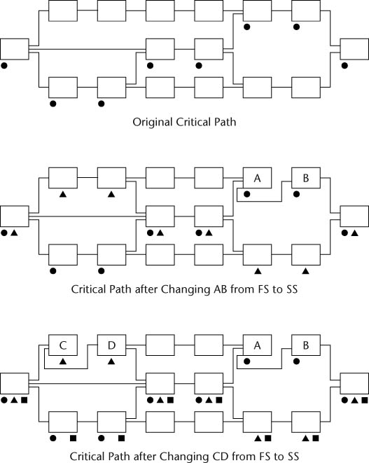
Schedule compression
Notes:
Once you are done developing the network diagram, one of two things happen
The project completion date as suggested by the schedule meets the requested completion date.
The more likely thing is that you are well past the requested completion time.
If (b) happens, then you need to find some way of squeezing more time out of the schedule. One way to do this is to reduce the amount of work done, but that is not the right approach. Rather you analyze the network diagram to identify areas where you can compress the project duration. Focus your attention on the critical path tasks because these are the tasks that determine the completion date of the project. Don’t try to save time by compressing the schedule on tasks at the early part of the development schedule, at this stage, people are still getting to know each other and may not be really working together as a time. That means you should look downstream on the critical path for those compression opportunities.
A second factor to consider is focusing on tasks that are partitionable. A partitionable task is the one whose work can be assigned to more than one individual working in parallel. If a task is partitionable it is a candidate for consideration. You might be able to partition it so that when some of it is finished, you can begin working on some successor task that depend on the part that is complete.
Keep in mind that as you replace SF with parallel sequences of tasks (SS) the critical path may change.

Slide 18
Management reserve
Padding task duration
  Individual task level
  Project level
Bad at the task level
BUT, good at the project level
  Accounts for risk
  Incentive (management reserve time not used can be the basis for bonus)
PERT = “Program Evaluation Review Technique”
  Uses these methods, with
  The critical path calculation as the basis
Notes:
Never pad at the individual level . Remember Parkinson’s law - work will expand to fill the time allotted to complete. Management reserve is nothing more than a contingency budget of time. The size is typically in the 5 - 10% rage. If a project has lesser number of unknowns then you need to be closer to 5%, but if you have a lot of new things in the project, keep it closer to 10%.
Once you have determined the size of the reserve, then you create a task for that duration and add it to the end of the project. It will be the last task and its completion will signal the end of the project. This management reserve task becomes the last one in your project plan, succeeded only by the project completion milestone.
But as a manager you should manage the task as if the reserve is not needed. It can be used as an incentive for the team. Most projects have penalties if you complete the task a little behind schedule, also have incentives for finishing early. Think of the reserve as a contingency fund that you do not want to spend.

Slide 19
Activity (in class, rest of the hour)
Working with teammates from your junior project:
Look at the WBS and estimates for this project
Start with an activity that looks like it starts on day 1
See how far you can build the PDM from there, putting in reasonable dependencies
Try to make them all FS dependencies, to begin with
Record the ES, EF, LS, LF, and slack for each task
Reexamine the tasks to see what’s really appropriate as an FS, FF, SS, or SF dependency relationship
Find and indicate the critical path
If there’s time left, re-evaluate your dependency relationships to see if you can compress the schedule
Notes:
WBS = Work Breakdown Structure

Slide 20
Questions?

