Slide 1


Valve – and more
Welcome to the Land of Do-As-You-Please
Notes:
Image from http://en.wikipedia.org/wiki/The_Magic_Faraway_Tree_(novel)

Slide 2
Warning
Trying to characterize a process at a particular company is extremely dicey.
Companies have hundreds and thousands of employees.
Management can do some things to set the culture. But usually the primary determinant of the culture is people you interact with every day.
Also people like different things.
Also, different companies are shaped by very different forces.
E.g., Yesterday – “Every group you join will be different, and will change with each new project.”

Slide 3
All Software Processes, Everywhere, Try to Do This:
Hire some smart talented people
Motivate them
Have them figure out some great idea
Then build in a coordinated way
Profit

Slide 4

Brief Example –
Software Process at Google
Freedom to work on different projects
Not a lot of managers and managers also code
“Proving yourself” to other software developers extremely important
Profound tons of resources focused on you
Intense code reviews – strict guidelines
Notes:
Google logo from http://velocityagency.com/a-google-centric-world/

Slide 5
What’s Google Want in New Hires?
On NPR Feb 27, 2014, Harvard Business School’s Nancy Koehn was asked what Google sought in their new hires. She said:
  Leaders,
  People who can step back and let others lead,
  Humility, and
  They know how to fail.

Slide 6
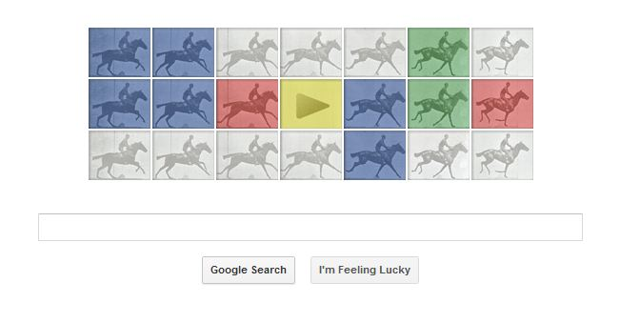
From the horse’s mouth:
April 19, 2014 New York Times interview with Lazlo Bock, who’s in charge of Google hiring:
  Grit – like taking hard college programs.
  Ability to learn things and solve problems.
  Both creative and logical.
  Combine things from two
  fields.
  Know how and why you
  achieved things.
  Can demonstrate how to achieve value.
Notes:
Interview from http://www.nytimes.com/2014/04/20/opinion/sunday/friedman-how-to-get-a-job-at-google-part-2.html?_r=0
Image from http://www.pricenfees.com/google-doodle-wishes-eadweard-j-muybridge-through-horses.html

Slide 7
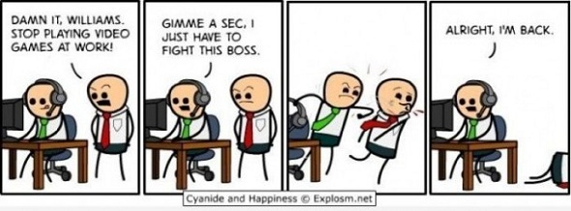
How About Video Game Companies?
From A Survey on a State of the Practice in Video Game Development – 2010 survey of Australian video game developers
  Scrum is most popular
  “Traditional Methods” not used at any studio, all are agile
  75% used version control
  35% used automated testing
Notes:
Image from http://www.joeaaronsellers.com/games/

Slide 8

What are the characteristics of
Valve and Its Processes?
In terms of “theories of the firm”:
  Existence – to build games – fun
    Thus it should be purposeful and fun
  Boundaries - open
  Organization - flat
  Heterogeneity of actions / performances they do
    Hiring and compensating the right people
  Evidence – tests for these actions
    Group decisions
Notes:
See http://en.wikipedia.org/wiki/Theory_of_the_firm
Image from http://assistantvillageidiot.blogspot.com/2012_04_01_archive.html

Slide 9
Unique to Valve - 1
“Cabals”
  See Ken Birdwell’s story of designing Half-Life: http://www.gamasutra.com/view/feature/3408/the_cabal_valves_design_process_.php
  Cross-section of the company
  Brainstormed and made decisions
  Needed enough people, including temporary non-contributors
  Tried to suppress egos
  Created a written group design
    Explained what things were for
  Did user play-testing as soon as possible
    Two hours = 100 fixes to do
  Got everyone involved
    Still relied on individual initiative
  Need people who are good subordinates, too

Slide 10
Their Cabal “Tip Sheet”
Include an expert from every functional area (programming, art, and so on).
Write down everything.
Not all ideas are good.
Only plan for technical things that either already work, or that you’re sure will work within a reasonable time before play testing.
Avoid all one-shot technical elements.

Slide 11
Unique to Valve - 2
“Stack Ranking”
  Peer review process
  Compare with peers
  Determines compensation
  Expected behavior:
    Come up with a bright idea
    Tell a coworker about it
    Work on it together
    Ship it!

Slide 12
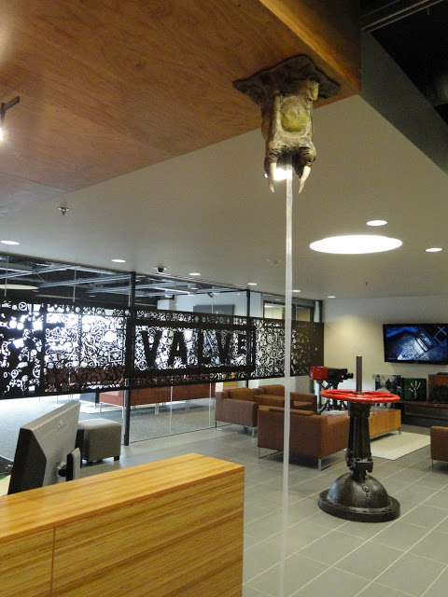
How people are rated
Skill level / technical ability
Productivity / output
Group contribution
Product contribution
Right – The Valve lobby, with valve
Notes:
Image from http://www.monstermache.net/2011/02/valve-software.html

Slide 13
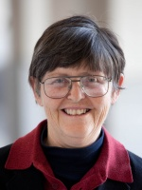
What does Jo Freeman say is the problem with “structureless” organizations
They are not really structureless
Elites form based on social relationships
between the group – then they wield disproportionate power
#2 is bad news
How does structure – even a non-democratic structure like a hierarchy – help this problem?
→ The issue in feminism is that hierarchical organizations are inherently “paternalistic.” So, what’s the alternative, for a less male-dominated culture?
Notes:
Article you read, which is from 1970.
http://www.bopsecrets.org/CF/structurelessness.htm
Jo Freeman picture from http://www.wilsoncenter.org/staff/jo-freeman

Slide 14
What Is Not Stated?
Details of how things get done.
Ways you learn to be productive / social.
Conflict resolution
How you “move up”
Mentoring?
Who needs to know what?

Slide 15

“A Lot Like High School”
“She doesn’t even like to play Super Smash Bros.”
Notes:
From http://www.foolquest.com/cliquebusters.htm

Slide 16
What is unique about these environments?
Planning?
Decision making?
Who’s responsible?
How to get something done?
  Say, integration testing?
Advice: Always be aware of the risks of structureless environments.
Giving folks autonomy has the potential to reap huge rewards.
Nobody has a perfect way to do it at scale.

Slide 17
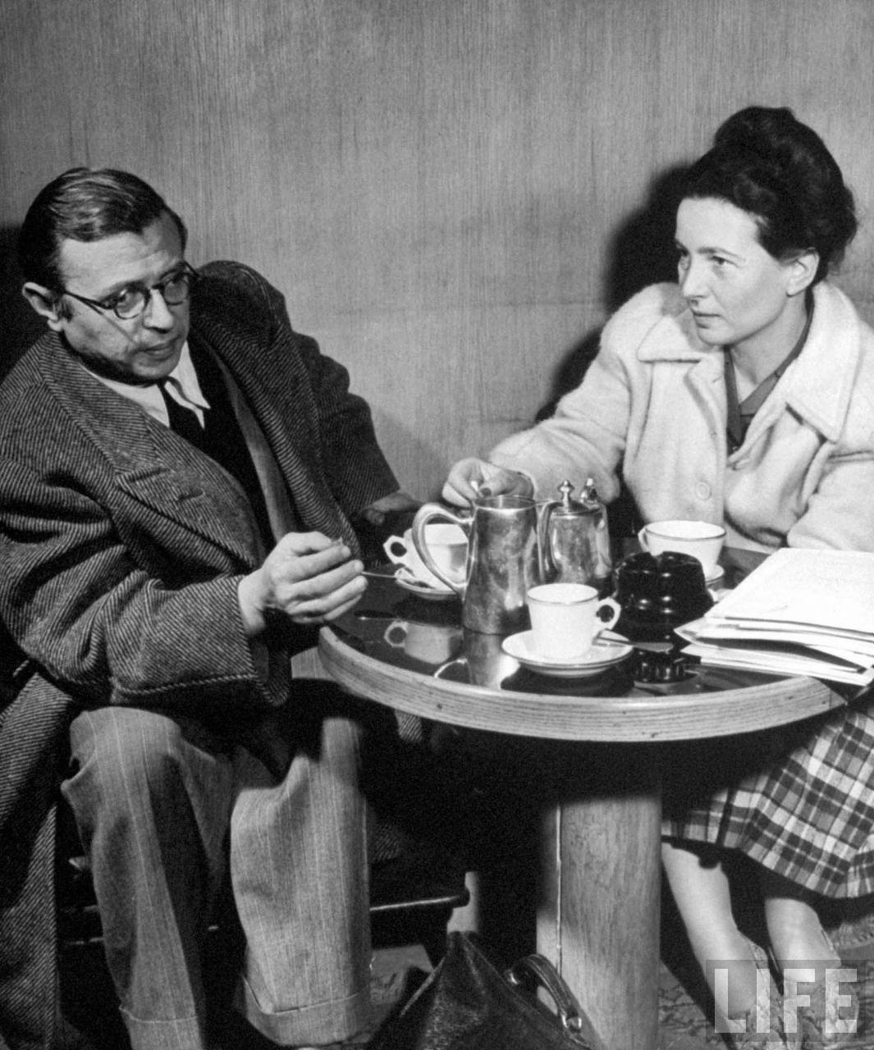
Another couple of philosophers weigh-in on social structure
Why do most people want to follow a hierarchical leadership, in their work, without asking a lot of questions?
Answer: We want to believe in what the leaders say.
Sartre and de Beauvoir postulated that we use “bad faith” to convince ourselves this is all working, even when we know it’s not.
  We choose, in anguish, to go along.
  Same as believing what politicians say, if we think they are on “our side.”
Jean-Paul Sartre and Simone de Beauvoir discuss life at a Paris coffee shop – a place that isn’t far off from Valve’s cultural model.
Notes:
See http://en.wikipedia.org/wiki/Bad_faith_(existentialism)
Image of the philosophers from http://theredlist.com/wiki-2-24-224-268-view-culture-art-fashion-profile-simone-de-beauvoir-jean-paul-sartre.html

Slide 18
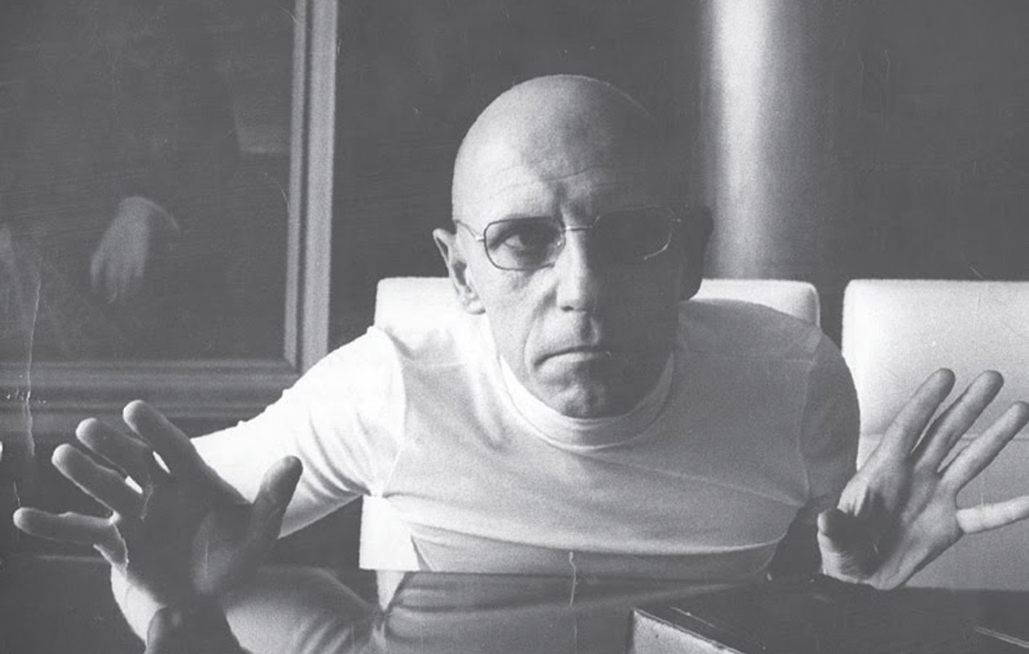
One more philosopher –
Michel Foucault
Agrees – “It’s all about power,”
regardless of structure.
Power is diffuse rather than
concentrated,
Embodied and enacted rather
than possessed,
Discursive rather than purely coercive, and
Constitutes agents rather than being deployed by them.
Power defines truth, and who is charged with saying what’s true.
It’s both negative and positive in its effects.
Foucault believed most expressions of power are only semi-conscious – It would ruin things for us if we realized we were slinging our weight around. Members of elites often usually deny that they keep others down.
Notes:
Comments from http://www.powercube.net/other-forms-of-power/foucault-power-is-everywhere/
Foucault photo from http://iphilo.fr/2014/09/04/michel-foucault-ou-la-theorie-comme-un-roman/

Slide 19
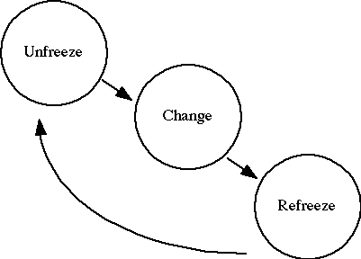
And a psychologist
Why don’t we all change to the “best” process, from whatever we have now?
Changing even something simple, say, your team’s development environment, invokes Kurt Lewin’s organizational change model:
  People know change is hard – requires “unfreezing.”
  You have to “learn” how to do the
  new stuff.
  Includes internalizing new meanings.
  Then “refreeze” around that.
Notes:
Image from http://www.adaptivecycle.nl/index.php?title=The_Importance_of_Change_Management_(Group_2)_Part_2

Slide 20
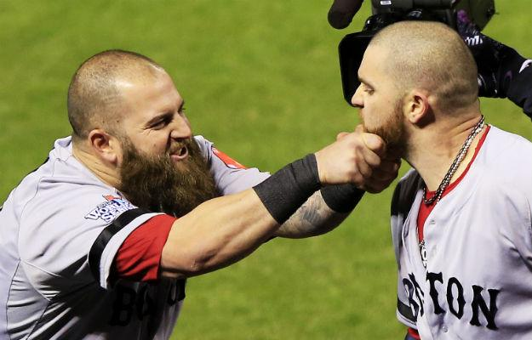

And a business person
Kurt Lewin’s model was adopted by Edgar Schein to explain what’s necessary to cause “transformational” organizational change:
Everyone assumes current success is based on everything about the current ways of acting.
  “Culture” is a learned defense
  mechanism, to avoid uncertainty
  and anxiety.
  All the cultural elements of
  behavior have “secondary value.”
Notes:
Images from http://www.foreignpolicy.com/posts/2013/11/21/licorice_buffalo_teeth_and_chicken_dinners_don_t_tell_the_ap_but_baseball_is_all_ab and http://www.recruiter.com/i/employer-pushing-your-social-boundaries-online/.

Slide 21
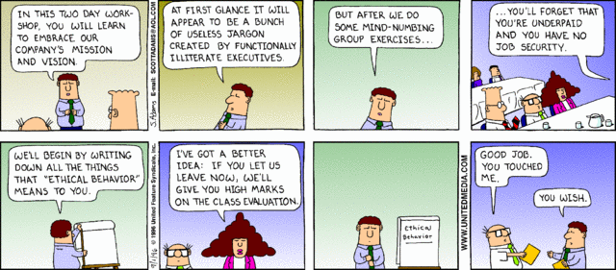
And Dilbert
Notes:
Cartoon from http://search.dilbert.com/comic/Company%20Vision

