Slide 1
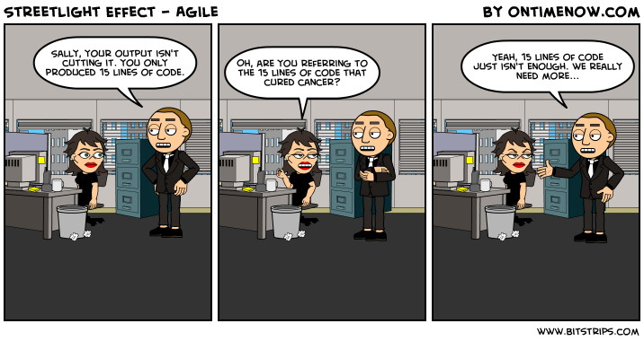
Agile Metrics
Read APM 336-338, 342-343, 351-356
Notes:
The streetlight effect: The streetlight effect is our human tendency to look for answers where it’s easy to look rather than where the actual information is. For instance, counting the lines of code produced is easy but doesn’t tell us anything about the quality of the application, the functionality it provides or even the effectiveness.
Cartoon and explanation from http://www.axosoft.com/blog/2012/08/23/measure-agile-metrics-that-work/

Slide 2
What’s a metric?
It measures something, like:
  The software product
    Its quality
    Its degree of completeness, so far
    Its suitability for some use
  The process and people creating it
    How close to “on plan” are we?
    Tracking how the team is working
    Or what our test coverage is
    Or how we are cutting risks
It’s a number, a measure, vs some standard
  Like “burndown” or “velocity”
    See slide 4 →
Want to measure – “Is this product any good?”
Easier to measure things like “bug count.”
And, “Will it be ready on time?”

Slide 3
Recall Philips
The big Ch 6 reading from Week 3…
What kind of metrics did he collect?
What purpose did these metrics serve?
Hint: If you don’t remember, realize this: Philips collects metrics for everything he wants to ensure is on-track, everything he wants to improve
  PSP is a perfect example

Slide 4
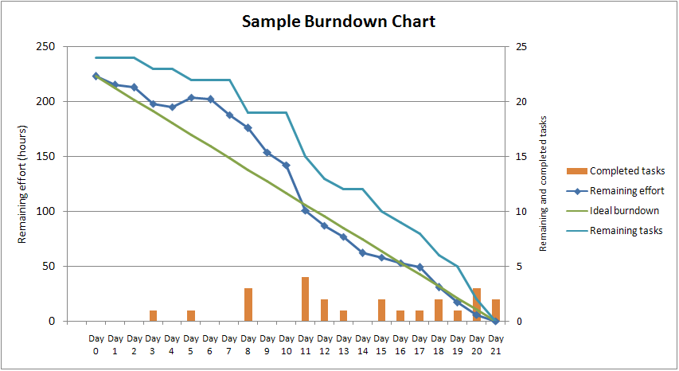
Agile likes burndown charts
“Velocity” is dy/dx on the remaining tasks.
Notes:
From http://en.wikipedia.org/wiki/Burn_down_chart

Slide 5
What if you’re not going to make it?
In agile, do you…
Work faster?
Work longer hours?
Reduce what’s due this sprint?
Push out the sprint deadline?

Slide 6

Agile Metrics
Why is the burn down chart not enough?
Hint: let’s say your team was accurately using an agile process yet generally slacking off – how would you know that?
Hint: let’s say your team was accurately using an agile process yet overall not producing enough value to justify continuing the project – how would you know that?
What I burned down today:
Notes:
Reddit image from http://onlinelearningtips.com/2013/05/08/why-you-should-follow-raskhistorians-on-reddit/http://onlinelearningtips.com/wp-content/uploads/2013/05/reddit_history-300x300.jpg

Slide 7
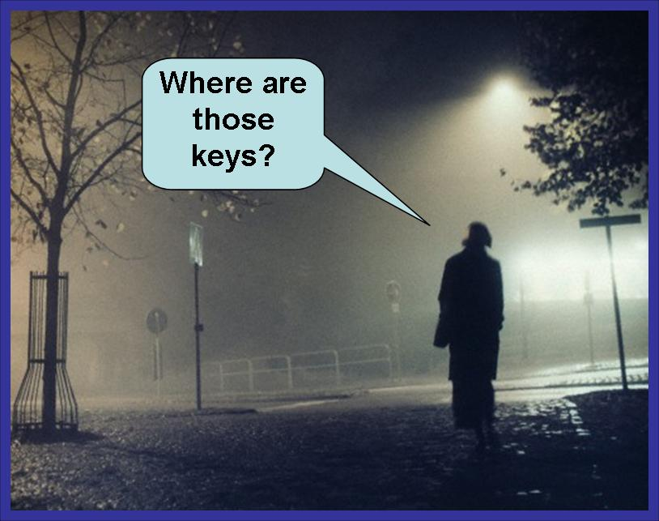
Measure value to the customer
First we must acknowledge that our performance measurement impacts agility
Second we must alter our obsession with time to an obsession for outcomes – that is customer value
Third we must separate the
outcome performance
measurement from the
output performance
measurement
  See next slide →
Notes:
Image from http://planninga-from-nanninga.blogspot.com/2010/08/strategic-planning-analogy-343-where-to.html

Slide 8
Outcomes vs. Outputs
Outcomes is a measure of the value produced for the customer
Output is various measures we can collect about our productivity
Output is only very approximately a proxy for outcomes
  Outcomes are delayed, for one thing
You actually want both (Highsmith)

Slide 9
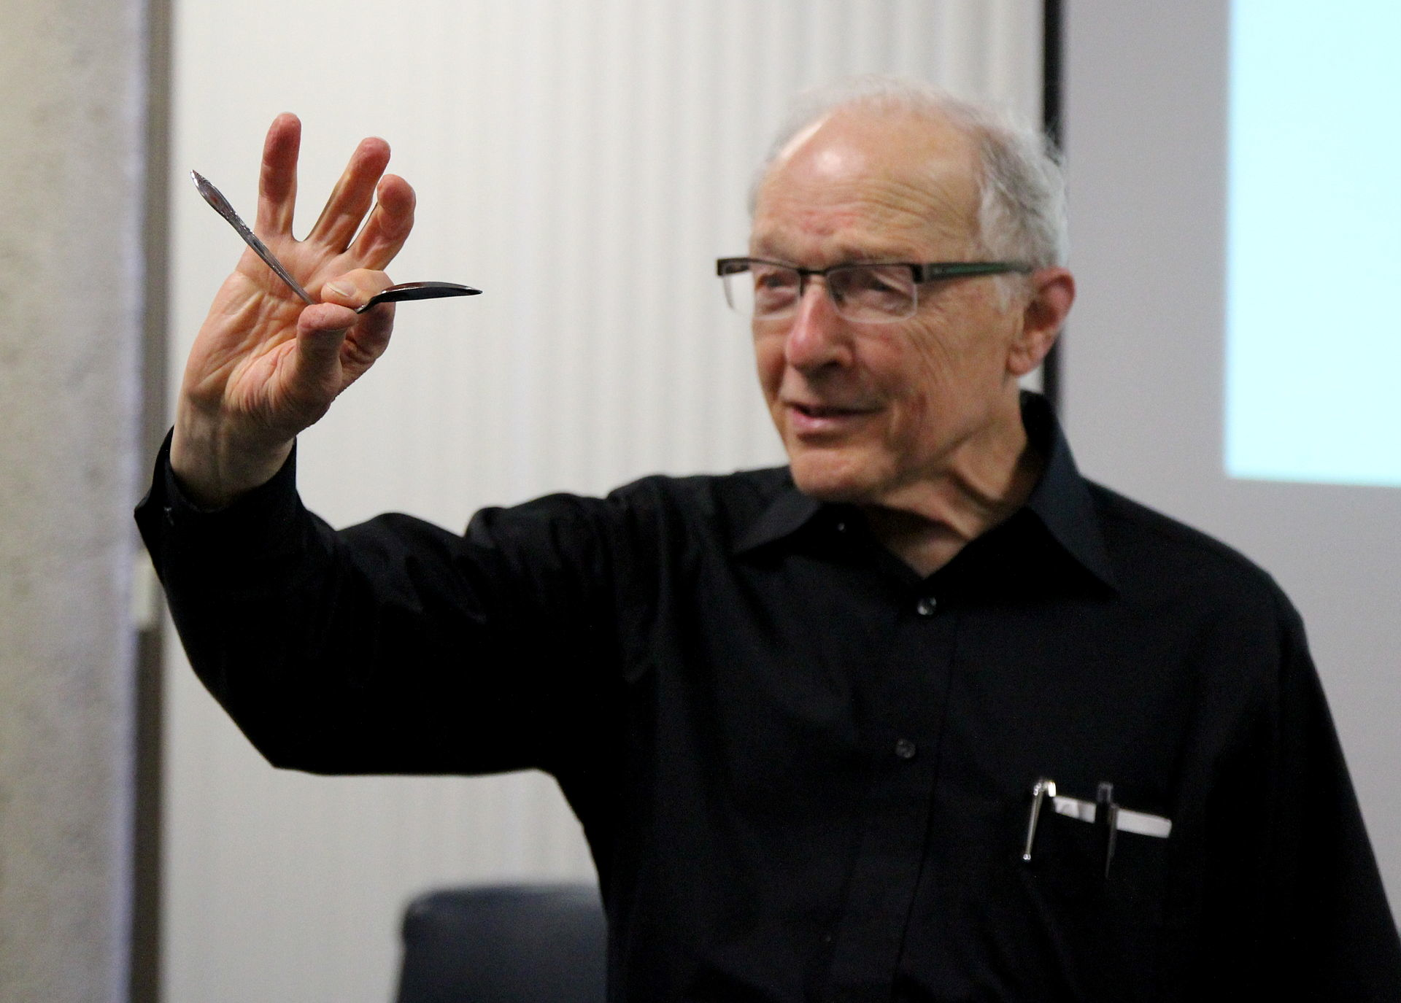
Problems?
On time
Under budget
Meets requirements
One company reported
it was on time, under budget, and met specifications 95% of the time
Above - Ray Hyman demonstrates Uri Geller's spoon bending feats at CFI lecture. June 17, 2012 Costa Mesa, CA
Notes:
Image from http://en.wikipedia.org/wiki/Spoon_bending

Slide 10
Beyond Burn Downs
Measuring value produced to the customer
Ensuring that your process is optimizing
Quantity of function
Productivity
Time
Effort
Reliability

Slide 11
Gaming the numbers
Highsmith says trying to improve metrics work for a while, and then start failing
Numbers apply pressure – a low to moderate amount of pressure is good
Where I am
Process improvement
My Office
Distance
CANDY

Slide 12
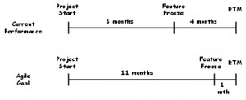
Shortening the Tail
Notes:
Image from http://jimhighsmith.com/shortening-the-tail/, same as on p 356.

