Slide 1
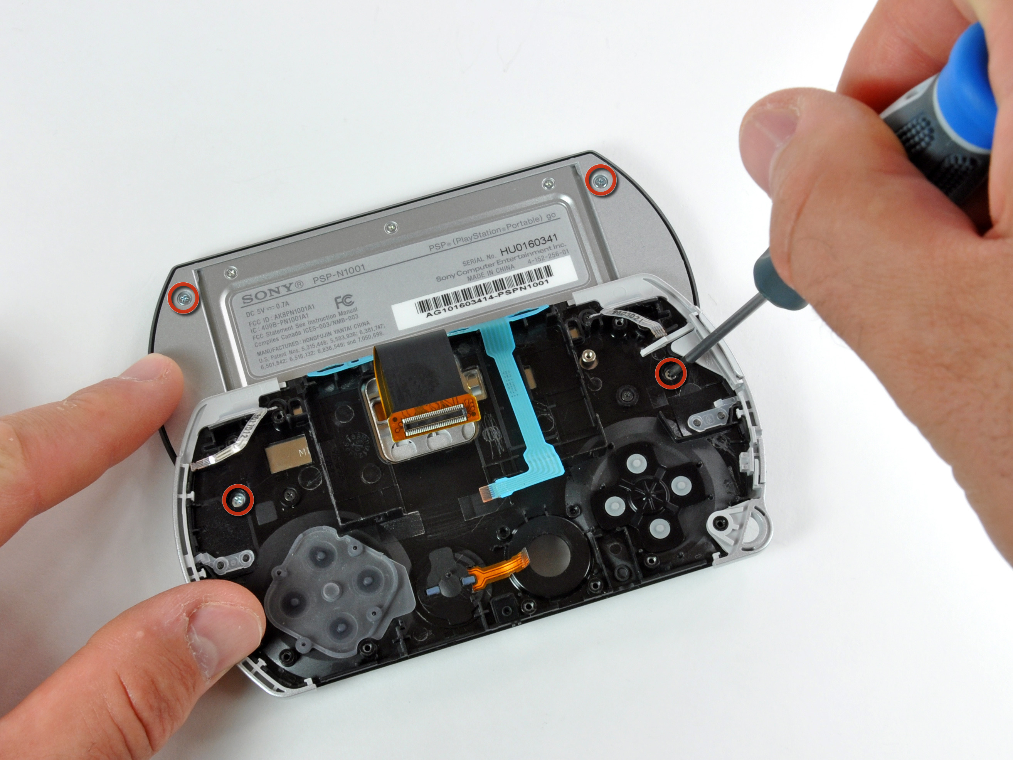

PSP – Monday & Tuesday
Starting to use it
with the ACM problems
“Why did we start putting software in cars?”
Notes:
PSP image of “How to fix a PSP” from https://www.ifixit.com/Device/PSP_Go.
Car blowing up from http://filmmakermagazine.com/87486-director-timothy-woodward-jr-on-shooting-action-sequences-and-the-futility-of-fixing-it-in-post/#.VCql_Uvselk.

Slide 2
PSP – Questions about forms?
Or ACM testing system?
  Java class must be named “main”.
“To Date” fields
  Your problems are small enough, we can leave these blank
Actual versus plan (your estimate)
  Do these!
  See if your estimates are getting better
Are all defects syntax?
  Can make subcodes for categories
What is “testing time”?
  You code, then when you start testing, all the rest is testing.

Slide 3
The weekend’s problems were practice
May toss timing results
Tonight – “How many can you do in 90 minutes?”
Pick something where you think you “get” what to do.
  Look at the problem just before starting.
  For now, keep Beta-wave thinking time out of the calculations. (Like go to dinner after reading it.)
  Use their automated tests to “know you are done”.
    Submit to ACM web site, after testing on your own.

Slide 4

Ideas for process improvement
How could you be faster at doing these types of problems?
  Discuss in groups of 3 or 4, for 5 minutes.
  Write down your team’s ideas, with your
  names on them, to turn in.
Generate a template for stdin/out.
Logging data like syntax errors? - would be nice!
Can we see the test cases? Link to test suite “here” above the problems.
Common errors Wiki?
  See Buffalo’s ICPC
  Problems Wiki, on Moodle!
More frequent planning.
Generic repository of useful
functions.
Turn on checking tools?
  But continue to log little errors.
Use debugger.
  More efficient than print statements.
Side sheet of silly logic errors (like = instead of ==).
A more refined set of bug-tracking codes.
  Buffalo will send out a spreadsheet for adding these.
Notes:
Clock image from http://www.speareducation.com/spear-review/2013/07/the-first-five-philosophy-of-success/five-minutes/

Slide 5
Things to track
Two things you want to track
  Discuss in teams of 3-4
  Write down your team’s ideas
Avg time
Avg velocity
Time spent in phases of the process
How many syntax errors?
Time spent logging (lump all together)?
Designing/planning to coding ratio, vs total defects?
Total number of defects per project and phase?
Time spent per bug (and by type)?
Number of times compiled?
Time spent planning?
Interruption time?
  What about long interruptions?
Does “longer” produce proportionally more bugs?
LOC vs rewrites required
How fast to fix?
Average time spent testing
Does planning reduce coding?
Bugs entered and fixed (on spreadsheet).
Severity of bugs.

Slide 6
Monday- Turn in forms from this weekend
Put your name on it.
→ Start working on problems.
Total of 90 minutes for tonight.
If you run out of problems, let us know!
Try to calculate lines of code/minute, including “everything”.
  Separate “logging per line of code.”
Need new blank forms.
Tonight – we may post Excel spreadsheet for this.

Slide 7
Tuesday – End up putting on common Google docs spreadsheet
First, use your own spreadsheet to log the data.
  On Moodle for Week 4, it’s “Buffalo’s PSP Tracking Sheet”
  Hang onto these, just in case!
When you’re done tonight, cut and paste to common spreadsheet, from your own spreadsheet.
  On Moodle for Week 4, it’s “Aggregate PSP Spreadsheet”.

