Slide 1
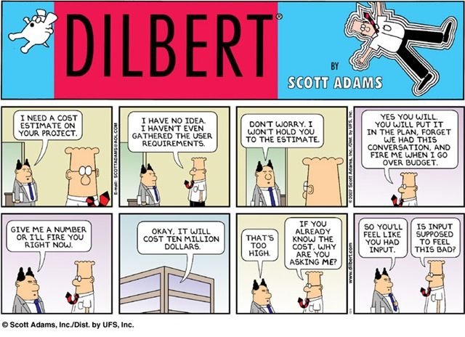

Old School Estimation
Notes:
Dilbert cartoon from http://lmsgoncalves.com/2014/08/11/sick-tired-losing-time-agile-estimations/

Slide 2
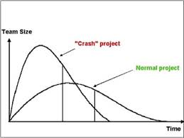
3 Models
Rayleigh
  Anticipates all stages of the process
  Doesn’t require a ton of previous data
  Estimates Staffing
  Assumes waterfall-ish
  approach
Notes:
Figure from http://www.bcs.org/content/ConWebDoc/12439

Slide 3
PSP’s probe
Built for *individual* productivity estimates
Relies of historical data, feeds back into the process
Break things into really small steps
Good for making yourself awesome

Slide 4
Philips’s Simple Estimation Technique
Relies on your ability to at least estimate small things correctly
Explicitly incorporates error
Easy and will at least get things started

Slide 5
Estimates vs. Commitments
Takes us back to Dilbert!
An estimate doesn’t mean I’ll do something in that length of time.
Saying that you will – that’s a commitment.
Need to verify if an estimate means that!
Notes:
See SPMH, p 222.

Slide 6
Try it out
Simplest Mail Client Activity

