Slide 1
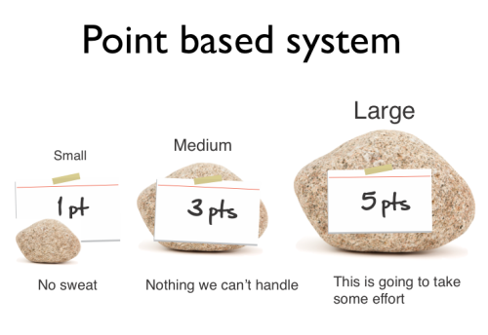

Agile Estimation
Notes:
Agile estimation method illustration, from http://agilewarrior.wordpress.com/2013/05/29/new-agile-estimation-video/

Slide 2

Get good at estimating
Classic problem – How much water comes out of the Mississippi River into the Gulf of Mexico each year?
Notes:
Image from http://noladishu.blogspot.com/2011/11/blum-and-roberts-2009-drowning-of.html
According to http://www.mississippiriverresource.com/River/RiverFacts.php, at New Orleans the average water flow is 600,000 cubic feet per second.
Since there are 31.6 million seconds in a year, and 147 billion cubic feet in a cubic mile, that makes 129 cubic miles of water in a year.

Slide 3
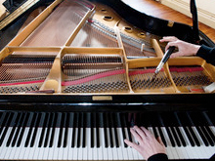
One more
How many piano tuners work in Terre Haute?
  61,112 people live here.
  There are 2 easy-to-find piano teachers listed.
  Indiana State University has a music school with 4 listed piano faculty.
  Schools and churches
  all have pianos,
  including Rose.
  Almost every child who takes
  piano lessons has a piano
  at home.
Notes:
The yellow pages on the web list 3, on 9-20-2014.
Image from http://www.thomdeanpianotuningandrepair.com

Slide 4
How do estimates go wrong?
Step 1: Developers due to pressure or optimism underestimate how long things will take
Step 2: Bad Problems
  Customer apply the pressure to make that schedule
  People get anomic*
FeatureDevotion is part of this, too. How?
*Sociologist Emile Durkheim’s term.
Notes:
Wikipedia entry for anomie is at http://en.wikipedia.org/wiki/Anomie

Slide 5
When should you estimate?
Fowler has a specific answer
Some Examples –
Allocation of resources.
  Organizations have a mostly fixed amount of money and people, and
  Usually there are too many worthwhile things to do.
Putting stories into the schedule.
  Points versus team velocity
Notes:
See p 10 of the pdf reading assignment from ThoughtWorks.

Slide 6
Why do it, exactly?
Fowler argues that you should never estimate unless you need the estimate to inform a particular decision.
For us, estimation is valuable when it helps you make a significant decision.
If they are going to affect significant decisions then go ahead and make the best estimates you can. Above all be wary of anyone who tells you they are always needed, or never needed. Any arguments about use of estimation always defer to the agile principle that you should decide what are the right techniques for your particular context.

Slide 7
“Points” or “ideal days”
What did Anand Vishwanath recommend?
A relative comparison of stories
Both development and testing time
Use Fibonacci numbers?
Why is this better than using “ideal days”?
The real resulting days don’t verify estimates!
Points are a relative, abstract scale, like “utility” is used in economics to represent value.
Notes:
See p 9 of the pdf reading assignment from ThoughtWorks.

Slide 8
Spikes
A place where it’s hard to estimate points.
Can figure backwards –
  It’s worth a week for half the team.
  So, how many points is that?
Can change later estimates!
Usually the spike is “throwaway” code.
Notes:
See pp 10-11 of the pdf reading assignment from ThoughtWorks.

Slide 9
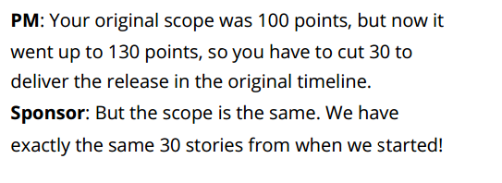
Now Points are Bad Too!
Stories represent 3 things:
Feature/Function
Richness/usability/depth
Technical complexity

Slide 10
Why are we doing this, again?
The major problems they want to solve by estimation are:
• Derive an estimated scale for a new bucket of stories to help plan future releases.
• Provide an estimated eﬀort for each story to help the business prioritize better (from a ROI perspective, value vs. cost)
• Synchronize the derived understanding of the story and its context across all distributed locations.
• Gain conﬁdence and build customer trust by fully understanding the business/ technical context before commitment to build.

Slide 11

People are the fragile part
Reflect on differences and Alistair
Cockburn’s discussion of the effect
of process
See IEEE Computer, Nov 2001,http://www.uml.org.cn/softwareprocess/pdf/IEEEArticle2Final2.pdf
Agile puts more emphasis on people.
A little more process costs you a lot.
Individual strengths are crucial.
People are highly variable and non-linear, with unique success and failure modes.
Notes:
See also http://alistair.cockburn.us/Characterizing+people+as+non-linear,+first-order+components+in+software+development/v/slim
Image – Cockburn demos how people can be non-linear. From http://alistair.cockburn.us

Slide 12
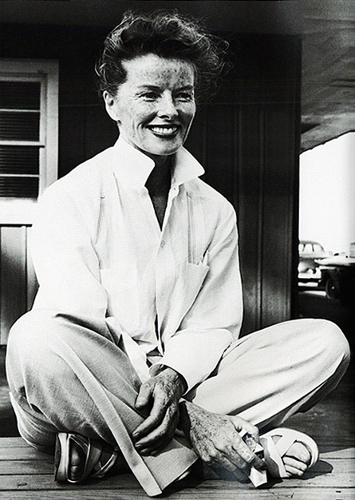
Cockburn’s “Oath of Non-Allegiance”
I promise not to exclude from consideration any idea based on its source, but to consider ideas across schools and heritages in order to find the ones that best suit the current situation.
Or,
If you obey all the rules,
you miss all the fun.
- Katharine Hepburn
Notes:
http://alistair.cockburn.us/oath+of+non-allegiance
Hepburn image from http://dressme-styleicon.blogspot.com/2013/03/katharine-hepburn.html

