Slide 1
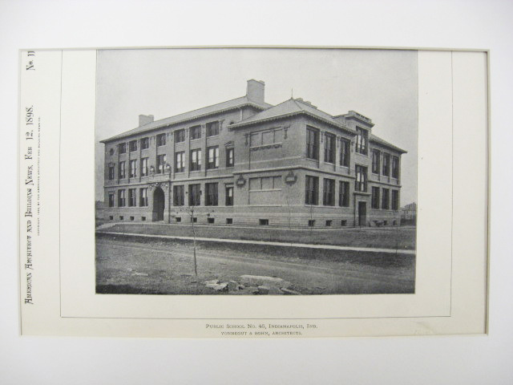

Planning – Old School
Plus a lot of stuff about process
Notes:
Print is of School 45 in Indianapolis, my grade school. Built in 1898. Architects were Vonnegut and Bohn. The Vonnegut was novelist Kurt Vonnegut’s grandfather. See http://en.wikipedia.org/wiki/Vonnegut_%26_Bohn. Image from http://www.stcroixarchitecture.com/products/public-school-number-45-indianapolis-in-1898-vonnegut-and-bohn

Slide 2
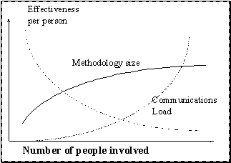
Alistair Cockburn’s principles for selecting a methodology
A larger group of people
needs a larger methodology.
A system whose undetected
defects will produce more
damage needs more publicly
visible correctness.
A relatively small increase in
methodology adds a
relatively large increase in cost.
The most effective way to transmit ideas among people is face-to-face interaction at a whiteboard.
Notes:
See http://alistair.cockburn.us/Methodology+per+project, which the figure also is from.

Slide 3
Get into teams by number, 1-4
Ref Phillips Sec 6.2.1 – 6.2.6 copy out on Moodle.
1’s – Prototyping, 6.2.1
2’s – RAD, 6.2.2
3’s – Spiral, 6.2.4
4’s – Lean (Agile), 6.2.5
Answer the 3 questions on the handout sheet!
We’ll show each team’s results on the screen.
Notes:
Section 6.2 starts on p 161.
Also see Section 6.4.5 starts on p 222.
Other resources - Fig 6.48 and 6.46 are on pp 230 and 228, respectively.

Slide 4
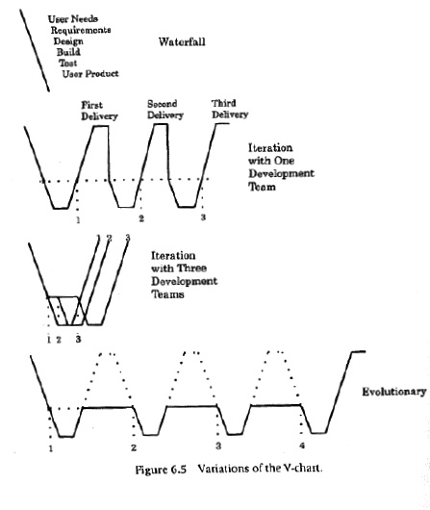
Behold the Waterfall and some V-charts
Notes:
Image from SPMH p 162

Slide 5
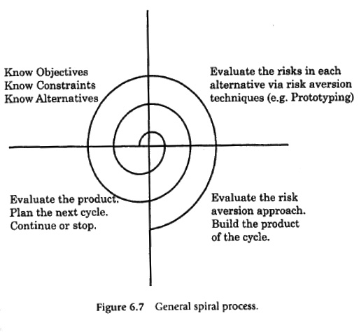
Behold the Spiral
Notes:
Image from SPMH p 169

Slide 6
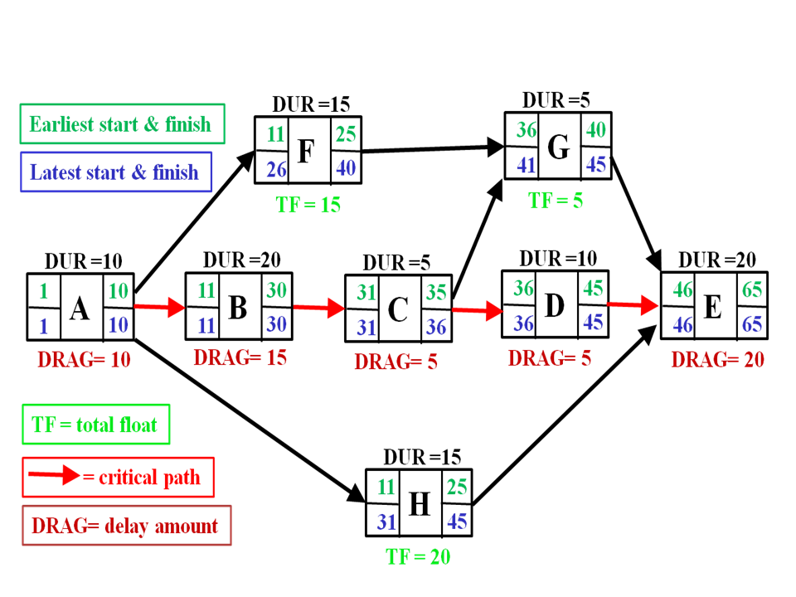
Making the PERT chart
Cards on the wall
Find critical path
Notes:
See SPMH pp 198+
Image is from http://en.wikipedia.org/wiki/Critical_path_method

Slide 7
Philip’s Waterfall Example
“Your primary customer wants a new report capability. This is similar to many of the projects you have done in the past. You and your customer know the product well, so you select the straight waterfall process…”
Notes:
SPMH p 223

Slide 8
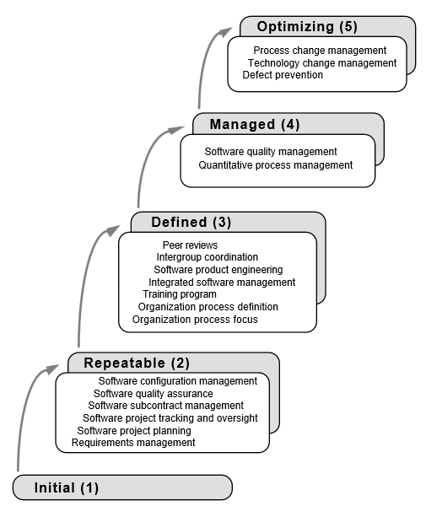
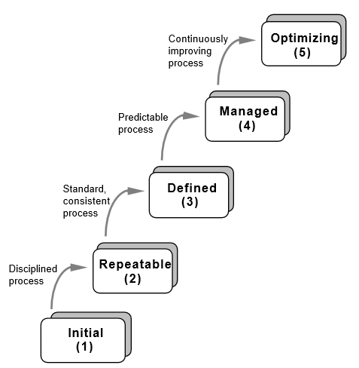
CMM - Can this be agile?
Notes:
See SPMH pp 184+

