Slide 1
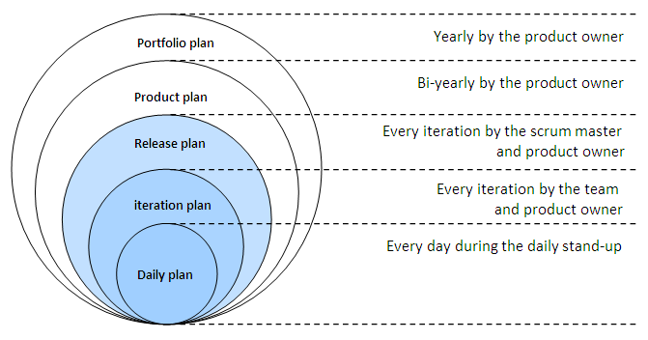

Planning – Agile Style
All kinds of iterations!
Notes:
Picture is the Agile Onion, from http://johandecoster.wordpress.com/category/estimating-and-planning/

Slide 2
How iterations simplify planning
3 main ways?
Flexibility – change when you discover issues
  Know where problems are before committing
It’s easier than up-front planning
Feedback to customer
  Lets them changer their mind
But – need to avoid “looming technical risk”
  Dodging “technical debt” – like building the DB

Slide 3
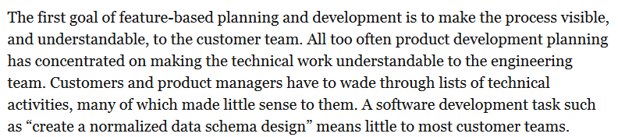
Visibility of iterations…
Difficult to explain to the customer:
Developer Skills
Technologies
Integration

Slide 4
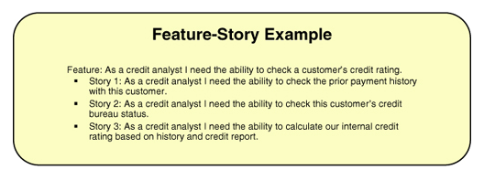
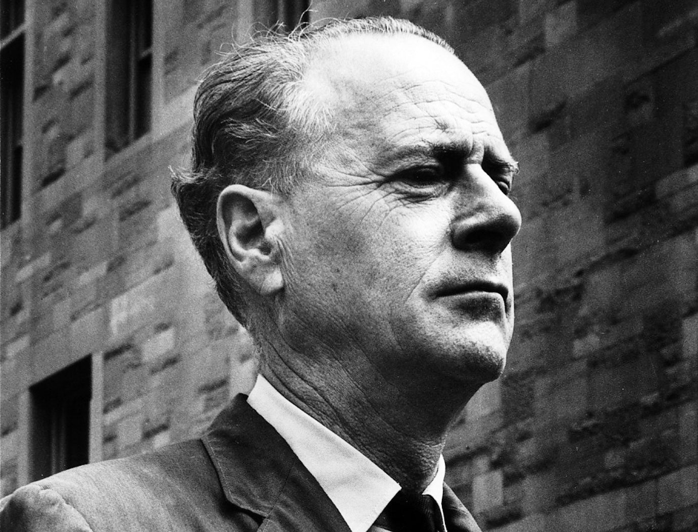
What’s a user story look like?
“The medium is the message.”
- McLuhan
Notes:
Marshall McLuhan image from http://www.periodicoenfoque.com.mx/2012/07/influyo-mcluhan-en-la-cultura-de-la-segunda-mitad-del-siglo-xx/

Slide 5
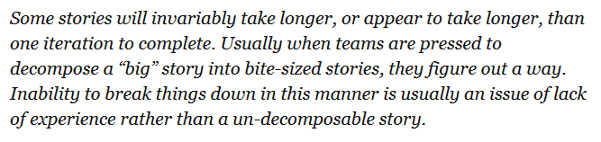
How about big, messy stories?
How about technical stories?
“A script will migrate the old database to the new system.”

Slide 6

How about things we discover they need?
“In planning a product, however, some items that need to be delivered may not sound – at least to customers or product managers – as though they provide direct benefit.”
Client wants children to be main users
For safety, they’ll all need to have short hair
To guarantee that, our system better provide the haircuts!
Notes:
Haircut image courtesy of http://library.austintexas.gov/archive/201211.

Slide 7
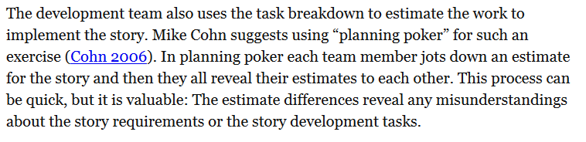
Remember planning poker?

Slide 8
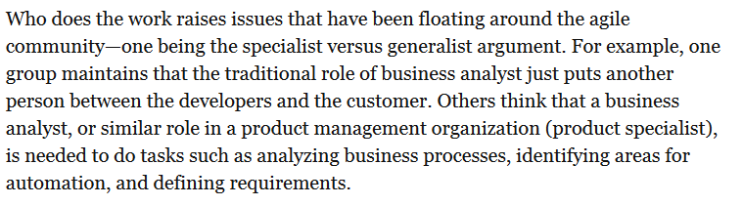
Remember the Business Analyst?

Slide 9
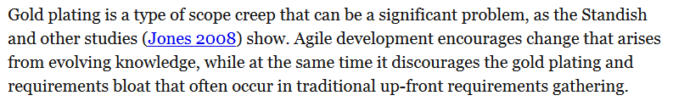
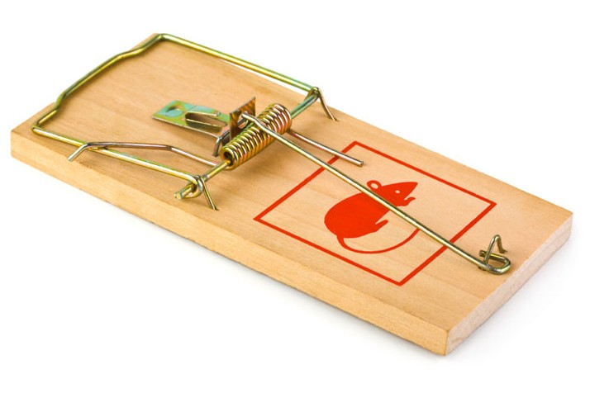
High quality ≠ More elaborate
Notes:
Unimproved mousetrap from http://cottagelife.com/13796/diy/tools-products/choosing-a-mousetrap

Slide 10
Iteration 0
Anticipation vs adaptation
See Highsmith’s presentation at http://agile2009.agilealliance.org/files/session_pdfs/Agile_2009_Release_Planning_Handouts.pdf, Slides 13 – 15.

