Slide 1
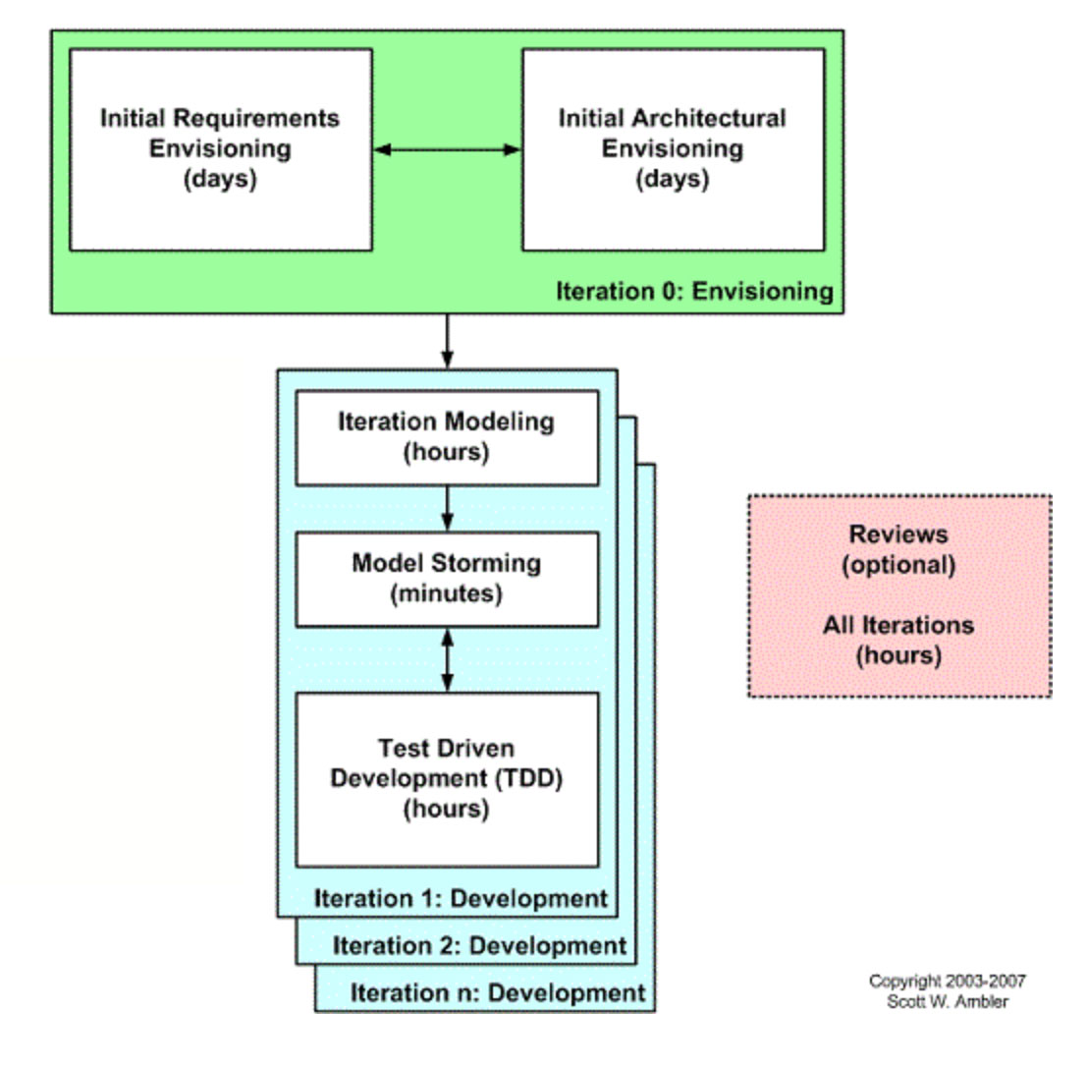
APM - Requirements
Notes:
Image – Scott Ambler’s version of the agile lifecycle, at http://agilemodeling.com/essays/agileRequirements.htm

Slide 2
Differences…
What is different vs. Philips?
What is the same?
How does Highsmith violate the Agile orthodoxy?

Slide 3
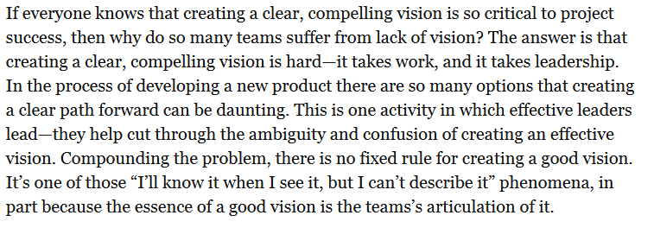
Contrast with Philips

Slide 4
Equivalents?
Do you think Highsmith’s “design the box” exercise of is similar to Philips’s Facilitated Meetings?
And is his Elevator Statement like the one you did in Tech Comm?
  For
  Who
  The
  That
  Unlike
  Our product
Notes:
P 96

Slide 5
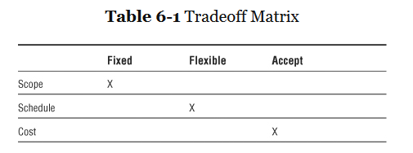
Like Microsoft’s Triangle?

Slide 6
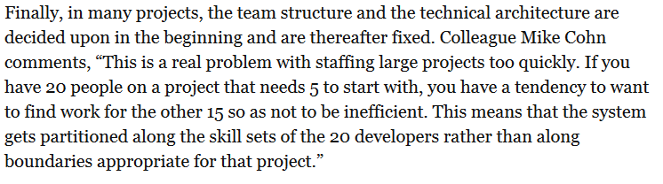
Design vs People Needs

Slide 7

Reliance on Quality People

Slide 8
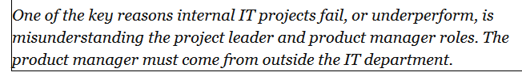
Product Manager – Arm’s Length

Slide 9
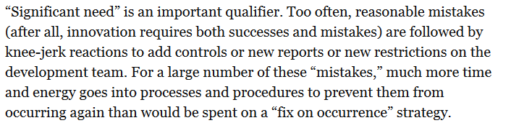
Not my experience on student projects

