Slide 1
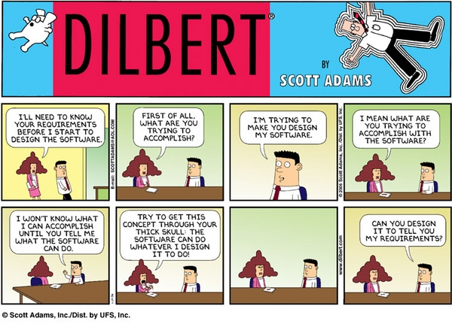
Requirements – “Old School”
Notes:
Dilbert cartoon from http://www.machinediscovery.com/nise/help.html

Slide 2
What did you think of SPMH?
Was it interesting to read?
Do you think it’ll be useful to you?
Lots and lots of possible tricks to use –
  It’s like a reference for experts
  Start with what Chandan’s giving you in 371

Slide 3
Step 1: There’s No “Customer”
In traditional IT-style software development, a “Business Analyst” type person writes the requirements.
  See http://thebusyba.com/the-ba-role-is-not-to-gather-requirements/
Customer(s)/ → Business Analyst → Developers
Product Mgr

Slide 4
What points were interesting to you?
Like, all the tricks Phillips describes?
What they mean?
And which ones to try?
And which ones will be covered in 371?

Slide 5
A few points I thought were key
“Tense situations”
  When customers are frustrated
  When the problem is bad management
  Managing expectations
Requirements Management: How to keep track of the decisions & make new ones?
How to get to “baselined requirements”?

Slide 6
Let’s talk techniques
Facilitated Meetings (JAD) – have a big meeting with all the stakeholders, start with a draft, have a bunch of extra people help document it, then turn that into a big requirements doc a few days later
System Storyboarding Technique – write random ideas on sticky notes and stick them on the wall

Slide 7
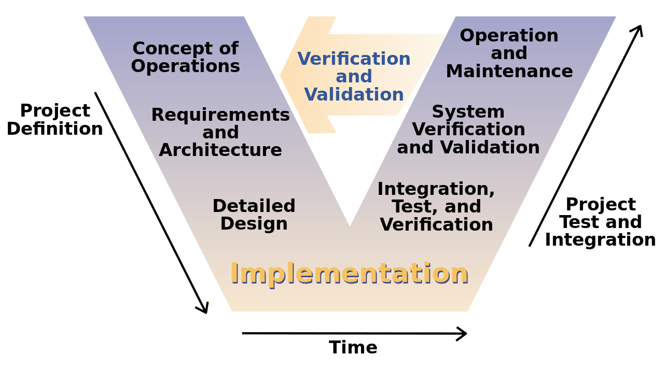
New, strange things…
ConOps – How they “do this” –
  Could be a video that shows detailed operation of the “concept” of the product
Mind Maps – crazy sketch of the various pieces of the product
Gilb Charts – turns qualitative requirements into quantitative ones
All sorts of software diagrams
→ See Phillips pp 270-1 for a good example!
Notes:
Image from http://en.wikipedia.org/wiki/V-Model

Slide 8
Elements of a good document
What is it’s function?
What is the management view?
Who are the readers?
What conventions must it follow
“Avoid creating a document to satisfy a checklist. If a document is not necessary, don’t create one. If it is necessary, it requires diligence from its creators and reviews.”

Slide 9
Characteristics of a good requirements document
Written by the developers or written by the customers?
“What if” requirements
Detailed in the right places, vague in the right places
Verifiable
Understandable by the customer
Traceable
Signed by the stakeholders

