Slide 1


Today’s Plan
In Class Exam – Quick Review
Thoughts on your Junior Projects, cntd
People and Roles on Projects
Notes:
Image from http://www.entrepreneur.com/article/236307

Slide 2

Mike’s Hints for Junior Projects
Move risk early
Constantly give working versions for your customer to try out
Code a specific amount of time each week, and if possible code together
Remember that the goal is to deliver good software to the customer (not just to do academically well in the courses)

Slide 3
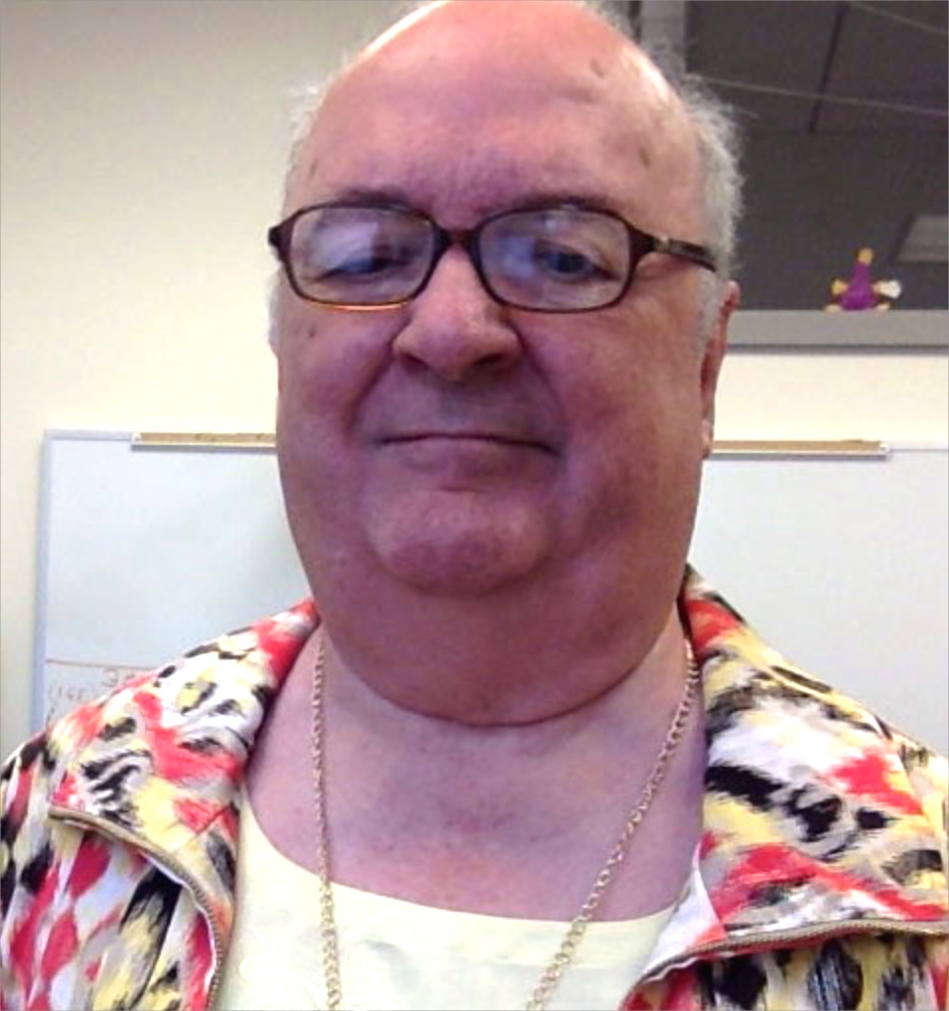

Steve’s Hints for Junior Projects
It’s normal to be worried at the start
Fail fast – work on hardest part first
These are new ideas – expect changing req
Find a way for every team member to add value (“Positive interdependence”)
Dual project goals are common in industry
  “Deliver good software to the customer” and
  Add to the team’s IP base, making the next job easier – so has to follow your own standards, etc.
  See next slide, from first day of class →
Notes:
Picture of Jascha Heifetz from http://www.jaschaheifetzsociety.org.

Slide 4
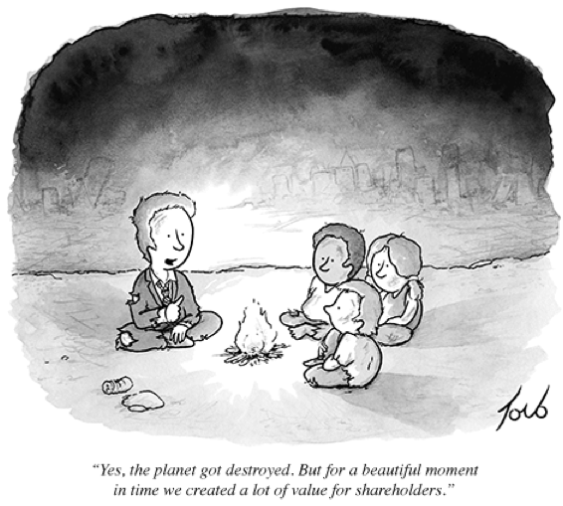
Sample big strategy – to combat risk
Harvard Business School’s steps in entrepreneurship:
  Perceive where extraordinary value lies.
  Create that value for customers.
  Capture it in rewards for your
  work.
Essence of requirements
discovery! But what do
you do with that value?
“Yes, the planet got destroyed. But for a beautiful moment in time we created a lot of value for shareholders.”
Notes:
Cartoon from http://www.ritholtz.com/blog/2012/11/shareholder-value/.
HBS’s steps from Daniel Isenberg, Worthless, Impossible, and Stupid: How Contrarian Entrepreneurs Create and Capture Extraordinary Value. Harvard Business Review Press, 2013.

Slide 5
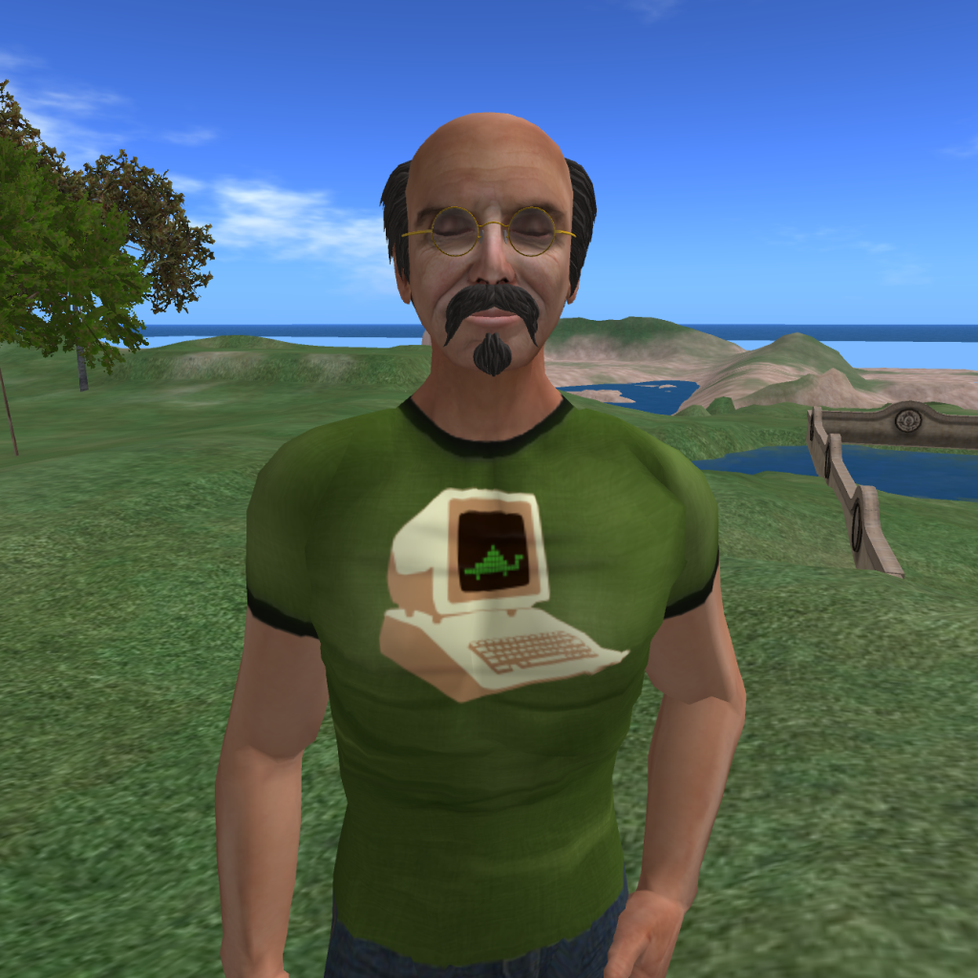
What are Project Roles?
“A role is defined mostly in social context as a set of connected behaviours, rights, obligations, beliefs, and norms as conceptualised by actors in a social situation.”
On a project, these are temporary and bounded by working with others on that project.
Everyone sees these roles differently:
  E.g., To a customer, you can’t blame teammates.
  E.g., Within the team, you often get treated in line with the perceived value of your latest contribution!
In industry, a project team is like a game, only you get paid. Everyone takes on a “persona” for that particular activity, related to the team’s expectations of you.
Notes:
Definition is from http://en.wikipedia.org/wiki/Role_(disambiguation)
See http://en.wikipedia.org/wiki/Persona for more on personas.
Avatar image from http://poultryreport.blogspot.com/2012/09/avatars-characters-persona.html

Slide 6
Review of Manager Roles – in my experience
Project Manager – in charge of “burndown” – keeping the project moving & people busy
Manager (Resource manager) – in charge of the people, usually on several projects
“Release Manager” – decides what goes out
Product Manager – in charge of project success, hands out money, may be an exec
Program Manager – a higher level product manager with a portfolio of projects

Slide 7
You can tell a lot about a process by the people roles it has
XP – only programmers and customer
In Scrum, the customer is called the “product owner” – is there are difference?
In Phillips’ Waterfall – the “configuration management” people are special
At Microsoft – developers and testers

Slide 8
Roles we haven’t talked about
Designer / Architect – Has a “design manager” social role, customer link
Tester – Interacts with developers and with release manager
Senior Developer – Fits current project to technologies, guides junior developers
Contractor/Specialist – Does things we don’t
DB engineer – Designs backend interfaces
And…

Slide 9
Where’s a Requirements Engineer Fit?
Customers
Requirements Engineers?
Developers
Marketing?
Engineering?

Slide 10
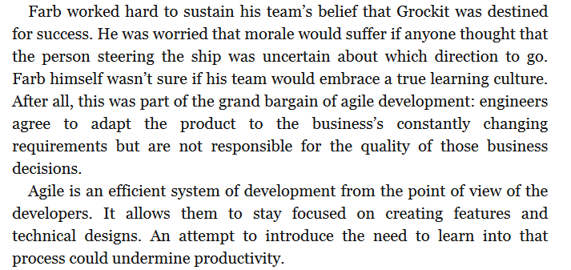
Fragile agile
Notes:
Quote from The Lean Startup: How Today's Entrepreneurs Use Continuous Innovation to Create Radically Successful Businesses, by Eric Ries, p 134

Slide 11
A role you’re just learning about
The ScrumMaster is a "servant leader" who helps the rest of the Scrum team follow the process. The ScrumMaster must have a good understanding of the Scrum framework and the ability to train others in its subtleties.
The ScrumMaster helps the product owner understand how to create and maintain the product backlog. He or she works with the entire Scrum team to evolve the Definition of Done. The ScrumMaster also works with the development team to find and implement the technical practices needed to get to Done at the end of each sprint.
Another responsibility of the ScrumMaster is to remove impediments to the team’s progress. These impediments may be external to the team (such as a lack of support from another team) or internal (such as the product owner not knowing how to properly prepare the product backlog). That said, the ScrumMaster fosters self-organization, meaning that the team itself should remove issues wherever possible.
The ScrumMaster may facilitate meetings and always acts as a coach for the Scrum team, helping it execute the Scrum process. He or she helps team members work together and learn the Scrum framework, and protects them from both internal and external distractions. The ScrumMaster keeps the Scrum team on track, productive, and growing in ability.
Notes:
More about the ScrumMaster’s role is at http://www.mountaingoatsoftware.com/agile/scrum/scrummaster

Slide 12

Requirements
Generally a weakness of Agile processes
  How do agile processes get around this?
Whose role to make the req all consistent?
“How do all these user stories they want relate to each other?”
Notes:
Image from http://thebusyba.com/the-ba-role-is-not-to-gather-requirements/

Slide 13

Architecture
Can be a weakness of Agile processes
  How do agile processes get around this?
  Who keeps the whole thing working together?
Whose fault if the whole thing doesn’t work?
Notes:
Image from http://www.ironegg.com/website-tips-basic-requirements-to-start-a-website/

Slide 14
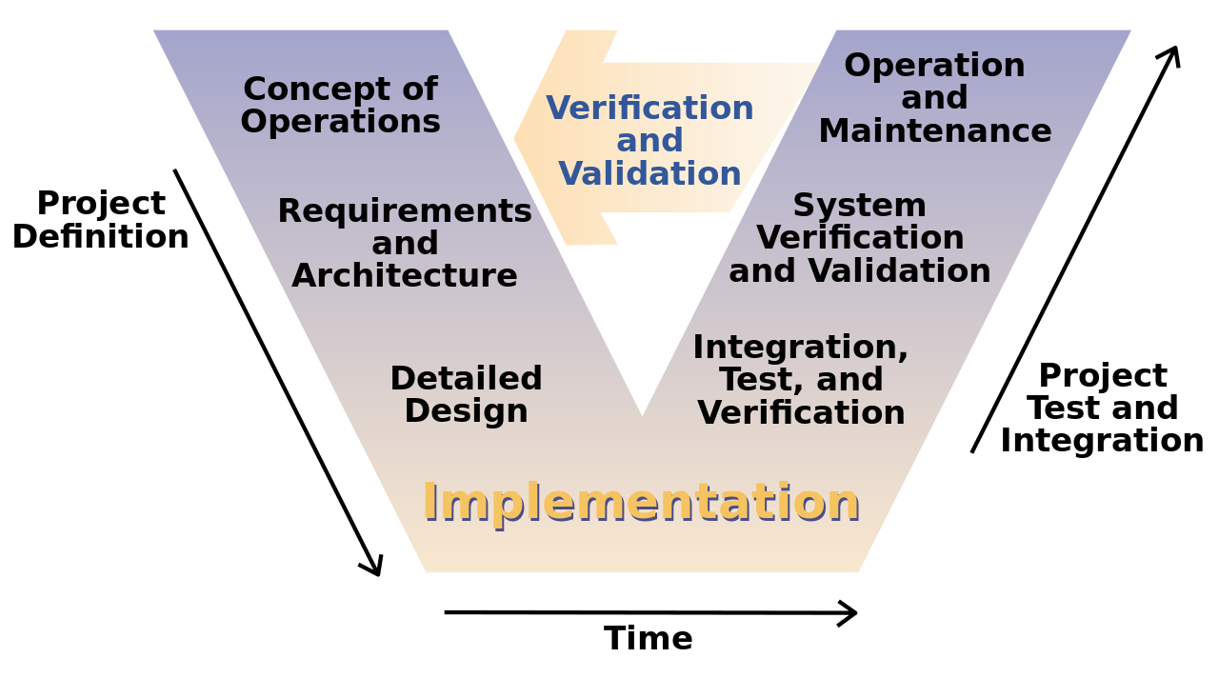
System & Acceptance Testing
The reverse of architecture and req, resp.
With Agile, how do you know those are right?
This is the “V model” of systems engineering. Acceptance testing is via “system verification and validation”.
When and where is this testing done before you ship it?
Notes:
Image from http://en.wikipedia.org/wiki/V-Model

Slide 15


Hybrid Approach Possible?
Let’s take testing as an example
MS – Lots of professional testers
Scrum/XP – not really a thing
Why wouldn’t you just add a professional testing in a simplistic way (say, to an XP project)?
Is there any role for professional testers on an agile project?
Notes:
Spider image from http://en.wikipedia.org/wiki/Zebra_spider
Cheetah image from http://www.discovery.com/tv-shows/man-cheetah-wild/videos/cheetah-videos.htm

Slide 16
Specialization
Every developer uses the database
There’s a database expert on the team
There’s a database team that you need to get approval from
There’s a separate team that handles storing your data for you

