Slide 1
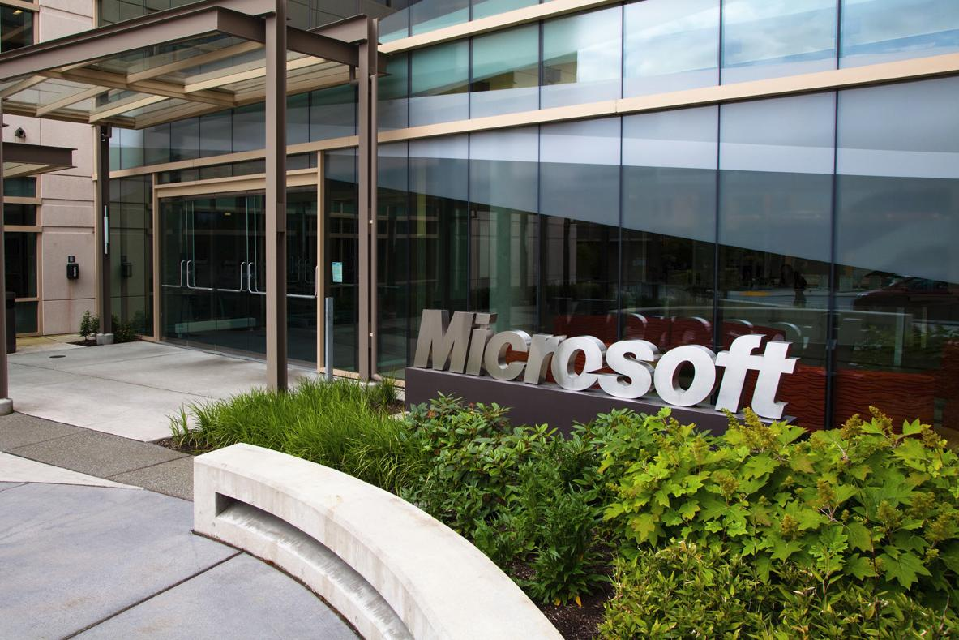

Microsoft’s Process
Redmond in the 90’s
Article by Roger Sherman, Director of Testing, Worldwide Products Group, Microsoft
Notes:
Microsoft headquarters image from http://www.digitaltrends.com/home/microsoft-just-launched-accelerator-program-home-automation-startups/#!bQ3tlS.
Article is from American Programmer, February, 1995.

Slide 2
What did you think was interesting about MS process?
What did you like?
What didn’t you like?
What was surprising?

Slide 3
Why isn’t it waterfall?
Milestones
  Several per customer release
    Goal – fix bugs early
  Stages the features
  Acceptance testing toward the end of each
    Test release document – scope
  “Post-mortem” after each, also plans next
This is an “spiral” development approach
When “code complete” goes to mfg.

Slide 4
Let’s talk “requirements”
These are what you do “acceptance testing” against!
Final acceptance criterion – 5 days of testing without a “must fix” bug
Reliability = “code stability”
Microsoft’s “client” is a product manager
→ See next slide!

Slide 5
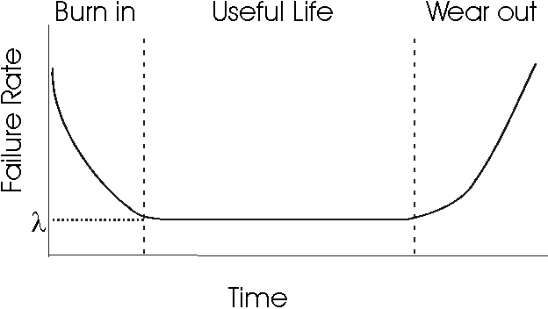
What is “reliability” here?
At Microsoft:
Rate at which the end user will encounter anomalies.
Goal is to maintain a product’s reliability while new features are being added.
And to increase reliability in the system testing phase until “good enough”.
Right – This is the classic reliability “U-curve” used in all of engineering. Does the “Wear out” phase happen with software?
“Bug convergence”
Notes:
Image from http://users.ece.cmu.edu/~koopman/des_s99/sw_reliability/

Slide 6
Let’s talk “requirements” - process
Vision statement
Analysis of competitors products
Satisfaction surveys
Annotated user studies
New technologies
Brainstorming to get great new features

Slide 7
From spec to schedule
Product specification
Divided into features
Milestones
Reliability
Schedule
Feature Set

Slide 8
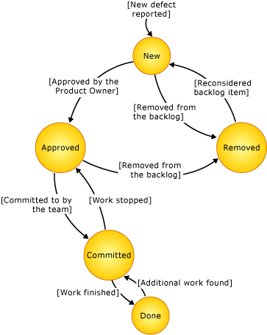
Tools
Source control – “Source Library Manager”
Bug tracking – RAID
  Does problem-resolution work-flow
  Also links issues to “release-ability” of the product
  And – can test hypotheses about causes!
Automated “project testing” by each developer
Putting “asserts” into debug versions of the code
Overnight “teacher pupil” test runs
  Automated tests – nearly 100% coverage
  UI testing with “monkeys”
Above – This is one of the bug tracking work flows you can choose today, built into Visual Studio.
Notes:
Image from http://msdn.microsoft.com/en-us/libraRy/ms400752(v=vs.110).aspx

Slide 9
Do they have Configuration Management?
Assumed to be a part of their bug resolution and feature selection processes for a release
Each developer also appears to have a “sandbox” for testing their own code in a build

Slide 10
Deciding what to launch
Reliability
Schedule
Feature Set

Slide 11
How many different kinds of testing are there?
Teacher/Pupil
Automated Regression Testing
Beta Testing
Monkey Testing
Intelligent Monkey Testing
Resource Constraint Testing
Daily Build Testing
Smoke Testing
Likely a bit of manual testing although they don’t talk about it too much

Slide 12
What different forces does MS have vs. more agile-oriented places?
They have to decide what works best, over a huge customer base
  E.g., tool bars vs menus vs hot keys
They are the “experts” on new features
  Propose these to management
  Must “exceed customer expectations” – want “best of breed”
  Their product experts challenge a product vision
Don’t put out partial products
  Do put out “betas”
High cost of recalls

Slide 13
Update on Microsoft’s Process
See https://www.cs.duke.edu/courses/fall98/cps108/slides/MSdev.pdf

