Slide 1


Extreme Programming

Slide 2
12 Practices
The Planning Game
Small Releases
System Metaphor
Simple Design
Continuous Testing
Refactoring
Pair Programming
Collective Code Ownership
Continuous Integration
40-Hour Work Week
On-Site Customer
Coding Standards

Slide 3
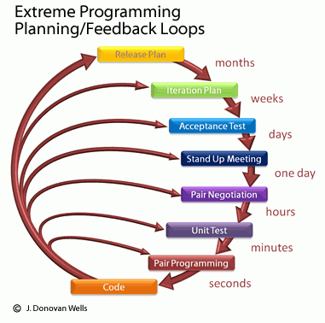
Day to day life on an XP team
Hint: starts with a daily “standup” meeting much like Scrum’s scrum
Notes:
Image of XP process from http://accelerateddevelopment.ca/blog/tag/requirements/.

Slide 4
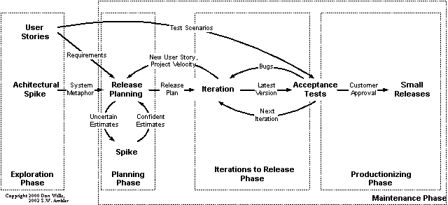
How does XP remove the need for extensive up-front requirements analysis?
Notes:
Image from http://eternalsunshineoftheismind.wordpress.com/2013/03/04/extreme-programming-xp-method-of-developing-i-s/.

Slide 5
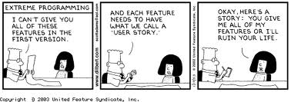
Or,
Notes:
Image from https://samup4web.wordpress.com/tag/user-story/.

Slide 6
How does XP remove the need for extensive design?
What about API conflicts?
What about the code getting bad?
What about making bad design decisions and finding out about it later?
“simplest thing that could possibly work”

Slide 7
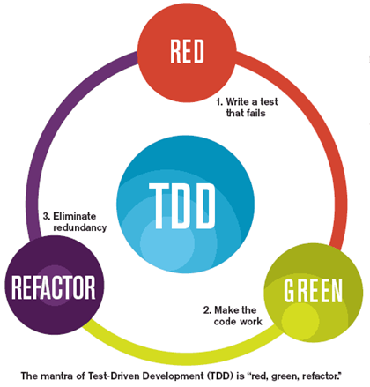
How does XP remove the need for extensive testing?
Notes:
Image from http://blog.typemock.com/2012/04/what-is-test-driven-development.html.

Slide 8
What are the limits?
*The Planning Game
Small Releases
System Metaphor
*Simple Design
*Continuous Testing
Refactoring
Pair Programming
Collective Code Ownership
*Continuous Integration
40-Hour Work Week
*On-Site Customer
Coding Standards

Slide 9
The difficulties of “the customer”
Custom development situation…
Product development situation…

Slide 10
Adding more programmers to an XP project
How many before relationships have to be more formal?
Can they be remote?

Slide 11
Your questions from the reading quiz
My pick
Your choice

