Slide 1
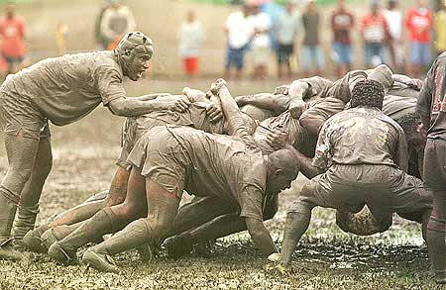

Waterfall/Scrum
We recommend you take notes because specific aspects of the processes will be on the exam.
Notes:
Pictured is the savage Scrum of the game Rugby, from which the Scrum agile software development process gets its name. From http://www.coretrek.no/scrum-i-et-noetteskall/category642.html.

Slide 2
This week’s plan
Learn 4 specific processes in 3 days
In class/takehome exam on them
  Friday
Goal – You know these well enough to discuss with other people in the software business.
  Say, on Oct 1!

Slide 3
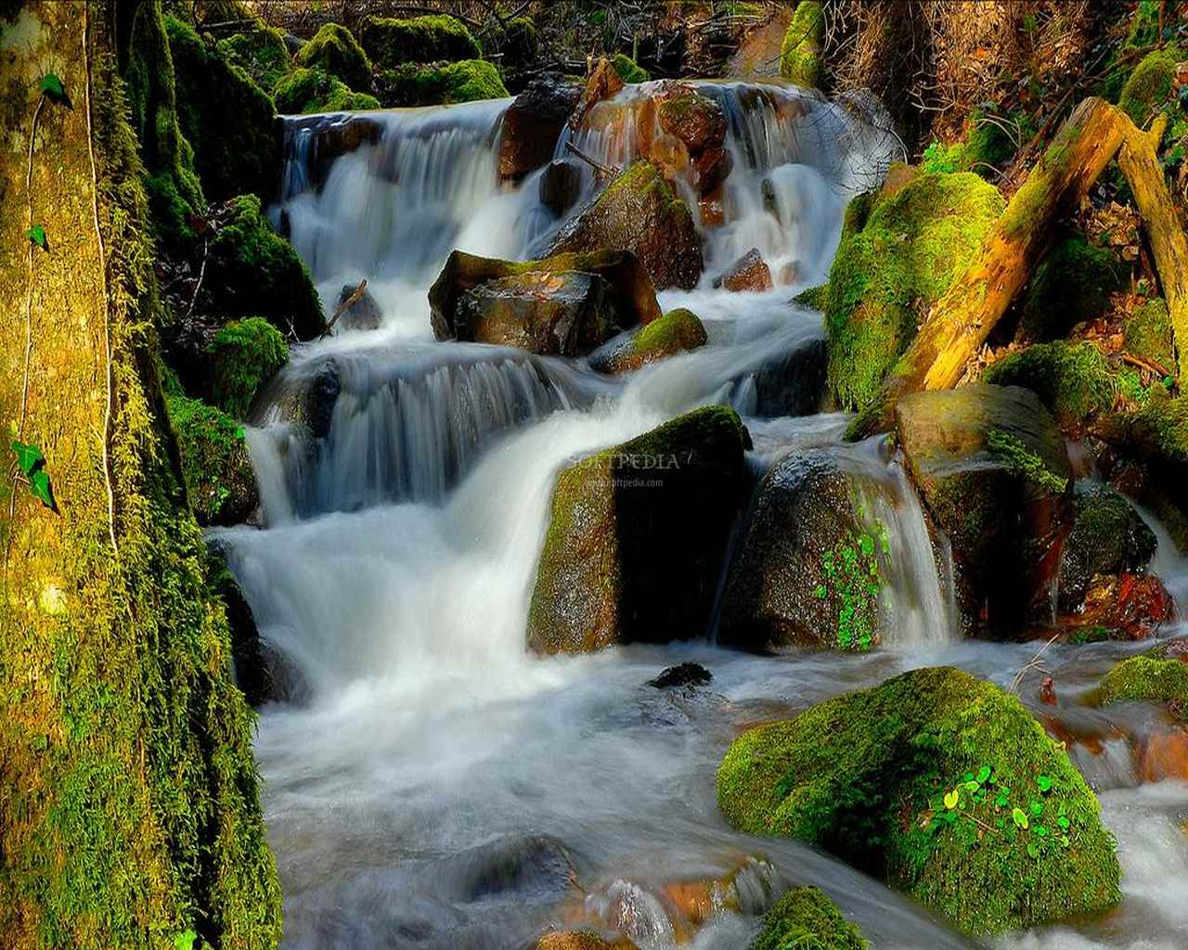
What is the waterfall process?
Analyze what to do
What are the stages?
Figure out a plan to do it
Make the pieces
Put them together
Ship it
Notes:
Staged waterfall image is from http://hdiphone-wallpapers.blogspot.com/2010/06/waterfalls-wallpapers-scenery.html.

Slide 4
Stages – in the Tech Republic Article
Requirements analysis
Design
Implementation
Testing
Installation
Maintenance
Each of these stages ends in a “milestone” – with the creation of some artifact representing the results of that work.

Slide 5
Work in groups of 3 to generate lists
Pros: advantages of the waterfall process
Cons: disadvantages of the waterfall process
Finally:
  Under what circumstances (given the pros and cons above) would waterfall be a potential process?

Slide 6
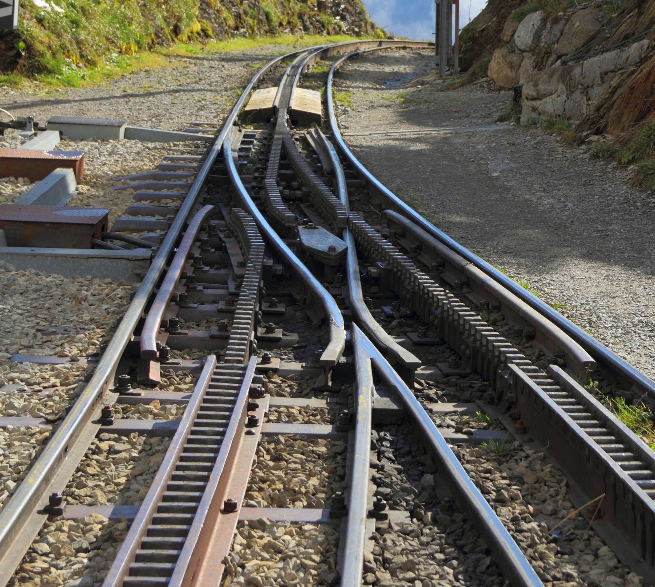
What is the product backlog?
How are things formulated? Why?
Who prioritizes?
Who estimates?
Switching gears…
Scrum!
Notes:
Geared railway turnout image from http://en.wikipedia.org/wiki/Railroad_switch.

Slide 7
The Sprint Planning Meeting
Before this – the team estimates features
  This rationalizes, and it unifies the team
  See the trick called Planning Poker
During – Can have fights with product owner
  What are their common interests?
  What are their opposing interests!
Sprint backlog results
Eight hour time limit
“Once a Sprint's Product Backlog is committed, no additional functionality can be added to the Sprint except by the team. ”

Slide 8
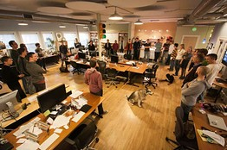
Day to day life in Scrum
“Daily Scrum” - 15 minute stand-up meetings
Work on code in the sprint backlog
What is missing
from this picture?
Notes:
Image of standup meeting from http://online.wsj.com/news/articles/SB10001424052970204652904577193460472598378.

Slide 9
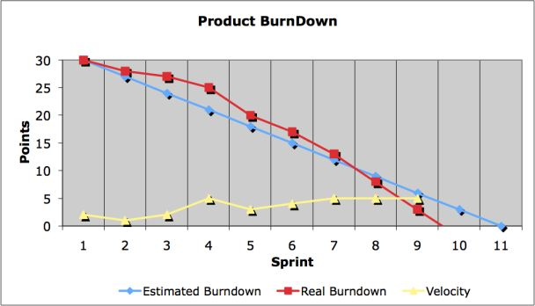
Reflecting
Sprint/Release burn down
Sprint Review
  Show product owner what now works
Sprint Retrospective
  How well is Scrum
  working?
What is missing again?
Notes:
Burn down chart image from http://www.scrum-institute.org/Burndown_Chart.php.

Slide 10
Your questions from the reading quiz
My pick
Your choice

