Slide 1
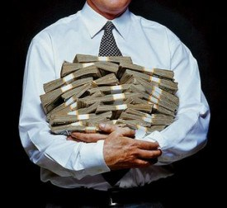
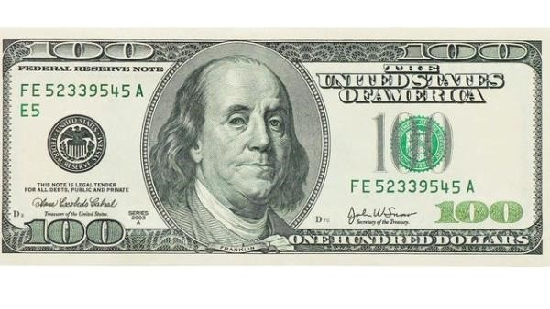

Compensation & Promotion
Is it all about the benjamins?
Notes:
From the article “Unjust Deserts?” by Mary Poppendieck. www.stickyminds.com, July/August 2004.
Image from http://deadline.com/2014/05/highest-paid-media-executives-2013-pay-list-sumner-redstone-721186/
“It’s all about the Benjamins” – See http://en.wikipedia.org/wiki/It%27s_All_About_the_Benjamins.
$100 bill image from http://www.examiner.com/article/new-100-bill-debut-of-new-technological-bill-coming-tuesday
Ref also the article referred to in Question 4 of the reading quiz, Dare Obasanjo’s weblog on stack ranking, at http://www.25hoursaday.com/weblog/2013/11/11/StackRankingWhyAreAmazonFacebookAndYahooCopyingMicrosoftsPerformanceReviewSystem.aspx

Slide 2
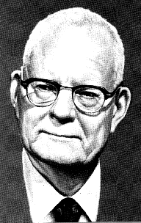
Deming’s contention
Deming believed that every business is a system, and the performance of individuals is largely the result of the way the system operates.
In his view, the system causes 80 percent of the problems in a business, and the system is management’s responsibility.
He wrote that using exhortations and incentives to get individuals to solve management problems simply doesn’t work.
Deming opposed ranking because it destroys pride in workmanship, and he opposed merit raises because they address the symptoms, rather than the causes, of problems.
Notes:
From the article, p 34.
W. Edwards Deming image from http://en.wikipedia.org/wiki/W._Edwards_Deming

Slide 3
Compensation and Promotion Systems Directly Affect Your Team
Even if you don’t want them to!
In the article, Sue didn’t want them to. But she saw that they did, anyway.

Slide 4
Imagine That You are a Great Programmer and Your Primary Goal is to Increase Your Job Satisfaction
What would the ideal company environment be that would let you advance quickly?
  And what does “advance” mean?
Bear in mind that you don’t want to don’t want to do stuff detrimental to the company or lie/cheat…you want to pick a company environment that’s aligned with your goals

Slide 5
Imagine That You are on a Really Good Team and Your Primary Goal is to Get Everybody Working Together, and to Reduce Turnover
What would the ideal company environment be that would let you do this?
How could you help make that happen?

Slide 6
Imagine That You Are on a Team That Has Some Really Dysfunctional Members
E.g.,
Don’t do anything.
Don’t show for meetings.
Wait till the last minute, then play hero.
Don’t share their skills.
Take all the credit.
Don’t consider you a peer.
Surprise the team with their big ideas, in front of the boss.
Criticize everyone else’s ideas.
What would the ideal company environment be, that would let you force them off the team?
Ideally with minimal chance they will sue you

Slide 7
Your Boss
Imagine your boss really wants to be promoted to upper management
  How will they act towards you?
  How will they want you to act?
Imagine your boss really wants to make you feel happy
  How will they act towards you?
  How will they want you to act?
Imagine your boss is really concerned about getting fired
  How will they act towards you?
  How will they want you to act?

Slide 8
Stack Ranking
What is it? Also curved ranking
What is Poppendieck’s problems with it?
Example, from Yahoo (2013):
  “Moving forward, we will have both annual goals and quarterly goals that we will all commit to, track, and grade ourselves based on … We will then cascade the goals down through the company at the department, team, and individual level.”
Notes:
Quote is from http://allthingsd.com/20131108/because-marissa-said-so-yahoos-bristle-at-mayers-new-qpr-ranking-system-and-silent-layoffs/

Slide 9
Stack Ranking
What is it? Also curved ranking
  Surely in the whole organization there ought to be a curve?
What is Poppendieck’s problems with it?
  Competition
  Perception of Unfairness
  The Perception in Impossibility
  Sub-Optimization
  Destroying Intrinsic Motivation

Slide 10
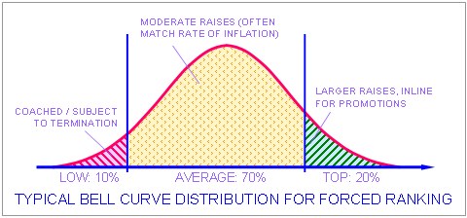
Typical Usage
“Jack Welch, General Electric’s former CEO, is often associated with a 20-70-10 distribution: the top 20 percent is rewarded for best performance, the middle 70 percent is rated ‘average’ and the bottom 10 percent is coached for improvement. The ‘rank-and-yank’ system, also associated with Jack Welch, automatically terminates employees in the bottom category, allowing organizations to purge the worst performers.” – Nagesh Belludi
Notes:
Quote and figure from http://www.rightattitudes.com/2006/09/27/performance-management-forced-ranking/

Slide 11
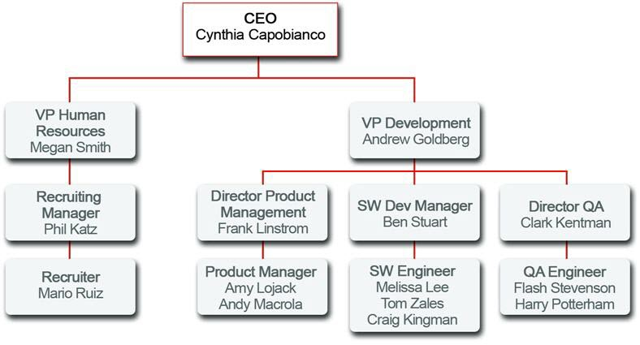
Worst of the worst
“Of course, each division head doesn’t have to push down this forced curve, to any lower level.”
And, of course, they do. It’s so easy that way. Not to mention “fair.”
Notes:
Image from http://www.salesforce.com/us/developer/docs/fundamentals/Content/adg_securing_data_role_hierarchies.htm

Slide 12
Make Sure the Promotion System is Unassailably Fair
Whenever somebody attached the phrase “unassailably fair” to a part of your process, you can be sure there’s gonna be some problems.
Often, self-fulfilling prophecies
  Just like in school?
Different ladders
  I once had a star performer who had come from an admin job. I gave her a 40% raise to gain parity with the rest of my department. I was told that this “wasn’t done.”

Slide 13
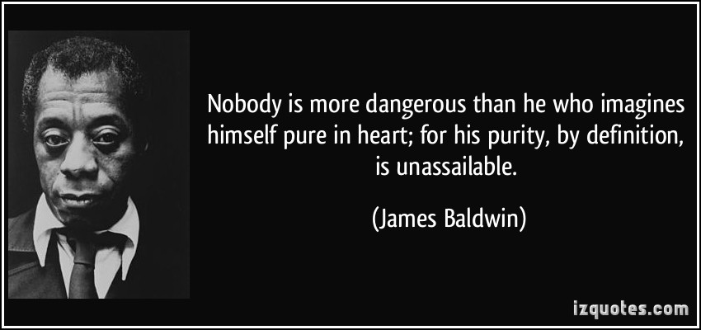
Assailing Unassailable…
The Soviet Union was built upon the belief that their system itself was “beyond good and evil.”
  Which explained a lot of the things they did!
Notes:
Quote from http://izquotes.com/quote/208855
The discussion of the Soviet Union is attributable to many places. The phrase “Beyond Good and Evil” goes back to a book by that name, by Nietzsche. Totalitarian states generally liked this read, and believed they could set all the rules, because their “truth” came first. There could not possibly be any reason to analyze the logic of their fundamental positions. If you think such belief is silly, it’s worthwhile to consider ways in which we make the same assumption. In companies, there often is a general sense that nothing the company does should be criticized, because it is what everyone shares a stake in. This includes the “systems” used by the company, like the way it compensate people. Those at the top usually make the most money, and so also have a strong interest in believing in the fairness of the systems which got them there. Is it any wonder that Deming is among the few to blame the underlying systems, and the top managers, for 80% of the problems a company has?

Slide 14
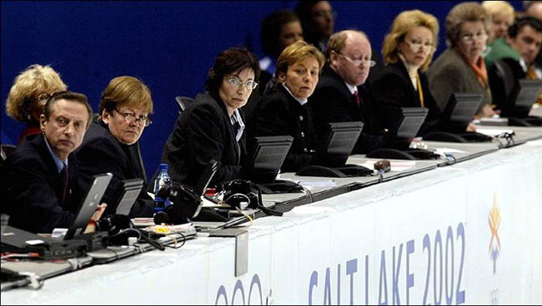
Not easy to do!
“…an overwhelming amount of evidence shows that each of us is a horribly unreliable rater of another person’s strengths and skills. It appears that, when it comes to rating someone else, our own strengths, skills, and biases get in the way and we end up rating the person not on some wonderfully objective scale, but on our own scale. Our rating of the other person simply answers the question: ‘Does
she have more or less
of this strength or skill
than I do?’ “
- Marcus Buckingham
Notes:
From “Performance Management and the Pony Express,” by Marcus Buckingham. https://hbr.org/2013/11/performance-management-and-the-pony-express
Image of Salt Lake City Olympic figure skating judging, from https://www.linkedin.com/pulse/article/20140722012752-32267018-educational-politics-needs-to-be-judged-like-olympic-skating

Slide 15

Find Motivators Other than Money
Do you like it when your company finds other motivators than money?
A search for motivators might lead you to conclude that the people you work with are very individualistic about this!
Notes:
Image from http://www.gopixpic.com/500/african-motives/http:%7C%7Ccloud*graphicleftovers*com%7C15919%7C351222%7Cblue-african-motives*jpg/

Slide 16

Or - Work for a company that doesn’t do this!
Microsoft got rid of their ranking system, in 2013.
Blamed it for a “lost decade” of
productivity.
“Every current and former Microsoft employee I interviewed—every one—cited stack ranking as the most destructive process inside of Microsoft, something that drove out untold numbers of employees.”
- Kurt Eichenwald
Notes:
See https://hbr.org/2013/11/dont-rate-your-employees-on-a-curve
Original article about Microsoft is at http://www.vanityfair.com/online/daily/2012/07/microsoft-downfall-emails-steve-ballmer
Image from http://www.marvelmasterworks.com/superman_lostdecade.html

Slide 17
Imagine that you are manager of a small team. Your team has been doing alright this year – not great, not bad. You get to award final bonuses, which don’t directly come out of your budget. To do this, you rank employees as 1-5, and they get bonuses between 20% and 0%. Strictly in terms of your own self interest, what do you do?
Award mostly high rankings (1s and 2s)
Award rankings across the whole range
Award rankings in the mid range (mostly 3s)
Award mostly low rankings (4s and 5s)
I need some more information to make my decision
  Better say “why” fast – your boss only has 5 minutes for questions on this.

