Slide 1
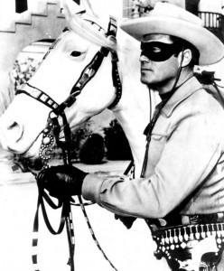

No Silver Bullet
Brooks rides again…
Notes:
Image is “The Lone Ranger,” who always fired silver bullets. From http://withgoodreasonradio.org/2011/07/selling-the-silver-bullet/

Slide 2
Essential Difficulties
What are these “essential difficulties” that Brooks is referring to?
Complexity
Conformity – To rules made by humans.
  Zip up your jacket!
Changeability – “All successful software gets changed.”
  See Slide 13
Invisibility

Slide 3
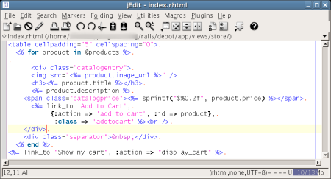
High Level Languages
“The most a high-level language can do is furnish all the constructs the programmer imagines in the abstract program.”
Notes:
Ruby on Rails image from http://tips.webdesign10.com/editors-for-ruby-on-rails-ubuntu-jedit-emacs-radrails-cream-scite

Slide 4
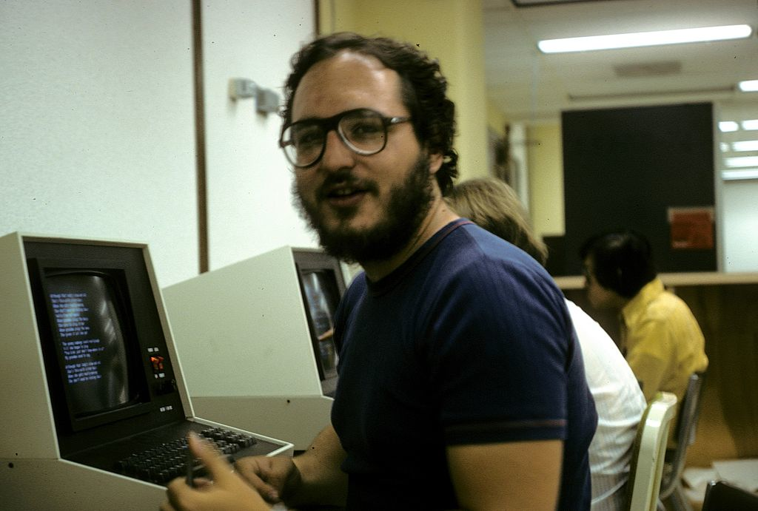
Time-sharing/Unified Programming Environments
Note that he includes Unix in this list
  An original reason for the popularity of Unix
  Came with common tools that could use each other. Like in pipes and filters.
Time-sharing on Unix at the University of Wisconsin, 1978
Notes:
Image from http://en.wikipedia.org/wiki/Time-sharing

Slide 5
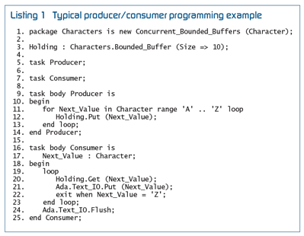
Will a new programming language
(like Ada) save us?
Brooks predicts that Ada’s greatest contribution will be “training programmers in modern software design techniques.”
Notes:
Ada programming sample from http://www.embedded.com/design/prototyping-and-development/4025713/Programming-real-time-with-Ada-2005

Slide 6

AI
AI-1, solving difficult problems using specialized techniques (pretty difficult to generalize)
AI-2, expert systems duplicating the skills of the expert (maybe offering suggestions)
  The rules are the important part
AI-3 Data al la Star Trek
Notes:
“Data” image from http://en.wikipedia.org/wiki/Data_(Star_Trek)

Slide 7
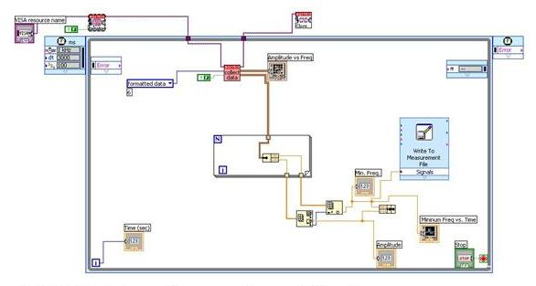
Graphical Programming Languages
A good way to see the overall argument
Buffalo’s objection – “Can it show merge sort?”
Notes:
Image of a LabVIEW program from http://www.jyi.org/issue/design-and-development-of-resonance-frequency-tracking-software-using-labview/

Slide 8
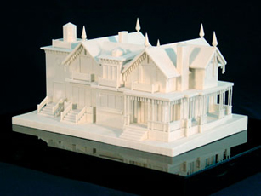
Bigger advances yet
Buy vs. build
  At NCR in the 1970’s, we built 100 text editors!
Requirements refinement and rapid prototyping / incremental development
“Agile”!
Notes:
House model developed on a 3D printer, from http://www.notjustprototypes.com/rapid_prototyping

Slide 9
Great Designers
“The differences are not minor – it is rather like Salieri and Mozart.
Study after study shows that the very best designers produce structures that are faster, smaller, simpler, cleaner, and produced with less effort.
The differences between the great and the average approach an order of magnitude.”
And they need great offices…
Notes:
Video from https://www.youtube.com/watch?v=-ciFTP_KRy4

Slide 10
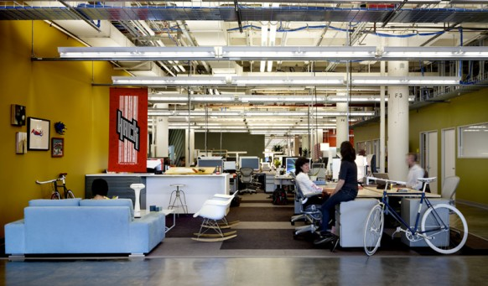
Like at Facebook
Notes:
Image from http://www.home-designing.com/2009/08/facebooks-new-cool-office

Slide 11
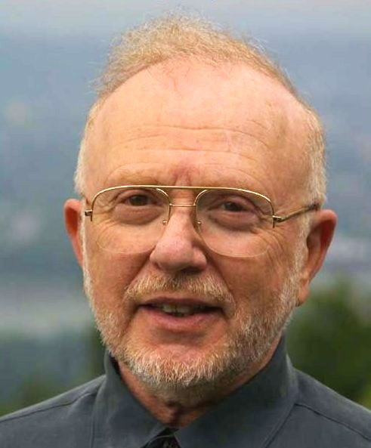
Update – 2007 OOPSLA
David Parnas:
People have a “very natural tendency to
look for easy answers to hard questions,
designing software is hard and it will always be hard.”
New technologies are often over-hyped: “they have to kind of paint it as a silver bullet because otherwise people won’t listen.”
Desire for people to seek better tools rather than “actually learning the trade.” Dave used the metaphor: “there is an old saying: ‘the poor workman blames his tools’ - people are poor workmen, I think most programmers are poor workmen.” Dave also said that people are looking for silver bullets to avoid learning the trade.
Notes:
See http://www.infoq.com/articles/No-Silver-Bullet-Summary
David Parnas’ picture from http://mbohlen.de/warum-softwarearchitektur-dokumentieren/

Slide 12
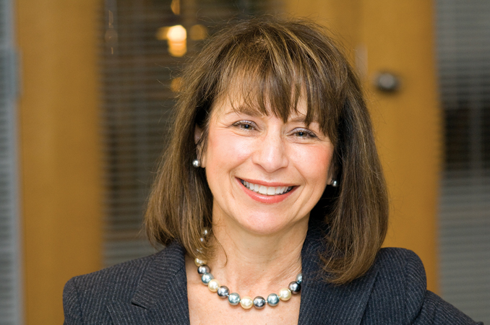
Update – 2007 OOPSLA
Linda Northrop:
The boundary between developers and those that we have, I think inappropriately called users, and our accidental innovations, help little.
To wrestle future werewolves we still need great designers, and I think we still have far too few, and we still need to cultivate an atmosphere of hard work but also an inner-disciplinary perspective that takes us uncomfortably out of our coding world.
Our world [is focused on] “the technology push”. I think the reason we have the technology push is because we don’t do the hard work to understand the needs of who we are trying to address.
Notes:
See http://www.infoq.com/articles/No-Silver-Bullet-Summary
Linda Northrop’s picture from http://gracehopper.org/speakers-honorees/speakers/linda-northrop/

Slide 13
Does all software change?
Software started out being build like everything else that’s engineered.
Really soon, though, we discovered it was easier to change most software.
Everyone took advantage of that:
  Customers asking for more, after delivery.
  Developers relying on being able to fix things.
  Generations of successful products, installed over the top of themselves.
There’s really “S-Type” and “E-Type” – see CSSE 375 and “Lehman’s Laws.”
Notes:
For S-type versus E-type, see http://en.wikipedia.org/wiki/Lehman's_laws_of_software_evolution

Slide 14
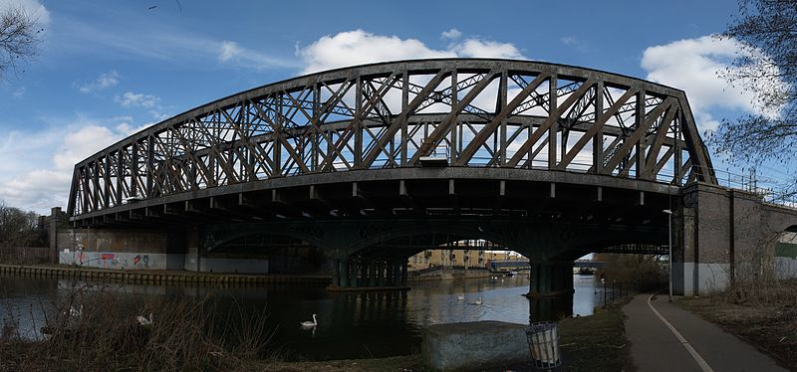
Improve on the “Essential” part?
Yes – some of it will be discovered to be “accidental”
Getting better requirements, in Agile
  This began as “how startups work.”
Domain-specific languages
  The main apps only need to be tailored.
Features like “auto-completion”
As software engineering
matures, some things
will become “routine.”
Notes:
1924 Peterborough truss railway bridge image from http://commons.wikimedia.org/wiki/File:Peterborough_truss_bridge.jpg. The bridge is actually straight.

Slide 15
Automatic programming?
Means two things:
“Higher level” – with underlying features assumed.
Only have to write the requirements – code is then generated.
  You get this somewhat with parameters.

Slide 16

Expert systems?
A typical silver bullet try.
You write a bunch of rules
about the domain, and
the application pops out at you
in response, a surprise!
Great for prototyping.
Works best with small systems.
Debugging is a bear!
Notes:
Bear image from http://en.wikipedia.org/wiki/Bear

