Slide 1
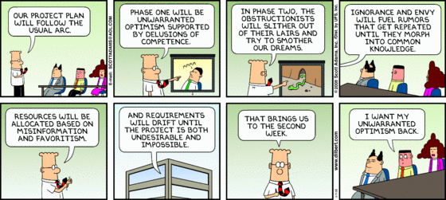

CSSE 372: Software Project Management
Why the pessimistic cartoon?

Slide 2
Who are you?
Name
Major
Domain track?
This past summer?

Slide 3
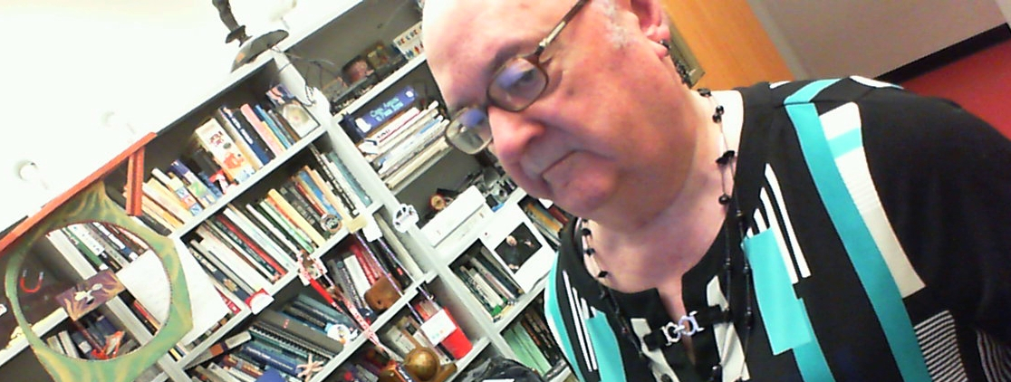
Who am I?
Officially, Steve Chenoweth
This is my 12th year at Rose
Before that, 30 years with software vendors
My biases:
I worked on lots of large projects, where reliability and performance required up-front architecture work.
I believe you need to learn to work with people who are really different from you. This is our business.
What’s the deal with selfies these days?

Slide 4
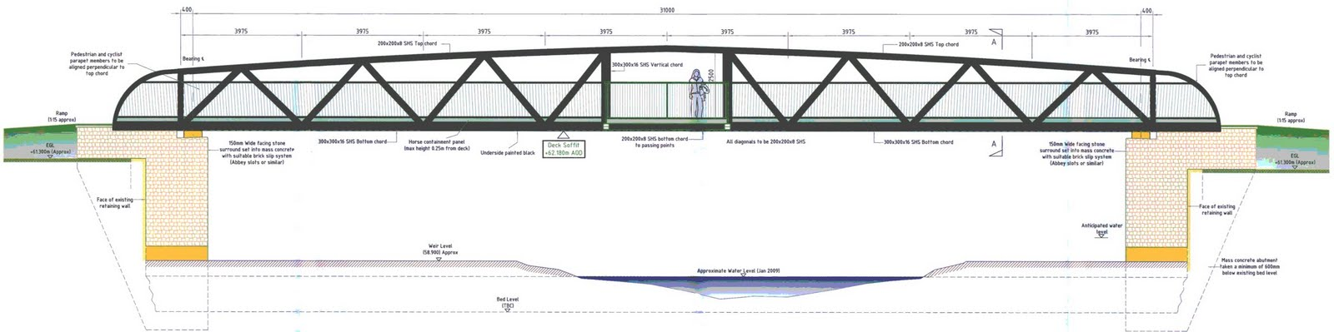
Why is this our business?
In most of engineering,
  The engineers focus on the technical side of engineering work.
  They know their limited domain really well, too.
  They demand that problems are well-defined.
  Risk-avoidance is the main overall concern.
  They often do lots of work for the same customers.
  Customers, as well as the engineers, may be experts on how it’s all supposed to be done.
  They’ve all been doing it for 2000 years.
  Competition may be limited.
How about in our business?
Notes:
Bridge image from http://goytvalleycycleway.blogspot.com.

Slide 5
And…
What is your bias?
What is your experience, vs what you’ll be doing in the software business?
What are your values, about what you should be doing in that business?

Slide 6
The Plan
Discussion of project past and the point of software process
Some logistics
A preview of next class

Slide 7
Managing a Rose-Hulman Software Project
You’ll be doing this in:
  Your junior project
  Your senior project
Every project is different, and the clients may be different.
It is most profitable to focus on those differences.
The processes you used last time may not work this time.
Why not focus on similarities?

Slide 8
So, what is an engineering project?
A temporary job, usually to make something.
  The “thing” to be done is new / different.
  That distinguishes it from factory work.
People are assembled just to do that.
In software, size, difficulty and duration vary widely!
  The bigger the project, the more management, to keep everything straight.
  The tougher the job, the more management.
  Long-lived projects include “maintenance.”

Slide 9
Basically - Two kinds of projects
Contract work
  You have a specific client, who wants something.
  You tend to work closely with them, to do it.
Product work
  You are trying to make something to sell, ahead of “the market.”
  Your biggest influence likely is a “product manager” whose idea this is.
Make once.
Sell once.
Make once.
Sell lots!
Is one of these more profitable?

Slide 10
Who are all the managers?
Different levels
& roles:
Product managers & executives
Resource managers
Sales managers
Our focus!
Designers / architects
Project managers
Us developers and testers (lots)
Systems engineers
Sales and support people

Slide 11
What do the managers do?
All managers do these things:
  Plan – ahead of time
  Lead - during
  Control - after
Project managers are “first level” managers:
  Typically don’t hire and fire.
  Do keep projects on schedule.
  Often also are “lead developers.”

Slide 12

…This is likely Exam Question 1
Assertion 1: For contract work, you want the absolute minimum process possible to produce work that does 1 thing:
Makes the customer happy.
Why?
But – Who is the customer?
Clients – not always happy just because the product is “cool.”
Notes:
Client image from http://www.forbes.com/fdc/welcome_mjx.shtml.

Slide 13
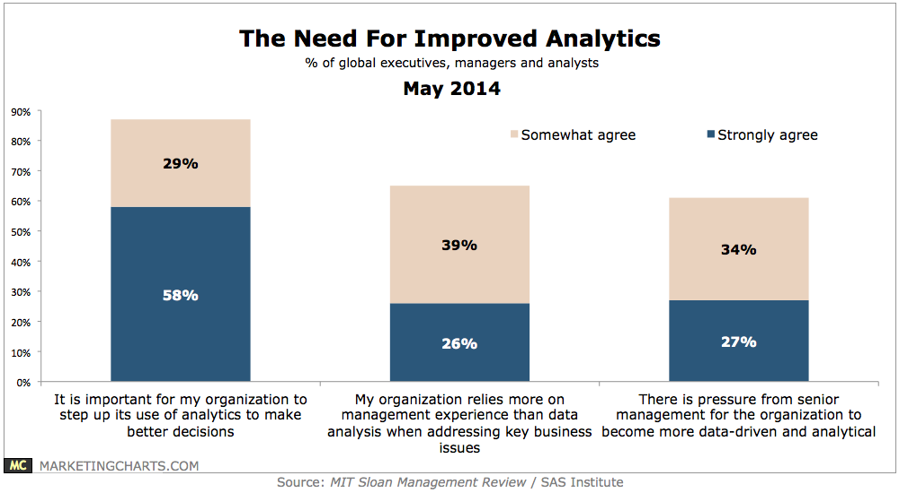
…This is likely Exam Question 2
Assertion 2: For product work, you want the absolute minimum process possible to produce work that does 2 things:
Makes the first customers happy.
Makes all of them happy, over the product lifetime.
And – Why do these
two things conflict?
One attempt to forecast a product need:
Notes:
Image of analytics market trend from http://www.trewmarketing.com/smartmarketingblog/marketing-trends/thursday-trends-guessing-become-data-driven/.

Slide 14
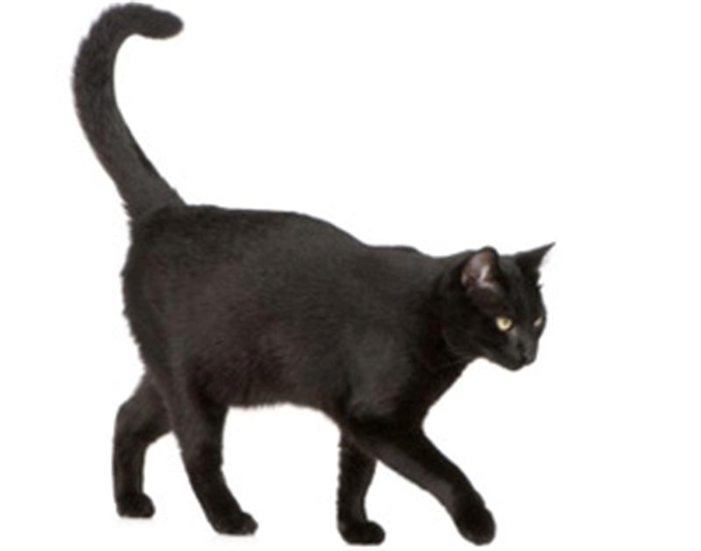
Why do most organizations have too much process?
Hint – software development is risky.
Hint – all organizations change processes slowly.
Hint – We are all superstitious
about how we achieved success.
Analogy – why do most CS departments continue to teach just theory?
Notes:
Cat from http://www.indiandownunder.com.au/2011/08/superstitions/.

Slide 15
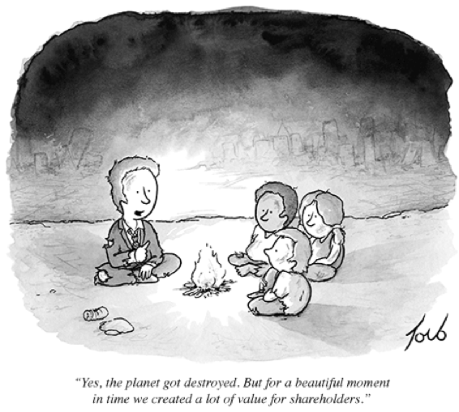
Sample big strategy – to combat risk
Harvard Business School’s steps in entrepreneurship:
  Perceive where extraordinary value lies.
  Create that value for customers.
  Capture it in rewards for your
  work.
How would those steps
apply to the risks
of software
development?
Notes:
Cartoon from http://www.ritholtz.com/blog/2012/11/shareholder-value/.
HBS’s steps from Daniel Isenberg, Worthless, Impossible, and Stupid: How Contrarian Entrepreneurs Create and Capture Extraordinary Value. Harvard Business Review Press, 2013.

Slide 16

Why is software development risky?
We deal with more novelty than the rest of engineering.
A lot of novelty can’t be achieved by a series of small adaptation steps.¹
This makes it very hard to plan and manage by any already-known process.
¹As in economist Joseph Schumpeter’s theory of the
discontinuous and unpredictable nature of innovation
and economic growth.
Notes:
Image of risk-taking from http://www.hipstercrite.com/2012/04/30/is-life-about-taking-risks/

Slide 17
The Plan
Discussion of project past and the point of software process
Some logistics
A preview of next class

Slide 18
This Course is an Experiment
My goal is to put you in a position to advocate for process change on your own teams. That requires:
  Knowledge about how things go wrong
  Ability to think flexibly about a vast variety of solutions
  Confidence to express your opinion
In particular, this is much more ambitious than just educating you about what’s out there or just advising you on completing your Junior project successfully
Why consider “a vast variety of solutions”?

Slide 19
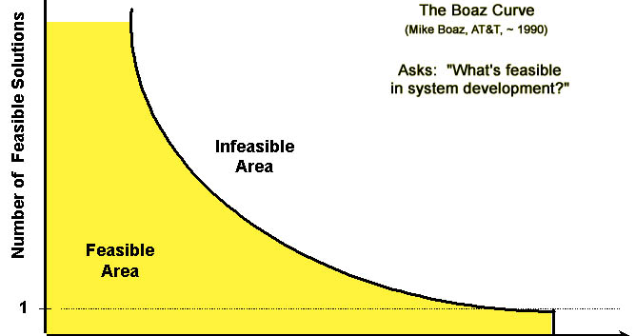
Meet Mike Boaz, of AT&T
Most
CSSE
projects
Junior &
Senior
projects
Most
Industry
projects
Google
Search
Increasing size, speed, and complexity requirements →

Slide 20
This Course is an Experiment
We’re going to be using a discussion-oriented approach in this course
Most classes will involve heavy use of class discussion
Your voice is welcome, even if you don’t have experience/are not certain/don’t have a strong opinion
I may call on you even if you don’t volunteer; this is because teaching how to advocate for your position is an explicit goal of the course
Most of the issues we discuss in this course are not about being right or wrong…but even if they were it is OK to be wrong

Slide 21
This is not a course about running your Junior Project
Though I hope you will find some of the stuff we talk about here useful in the junior project
DON’T start the junior project as if you’ve never had a software engineering course in your life
If you would like some advice for your Junior project, I would be glad to advise you
Why not link 372 to your junior project?

Slide 22
The Reading
You need to do the reading
No seriously, the reading is absolutely required
You need to do the reading
How well?

Slide 23
The Reading
I expect you to do reading before every class
Which is work
Which means I have explicitly reduced the work in other areas of the course
Because I want you realize how absolutely important doing the reading is
Each reading quiz is worth about 1% of your final course grade

Slide 24
You May Find the Reading Difficult
It’s difficult to find good sources – oftentimes the material is either too advanced to too simplistic
Wikipedia is your friend for unfamiliar terms/concepts
Or just ask in class
Read the material it its entirely first, then do the quiz

Slide 25
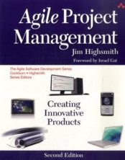
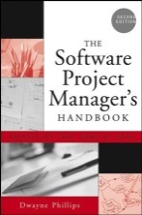
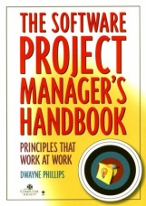
New School (Agile)
Old School

Slide 26
The one thing that Buffalo and I may do differently – two of these 4 assignments.
Reading quizzes | 35%
Assignments (4 currently planned) | 40%
Final Exam | 20%
Class Participation | 5%
Based on my bias, what would I give you?

Slide 27
Reading Quizzes | No late submissions allowed. BUT, I do allow up to 3 missed quizzes without affecting your overall grades.
Illness | I generally allow a 24-48 hour extension, as long as this privilege does not seem to be getting abused
Job Interview or Conference | I generally allow a 24-48 hour extension, as long as ALL these requirements are met: The event is timed in such a way that doing the assignment is infeasable (e.g. just missing the final 2 days of a week-long assignment is not sufficient) The event is out of town I am notified in advance
Difficulty Understanding the Material | I generally allow a 24-48 hour extension, as long as ALL these requirements are met: There is evidence that significant time has already been devoted to attempting the assignment The student meets with me, in person, and works through the difficulty I am notified before the due date
Exams/Assignments in other courses | I DO NOT generally allow an extension.

Slide 28
The Plan
Discussion of project past and the point of software process
Some logistics
A preview of next class

Slide 29

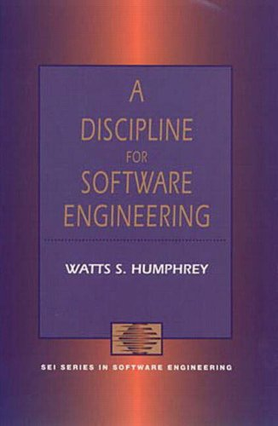
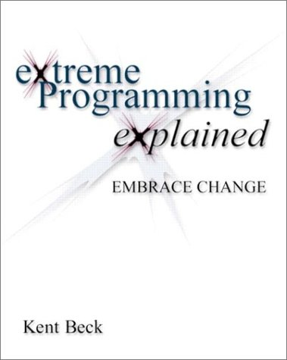
A personal version of the story thus far
1975
1995
1999

Slide 30
What is CM?
Software Configuration Management, but let me say slightly more than just that
Guess what’s a big part of tonight’s reading?

