Slide 1
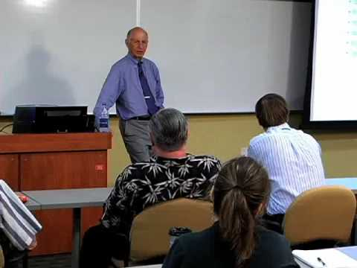

The Personal Software Process
“I want you to take this personally…”
Estimation Based on Real Data*
* Would Martin Fowler approve?
Notes:
No! But here we see the different goals of old-school vs. agile. Fowler would say this is to much effort to get estimating right, for a marginal gain.
Image of the late Watts Humphrey from http://article.wn.com/view/2014/06/23/Top_Collegiate_Software_Programmers_to_Compete_for_World_Cha_g/.

Slide 2
PSP Principles (assumptions?)
Every engineer is different; to be most effective, engineers must plan their work and they must base their plans on their own personal data.
To improve their performance consistently, engineers must use well-defined and measured processes - personally.
To produce quality products, engineers must feel personally responsible for the quality of their products. Superior products are not produced by mistake; engineers must strive to do quality work.
It costs less to find / fix defects earlier in a process vs later.
It is more efficient to prevent defects than to find and fix them.
The right way is always the fastest and cheapest way to do a job.

Slide 3
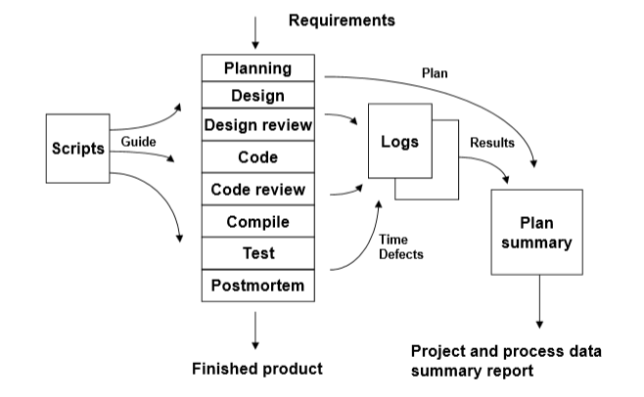
These are your “personal process” for doing each step!
Notes:
What does this tell you about PSP assumptions?
Notice scripts – what are they?
Noice logs – what are they?

Slide 4
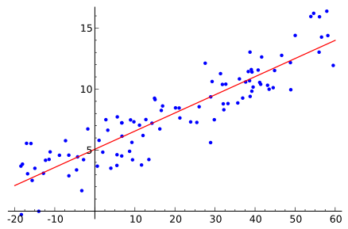
PROBE
A mechanism of going from design -> LOC
Then those lines of code -> time
Uses linear regression* based on previous data
* You don’t get this in MA 381, but it’s not difficult. What’s the straight line through a bunch of data that’s “closest to correct” look like? Computes “least squares” to calculate that line.
Notes:
See for example http://en.wikipedia.org/wiki/Simple_linear_regression, which the image also is from.

Slide 5
PSP estimating example
“For coding objects of this size, in the recent past, it’s been taking me this many hours.”
Would need a “linear regression” of estimated object size vs time taken.

Slide 6
Tracking - time
Time spent in the various stages of development (and overall)
Includes every break/interruption

Slide 7
Tracking - Size
LOC
Problematical?
Humphrey argues that, for a single programmer working in a given computer language, this is a good independent variable.

Slide 8
Tracking - defects
Every failed compilation, every bug, every misspelling…
You also track which stage it was inserted in, and which one it was found in.
Try to decide ahead of time what to count!
  And when to count them…
  E.g., Do we care if Junit fails the first 20 times, as I’m building the code?

Slide 9
What is this data used to calculate?
Defect density (bugs per KLOC)
  For PSP practitioners, “good” is 5/KLOC
  For non-PSP, defects are 20-40 per KLOC

Slide 10
Development time ratios
One stage to another
  How much time should you spend on design?
  Humphrey recommends 1 to 1
    Pushing the right way to the start
  What if I’m using the code as the low-level design, and “the code is the design”?

Slide 11
Yield
% Defects removed per stage
Phase yield – E.g.,
  Program enters unit test with 20 defects
  Unit testing found 9
  Yield = 45%
Process yield – Percentage of defects removed “before first compile & unit test”
  Suggest 70% or better

Slide 12
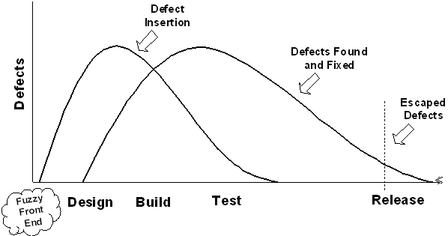
Big Picture of Defects
These follow another “Rayleigh curve”
  For both insertion and removal
Notes:
Not in Humphrey’s article.
From http://www.isixsigma.com/methodology/metrics/six-sigma-software-metrics-part-2/

Slide 13
A/FR
Appraisal vs Failure Recovery ratio
  Ratio measures the quality of the engineering process
  Uses cost-of-quality parameters
  Appraisal cost is time spent in design and code reviews, including time spent repairing defects found in those reviews.
  F = “failure quality cost” – the time spent in failure recovery and repair.
  R either means “Recovery” or the “Ratio” of these! 2.0 or higher is good.

Slide 14
If you actually did this PSP stuff, would it make you a better programmer?
1 – Definitely
2 – Probably
3 – Probably not
4 – Definitely not
5 – I have some other more complex opinion

Slide 15
How can you improve if…
You don’t know were you’re spending your time?
You don’t know what problems you have?
So I propose an experiment…

Slide 16
COCOMO II and the Estimation project
What we did, Week 4, last year
Least favorite assignment of last year
Collected metrics but did not aid reflection

Slide 17
Issues with self-reflection
If you are prejudiced about this, ahead of time, will you try to justify that in trying it?
If you find it super-valuable already, will that rosy outlook make it succeed?
I.e., would you fudge the figures to favor your preexisting opinion?
Are you willing to be surprised?
Are you ok with “mixed results”?

Slide 18
Ready to try it?
On Moodle, Week 3, click on “The first PSP assignment (DUE Sunday night)”.
See handouts for the forms to use.
These are just for the weekend HW.

